Slide 1
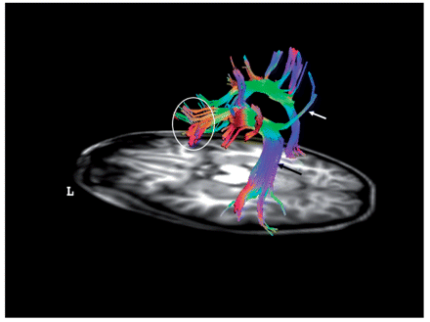
Figure 1 The superior longitudinal fasciculus. Diffusion Tensor Imaging-fibre tractography of the superior ...
Notes:
Figure 1 The superior longitudinal fasciculus. Diffusion Tensor Imaging-fibre tractography of the superior longitudinal fasciculus of both sides, over an axial T1 MRI-cut at the level of the temporal lobe. Left lateral view. Tracts are directional colour coded for better tracking. Blue colour indicates top–down; green indicates anterior–posterior and red indicates right to left directions. Reversed directions are encoded within the same colours. White arrow = parieto-frontal fibres (dorsal part of the superior longitudinal fasciculus); black arrow = AF. Within the circle, the opercular endpoint is depicted. Notice the asymmetry of the fibres for more prominent left AF. (Images courtesy of Miami Children's Hospital, Department of Radiology).
Unless provided in the caption above, the following copyright applies to the content of this slide: © The Author (2009). Published by Oxford University Press on behalf of the Guarantors of Brain. All rights reserved. For Permissions, please email: journals.permissions@oxfordjournals.org

Slide 2
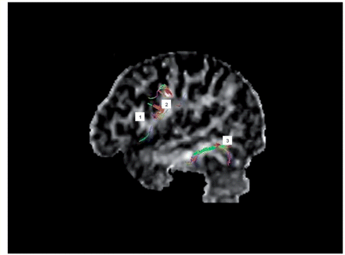
Figure 2 Localizing the endpoints of the AF. Diffusion Tensor Imaging-fibre tractography of the superior longitudinal ...
Notes:
Figure 2 Localizing the endpoints of the AF. Diffusion Tensor Imaging-fibre tractography of the superior longitudinal fasciculus with fibres directional-colour-coded depicted on a left parasagittal brain fractional-anisotropy MR image. The frontal lobe appears on the left side. The following gyrus white matter banks are numbered for easy landmark identifications: 1 = inferior frontal gyrus, pars opercularis (Broca's area); 2 = Precentral gyrus; 3 = middle temporal gyrus. Notice the fibres emerging in the middle temporal gyrus and in the precentral gyrus. No emerging fibres are seen in the Broca's area (Images courtesy of Miami Children's Hospital, Department of Radiology).
Unless provided in the caption above, the following copyright applies to the content of this slide: © The Author (2009). Published by Oxford University Press on behalf of the Guarantors of Brain. All rights reserved. For Permissions, please email: journals.permissions@oxfordjournals.org

Slide 3
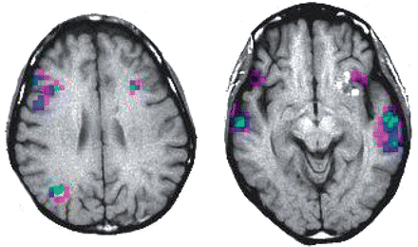
Figure 3 Functional MRI of language. Example of a subject with inter-hemispheric dissociated Broca's–Wernicke's area ...
Notes:
Figure 3 Functional MRI of language. Example of a subject with inter-hemispheric dissociated Broca's–Wernicke's area lateralization (one area in the left hemisphere and the other one in the right). MRI displayed with radiological convention: Left hemisphere is located in the right. Left image: activation obtained with a paradigm of semantic fluency. Right image: activation in primary and secondary auditory areas from a passive listening task. Notice frontal areas associated with expressive language located in the right hemisphere while posterior receptive areas are dominant on the left hemisphere. Activation is colour coded for signal intensity from magenta (weak) to blue to green to yellow (strong). (Images courtesy of Miami Children's Hospital, Department of Radiology).
Unless provided in the caption above, the following copyright applies to the content of this slide: © The Author (2009). Published by Oxford University Press on behalf of the Guarantors of Brain. All rights reserved. For Permissions, please email: journals.permissions@oxfordjournals.org

Slide 4
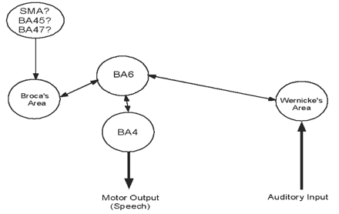
Figure 4 Language network model. Language cortical modules or systems are represented by circles. Arrows depict the ...
Notes:
Figure 4 Language network model. Language cortical modules or systems are represented by circles. Arrows depict the flow of information from auditory input to speech and viceversa. The standard model interconnects comprehension (Wernicke) and production (Broca) areas in a direct manner through the AF. Recent findings suggest a relay station located in the precentral gyrus, represented here by the circle labeled BA6, an area with premotor functions. Input to Broca's area may have several sources. Lesions in any module or connection should produce a specific type of language or speech syndrome. Several connections are shown with bi-directional flow representing a theoretical point of view of the authors, supported for some recent articles (see text).
Unless provided in the caption above, the following copyright applies to the content of this slide: © The Author (2009). Published by Oxford University Press on behalf of the Guarantors of Brain. All rights reserved. For Permissions, please email: journals.permissions@oxfordjournals.org

