Slide 1
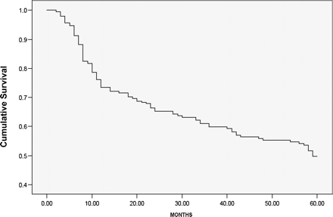
Fig. 1 Kaplan–Meier survival curve of patients discharged alive after severe acute kidney injury necessitating renal ...
Notes:
Fig. 1 Kaplan–Meier survival curve of patients discharged alive after severe acute kidney injury necessitating renal replacement therapy.
Unless provided in the caption above, the following copyright applies to the content of this slide: © Oxford University Press 2008

Slide 2
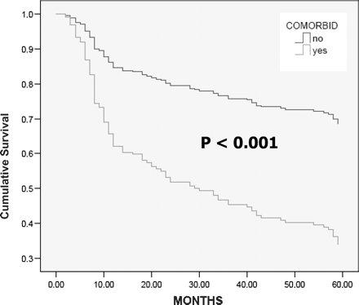
Fig. 2 Kaplan–Meier survival curve of patients with or without pre-existing extrarenal comorbidity.
Notes:
Fig. 2 Kaplan–Meier survival curve of patients with or without pre-existing extrarenal comorbidity.
Unless provided in the caption above, the following copyright applies to the content of this slide: © Oxford University Press 2008

Slide 3
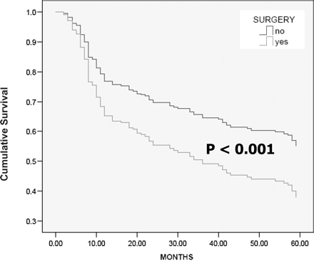
Fig. 3 Kaplan–Meier survival curve of surgical and medical patients.
Notes:
Fig. 3 Kaplan–Meier survival curve of surgical and medical patients.
Unless provided in the caption above, the following copyright applies to the content of this slide: © Oxford University Press 2008

Slide 4
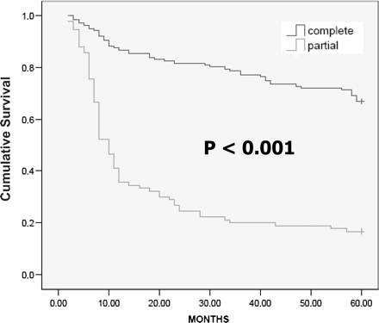
Fig. 4 Kaplan–Meier survival curve of patients with complete or partial renal recovery.
Notes:
Fig. 4 Kaplan–Meier survival curve of patients with complete or partial renal recovery.
Unless provided in the caption above, the following copyright applies to the content of this slide: © Oxford University Press 2008

