Slide 1
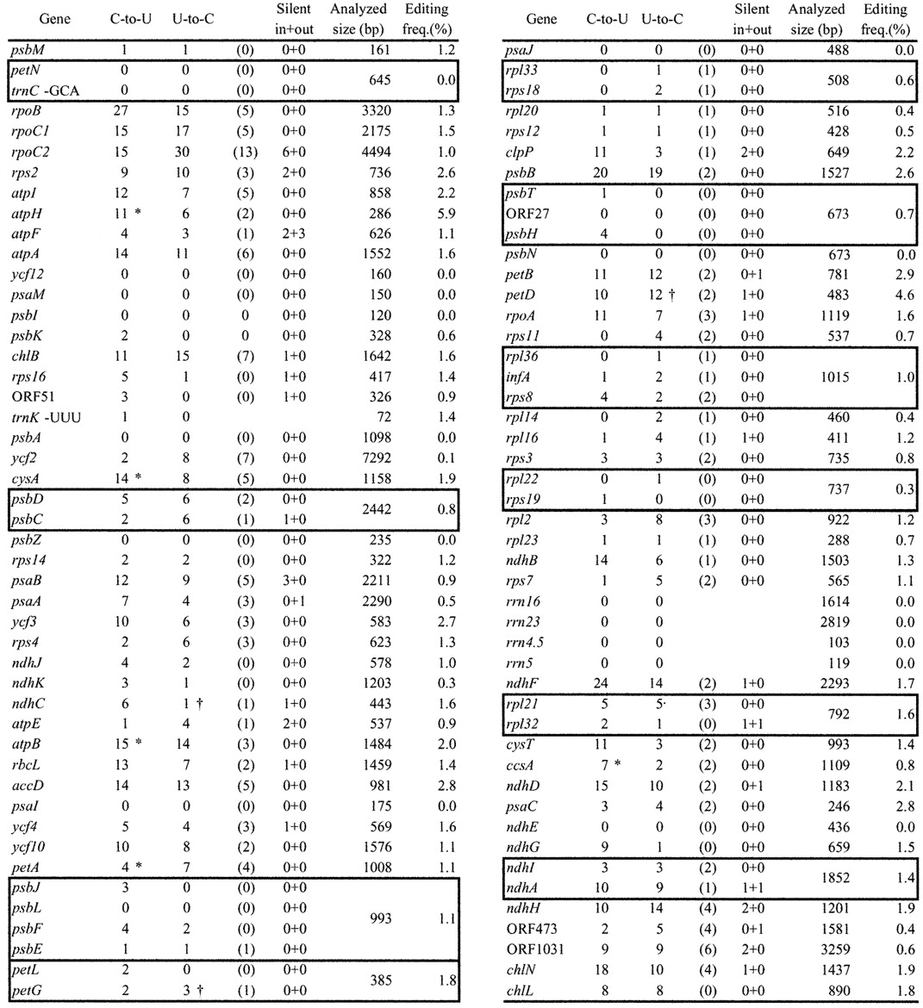
Figure 1. Number of editing sites in the chloroplast of A.formosae. The number of RNA editing sites ...
Notes:
Figure 1. Number of editing sites in the chloroplast of A.formosae. The number of RNA editing sites converting C‐to‐U and U‐to‐C is shown. The number of those converting nonsense codons into sense codons is shown in parentheses. Editing sites, which do not alter the coding amino acid are shown as silent (in) and those found outside of the coding region as (out). Editing frequency shows percentage of editing sites per analyzed size (bp). Editing sites on co‐transcripts are shown in boxes. *Containing the creation of an initiation codon. (†) Containing the creation of a termination codon.
Unless provided in the caption above, the following copyright applies to the content of this slide:

Slide 2
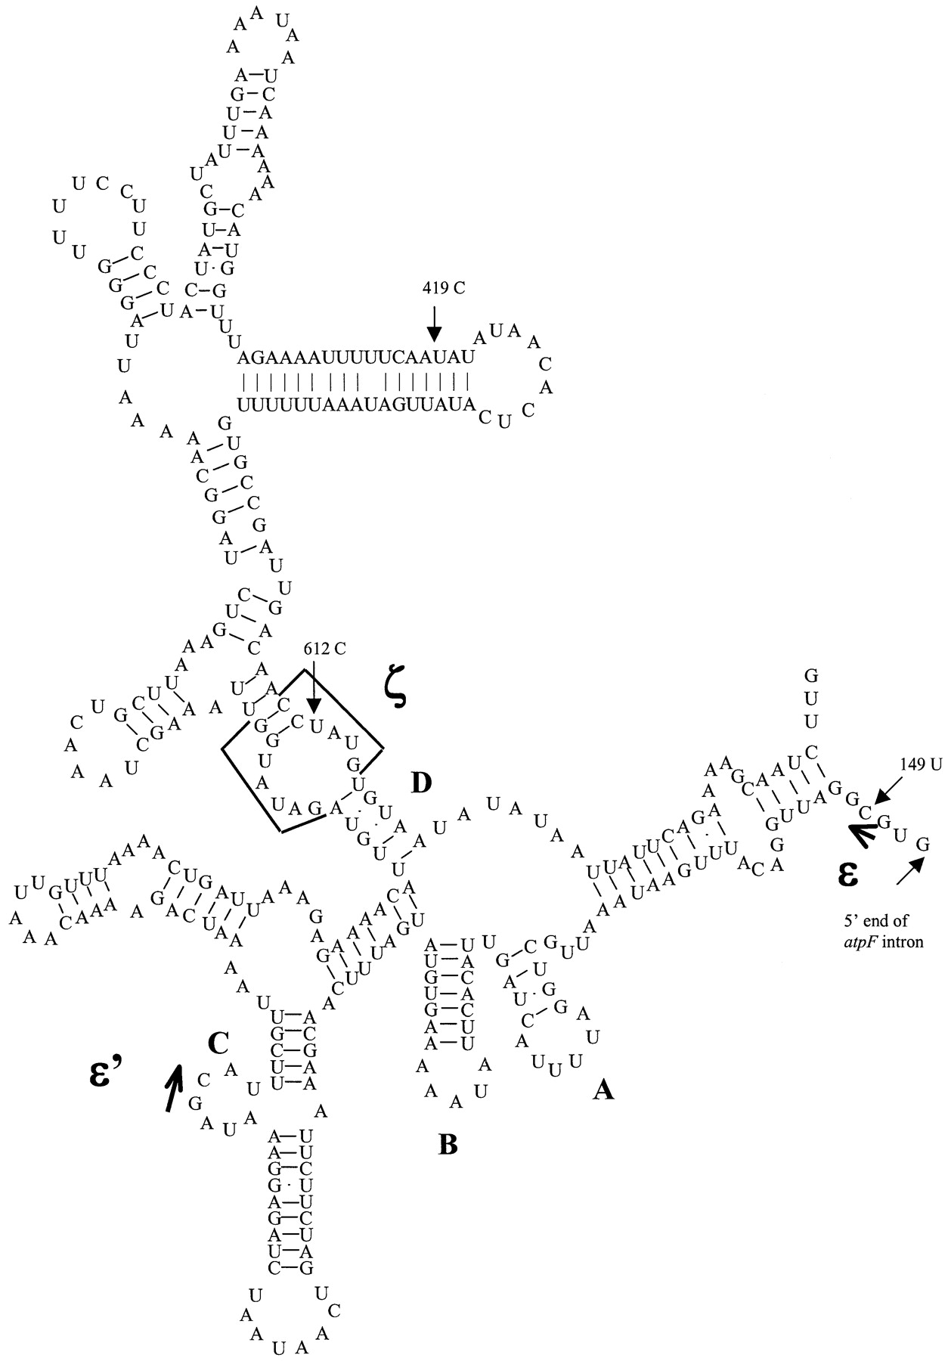
Figure 2. Schematic representation of the predicted secondary structure of domain I in the group II intron of ...
Notes:
Figure 2. Schematic representation of the predicted secondary structure of domain I in the group II intron of AnthocerosatpF. Sub‐domains A, B, C and D together with ϵ, ϵ’ and ζ sites are shown. Edited sites 149, 419 and 612 positions from the translation start, and the 5′ end of the intron are shown with arrows.
Unless provided in the caption above, the following copyright applies to the content of this slide:

