Slide 1
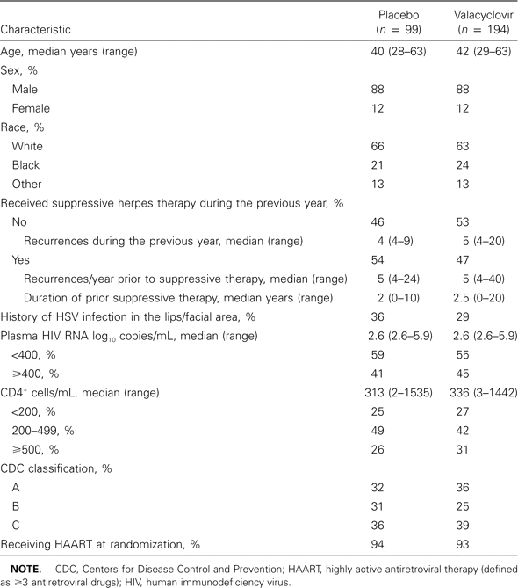
Table 1 Demographic characteristics of patients randomized to receive placebo or valacyclovir
Notes:
Table 1 Demographic characteristics of patients randomized to receive placebo or valacyclovir
Unless provided in the caption above, the following copyright applies to the content of this slide: © 2003 by the Infectious Diseases Society of America

Slide 2
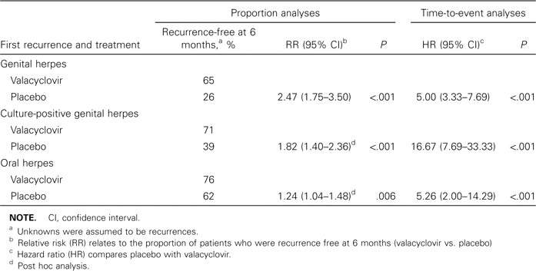
Table 2 Efficacy of oral valacyclovir for the suppression of genital herpes in human immunodeficiency ...
Notes:
Table 2 Efficacy of oral valacyclovir for the suppression of genital herpes in human immunodeficiency virus–seropositive patients
Unless provided in the caption above, the following copyright applies to the content of this slide: © 2003 by the Infectious Diseases Society of America

Slide 3
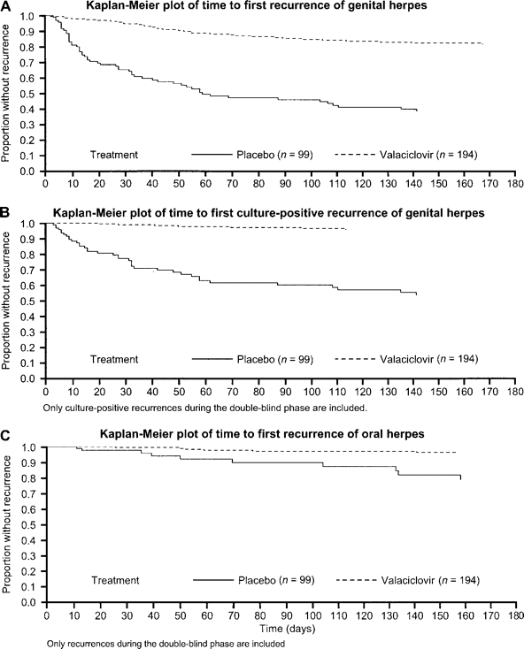
Figure 1 A Kaplan-Meier plot of the time to the first recurrence of genital herpes. B Kaplan-Meier plot of the time to ...
Notes:
Figure 1 A Kaplan-Meier plot of the time to the first recurrence of genital herpes. B Kaplan-Meier plot of the time to the first culture-positive recurrence of genital herpes. C Kaplan-Meier plot of the time to the first recurrence of oral herpes
Unless provided in the caption above, the following copyright applies to the content of this slide: © 2003 by the Infectious Diseases Society of America

