Slide 1
Figure 1 Location of region of interest for the pedunculopontine nucleus overlaid on MNI template in radiologic ...
Notes:
Figure 1 Location of region of interest for the pedunculopontine nucleus overlaid on MNI template in radiologic convention. (A) x = −7, y = −22, z = −22. pedunculopontine nucleus location mean (range) in MNI coordinates: ±7 (6–9), −32 (−30 to −35), −22 (−17 to −26). L = left; R = right.
Unless provided in the caption above, the following copyright applies to the content of this slide: © The Author (2013). Published by Oxford University Press on behalf of the Guarantors of Brain. All rights reserved. For Permissions, please email: journals.permissions@oup.com

Slide 2
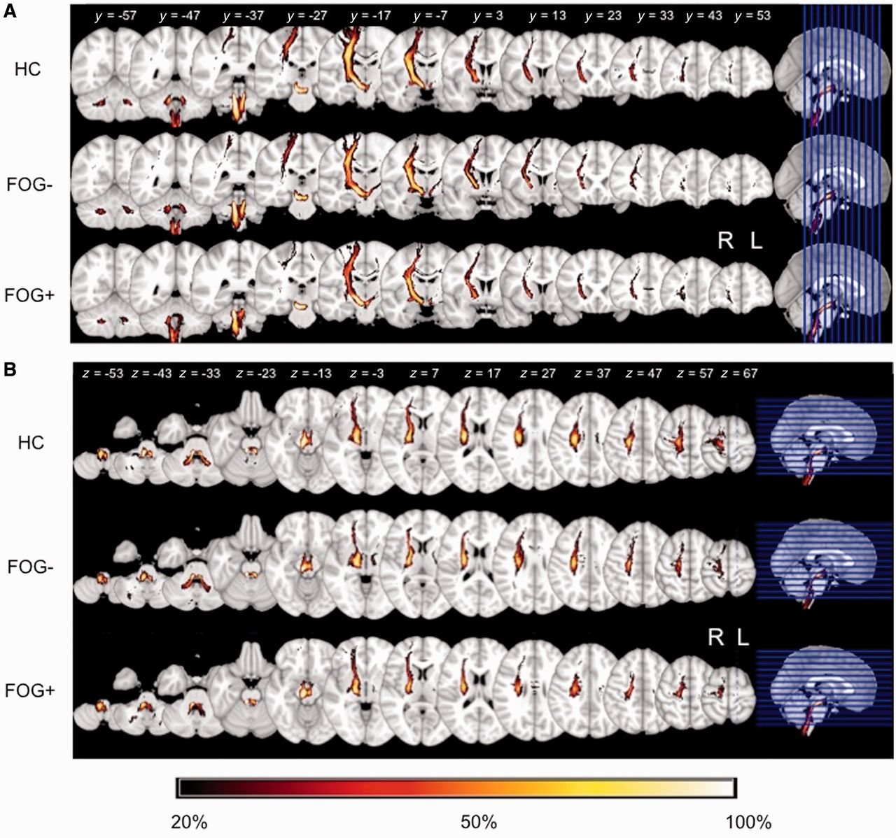
Figure 2 Summed group images of fibre tracts passing through the right pedunculopontine nucleus region of interest in ...
Notes:
Figure 2 Summed group images of fibre tracts passing through the right pedunculopontine nucleus region of interest in the coronal view (A) and the axial view (B). Data are displayed in MNI space on the 1 mm MNI template and are in radiologic convention. The colour bar describes the percentage of participants with overlap in the given region; warmer areas indicate regions of greater fibre tract overlap. FOG+ = patients with freezing of gait; FOG− = patients without freezing of gait; L = left; R = right.
Unless provided in the caption above, the following copyright applies to the content of this slide: © The Author (2013). Published by Oxford University Press on behalf of the Guarantors of Brain. All rights reserved. For Permissions, please email: journals.permissions@oup.com

Slide 3
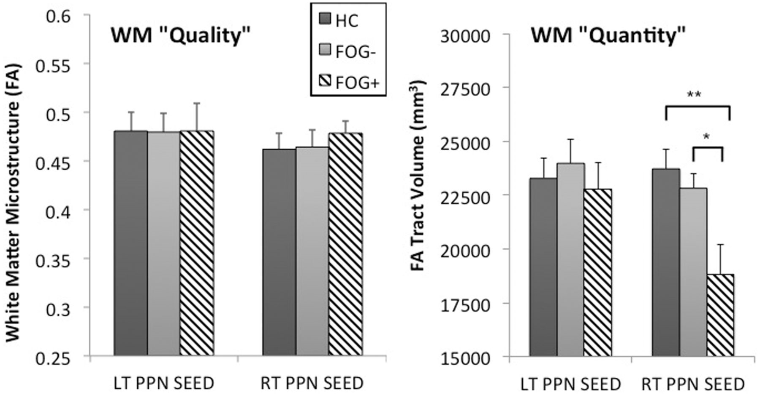
Figure 3 Microstructural integrity and tract volume for locomotor network fibre tracts passing through the right and ...
Notes:
Figure 3 Microstructural integrity and tract volume for locomotor network fibre tracts passing through the right and left pedunculopontine nucleus (PPN) regions of interest. No group or hemispheric differences were observed for microstructural integrity. Patients with freezing of gait (FOG+) had significantly reduced volume of fibre tracts solely in the right hemisphere compared to both healthy controls (HC) and patients without freezing of gait (FOG−). No differences were found between healthy control subjects and patients without freezing of gait. Data are mean ± SD, *P < 0.05, **P < 0.01. FA = fractional anisotropy; WM = white matter.
Unless provided in the caption above, the following copyright applies to the content of this slide: © The Author (2013). Published by Oxford University Press on behalf of the Guarantors of Brain. All rights reserved. For Permissions, please email: journals.permissions@oup.com

Slide 4
Figure 4 Axial view of right hemispheric pedunculopontine nucleus tracts observed in healthy control subjects and ...
Notes:
Figure 4 Axial view of right hemispheric pedunculopontine nucleus tracts observed in healthy control subjects and patients without freezing of gait, but not in patients with freezing of gait. Prominent areas include putamen, internal globus pallidum, thalamus, precentral gyrus, postcentral gyrus, superior frontal gyrus, middle frontal gyrus, supplementary motor area, pre-supplementary motor area, and cerebellar locomotor region. Data are displayed in MNI space on the 1 mm MNI template and are in radiologic convention. L = left; R = right.
Unless provided in the caption above, the following copyright applies to the content of this slide: © The Author (2013). Published by Oxford University Press on behalf of the Guarantors of Brain. All rights reserved. For Permissions, please email: journals.permissions@oup.com

Slide 5
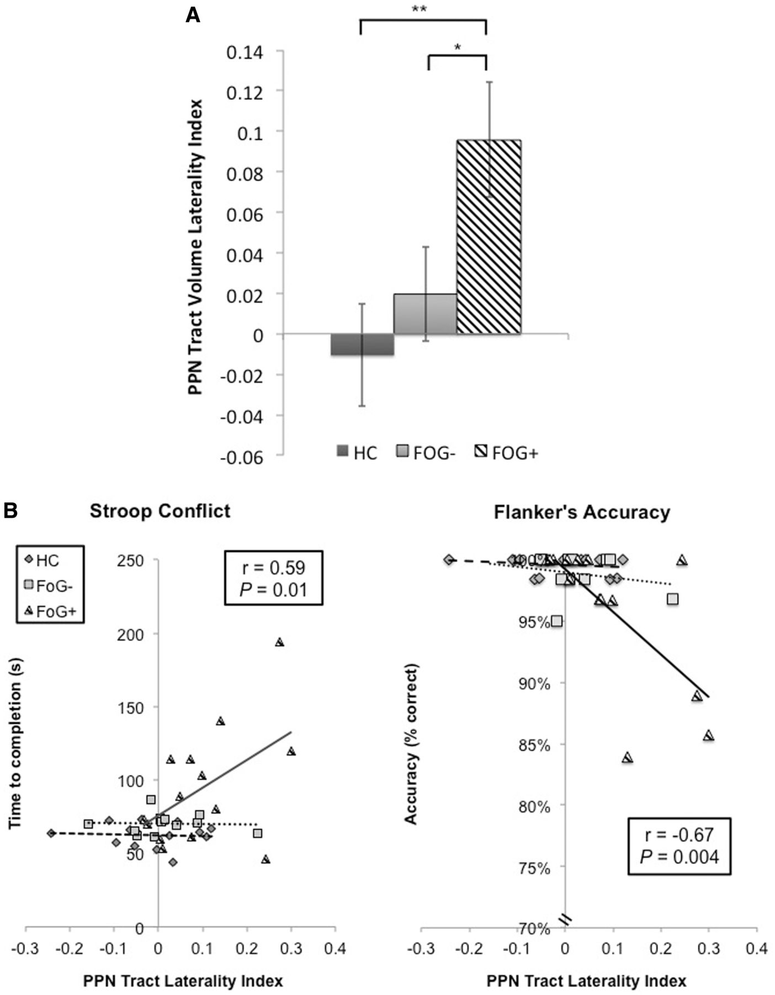
Figure 5 (A) Significant group differences in laterality of fibre tract volume of locomotor network fibre tracts ...
Notes:
Figure 5 (A) Significant group differences in laterality of fibre tract volume of locomotor network fibre tracts passing through the pedunculopontine nucleus (PPN). Pedunculopontine nucleus tract volume was significantly more left lateralized in patients with freezing of gait (FOG+) compared with patients without freezing of gait (FOG−) or healthy control subjects (HC). No differences were found between healthy control subjects and patients without freezing of gait. A value of zero would indicate equal pedunculopontine nucleus tract volume in the left and right hemisphere. Data are mean ± SD. (B) Linear regression between pedunculopontine nucleus tract laterality index and time to complete the Stroop conflict task as well as accuracy on the Flanker’s congruent task. Significant relationships exist solely for the group with freezing of gait, such that the more left-lateralized the pedunculopontine nucleus tract volume, the poorer the performance. Data are mean ± SD, *P < 0.05, **P < 0.01.
Unless provided in the caption above, the following copyright applies to the content of this slide: © The Author (2013). Published by Oxford University Press on behalf of the Guarantors of Brain. All rights reserved. For Permissions, please email: journals.permissions@oup.com

