Slide 1
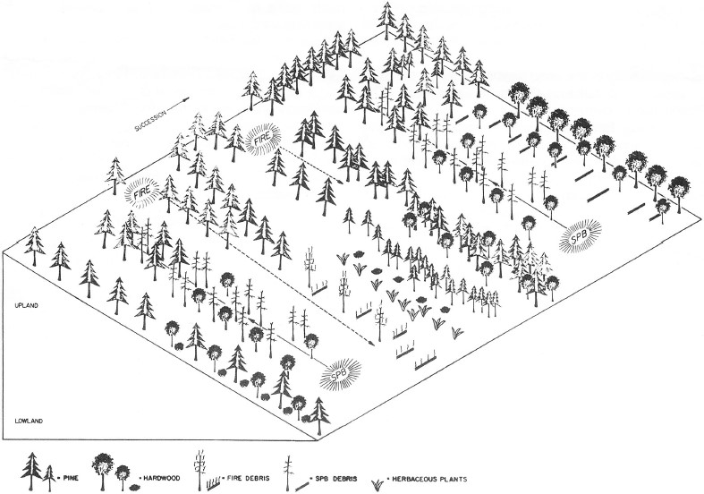
Fig. 1 Diagrammatic representation of interactions between southern pine beetle and fire in the southeastern ...
Notes:
Fig. 1 Diagrammatic representation of interactions between southern pine beetle and fire in the southeastern coniferous forest. Successional transitions extend from left to right; dotted arrows indicate direction of movement. Fire is a regular feature of the generally dry uplands, but moves into generally moist lowlands where drought or southern pine beetle creates favorable conditions for combustion. Southern pine beetle is a regular feature of both forests, but is most abundant where pines occur at high density and stress levels. Fire is necessary for regeneration of pines, especially after succession to hardwoods if fire return is delayed. From Schowalter et al. (1981a).
Unless provided in the caption above, the following copyright applies to the content of this slide: © The Author 2012. Published by Oxford University Press on behalf of Entomological Society of America.This is an Open Access article distributed under the terms of the Creative Commons Attribution License (http://creativecommons.org/licenses/by/3.0/), which permits unrestricted reuse, distribution, and reproduction in any medium, providedthe original work is properly cited.

Slide 2
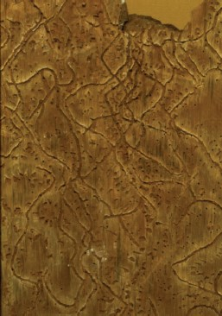
Fig. 2 Gallery structure of the southern pine beetle in loblolly pine bark, viewed outward from the phloem-cambium ...
Notes:
Fig. 2 Gallery structure of the southern pine beetle in loblolly pine bark, viewed outward from the phloem-cambium interface.
Unless provided in the caption above, the following copyright applies to the content of this slide: © The Author 2012. Published by Oxford University Press on behalf of Entomological Society of America.This is an Open Access article distributed under the terms of the Creative Commons Attribution License (http://creativecommons.org/licenses/by/3.0/), which permits unrestricted reuse, distribution, and reproduction in any medium, providedthe original work is properly cited.

Slide 3
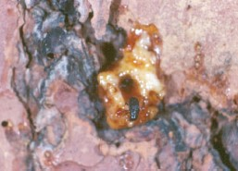
Fig. 3 The oleoresin, or pitch, flowing from severed resin ducts constitutes a physical-chemical defense that ...
Notes:
Fig. 3 The oleoresin, or pitch, flowing from severed resin ducts constitutes a physical-chemical defense that hinders penetration of the bark barrier by insects and pathogens. From Schowalter (2011) with permission from Elsevier.
Unless provided in the caption above, the following copyright applies to the content of this slide: © The Author 2012. Published by Oxford University Press on behalf of Entomological Society of America.This is an Open Access article distributed under the terms of the Creative Commons Attribution License (http://creativecommons.org/licenses/by/3.0/), which permits unrestricted reuse, distribution, and reproduction in any medium, providedthe original work is properly cited.

Slide 4
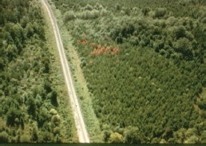
Fig. 4 Southern pine beetle “spot” in an even-aged loblolly pine plantation. U.S. Forest Service photo.
Notes:
Fig. 4 Southern pine beetle “spot” in an even-aged loblolly pine plantation. U.S. Forest Service photo.
Unless provided in the caption above, the following copyright applies to the content of this slide: © The Author 2012. Published by Oxford University Press on behalf of Entomological Society of America.This is an Open Access article distributed under the terms of the Creative Commons Attribution License (http://creativecommons.org/licenses/by/3.0/), which permits unrestricted reuse, distribution, and reproduction in any medium, providedthe original work is properly cited.

Slide 5
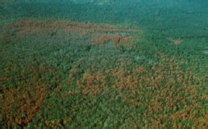
Fig. 5 Coalescing spots of southern pine beetle infestation in loblolly pine forest. U.S. Forest Service photo.
Notes:
Fig. 5 Coalescing spots of southern pine beetle infestation in loblolly pine forest. U.S. Forest Service photo.
Unless provided in the caption above, the following copyright applies to the content of this slide: © The Author 2012. Published by Oxford University Press on behalf of Entomological Society of America.This is an Open Access article distributed under the terms of the Creative Commons Attribution License (http://creativecommons.org/licenses/by/3.0/), which permits unrestricted reuse, distribution, and reproduction in any medium, providedthe original work is properly cited.

Slide 6
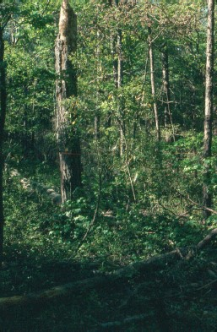
Fig. 6 Successional transition from pine-dominated forest to hardwood forest in the wake of southern pine beetle ...
Notes:
Fig. 6 Successional transition from pine-dominated forest to hardwood forest in the wake of southern pine beetle infestation. In the absence of fire, shade-tolerant hardwoods eventually replace shade-intolerant pines naturally.
Unless provided in the caption above, the following copyright applies to the content of this slide: © The Author 2012. Published by Oxford University Press on behalf of Entomological Society of America.This is an Open Access article distributed under the terms of the Creative Commons Attribution License (http://creativecommons.org/licenses/by/3.0/), which permits unrestricted reuse, distribution, and reproduction in any medium, providedthe original work is properly cited.

Slide 7
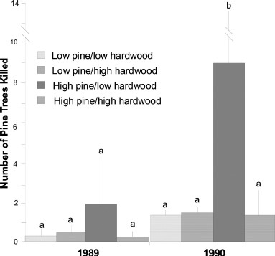
Fig. 7 Effect of host (pine) and nonhost (hardwood) densities on population growth of the southern pine beetle, ...
Notes:
Fig. 7 Effect of host (pine) and nonhost (hardwood) densities on population growth of the southern pine beetle, measured as pine mortality in 1989 (Mississippi) and 1990 (Louisiana). Low pine basal area is 11–14 m2/ha (50 feet2/acre); high pine basal area is 23–29 m2/ha (100 feet2/acre); low hardwood basal area is 0–4 m2/ha (15 feet2/acre); high hardwood basal area is 9–14 m2/ha (45 feet2/acre). Vertical lines indicate standard error of the mean. Bars within same letter did not differ at an experiment-wise error rate of P < 0.05 for data combined for the 2 yr. From Schowalter and Turchin (1993) with permission from the Society of American Foresters.
Unless provided in the caption above, the following copyright applies to the content of this slide: © The Author 2012. Published by Oxford University Press on behalf of Entomological Society of America.This is an Open Access article distributed under the terms of the Creative Commons Attribution License (http://creativecommons.org/licenses/by/3.0/), which permits unrestricted reuse, distribution, and reproduction in any medium, providedthe original work is properly cited.

Slide 8
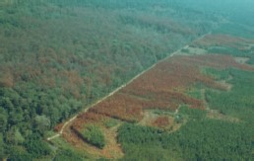
Fig. 8 Control of southern pine beetle infestation in a loblolly pine plantation by means of a 10-m (30 feet) ...
Notes:
Fig. 8 Control of southern pine beetle infestation in a loblolly pine plantation by means of a 10-m (30 feet) barrier to prevent continued spread. Note the greater degree of tree mortality in the even-aged pine plantation compared with the older, more diverse infestation source across the road. U.S. Forest Service photo.
Unless provided in the caption above, the following copyright applies to the content of this slide: © The Author 2012. Published by Oxford University Press on behalf of Entomological Society of America.This is an Open Access article distributed under the terms of the Creative Commons Attribution License (http://creativecommons.org/licenses/by/3.0/), which permits unrestricted reuse, distribution, and reproduction in any medium, providedthe original work is properly cited.

