Slide 1
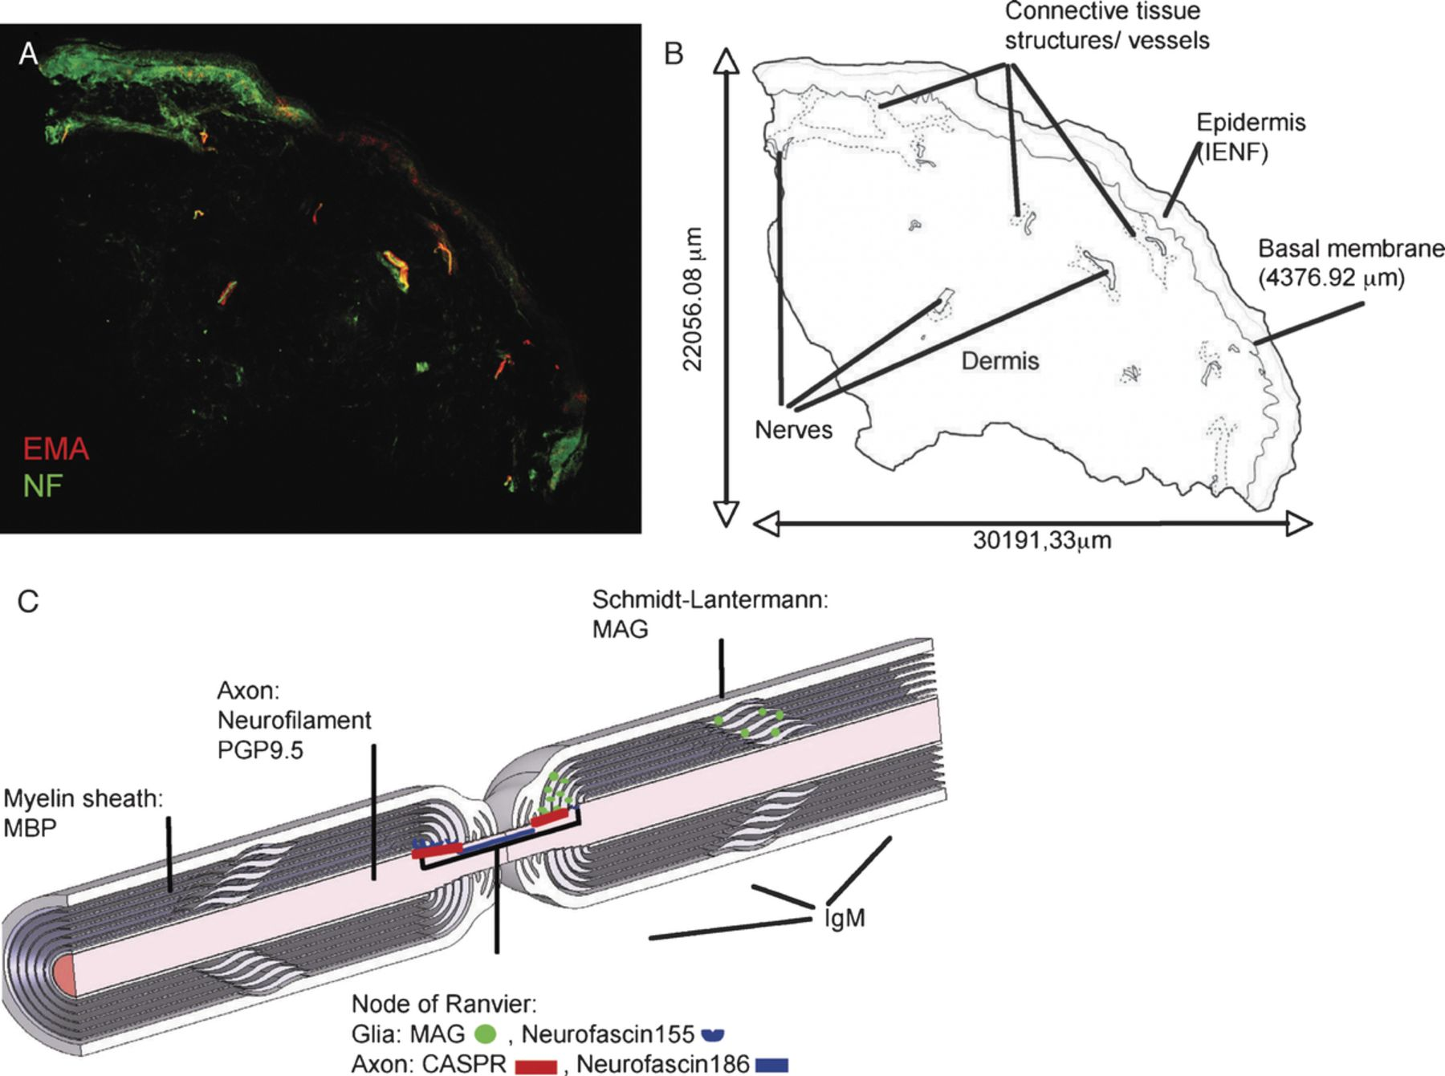
FIGURE 1. Innervation of hairy skin. (A) A 3-mm punch biopsy of hairy skin of a control patient. A general overview of ...
Notes:
FIGURE 1. Innervation of hairy skin. (A) A 3-mm punch biopsy of hairy skin of a control patient. A general overview of hairy skin innervation is shown by the staining for individual fibers using antibodies against neurofilament (green) and for perineurial cells using an antibody against epithelial membrane protein (red). The background is enhanced to visualize the biopsy outline; this accentuates the edge effect of the neurofilament staining in the upper left and lower right. (B) Schematic drawing of the structures within this skin punch biopsy. Myelinated nerves were only found in the dermis, whereas unmyelinated fibers are localized in the epidermis. (C) Schematic drawing of a myelinated nerve with its main structures highlighted as they relate to this study.
Unless provided in the caption above, the following copyright applies to the content of this slide: Copyright © 2009 by the American Association of Neuropathologists, Inc.

Slide 2
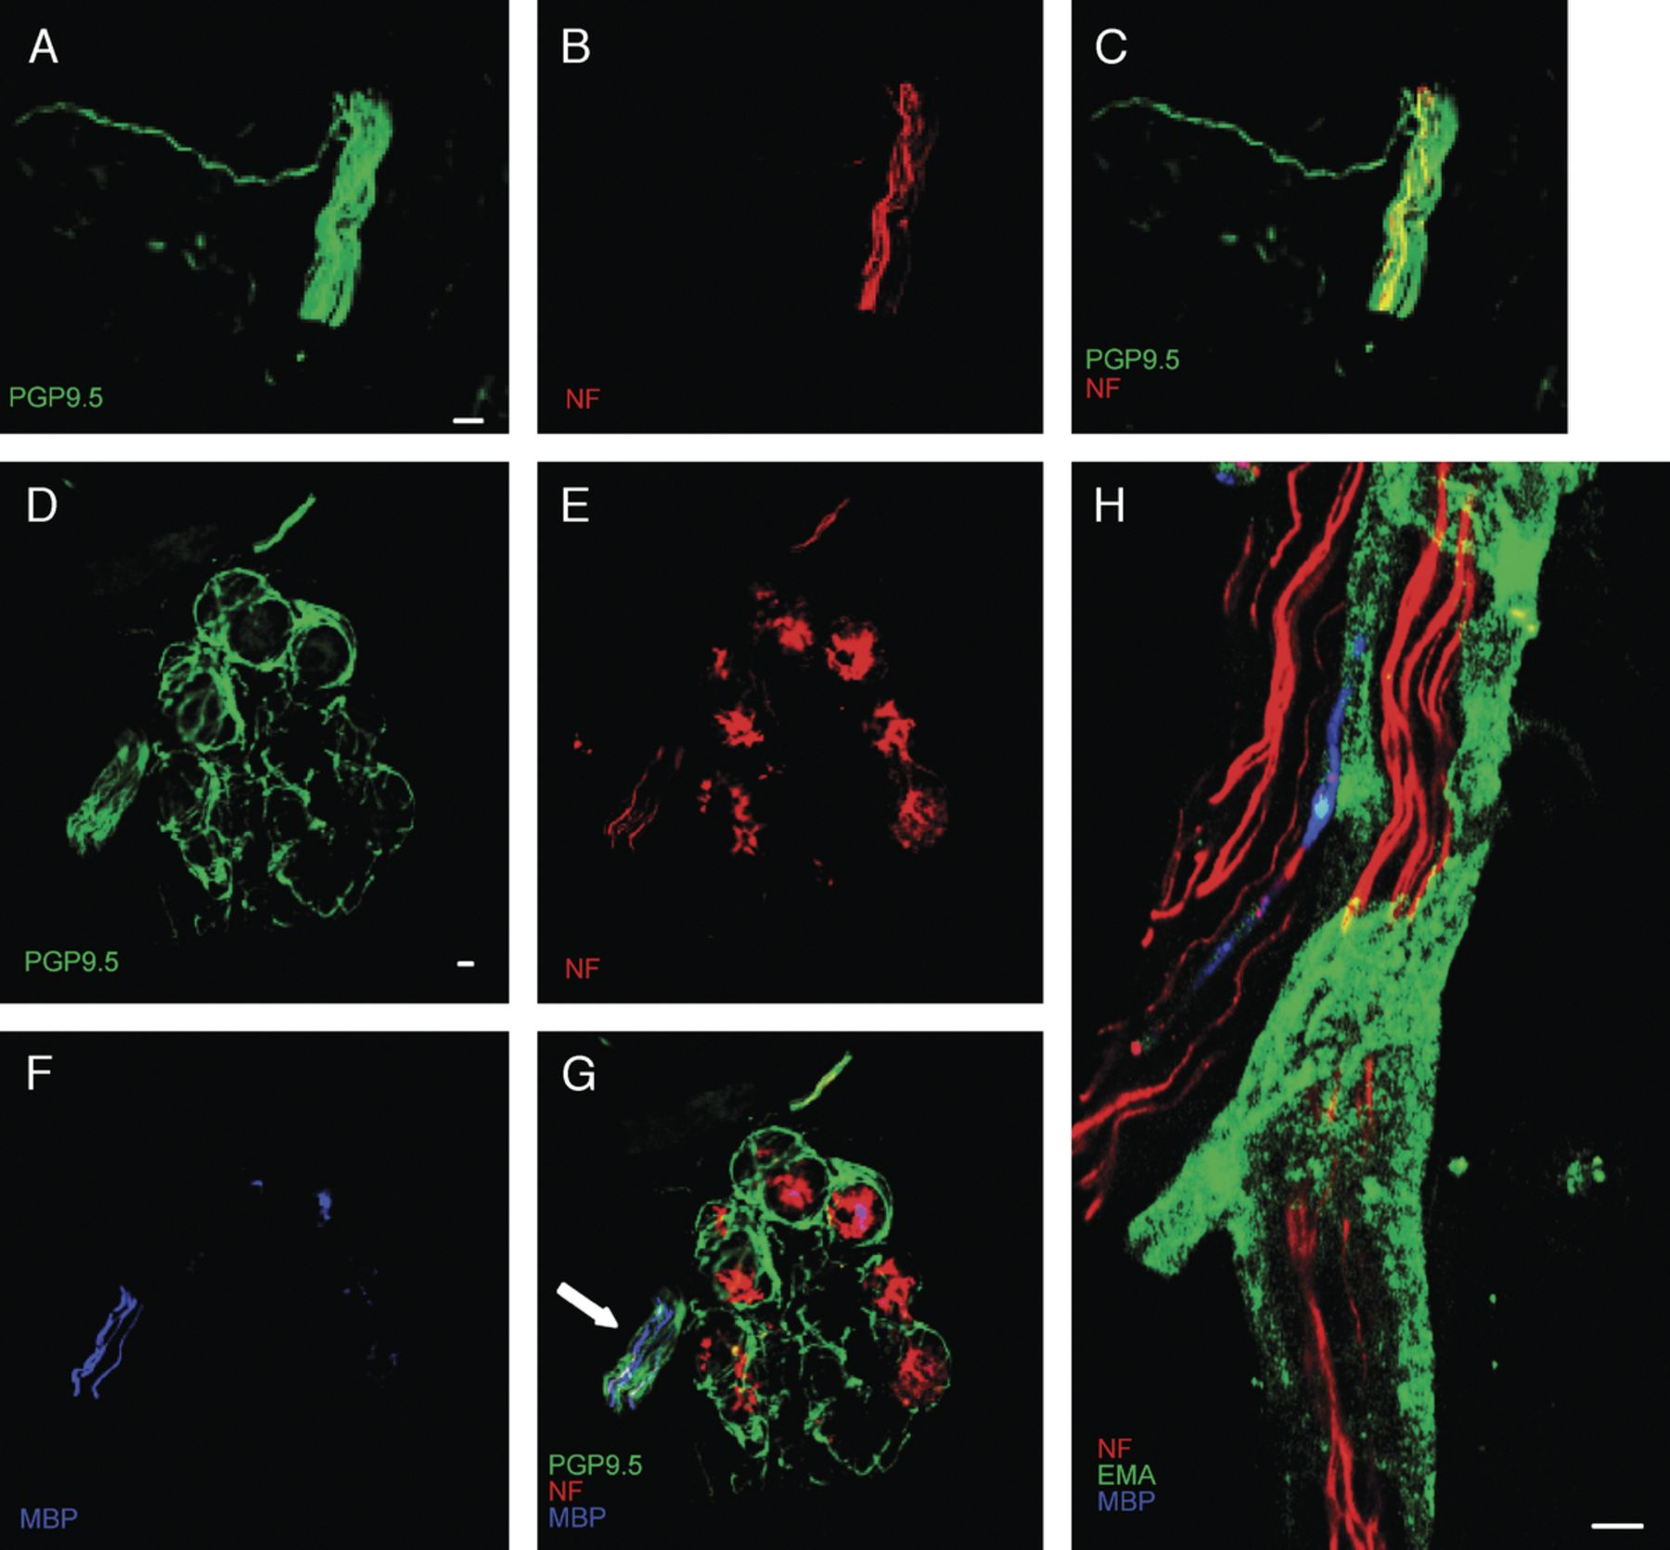
FIGURE 2. Axon markers of skin nerves in control patients. (A-C) Neurofilament (NF) and protein gene product 9.5 ...
Notes:
FIGURE 2. Axon markers of skin nerves in control patients. (A-C) Neurofilament (NF) and protein gene product 9.5 (PGP9.5) staining of a nerve bundle. Protein gene product 9.5 (green, A), NF (red, B), and overlay (C, yellow). (D-G) Glandular innervation triple stained using anti-PGP9.5 (D, green), anti-NF (E, red), and anti-myelin basic protein (F, blue). Double-positive nerve fibers are yellow in (G). Arrow indicates a nerve bundle containing some myelinated fibers. Round structures (red) are nonspecifically stained. (H) A typical skin nerve is ensheathed in a perineurial cell layer (epithelial membrane antigen, green) and contains nonmyelinated (NF, red) and myelinated (MBP, blue) axons. Scale bar = 10 μm.
Unless provided in the caption above, the following copyright applies to the content of this slide: Copyright © 2009 by the American Association of Neuropathologists, Inc.

Slide 3
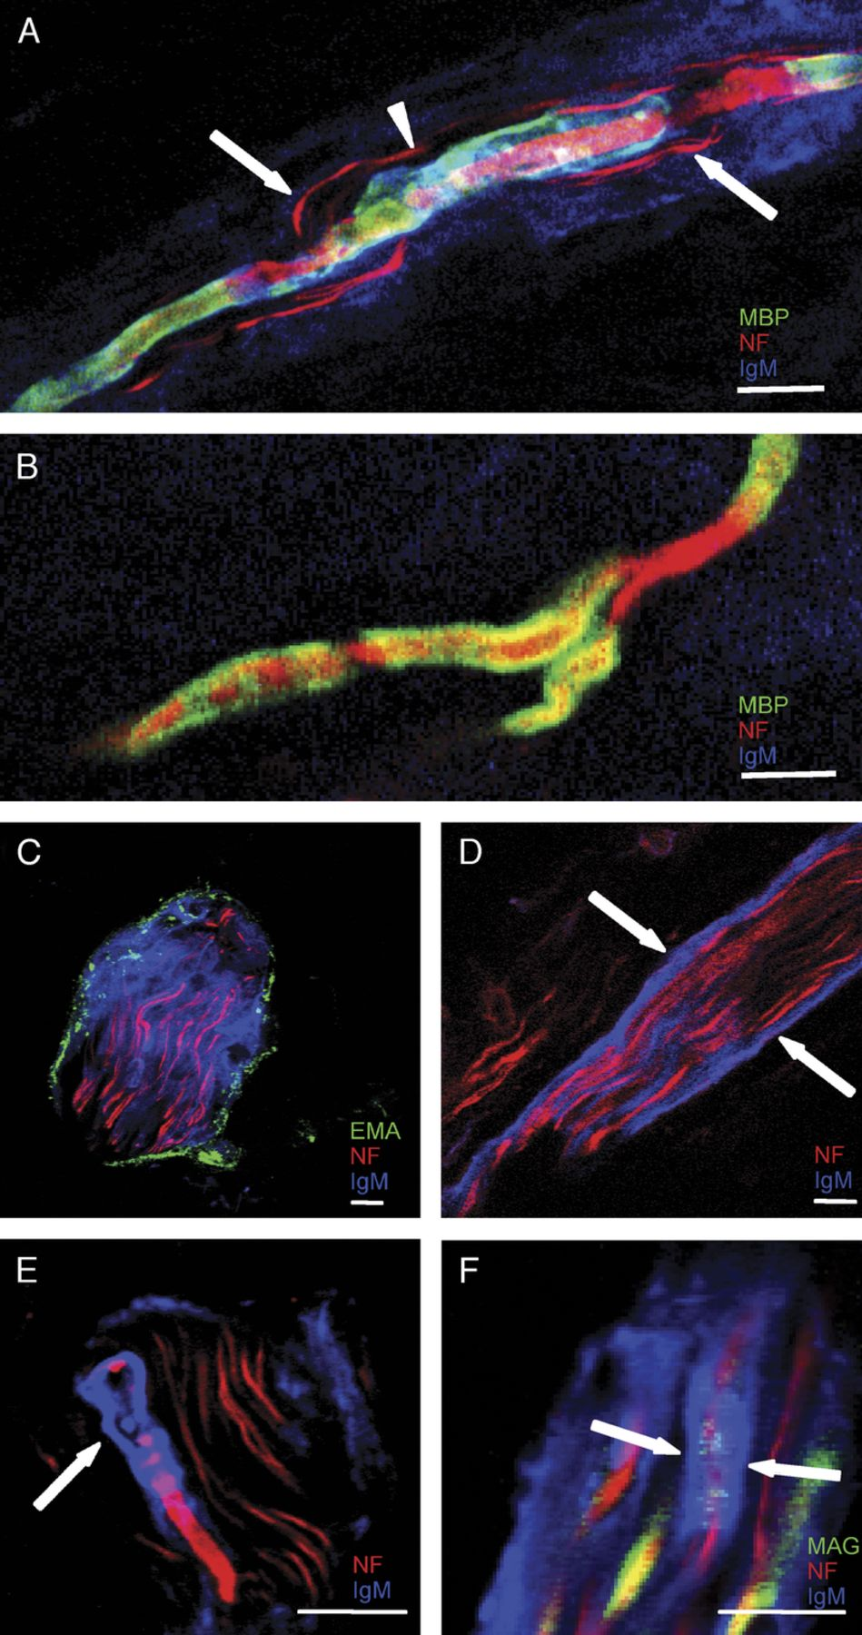
FIGURE 3. Immunoglobulin M (IgM) deposits in cutaneous nerves of anti-myelin-associated glycoprotein (MAG) neuropathy ...
Notes:
FIGURE 3. Immunoglobulin M (IgM) deposits in cutaneous nerves of anti-myelin-associated glycoprotein (MAG) neuropathy patients. (A) Myelinated fiber (arrowhead) running in parallel with nonmyelinated fibers (red, arrows) in a nerve bundle with IgM deposition. IgM (blue), neurofilament (red), and myelin (green). Sites of triple colocalization (arrowhead) are white. (B) A single branching myelinated fiber of the same patient does not show IgM deposits using the same microscope settings: neurofilament (red); myelin (green); colocalization, yellow (C-F) Examples of different types of IgM deposits (C). Nerve delineated by a perineurium (green) filled with diffuse IgM deposits (blue) and neurofilament (red). (D) Nerve (red) in which IgM deposits (blue) concentrate around the perineurium (arrows). (E) Fiber-specific IgM (blue, arrow) is also found on an individual myelinated nerve fiber in a bundle of fibers (red). (F) IgM deposits are also at nodes shown with an antibody against MAG (green, arrows). Scale bar = 10 μm.
Unless provided in the caption above, the following copyright applies to the content of this slide: Copyright © 2009 by the American Association of Neuropathologists, Inc.

Slide 4
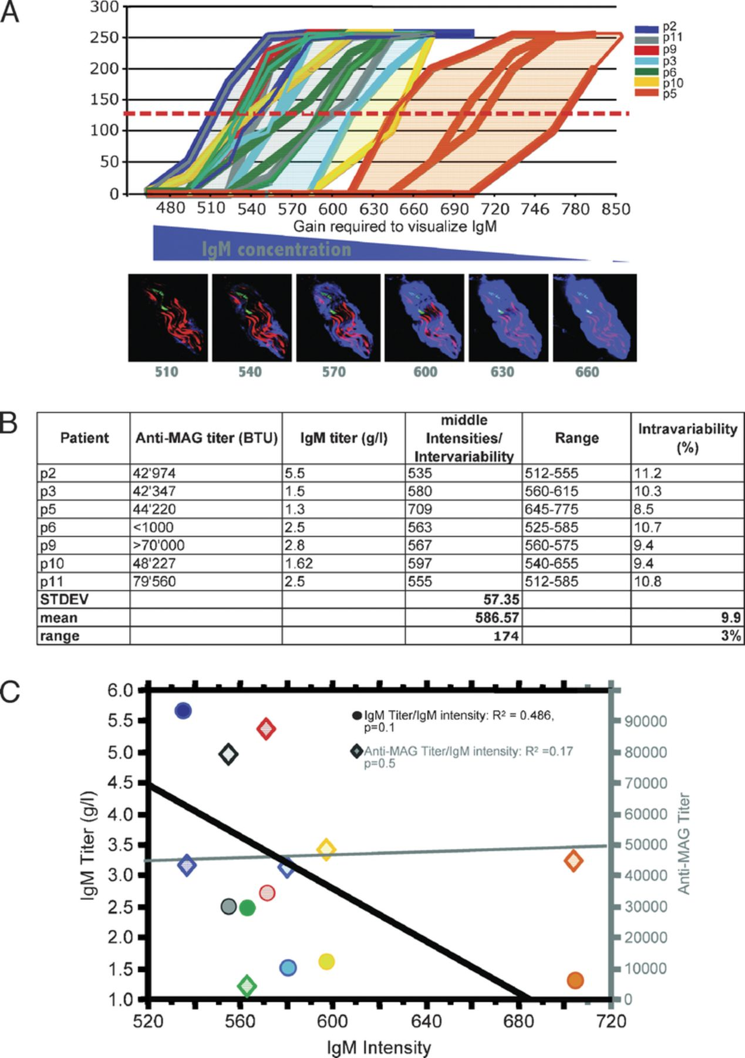
FIGURE 4. Quantification of immunoglobulin M (IgM) deposition and correlations with IgM levels. (A) Quantitative ...
Notes:
FIGURE 4. Quantification of immunoglobulin M (IgM) deposition and correlations with IgM levels. (A) Quantitative analysis of IgM accumulation levels in nerve bundles: Pixel intensities of IgM staining of individual patients are shown as a function of detector gain. High detector gain numbers indicate lower IgM accumulation. Red dashed line indicates middle intensity value of pixels at 128. Fluorescent image panels demonstrate the visibility increase by increasing detector gain value from 510 to 660. (B) Correlations of intensity values with IgM and anti-myelin-associated glycoprotein (MAG) titers (Table). Interpatient and intrapatient variabilities are shown in percent (last column). (C) Regression analysis demonstrates a linear dependence between the average IgM accumulation levels in nerves with IgM levels of patients (•, r2 = 0.486; p = 0.1); specific anti-MAG titer did not correlate (♦, r2 = 0.17)
Unless provided in the caption above, the following copyright applies to the content of this slide: Copyright © 2009 by the American Association of Neuropathologists, Inc.

Slide 5
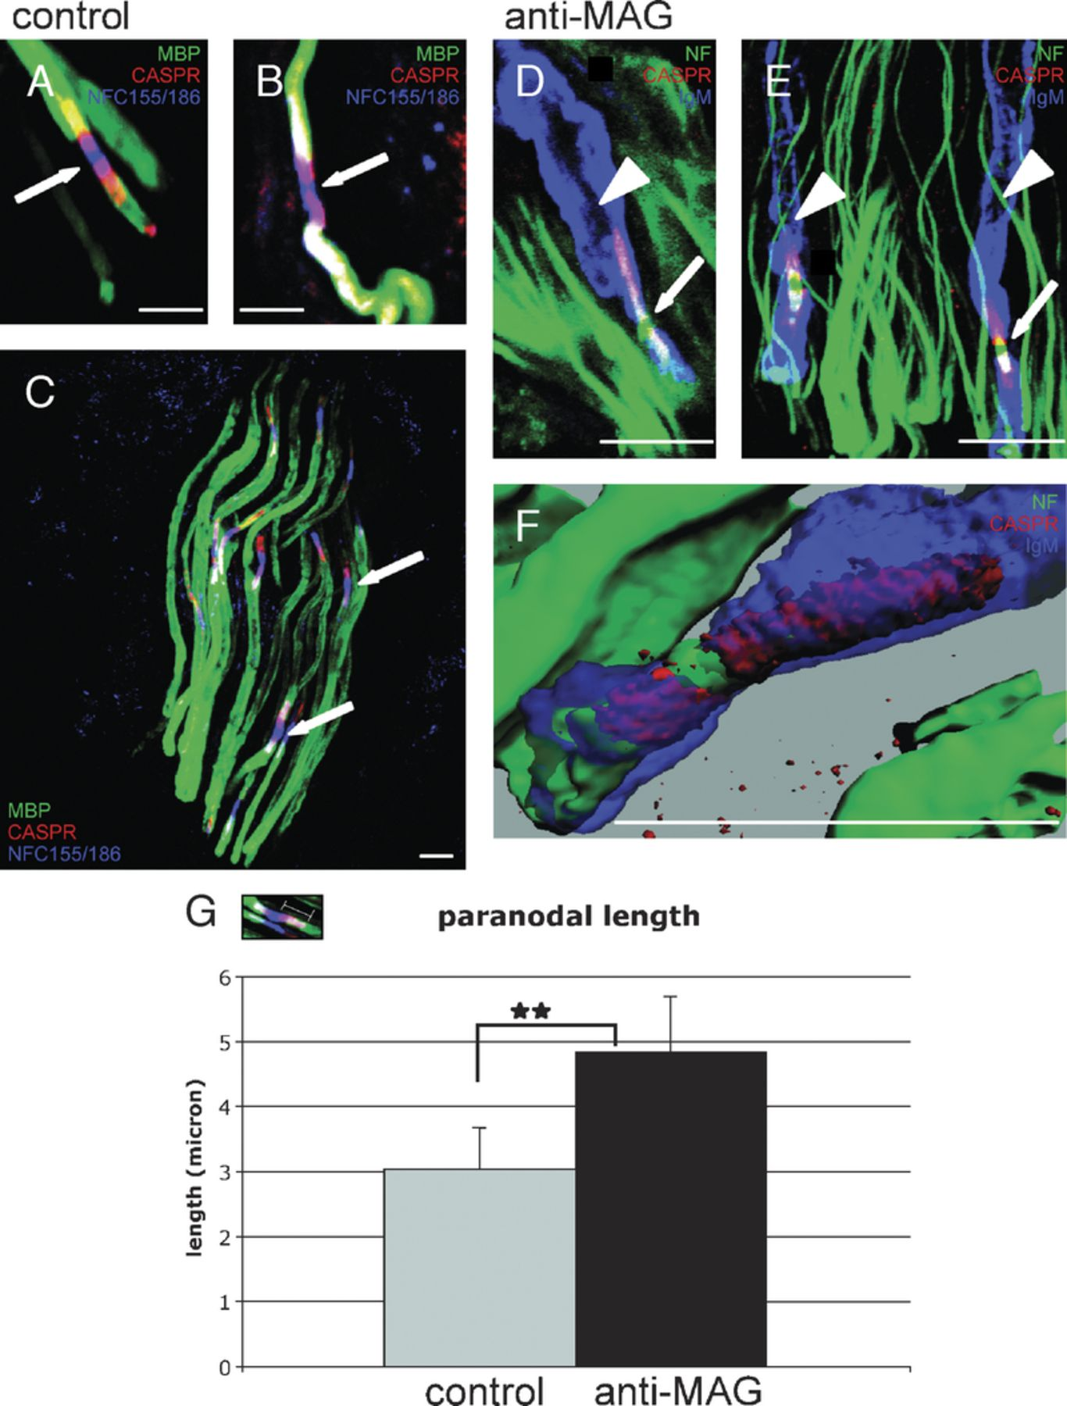
FIGURE 5. Paranodal integrity in skin nerves of anti-myelin-associated glycoprotein (MAG) neuropathy patients. (A-C) ...
Notes:
FIGURE 5. Paranodal integrity in skin nerves of anti-myelin-associated glycoprotein (MAG) neuropathy patients. (A-C) Paranodal and nodal (arrows) structures of control skin nerves are stained using antibodies against contactin associated protein (CASPR; red), neurofascin 155/186 (blue), and myelin basic protein (green). Colocalization sites of all 3 labels are white. Note the colocalization of neurofascin 155 with CASPR at the paranode (purple), whereas the node itself is only neurofascin 186-positive (blue). (D-F) Paranodal structures with heavy immunoglobulin M (IgM) deposits (arrows) of anti-MAG neuropathy patients identified using antibodies against IgM (blue), neurofilament (green), and CASPR (red). Colocalization of CASPR (red) and IgM (blue) is purple; triple-positive structures are white. Arrowheads highlight IgM deposits where neurofilament staining is lost. (F) Three-dimensional reconstruction of nodal area with heavy IgM deposits CASPR (red), neurofilament (green), IgM (blue). (G) The lengths of 46 CASPR-positive structures were measured in 22 anti-MAG neuropathy and 24 control samples. Data are represented as mean ± standard deviation; p = 0.002. Scale bar = 10 μm.
Unless provided in the caption above, the following copyright applies to the content of this slide: Copyright © 2009 by the American Association of Neuropathologists, Inc.

Slide 6
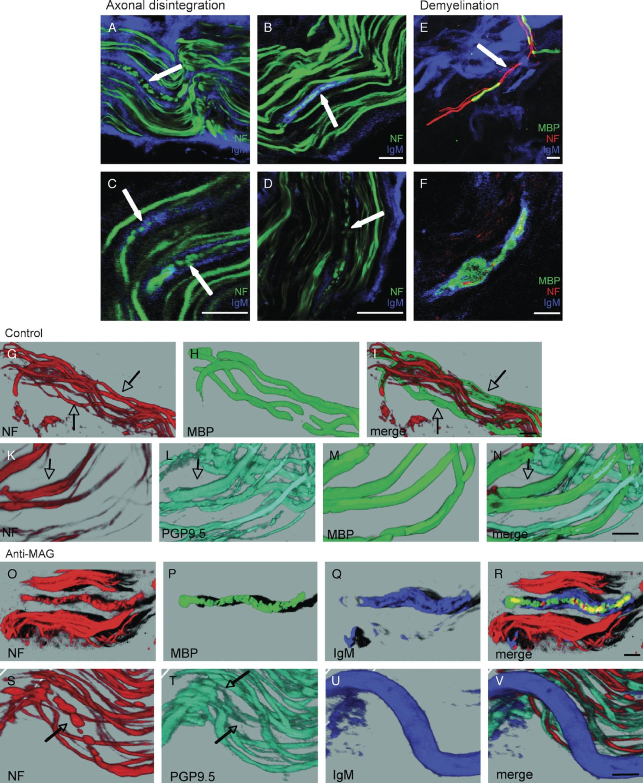
FIGURE 6. Immunoglobulin M (IgM)-induced changes in the neurofilament network and myelin in skin nerves of ...
Notes:
FIGURE 6. Immunoglobulin M (IgM)-induced changes in the neurofilament network and myelin in skin nerves of anti-myelin-associated glycoprotein (MAG) neuropathy patients. (A-D) Four examples of disintegrated neurofilament (NF) in anti-MAG patients are shown. Neurofilament is green, whereas IgM is blue. Note the colocalization of IgM deposits with loss of NF staining (arrows). (E, F) Two types of observed myelin abnormalities, that is, focal demyelination (arrow) (E) and myelin disintegration and ovoid formation (F). Note the remains of axons in this structure. For both panels, NF is red, myelin is green, and IgM is blue. Scale bar = 10 μm. (G-N) In control skin nerves, NF staining is homogeneous in nerve fibers. Neurofilament correlates with protein gene product 9.5 (PGP9.5) expression. Neurofilament is red, PGP9.5 is cyan, and myelin basic protein (MBP; green). (O-R) In skin nerves of anti-MAG neuropathy patients, NF is discontinuous in myelinated fibers that have myelin-penetrating IgM deposits. NF is red, MBP is green, and IgM is blue. (S-V) In skin nerves of anti-MAG patients, discontinuous NF correlates with discontinuous or lost (arrows) PGP9.5 in axons with specific IgM deposits. NF is red, PGP9.5 is cyan, MBP is green, and IgM is blue.
Unless provided in the caption above, the following copyright applies to the content of this slide: Copyright © 2009 by the American Association of Neuropathologists, Inc.

Slide 7
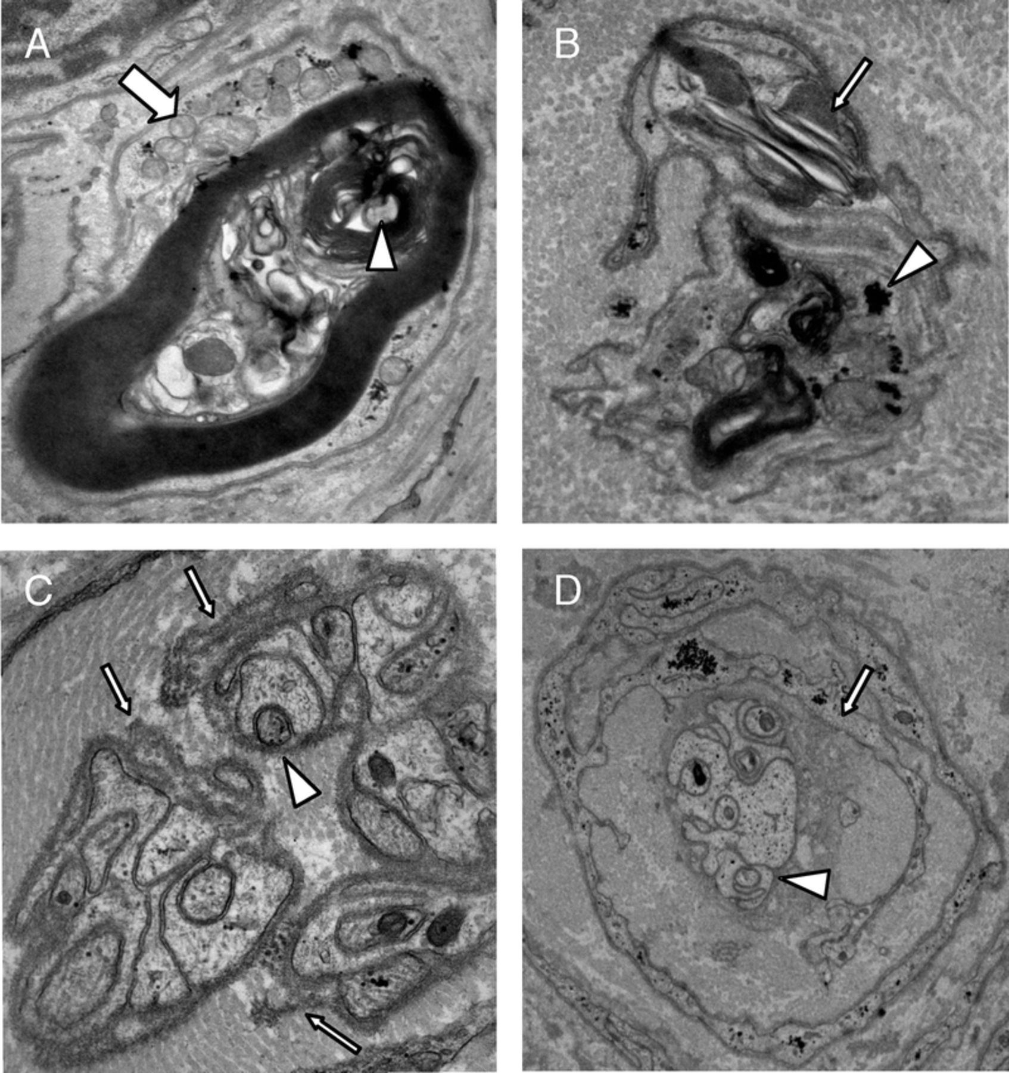
FIGURE 7. Ultrastructural analysis of dermal nerves of anti-myelin-associated glycoprotein (MAG) neuropathy patients. ...
Notes:
FIGURE 7. Ultrastructural analysis of dermal nerves of anti-myelin-associated glycoprotein (MAG) neuropathy patients. (A) Axonal degeneration (arrowhead) with collapse and fragmentation myelin. Schwann cell cytoplasm contains numerous mitochondria (arrow) and is surrounded by a ruffled cell membrane. (B) A degenerating myelinating Schwann cell contains myelin debris, large Reich granule (arrow), and glycogen aggregates (arrowhead). (C) Partial view of a nerve bundle with bands of Büngner characterized by Schwann cell hypertrophy within abundant leftover basal membranes (arrows). Axons are not completely enwrapped in Schwann cell processes (arrowhead). (D) Concentrically organized, probably hyperactive Schwann cells. Cells are ensheathed by a basement membrane and have focal pinocytotic vesicles (arrow). In the center is a Schwann cell cluster with lucent cytoplasm and some axon sprouts with one mesaxon (arrowhead).
Unless provided in the caption above, the following copyright applies to the content of this slide: Copyright © 2009 by the American Association of Neuropathologists, Inc.

