Slide 1
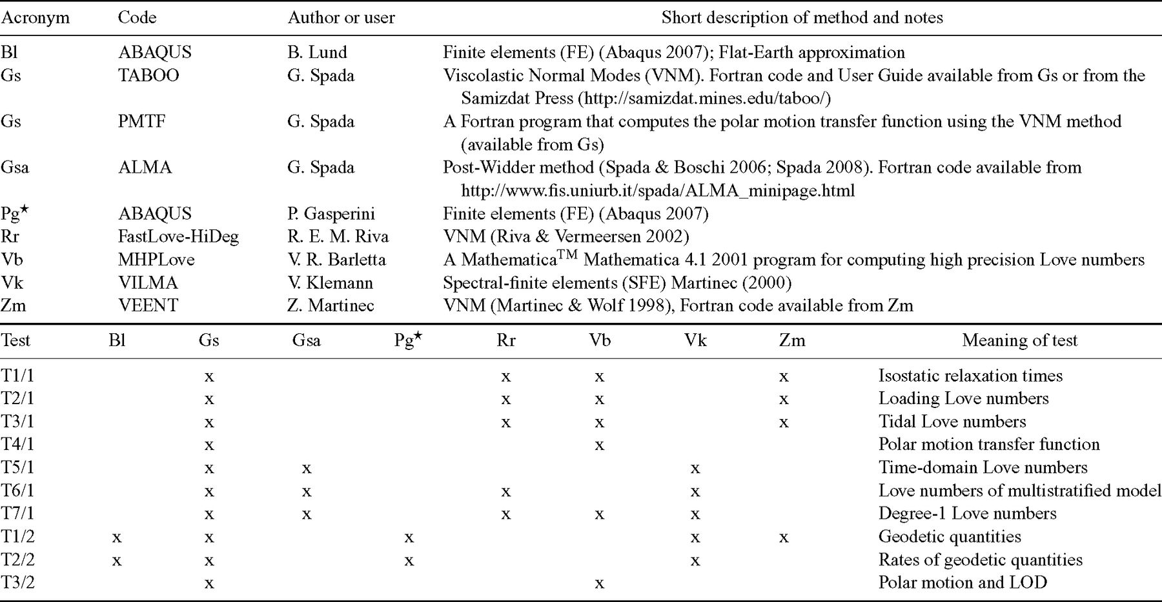
Table 1 Top: participating WG COST Action ES0701 members and external contributors (starred), with notes about the ...
Notes:
Table 1 Top: participating WG COST Action ES0701 members and external contributors (starred), with notes about the independently developed codes and methods. Bottom: contributions to the benchmark tests so far. (Here abbreviation TX/Y denotes test ‘X’ of Test Class ‘Y’.)
Unless provided in the caption above, the following copyright applies to the content of this slide: © 2011 The Authors Published by Oxford University Press on behalf of the Royal Astronomical SocietyThis is an Open Access article distributed under the terms of the Creative Commons Attribution Non-Commercial License (http://creativecommons.org/licenses/by-nc/3.0/), which permits non-commercial re-use, distribution, and reproduction in any medium, provided the original work is properly cited. For commercial re-use, please contact journals.permissions@oup.com

Slide 2
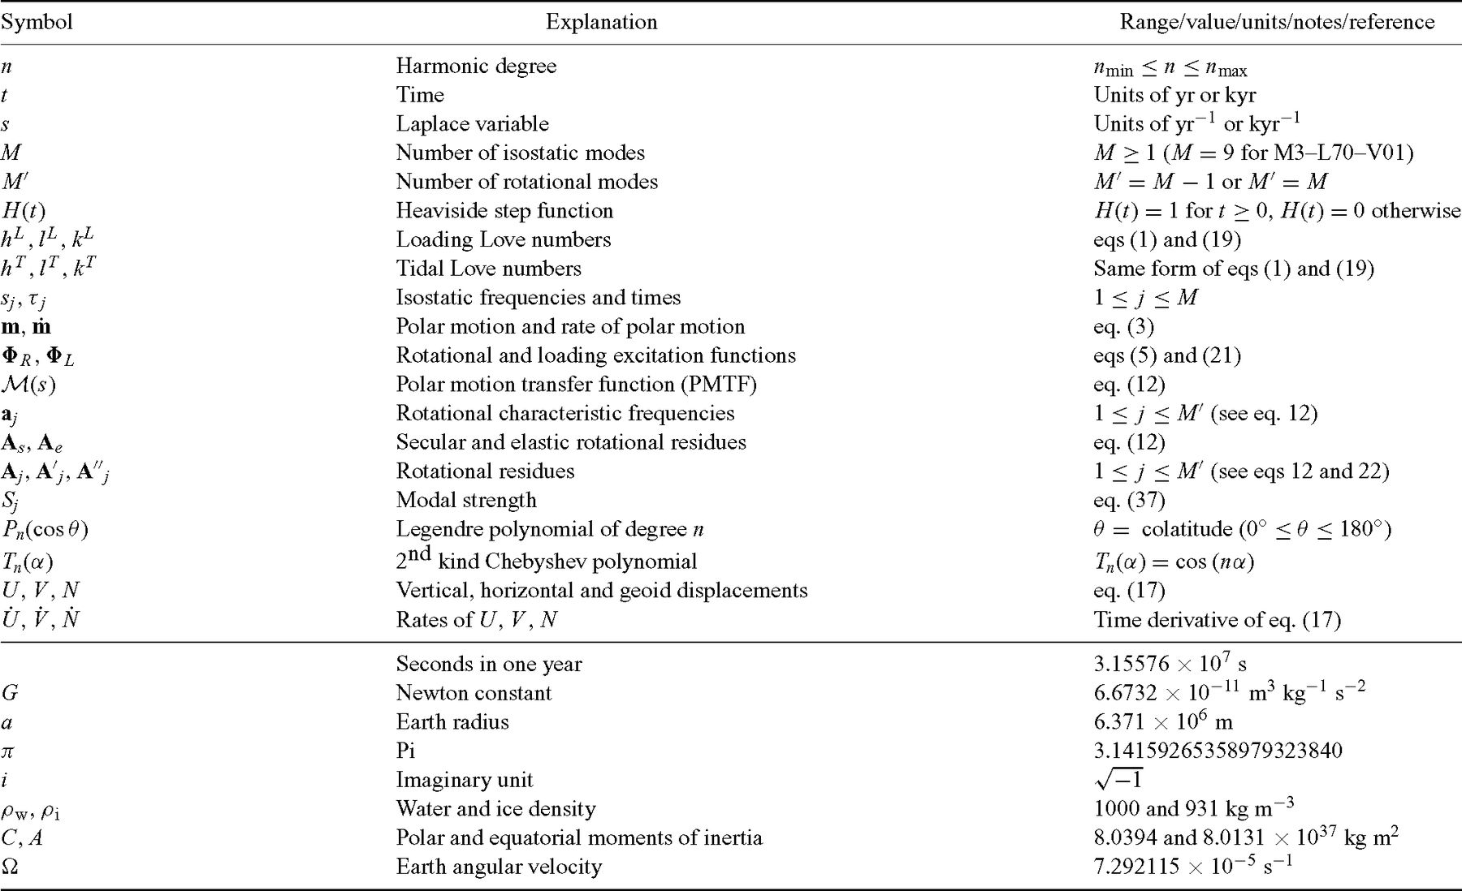
Table 2 The top part of this frequently used symbols throughout the manuscript. Numerical values of physical ...
Notes:
Table 2 The top part of this frequently used symbols throughout the manuscript. Numerical values of physical constants used as parameters and common to all test suites are shown in the bottom part.
Unless provided in the caption above, the following copyright applies to the content of this slide: © 2011 The Authors Published by Oxford University Press on behalf of the Royal Astronomical SocietyThis is an Open Access article distributed under the terms of the Creative Commons Attribution Non-Commercial License (http://creativecommons.org/licenses/by-nc/3.0/), which permits non-commercial re-use, distribution, and reproduction in any medium, provided the original work is properly cited. For commercial re-use, please contact journals.permissions@oup.com

Slide 3
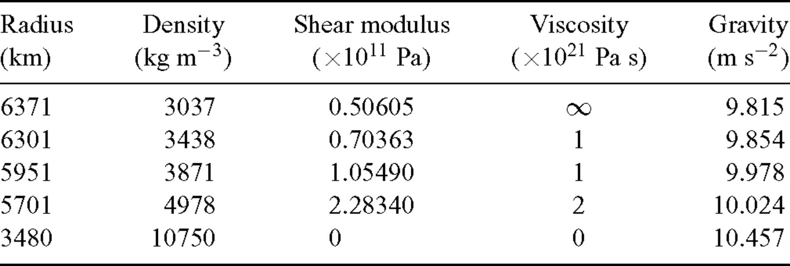
Table 3 Model parameters for M3-L70-V01, the reference model for this benchmark study. The (unperturbed) gravity at ...
Notes:
Table 3 Model parameters for M3-L70-V01, the reference model for this benchmark study. The (unperturbed) gravity at the interfaces is computed according to the reference density profile. These parameters are also adopted in model M3-L70-V01f, the flat-Earth variant of M3-L70-V01 implemented in the FE scheme of Bl (see Section 4.2.3).
Unless provided in the caption above, the following copyright applies to the content of this slide: © 2011 The Authors Published by Oxford University Press on behalf of the Royal Astronomical SocietyThis is an Open Access article distributed under the terms of the Creative Commons Attribution Non-Commercial License (http://creativecommons.org/licenses/by-nc/3.0/), which permits non-commercial re-use, distribution, and reproduction in any medium, provided the original work is properly cited. For commercial re-use, please contact journals.permissions@oup.com

Slide 4
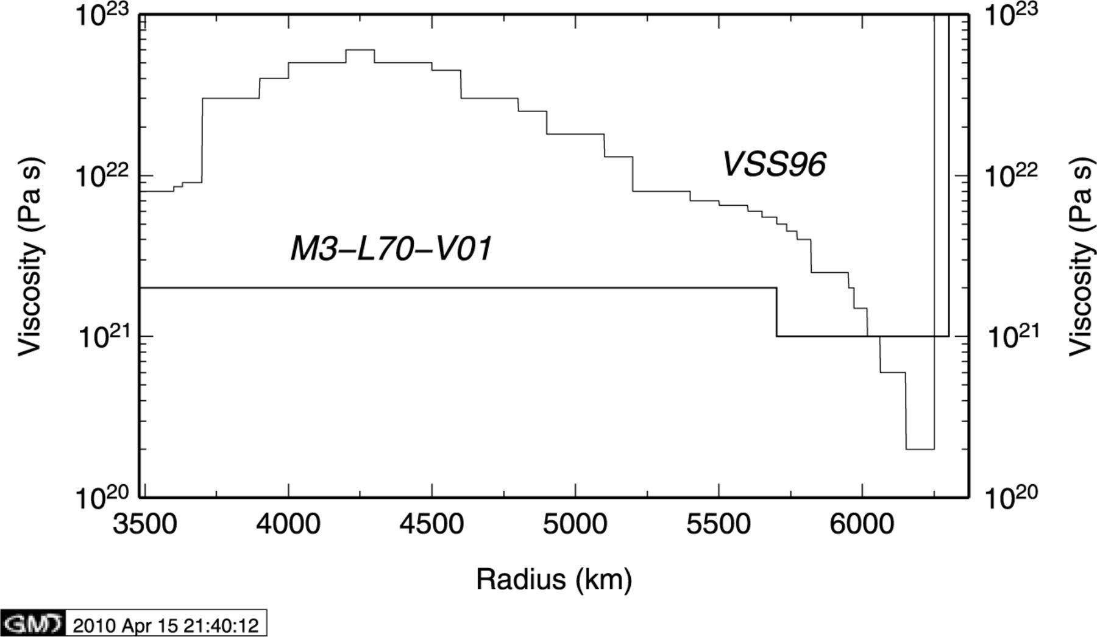
Figure 1 Viscosity profile of models M3–L70–V01 (a three-layer viscosity profile, see Table 3) and VSS96 (a 28-layer ...
Notes:
Figure 1 Viscosity profile of models M3–L70–V01 (a three-layer viscosity profile, see Table 3) and VSS96 (a 28-layer profile from Vermeersen et al. 1996a). VSS96 is used in Test 6/1.
Unless provided in the caption above, the following copyright applies to the content of this slide: © 2011 The Authors Published by Oxford University Press on behalf of the Royal Astronomical SocietyThis is an Open Access article distributed under the terms of the Creative Commons Attribution Non-Commercial License (http://creativecommons.org/licenses/by-nc/3.0/), which permits non-commercial re-use, distribution, and reproduction in any medium, provided the original work is properly cited. For commercial re-use, please contact journals.permissions@oup.com

Slide 5
Table 4 Description of the geometry of the ice loads. For all loads, the ice density is ρ_{i}= 931 kg ...
Notes:
Table 4 Description of the geometry of the ice loads. For all loads, the ice density is ρi= 931 kg m−3. The reference value for Earth radius a and the definition of Tn(x), the Chebyshev polynomials of the second kind, are given in Table 2. Here h and α denote the ice thickness and the load half-extension, respectively, while mδ is the mass of the point load. The Legendre coefficients σn are adopted from Spada (2003). Reference numerical values for h, α and mδ suggested for the spatial domain tests are also given. For Test 2/3, the colatitude and longitude of the centroid of the load geometries are θc= 25° and λc= 75°.
Unless provided in the caption above, the following copyright applies to the content of this slide: © 2011 The Authors Published by Oxford University Press on behalf of the Royal Astronomical SocietyThis is an Open Access article distributed under the terms of the Creative Commons Attribution Non-Commercial License (http://creativecommons.org/licenses/by-nc/3.0/), which permits non-commercial re-use, distribution, and reproduction in any medium, provided the original work is properly cited. For commercial re-use, please contact journals.permissions@oup.com

Slide 6
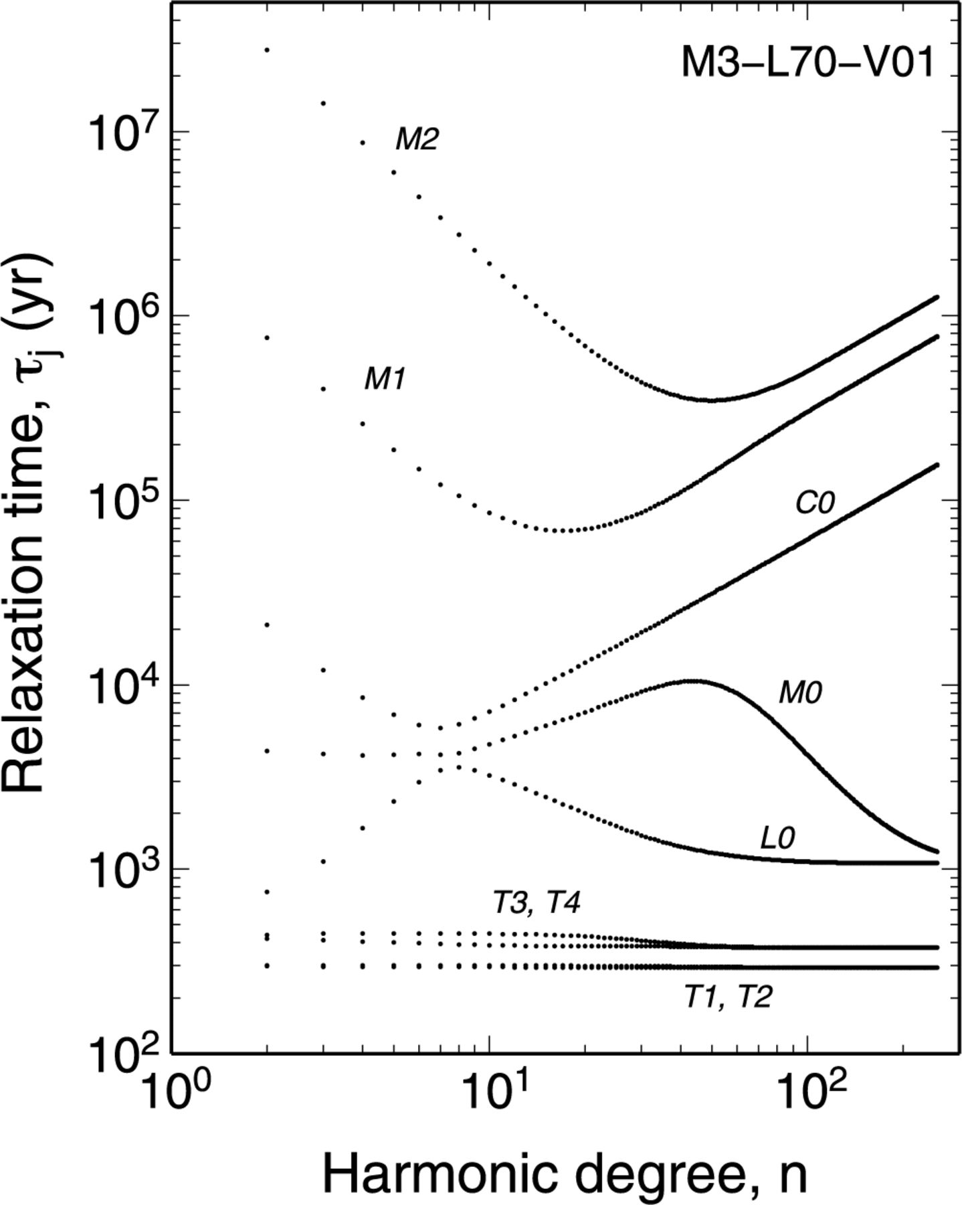
Figure 2 Spectrum of the isostatic relaxation times τ_{j}, (j= 1, …, M), expressed in years, for model ...
Notes:
Figure 2 Spectrum of the isostatic relaxation times τj, (j= 1, …, M), expressed in years, for model M3–L70–V01 in the range of degrees 2 ≤n≤ 256, according to data sets provided by Vb, Rr, Gs and Zm (Test 1/1). The number of modes is M= 9, branches are labelled according to usual conventions.
Unless provided in the caption above, the following copyright applies to the content of this slide: © 2011 The Authors Published by Oxford University Press on behalf of the Royal Astronomical SocietyThis is an Open Access article distributed under the terms of the Creative Commons Attribution Non-Commercial License (http://creativecommons.org/licenses/by-nc/3.0/), which permits non-commercial re-use, distribution, and reproduction in any medium, provided the original work is properly cited. For commercial re-use, please contact journals.permissions@oup.com

Slide 7
Table 5 Description of the geometry of the ice loads. For all loads, the ice density is ρ_{i}= 931 kg ...
Notes:
Table 5 Description of the geometry of the ice loads. For all loads, the ice density is ρi= 931 kg m−3. The reference value for Earth radius a and the definition of Tn(x), the Chebyshev polynomials of the second kind, are given in Table 2. Here h and α denote the ice thickness and the load half-extension, respectively, while mδ is the mass of the point load. The Legendre coefficients σn are adopted from Spada (2003). Reference numerical values for h, α and mδ suggested for the spatial domain tests are also given. For Test 2/3, the colatitude and longitude of the centroid of the load geometries are θc= 25° and λc= 75°.
Unless provided in the caption above, the following copyright applies to the content of this slide: © 2011 The Authors Published by Oxford University Press on behalf of the Royal Astronomical SocietyThis is an Open Access article distributed under the terms of the Creative Commons Attribution Non-Commercial License (http://creativecommons.org/licenses/by-nc/3.0/), which permits non-commercial re-use, distribution, and reproduction in any medium, provided the original work is properly cited. For commercial re-use, please contact journals.permissions@oup.com

Slide 8
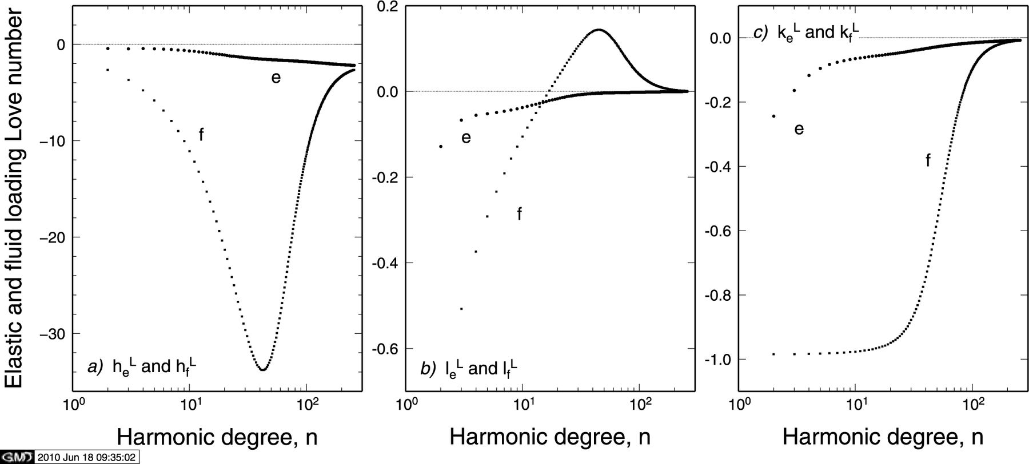
Figure 3 Elastic (e, circles) and fluid (f, squares) loading Love numbers for model M3–L70–V01 as a function of ...
Notes:
Figure 3 Elastic (e, circles) and fluid (f, squares) loading Love numbers for model M3–L70–V01 as a function of harmonic degree (Test 2/1), computed according to contributors Vb, Rr and Gs. Vertical, horizontal and potential Love numbers are shown in frames (a), (b) and (c), respectively.
Unless provided in the caption above, the following copyright applies to the content of this slide: © 2011 The Authors Published by Oxford University Press on behalf of the Royal Astronomical SocietyThis is an Open Access article distributed under the terms of the Creative Commons Attribution Non-Commercial License (http://creativecommons.org/licenses/by-nc/3.0/), which permits non-commercial re-use, distribution, and reproduction in any medium, provided the original work is properly cited. For commercial re-use, please contact journals.permissions@oup.com

Slide 9
Table 6 Elastic and fluid loading Love numbers according to predictions from Vb, Rr, and Gs (VRG) for Test 2/1. ...
Notes:
Table 6 Elastic and fluid loading Love numbers according to predictions from Vb, Rr, and Gs (VRG) for Test 2/1. Results provided by Zm differ from VRG by less than one part in 105 for degrees in the range 2−128. Here yx and yx are abbreviations for y× 10x and y× 10−x, respectively.
Unless provided in the caption above, the following copyright applies to the content of this slide: © 2011 The Authors Published by Oxford University Press on behalf of the Royal Astronomical SocietyThis is an Open Access article distributed under the terms of the Creative Commons Attribution Non-Commercial License (http://creativecommons.org/licenses/by-nc/3.0/), which permits non-commercial re-use, distribution, and reproduction in any medium, provided the original work is properly cited. For commercial re-use, please contact journals.permissions@oup.com

Slide 10
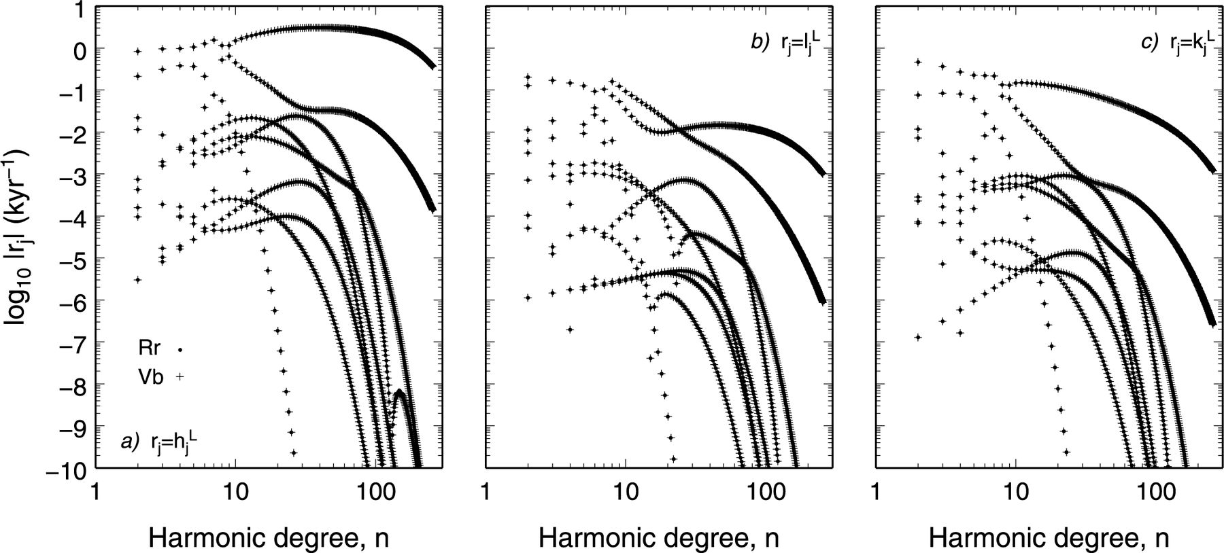
Figure 4 Comparison between absolute values of residues of the loading Love numbers computed for model M3–L70–V01 by ...
Notes:
Figure 4 Comparison between absolute values of residues of the loading Love numbers computed for model M3–L70–V01 by Rr and Vb (Test 2/1). Smoothness of the nine branches with varying n may indicate that Love number formalism is correctly implemented.
Unless provided in the caption above, the following copyright applies to the content of this slide: © 2011 The Authors Published by Oxford University Press on behalf of the Royal Astronomical SocietyThis is an Open Access article distributed under the terms of the Creative Commons Attribution Non-Commercial License (http://creativecommons.org/licenses/by-nc/3.0/), which permits non-commercial re-use, distribution, and reproduction in any medium, provided the original work is properly cited. For commercial re-use, please contact journals.permissions@oup.com

Slide 11
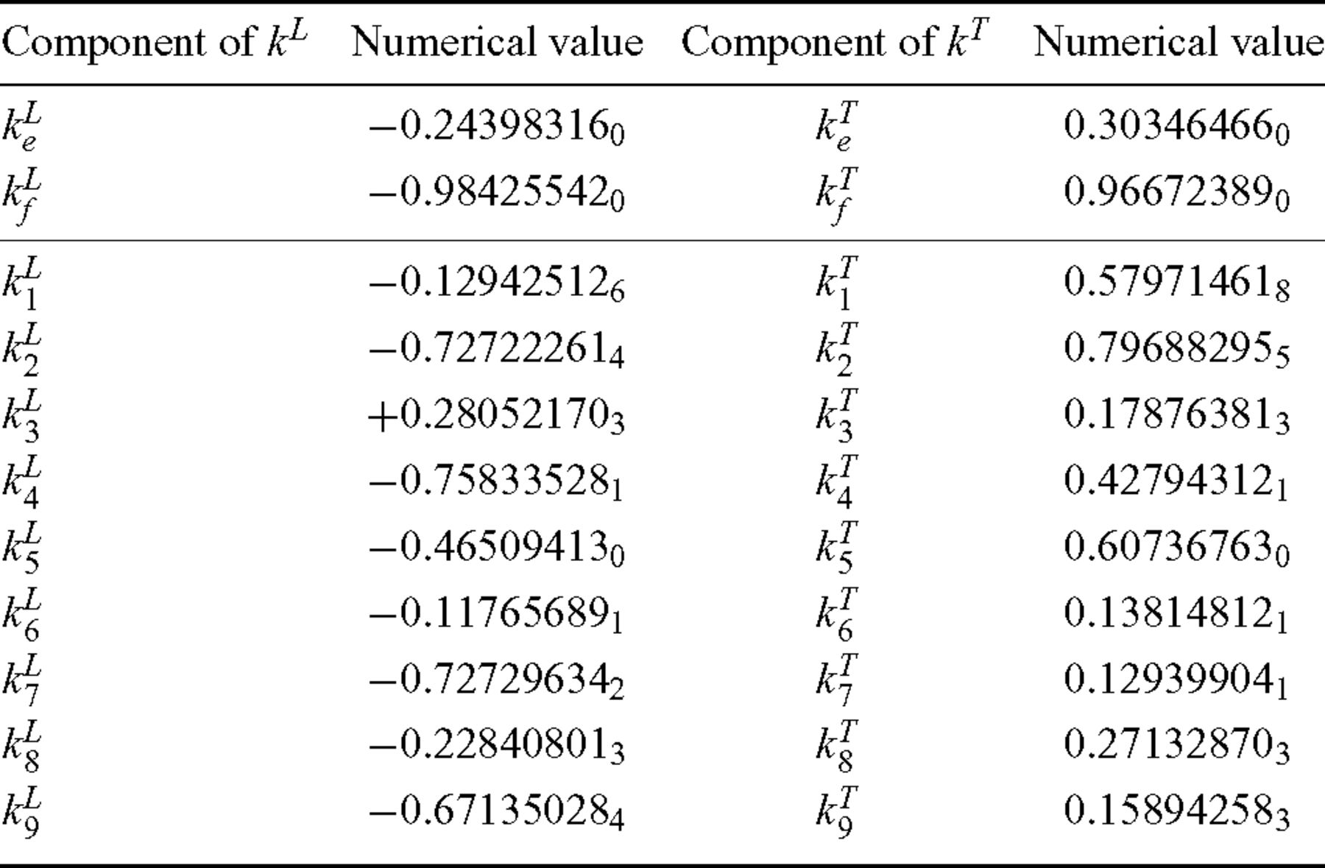
Table 7 Spectral components of loading Love number k^{L} (left, Test 2/1) and of tidal Love number ...
Notes:
Table 7 Spectral components of loading Love number kL (left, Test 2/1) and of tidal Love number kT (right, 3/1) of harmonic degree n= 2 according to predictions from Vb, Rr, Gs and Zm. All these codes agree to within one part in 108.
Unless provided in the caption above, the following copyright applies to the content of this slide: © 2011 The Authors Published by Oxford University Press on behalf of the Royal Astronomical SocietyThis is an Open Access article distributed under the terms of the Creative Commons Attribution Non-Commercial License (http://creativecommons.org/licenses/by-nc/3.0/), which permits non-commercial re-use, distribution, and reproduction in any medium, provided the original work is properly cited. For commercial re-use, please contact journals.permissions@oup.com

Slide 12
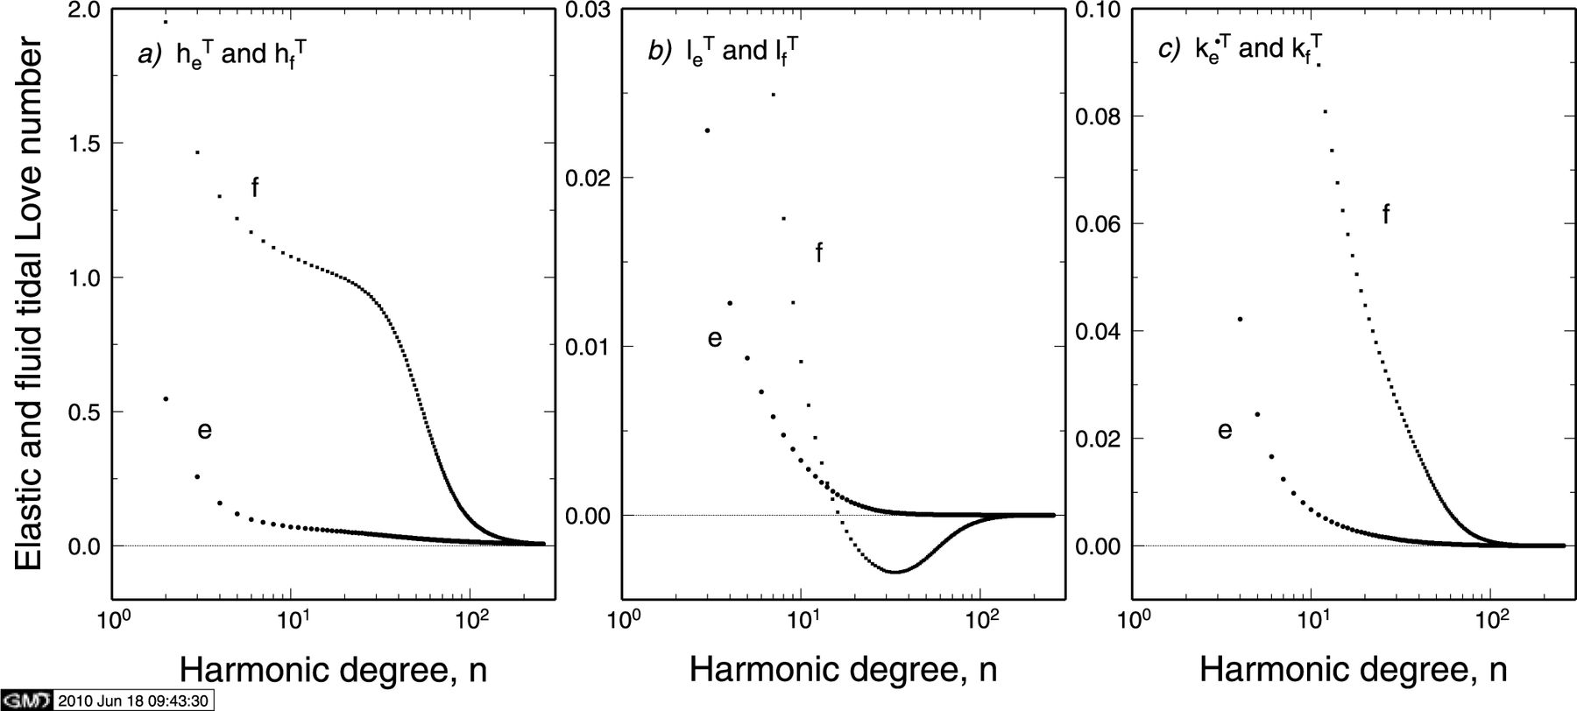
Figure 5 Elastic (e) and fluid (f) tidal Love numbers for model M3–L70–V01 as a function of harmonic degree n (Test ...
Notes:
Figure 5 Elastic (e) and fluid (f) tidal Love numbers for model M3–L70–V01 as a function of harmonic degree n (Test 3/1), computed according to codes Vb, Rr and Gs (results are indistinguishable in this figure). Vertical, horizontal and potential Love numbers are considered in frames (a), (b) and (c), respectively. In frames (b) and (c), low-degree Love numbers are out of range of figure.
Unless provided in the caption above, the following copyright applies to the content of this slide: © 2011 The Authors Published by Oxford University Press on behalf of the Royal Astronomical SocietyThis is an Open Access article distributed under the terms of the Creative Commons Attribution Non-Commercial License (http://creativecommons.org/licenses/by-nc/3.0/), which permits non-commercial re-use, distribution, and reproduction in any medium, provided the original work is properly cited. For commercial re-use, please contact journals.permissions@oup.com

Slide 13
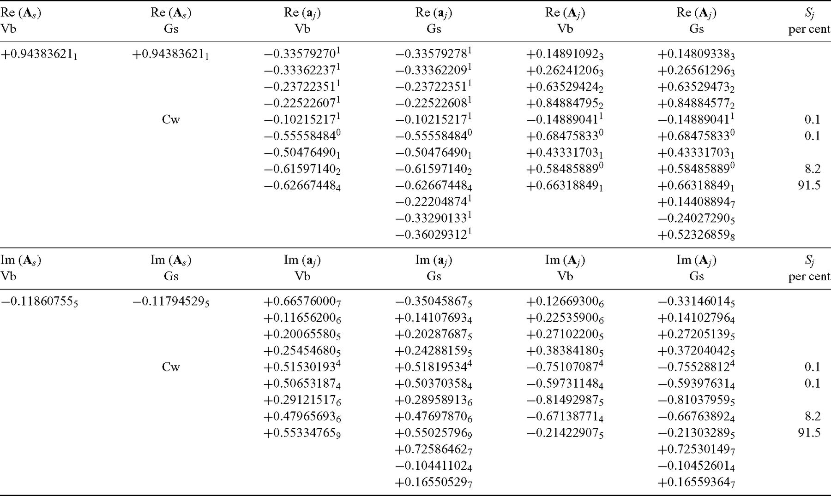
Table 8 Test 4/1 comparison between real (top) and imaginary parts (bottom) of the coefficients that enter the PMTF ...
Notes:
Table 8 Test 4/1 comparison between real (top) and imaginary parts (bottom) of the coefficients that enter the PMTF contributed by Vb and Gs ( defined by eq. 12). As is non-dimensional, all other quantities have units of kyr−1. For both solutions, the Chandler wobble term is included in (the rotational mode carrying the Chandler wobble is marked by Cw). For Gs, M= 12 since the Maxwell modes (of vanishing strength) are included in the Love numbers. Only modal strengths Si≥ 0.1 per cent are shown.
Unless provided in the caption above, the following copyright applies to the content of this slide: © 2011 The Authors Published by Oxford University Press on behalf of the Royal Astronomical SocietyThis is an Open Access article distributed under the terms of the Creative Commons Attribution Non-Commercial License (http://creativecommons.org/licenses/by-nc/3.0/), which permits non-commercial re-use, distribution, and reproduction in any medium, provided the original work is properly cited. For commercial re-use, please contact journals.permissions@oup.com

Slide 14
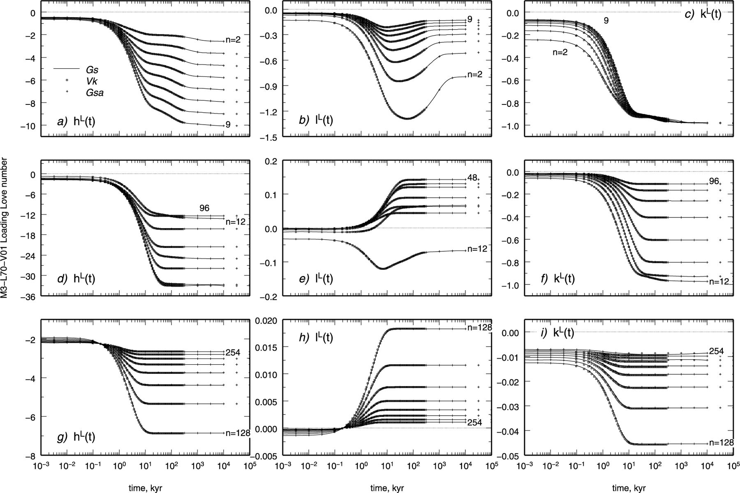
Figure 6 Time-domain loading Love numbers for Test 5/1 in the ranges of harmonic degrees 2 ≤n≤ 9 (top panels), 12 ≤n≤ ...
Notes:
Figure 6 Time-domain loading Love numbers for Test 5/1 in the ranges of harmonic degrees 2 ≤n≤ 9 (top panels), 12 ≤n≤ 96 (middle panels), 128 ≤n≤ 254 (bottom panels). Love numbers have been contributed by Gs (solid lines), Vk (squares) and Gsa (crosses) based on three independent solution methods (see text).
Unless provided in the caption above, the following copyright applies to the content of this slide: © 2011 The Authors Published by Oxford University Press on behalf of the Royal Astronomical SocietyThis is an Open Access article distributed under the terms of the Creative Commons Attribution Non-Commercial License (http://creativecommons.org/licenses/by-nc/3.0/), which permits non-commercial re-use, distribution, and reproduction in any medium, provided the original work is properly cited. For commercial re-use, please contact journals.permissions@oup.com

Slide 15
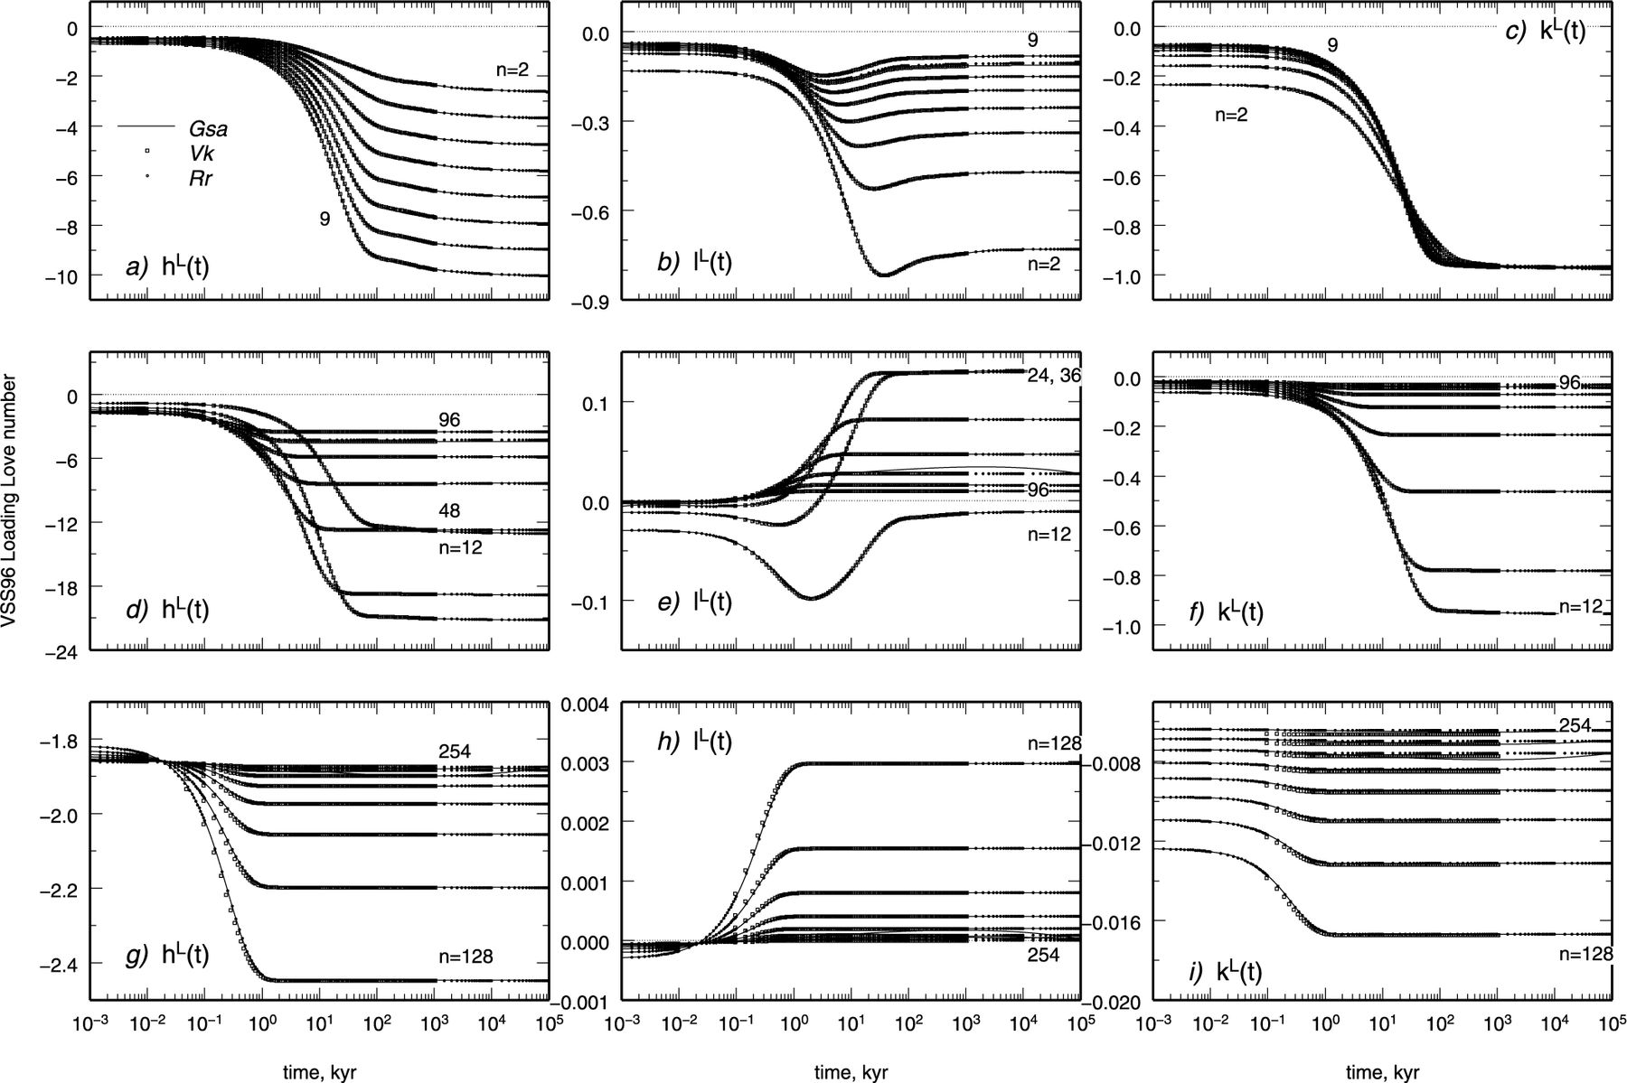
Figure 7 Time-domain loading Love numbers for Test 6/1 (multistratified model VSS96) in the ranges of harmonic degrees ...
Notes:
Figure 7 Time-domain loading Love numbers for Test 6/1 (multistratified model VSS96) in the ranges of harmonic degrees 2 ≤n≤ 9 (top panels), 12 ≤n≤ 96 (middle panels), 128 ≤n≤ 254 (bottom panels). Love numbers have been contributed by Vk (squares), Gsa (solid lines, 201 points in the whole time range) and Rr (dots, 144 points) based on codes VILMA, ALMA and FastLove-HiDeg, respectively. Note that the y-axes range is not the same as in Fig. 6.
Unless provided in the caption above, the following copyright applies to the content of this slide: © 2011 The Authors Published by Oxford University Press on behalf of the Royal Astronomical SocietyThis is an Open Access article distributed under the terms of the Creative Commons Attribution Non-Commercial License (http://creativecommons.org/licenses/by-nc/3.0/), which permits non-commercial re-use, distribution, and reproduction in any medium, provided the original work is properly cited. For commercial re-use, please contact journals.permissions@oup.com

Slide 16
Table 9 Spectral form of loading Love numbers of degree n= 1 in the CM provided by Vb for Test 7/1. Others have ...
Notes:
Table 9 Spectral form of loading Love numbers of degree n= 1 in the CM provided by Vb for Test 7/1. Others have contributed a different number of modes (M= 9 for Gs and M= 12 for Rr), but the agreement between VNM and time-domain solutions shown in Fig. 8 clearly demonstrates that all the strength is contained in the M= 6 modes reported here.
Unless provided in the caption above, the following copyright applies to the content of this slide: © 2011 The Authors Published by Oxford University Press on behalf of the Royal Astronomical SocietyThis is an Open Access article distributed under the terms of the Creative Commons Attribution Non-Commercial License (http://creativecommons.org/licenses/by-nc/3.0/), which permits non-commercial re-use, distribution, and reproduction in any medium, provided the original work is properly cited. For commercial re-use, please contact journals.permissions@oup.com

Slide 17
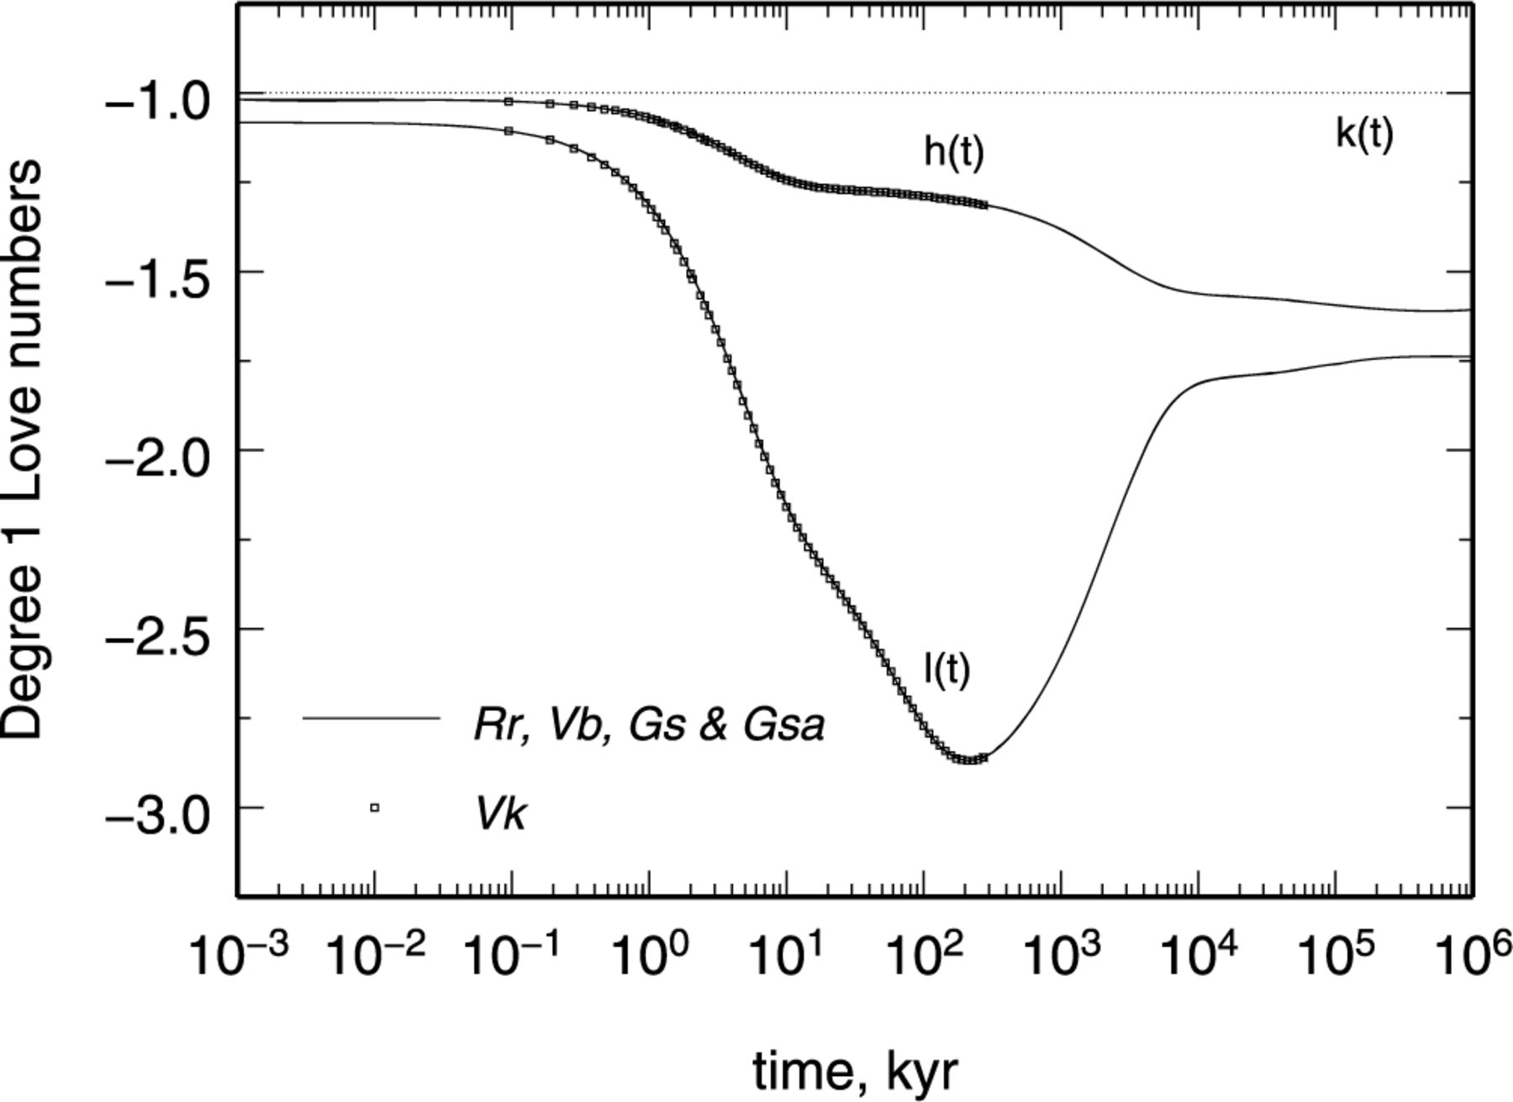
Figure 8 Time-domain loading Love numbers of degree n= 1 for Test 7/1 obtained by contributors Rr, Vb, Gs (by VNM), ...
Notes:
Figure 8 Time-domain loading Love numbers of degree n= 1 for Test 7/1 obtained by contributors Rr, Vb, Gs (by VNM), Gsa (by Post–Widder formula) and Vk (by SFE, squares). Note that kL(t) = −1 (dashed line).
Unless provided in the caption above, the following copyright applies to the content of this slide: © 2011 The Authors Published by Oxford University Press on behalf of the Royal Astronomical SocietyThis is an Open Access article distributed under the terms of the Creative Commons Attribution Non-Commercial License (http://creativecommons.org/licenses/by-nc/3.0/), which permits non-commercial re-use, distribution, and reproduction in any medium, provided the original work is properly cited. For commercial re-use, please contact journals.permissions@oup.com

Slide 18
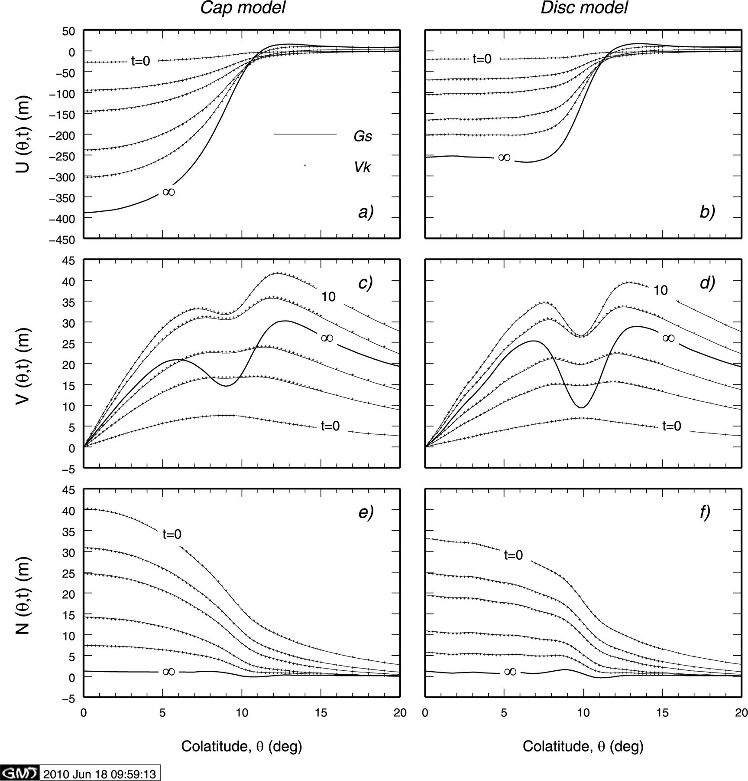
Figure 9 Vertical, horizontal and geoid displacements at the Earth's surface (Test 1/2) according to Gs (VNM method, ...
Notes:
Figure 9 Vertical, horizontal and geoid displacements at the Earth's surface (Test 1/2) according to Gs (VNM method, solid lines) and Vk (SFE, dots) for a cap ice-sheet model (left-hand side) and a disc (right-hand side) imposed at time t= 0. Symbol ‘∞’ stands for t= 103 kyr for Gs and corresponds to isostatic equilibrium, this datum is not available for Vk.
Unless provided in the caption above, the following copyright applies to the content of this slide: © 2011 The Authors Published by Oxford University Press on behalf of the Royal Astronomical SocietyThis is an Open Access article distributed under the terms of the Creative Commons Attribution Non-Commercial License (http://creativecommons.org/licenses/by-nc/3.0/), which permits non-commercial re-use, distribution, and reproduction in any medium, provided the original work is properly cited. For commercial re-use, please contact journals.permissions@oup.com

Slide 19
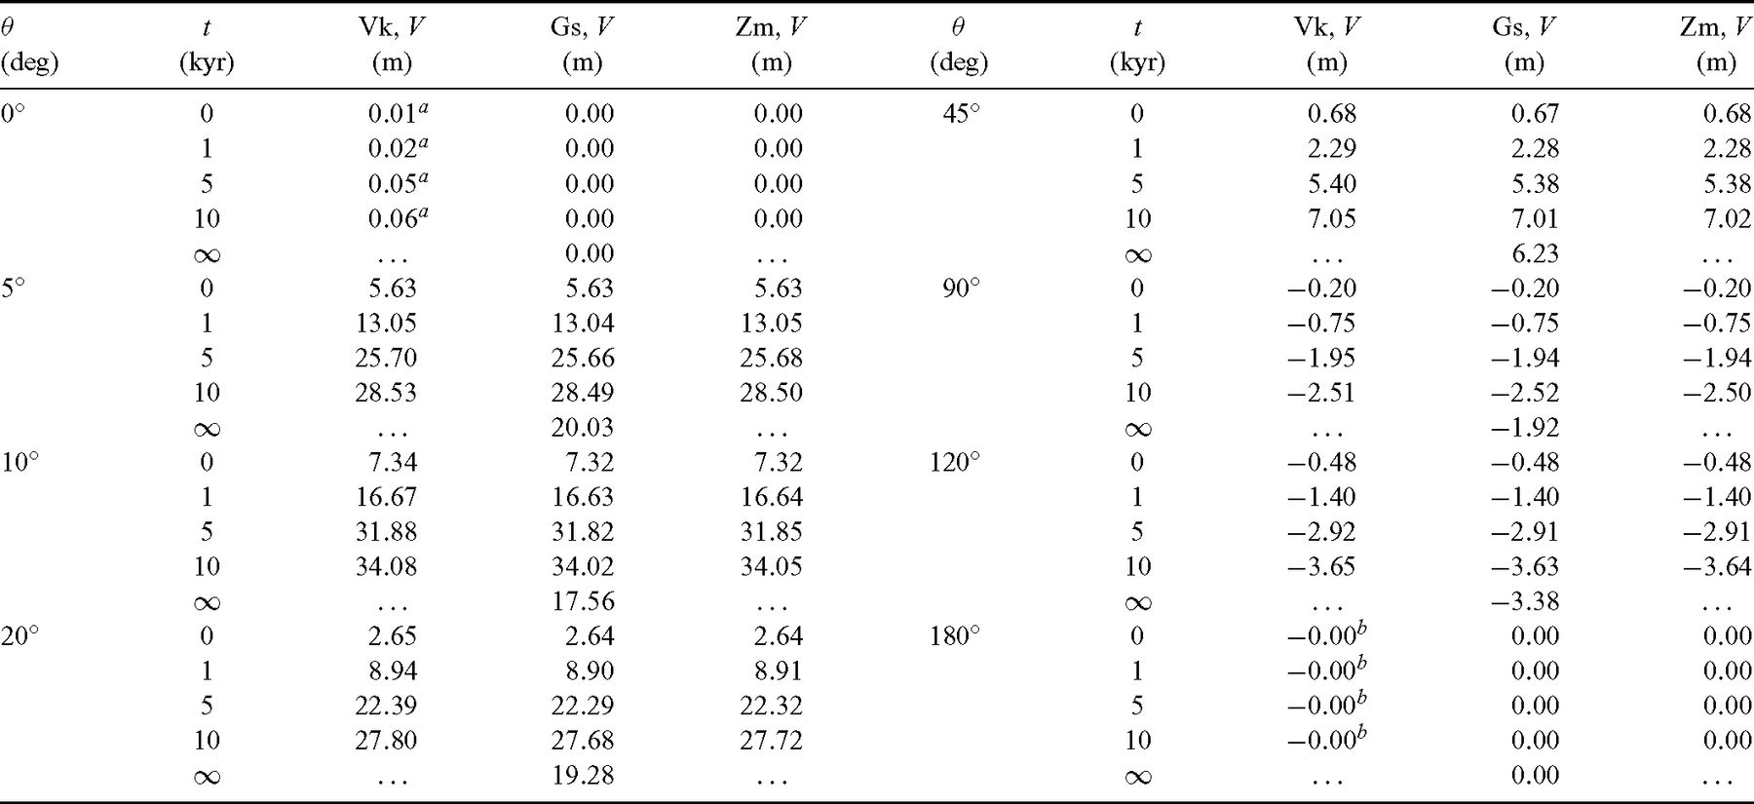
Table 11 As in Table 10, but for horizontal displacement V(θ, t) in Test 1/2.
Notes:
Table 11 As in Table 10, but for horizontal displacement V(θ, t) in Test 1/2.
Unless provided in the caption above, the following copyright applies to the content of this slide: © 2011 The Authors Published by Oxford University Press on behalf of the Royal Astronomical SocietyThis is an Open Access article distributed under the terms of the Creative Commons Attribution Non-Commercial License (http://creativecommons.org/licenses/by-nc/3.0/), which permits non-commercial re-use, distribution, and reproduction in any medium, provided the original work is properly cited. For commercial re-use, please contact journals.permissions@oup.com

Slide 20
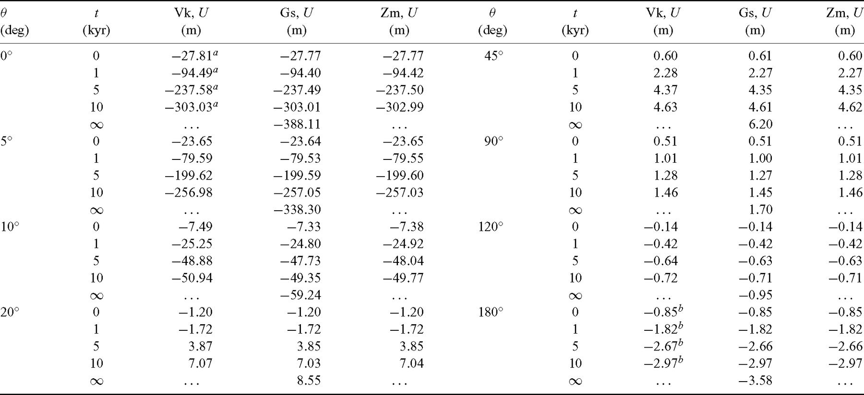
Table 10 Comparison between vertical displacements U(θ, t) independently computed by Vk, Gs and Zm for Test 1/2 (cap ...
Notes:
Table 10 Comparison between vertical displacements U(θ, t) independently computed by Vk, Gs and Zm for Test 1/2 (cap load model). Numbers in parentheses following the contributor abbreviation is time in units of kyr. Units for U, V and N are metres throughout. The figures are obtained by truncating the outputs of codes at the centimetre level. Superscripts a and b indicate that the corresponding quantities are computed by Vk at θ= 0.01° and θ= 179.99°, respectively. Symbol ‘∞’ stands for t= 103 kyr for Gs. The corresponding values are not available for Vk and Zm, since the computations would require an exceedingly long CPU time.
Unless provided in the caption above, the following copyright applies to the content of this slide: © 2011 The Authors Published by Oxford University Press on behalf of the Royal Astronomical SocietyThis is an Open Access article distributed under the terms of the Creative Commons Attribution Non-Commercial License (http://creativecommons.org/licenses/by-nc/3.0/), which permits non-commercial re-use, distribution, and reproduction in any medium, provided the original work is properly cited. For commercial re-use, please contact journals.permissions@oup.com

Slide 21
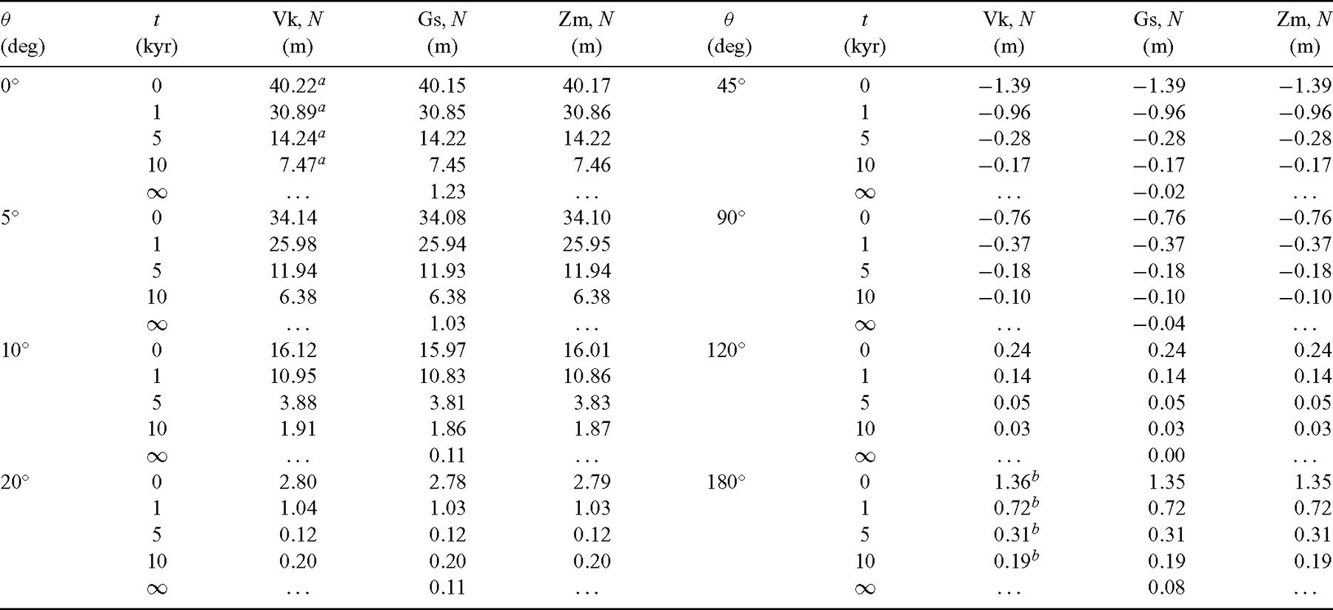
Table 12 As in Table 10, but for the variation of geoid height N(θ, t) in Test 1/2.
Notes:
Table 12 As in Table 10, but for the variation of geoid height N(θ, t) in Test 1/2.
Unless provided in the caption above, the following copyright applies to the content of this slide: © 2011 The Authors Published by Oxford University Press on behalf of the Royal Astronomical SocietyThis is an Open Access article distributed under the terms of the Creative Commons Attribution Non-Commercial License (http://creativecommons.org/licenses/by-nc/3.0/), which permits non-commercial re-use, distribution, and reproduction in any medium, provided the original work is properly cited. For commercial re-use, please contact journals.permissions@oup.com

Slide 22
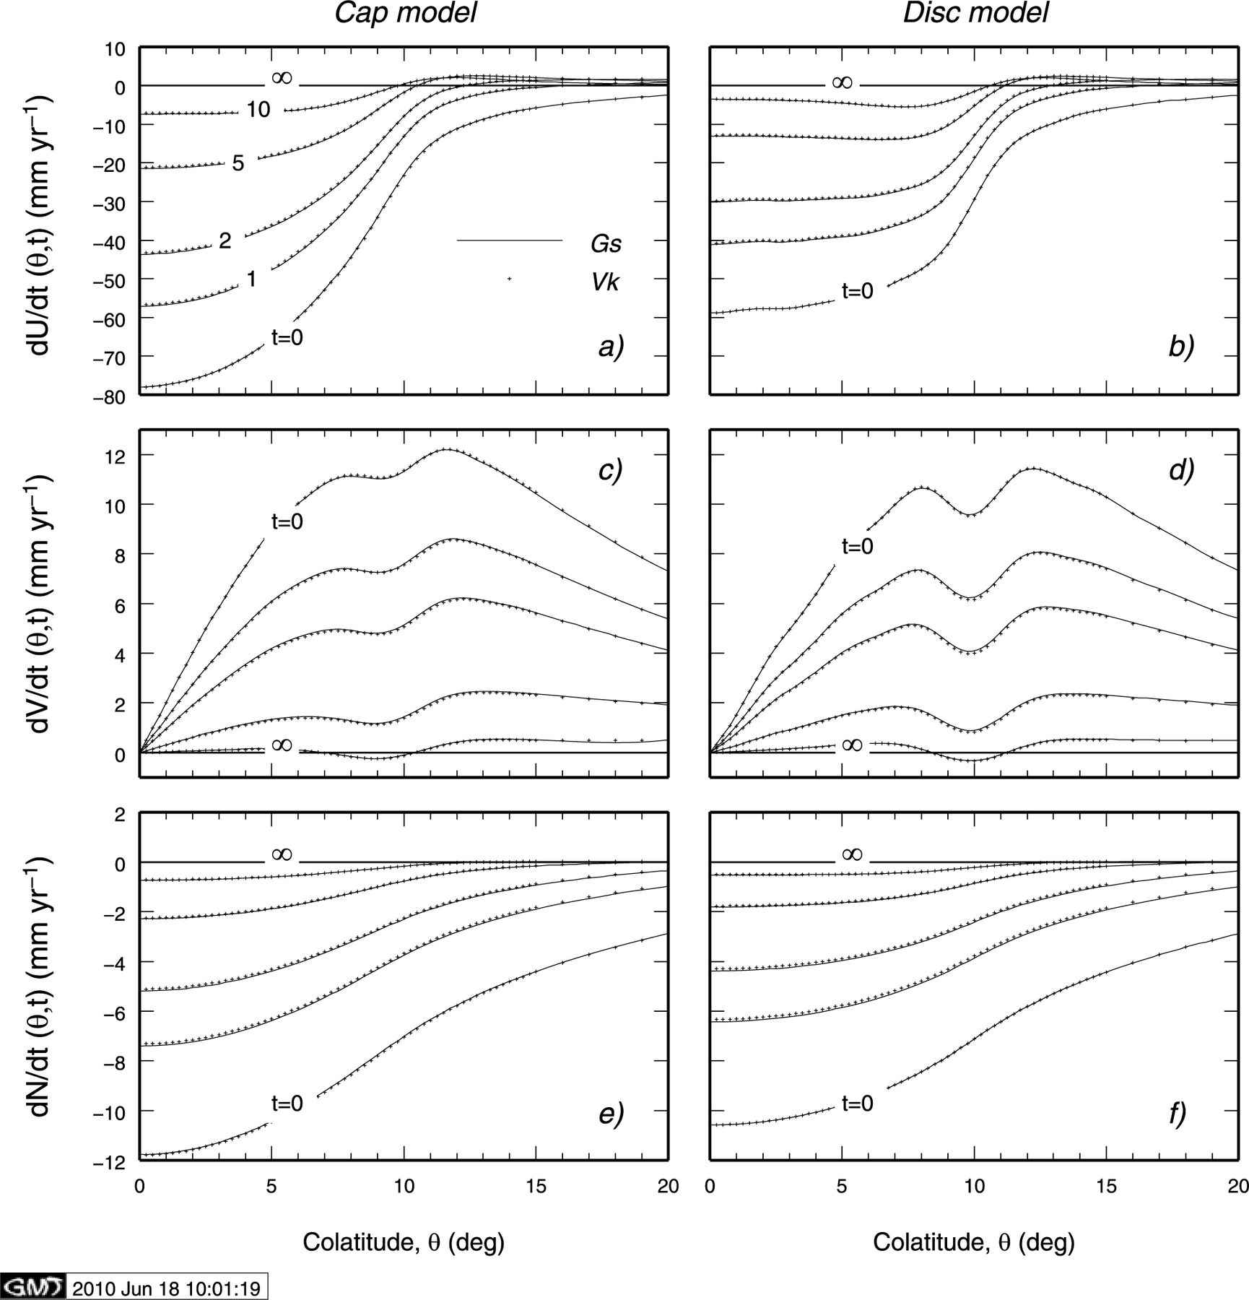
Figure 10 Rates of vertical, horizontal and geoid displacements at the Earth's surface (Test 2/2) according to Gs (VNM ...
Notes:
Figure 10 Rates of vertical, horizontal and geoid displacements at the Earth's surface (Test 2/2) according to Gs (VNM method, solid lines) and Vk (SFE, dots) for a cap ice-sheet model (left-hand side) and a disc (right-hand side) imposed at time t= 0. Symbol ‘∞’ marking the horizontal lines in each plot stands for t= 103 kyr.
Unless provided in the caption above, the following copyright applies to the content of this slide: © 2011 The Authors Published by Oxford University Press on behalf of the Royal Astronomical SocietyThis is an Open Access article distributed under the terms of the Creative Commons Attribution Non-Commercial License (http://creativecommons.org/licenses/by-nc/3.0/), which permits non-commercial re-use, distribution, and reproduction in any medium, provided the original work is properly cited. For commercial re-use, please contact journals.permissions@oup.com

Slide 23
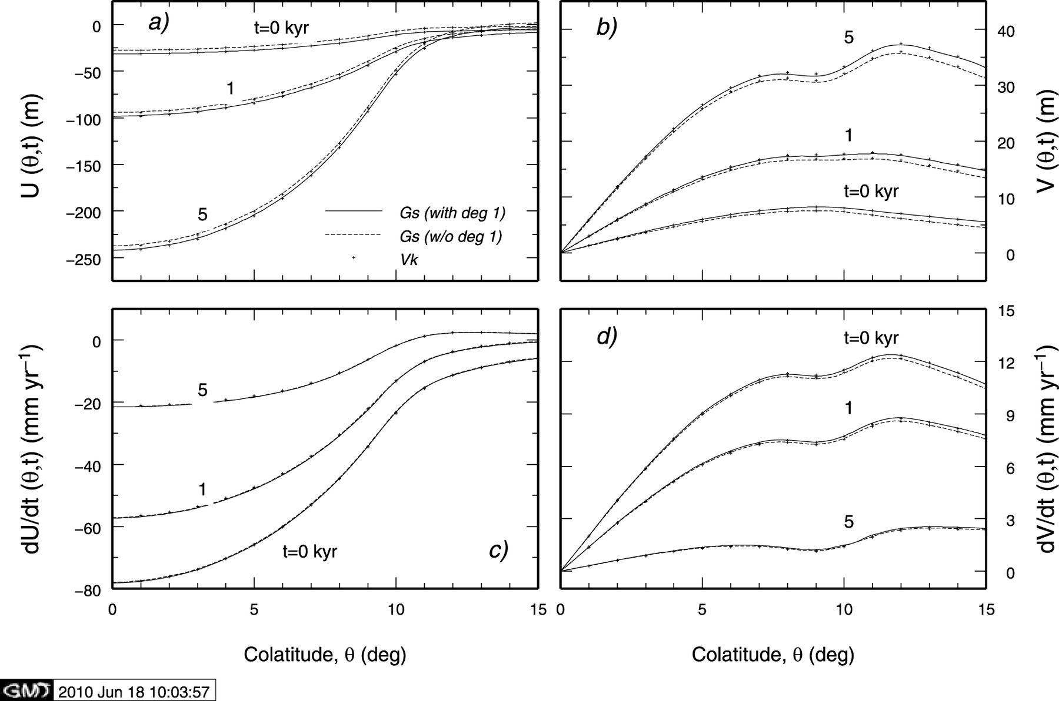
Figure 11 Vertical (a) and horizontal displacements (b) computed for model M3–L70–V01 in the CM frame. VNM predictions ...
Notes:
Figure 11 Vertical (a) and horizontal displacements (b) computed for model M3–L70–V01 in the CM frame. VNM predictions by Gs are shown for the case where the degree n= 1 component of the surface load (cap) is included (solid lines) or excluded (dashed). Crosses denote solutions of Vk (SFE method). In the two bottom frames the test is repeated for vertical (frame c) and horizontal velocities (d).
Unless provided in the caption above, the following copyright applies to the content of this slide: © 2011 The Authors Published by Oxford University Press on behalf of the Royal Astronomical SocietyThis is an Open Access article distributed under the terms of the Creative Commons Attribution Non-Commercial License (http://creativecommons.org/licenses/by-nc/3.0/), which permits non-commercial re-use, distribution, and reproduction in any medium, provided the original work is properly cited. For commercial re-use, please contact journals.permissions@oup.com

Slide 24
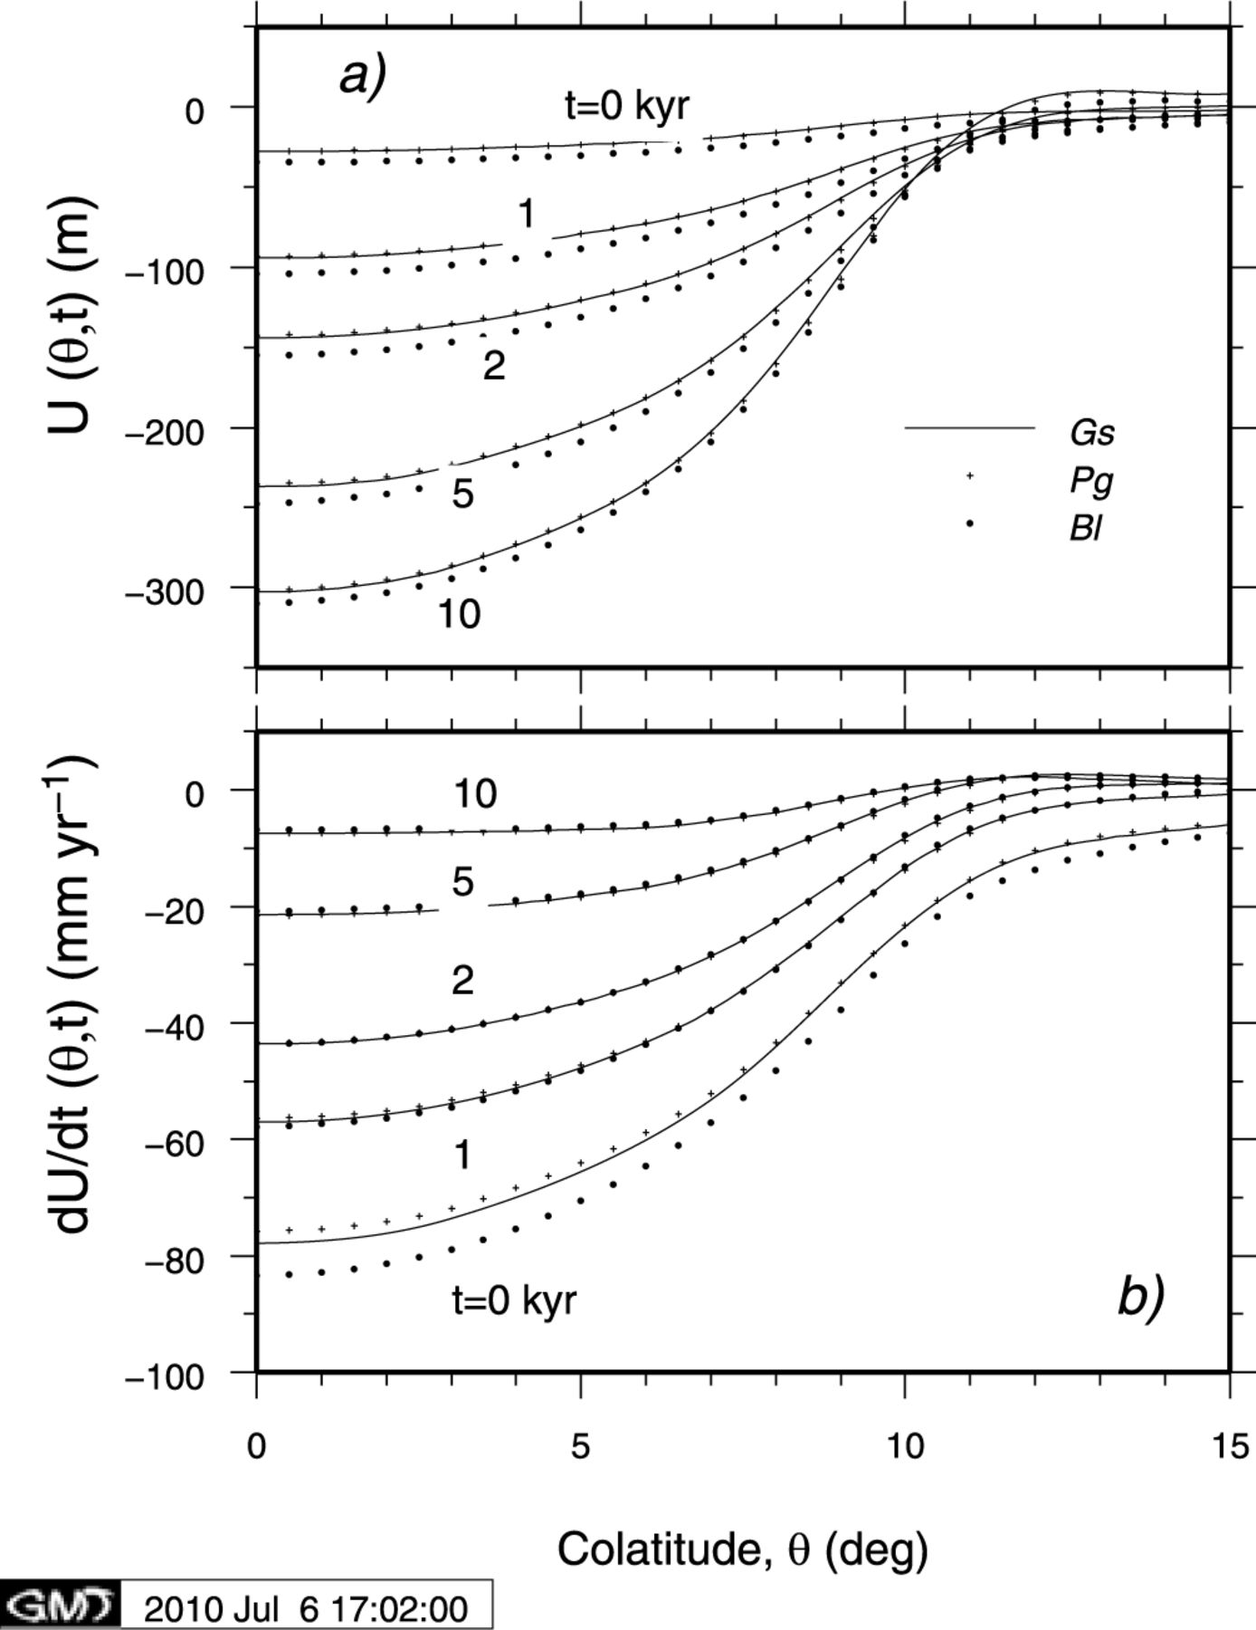
Figure 12 Vertical displacement (a) and rate of vertical displacement (b) computed for Tests 1/2 and 2/2 using two FE ...
Notes:
Figure 12 Vertical displacement (a) and rate of vertical displacement (b) computed for Tests 1/2 and 2/2 using two FE implementations of model M3–L70–V01. The first provided by Pg (crosses) is based on an FE spherical model and includes self-gravitation. The second, provided by Bl (dots) is for a flat Earth (M3–L70–V01f). The FE results are compared with the VNM results obtained by Gs. A cap ice model is used.
Unless provided in the caption above, the following copyright applies to the content of this slide: © 2011 The Authors Published by Oxford University Press on behalf of the Royal Astronomical SocietyThis is an Open Access article distributed under the terms of the Creative Commons Attribution Non-Commercial License (http://creativecommons.org/licenses/by-nc/3.0/), which permits non-commercial re-use, distribution, and reproduction in any medium, provided the original work is properly cited. For commercial re-use, please contact journals.permissions@oup.com

Slide 25
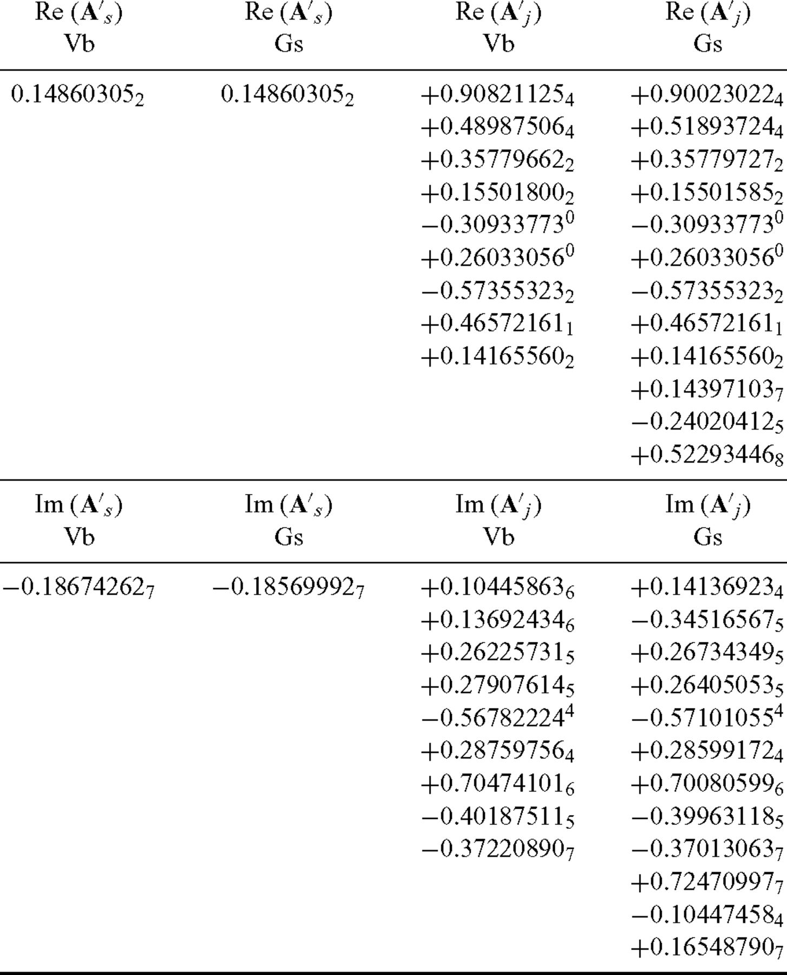
Table 13 Real (top) and imaginary parts (bottom) of constants A_{s} and A′_{j} (in units of ...
Notes:
Table 13 Real (top) and imaginary parts (bottom) of constants As and A′j (in units of kyr−1) provided by contributors Vb and Gs. In the numerical computations by Gs, upper bounds on the moduli of coefficients are |Re(A″j)| ≤ 10−6 kyr−1 and |Im(A″j)| ≤ 10−5 kyr−1 for all rotational modes, while according to Vb the algebraically exact result holds.
Unless provided in the caption above, the following copyright applies to the content of this slide: © 2011 The Authors Published by Oxford University Press on behalf of the Royal Astronomical SocietyThis is an Open Access article distributed under the terms of the Creative Commons Attribution Non-Commercial License (http://creativecommons.org/licenses/by-nc/3.0/), which permits non-commercial re-use, distribution, and reproduction in any medium, provided the original work is properly cited. For commercial re-use, please contact journals.permissions@oup.com

Slide 26
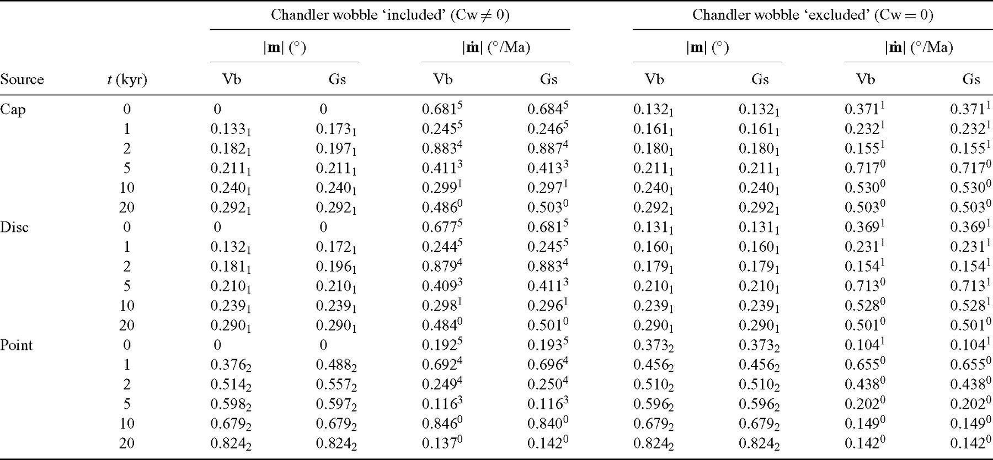
Table 14 Solutions of Liouville equations for polar motion and the rate of polar motion for Test 3/2. Three ice load ...
Notes:
Table 14 Solutions of Liouville equations for polar motion and the rate of polar motion for Test 3/2. Three ice load models are employed, with corresponding geometrical factors Gcap=−(0.5414+ i 0.2023), Gdisc=−(0.5394+ i 0.2013) and Gpoint=−(0.1524+ i 0.5704). The cases Cw ≠ 0 and Cw = 0 are separately considered. Numerical values are obtained by truncating the outputs provided from Gs and Vb to three significant digits. Some of these solutions are displayed in Fig. 13.
Unless provided in the caption above, the following copyright applies to the content of this slide: © 2011 The Authors Published by Oxford University Press on behalf of the Royal Astronomical SocietyThis is an Open Access article distributed under the terms of the Creative Commons Attribution Non-Commercial License (http://creativecommons.org/licenses/by-nc/3.0/), which permits non-commercial re-use, distribution, and reproduction in any medium, provided the original work is properly cited. For commercial re-use, please contact journals.permissions@oup.com

Slide 27
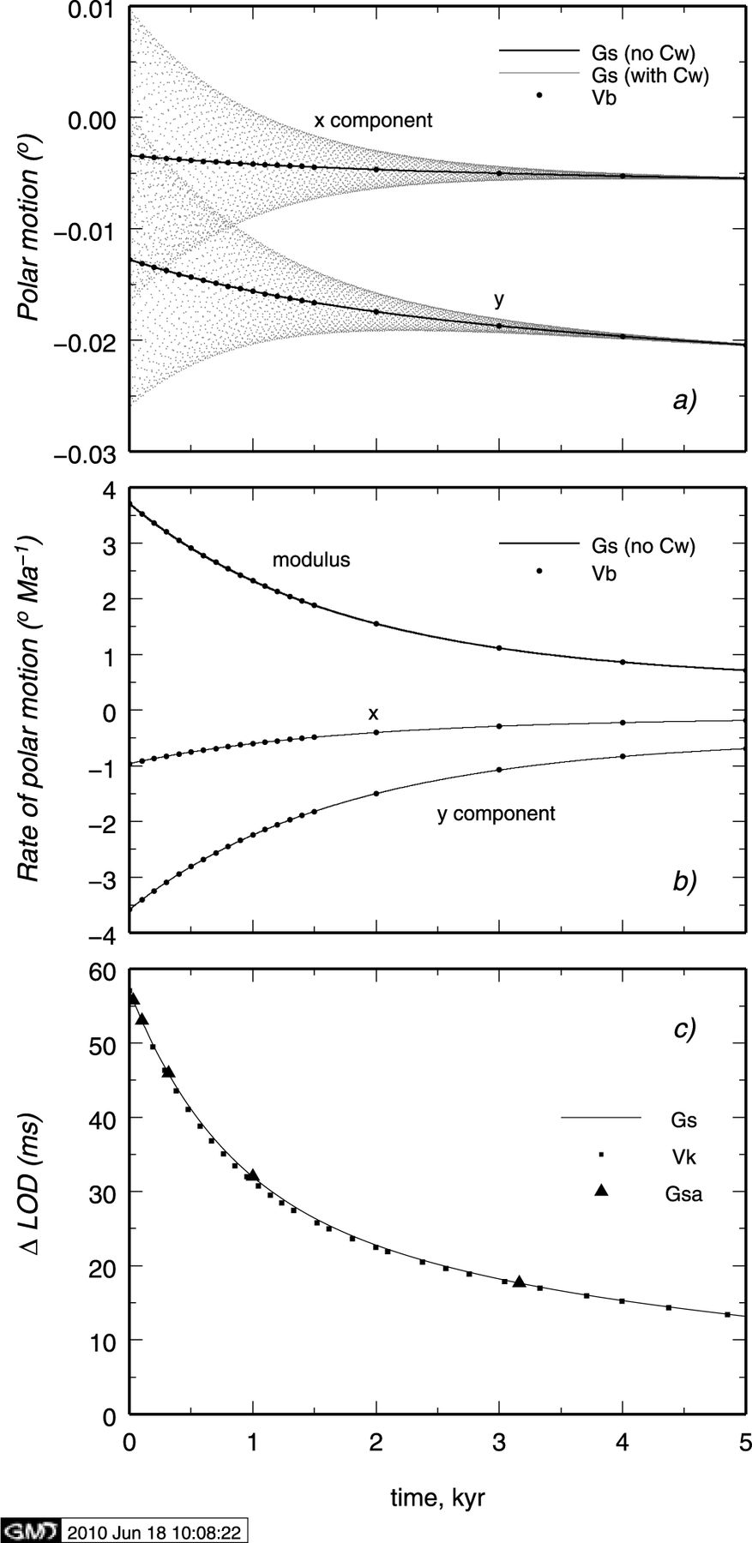
Figure 13 Polar motion (a), rate of polar motion (b) and LOD variation (c) computed for model M3–L70–V01 (Test 3/2). In ...
Notes:
Figure 13 Polar motion (a), rate of polar motion (b) and LOD variation (c) computed for model M3–L70–V01 (Test 3/2). In all computations, a cap surface load is assumed.
Unless provided in the caption above, the following copyright applies to the content of this slide: © 2011 The Authors Published by Oxford University Press on behalf of the Royal Astronomical SocietyThis is an Open Access article distributed under the terms of the Creative Commons Attribution Non-Commercial License (http://creativecommons.org/licenses/by-nc/3.0/), which permits non-commercial re-use, distribution, and reproduction in any medium, provided the original work is properly cited. For commercial re-use, please contact journals.permissions@oup.com

