Slide 1
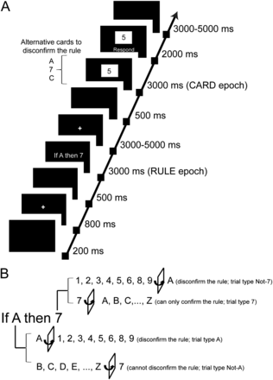
Figure 1. Schematic representation of the experimental paradigm. We developed a modified version of the Wason Selection ...
Notes:
Figure 1. Schematic representation of the experimental paradigm. We developed a modified version of the Wason Selection Task, in which participants engage in a card-turning game with the goal of disconfirming a given rule (e.g., “If there is an A on one side of the card, there is a 7 on the other”). Cards always had a digit on one side and a letter on the other. (A) On each trial, participants were first shown a rule, followed by a single card (e.g., 5) that might or might not be able to disconfirm the rule. (B) Before starting the experiment, participants practiced the task with feedback to ensure they understood the rules and to reduce errors and individual differences in cognitive strategies. For the example shown here, if the face side contains any digit but the one mentioned in the rule (i.e., a 7), then the rule is disconfirmed if A appears on the reverse side. By contrast, if there is a 7 on the face, no letter on the reverse side can disconfirm the rule. If there is an A on the face, any digit on the reverse other than 7 can disconfirm the rule. If any letter but A appears on the face no digit on the reverse side can disconfirm the rule.
Unless provided in the caption above, the following copyright applies to the content of this slide: © The Author 2013. Published by Oxford University Press. All rights reserved. For Permissions, please e-mail: journals.permissions@oup.com

Slide 2
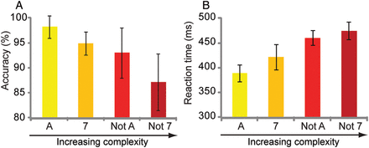
Figure 2. Behavioral data obtained during scanning for the 4 card types of the modified WST. The A condition trials ...
Notes:
Figure 2. Behavioral data obtained during scanning for the 4 card types of the modified WST. The A condition trials were the least complex and thus the easiest, and the “Not-7” trials were most difficult. (A) Accuracy. (B) Reaction time (error bars represent the within-subjects standard error of the mean).
Unless provided in the caption above, the following copyright applies to the content of this slide: © The Author 2013. Published by Oxford University Press. All rights reserved. For Permissions, please e-mail: journals.permissions@oup.com

Slide 3
Figure 3. Brain activity during rule processing. Processing of the rule was associated with significant activity in a ...
Notes:
Figure 3. Brain activity during rule processing. Processing of the rule was associated with significant activity in a diffuse set of regions encompassing the lateral prefrontal, lateral frontal, parietal and occipital cortices, and the dorsal cingulate cortex (P < 0.05 FWE corrected at cluster level).
Unless provided in the caption above, the following copyright applies to the content of this slide: © The Author 2013. Published by Oxford University Press. All rights reserved. For Permissions, please e-mail: journals.permissions@oup.com

Slide 4
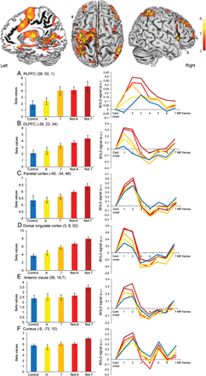
Figure 4. Brain activity during card processing. After isolating the average effect of card processing on brain ...
Notes:
Figure 4. Brain activity during card processing. After isolating the average effect of card processing on brain activity (P < 0.05 FWE corrected at cluster level), post hoc analyses were performed on the card-specific beta series. Overall, results from the post hoc analyses showed that brain activity increased as a function of card complexity. Statistically, this observation was confirmed for the majority of the regions. The BOLD time-series (scaled to zero at stimulus onset) shown in the right panels support this conclusion (blue = control; yellow = A; orange = 7; red = Not-A; dark red = Not-7).
Unless provided in the caption above, the following copyright applies to the content of this slide: © The Author 2013. Published by Oxford University Press. All rights reserved. For Permissions, please e-mail: journals.permissions@oup.com

Slide 5
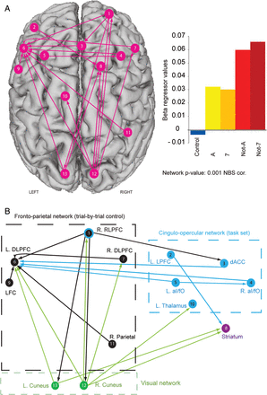
Figure 5. Changes in effective brain connectivity as a function of card complexity. (A) Large-scale brain network ...
Notes:
Figure 5. Changes in effective brain connectivity as a function of card complexity. (A) Large-scale brain network showing global changes in connectivity for the different card conditions. The network was isolated by conducting a psychophysiological interaction analysis (PPI) for every pair of regions of interest, resulting in an 18 × 18 connectivity matrix for each individual and card type. The 18 regions represent the main clusters involved in card processing isolated using the general linear model framework (see Table 3 for details). In these matrices, elements (i,j) stored the parameter estimate (β) for the PPI term and quantified the card-dependent influence that region i exerts on region j (PPI effective connectivity, see Materials and Methods). Matrices were used to test whether the extent of card-dependent influence from one region to another significantly differed across card conditions. A within-subjects ANOVA was used to test this hypothesis. The NBS was used to correct for multiple comparisons. The x-axis in the bar chart depicts the 5 card conditions, and the y-axis indicates the absolute median value of connectivity between each pairwise connection. (B) Schematic representation of large-scale brain networks involved in limiting the processing of relational complexity: fronto-parietal (black), cingulo-opercular (light blue), and visual (green). DLPFC: dorsolateral prefrontal cortex; dACC: dorsal anterior cingulate cortex; RLPFC: rostrolateral prefrontal cortex (note that this region is associated with both the fronto-parietal and cingulo-opercular networks; see text for details); LFC, lateral frontal cortex; LPFC, lateral prefrontal cortex; aI/fO, anterior insula/frontal operculum.
Unless provided in the caption above, the following copyright applies to the content of this slide: © The Author 2013. Published by Oxford University Press. All rights reserved. For Permissions, please e-mail: journals.permissions@oup.com

