Slide 1
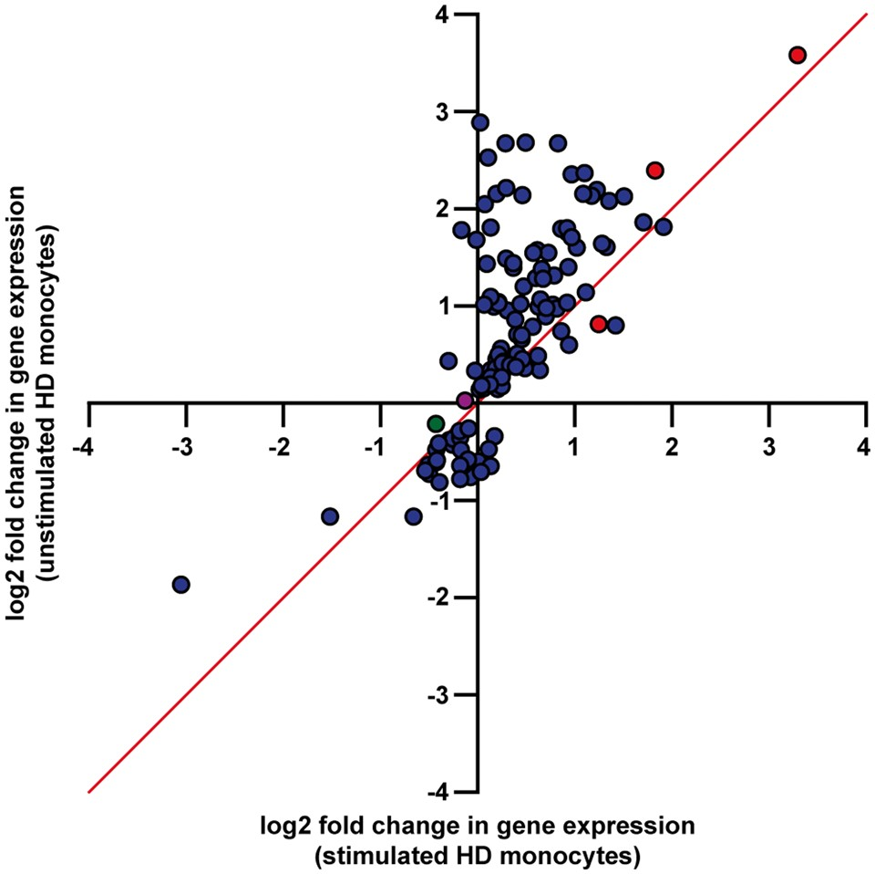
Figure 1. Comparison of log2 fold changes in resting and stimulated HD and control monocytes. The log2 fold changes for ...
Notes:
Figure 1. Comparison of log2 fold changes in resting and stimulated HD and control monocytes. The log2 fold changes for the 130 differentially expressed genes in resting HD monocytes (FDR < 0.05) were compared between the unstimulated and stimulated datasets. The magnitude of the relative expression difference was greater in the unstimulated samples for 116 of these genes, suggesting that transcriptional differences between HD and control monocytes become less pronounced in response to stimulation. Genes which were only differentially expressed in the unstimulated samples are shown in blue, while the three genes which were differentially expressed in both datasets are shown in red. HTT is further shown in green, while the NFĸB transcription factor RELA (p65) is shown in purple (however neither of these genes were differentially expressed). The line x = y is also shown. The top 20 gene expression changes in resting HD monocytes (ranked by FDR) Gene nameEnsembl IDRPKM (control)RPKM (HD)Log2 fold changeP-valueFDRProtein functionFAM124AENSG000001505100.2420.8122.6844.61E-086.05E-04Functionally uncharacterizedIL19ENSG000001422240.5861.4732.3581.15E-077.57E-04Proinflammatory cytokineIL23AENSG000001109441.9143.5971.5767.84E-072.55E-03Proinflammatory cytokineFAM213BENSG000001578707.8375.201−0.6048.99E-072.55E-03Prostaglandin metabolismTGFAENSG000001632350.6651.3921.5509.69E-072.55E-03Growth factor; promotes cell proliferationFZD7ENSG000001557600.3970.246−0.7211.39E-063.04E-03Wnt protein receptorC6orf223ENSG000001815770.0630.2972.1271.92E-063.60E-03Functionally uncharacterizedPROCRENSG000001010003.69510.8721.5523.61E-065.69E-03Receptor for activated protein CNT5EENSG000001353180.2100.7252.0824.24E-065.69E-03Hydrolyses extracellular nucleotidesSMOENSG000001286020.2590.124−1.1614.33E-065.69E-03G protein-coupled receptorCISHENSG000001147372.7235.1611.4395.90E-067.04E-03Negative regulation of JAK/STAT signallingC6orf165ENSG000002132040.0380.0861.2056.57E-067.20E-03Functionally uncharacterizedCCL19ENSG000001727240.5181.7671.7638.79E-068.89E-03Chemoattraction of T and B lymphocytesPTGS2ENSG000000737562.31918.6041.8139.52E-068.93E-03Prostaglandin synthesis enzymeHPSEENSG0000017308311.32224.9411.1421.10E-059.68E-03Extracellular matrix remodellingVEGFAENSG000001127155.47514.2510.8981.35E-051.11E-02Promotes angiogenesis and endothelial cell growthANXA11ENSG00000122359136.875105.621−0.3741.72E-051.33E-02Phospholipid-binding proteinCDK2ENSG000001233745.5347.1860.3901.88E-051.39E-02Cell cycle regulationR3HCC1ENSG0000010467915.22511.394−0.4212.18E-051.45E-02Nucleic acid bindingPGAP3ENSG000001613952.9432.310−0.3642.28E-051.45E-02GPI-specific phospholipase
Unless provided in the caption above, the following copyright applies to the content of this slide: © The Author 2016. Published by Oxford University Press.This is an Open Access article distributed under the terms of the Creative Commons Attribution License (http://creativecommons.org/licenses/by/4.0/), which permits unrestricted reuse, distribution, and reproduction in any medium, provided the original work is properly cited.

Slide 2
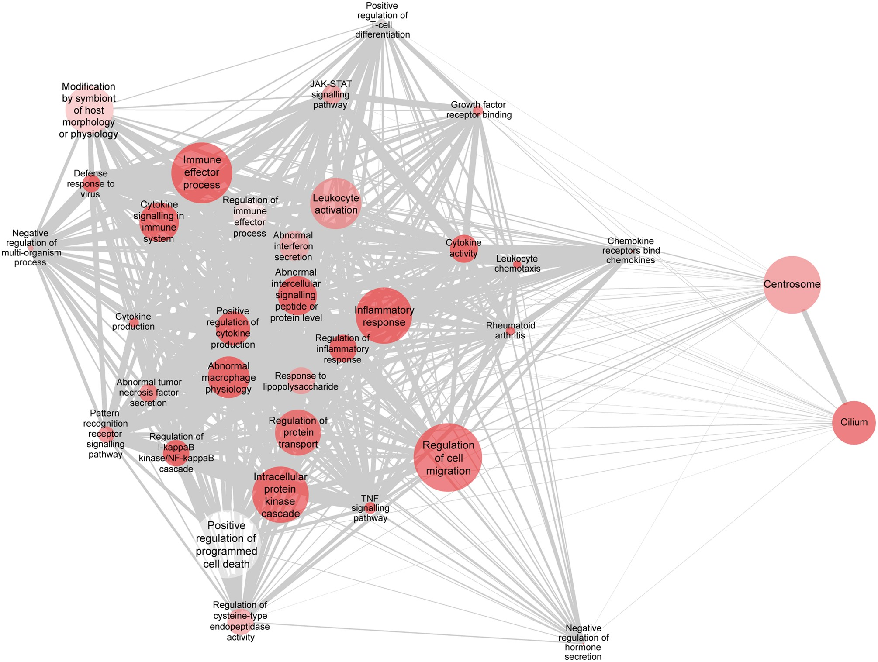
Figure 2. Functional gene sets associated with innate immunity and inflammation are enriched in resting HD monocytes. ...
Notes:
Figure 2. Functional gene sets associated with innate immunity and inflammation are enriched in resting HD monocytes. GSEA identified biologically relevant gene sets that are enriched in resting HD monocytes. A network diagram of significant biological themes among the upregulated genes is shown, indicating number of genes (node size), statistical significance (darkest shading = lowest P-value) and gene content similarity via the Jaccard coefficient (edge thickness). Nodes with similar gene content cluster more closely due to an edge-weighted layout (modified for readability). An FDR cut-off of < 0.05 was used to determine gene set inclusion in the diagram, before the Jaccard coefficient was used to filter out gene sets with similar gene content. The diagram was rendered in Cytoscape 3.3.0.
Unless provided in the caption above, the following copyright applies to the content of this slide: © The Author 2016. Published by Oxford University Press.This is an Open Access article distributed under the terms of the Creative Commons Attribution License (http://creativecommons.org/licenses/by/4.0/), which permits unrestricted reuse, distribution, and reproduction in any medium, provided the original work is properly cited.

Slide 3
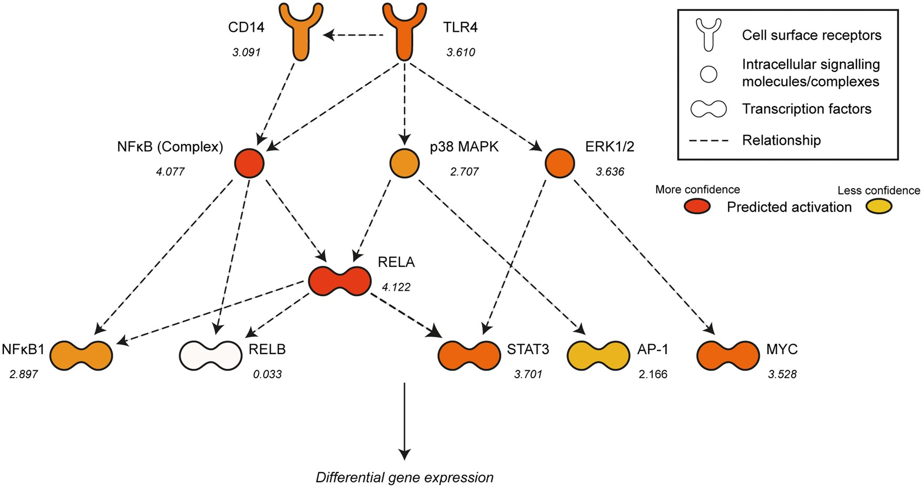
Figure 3. Specific intracellular signalling pathways are predicted to be abnormally activated in resting HD monocytes. ...
Notes:
Figure 3. Specific intracellular signalling pathways are predicted to be abnormally activated in resting HD monocytes. IPA analysis of upstream regulators of gene transcription identified numerous signalling pathway components downstream of the TLR4 receptor which are predicted to be abnormally activated in resting HD monocytes. Upstream regulators with significantly inferred activation are shown in orange (darker colour = higher activation z-score). The activation z-score for each component is also shown (>2 or < −2 is considered to be significant). IPA of upstream transcriptional regulators in resting HD monocytes Upstream regulatorActivation z-scoreP-value of overlapFunctionTNF5.7642.18E-13Proinflammatory cytokineIL1B5.7548.08E-14Proinflammatory cytokineMyD884.7612.92E-12Cytoplasmic adaptor protein for the TLR familyIFN-γ4.6353.09E-07Cytokine involved in mediating the innate immune responseIL1A4.5361.69E-11Proinflammatory cytokineTLR34.3231.99E-09Cell surface receptor involved in the activation of the innate immune responseRELA4.1225.86E-08Transcription factor; one of five NFκB family membersNFκB (complex)4.0772.63E-08A family of five transcription factors and their regulators that mediate the inflammatory responseTLR93.7734.33E-07Cell surface receptor involved in the activation of the innate immune responseTLR23.7703.94E-09Cell surface receptor involved in the activation of the innate immune responseSTAT33.7012.34E-07Transcription factorIL63.6547.39E-06Proinflammatory cytokineTICAM1/TRIF3.6512.59E-08TLR cytoplasmic adaptor protein; mediates an alternative pathway to MyD88ERK1/23.6365.33E-06Protein kinase intracellular signalling moleculesTLR43.6107.68E-12Cell surface receptor involved in the activation of the innate immune responseIPA was used to identify transcriptional regulators with significant target gene overlap with changes in the resting HD monocyte transcriptome. A P-value cut-off of < 0.01 was used to determine which genes were included in the analysis. The upstream regulators were ranked by activation z-score and the 15 most significant were included in the table.
Unless provided in the caption above, the following copyright applies to the content of this slide: © The Author 2016. Published by Oxford University Press.This is an Open Access article distributed under the terms of the Creative Commons Attribution License (http://creativecommons.org/licenses/by/4.0/), which permits unrestricted reuse, distribution, and reproduction in any medium, provided the original work is properly cited.

Slide 4
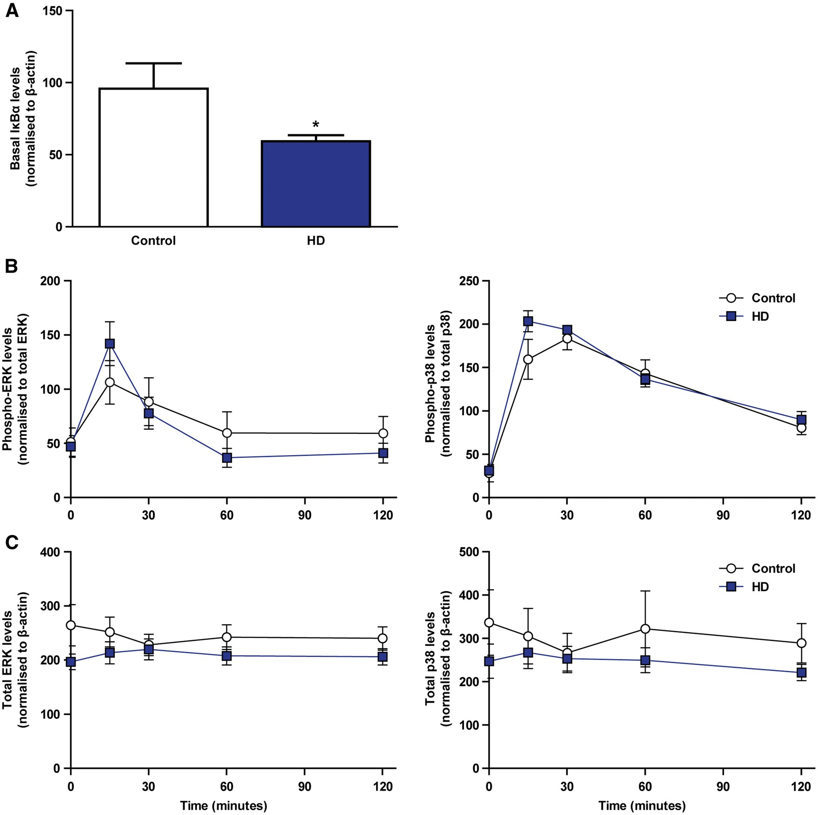
Figure 4. NFĸB but not ERK or p38 MAPK signalling is abnormally activated in resting HD myeloid cells. Monocyte-derived ...
Notes:
Figure 4. NFĸB but not ERK or p38 MAPK signalling is abnormally activated in resting HD myeloid cells. Monocyte-derived macrophages were isolated from HD and control peripheral blood samples and pulsed with LPS and IFN-γ for 15, 30, 60 and 120 min, or left unstimulated. Western blotting was then carried out on the unstimulated samples to quantify the basal levels of IĸBα, while additional Western blotting was carried out on all samples to quantify the levels of total and active, phosphorylated ERK and p38 MAPK. (A) Resting HD myeloid cells express significantly reduced IĸBα protein compared with control (control n = 7, HD n = 9). However, no significant differences were seen in (B) the ratio of phosphorylated to total enzyme, or (C) the ratio of total enzyme to β-actin for either ERK or p38 at any of the time points that were studied (n = 10). Error bars represent ± SEM, *P < 0.05.
Unless provided in the caption above, the following copyright applies to the content of this slide: © The Author 2016. Published by Oxford University Press.This is an Open Access article distributed under the terms of the Creative Commons Attribution License (http://creativecommons.org/licenses/by/4.0/), which permits unrestricted reuse, distribution, and reproduction in any medium, provided the original work is properly cited.

