Slide 1
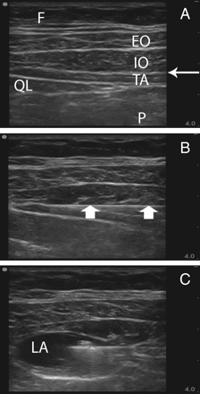
Fig 1 Sonographic anatomy of the US-guided TAP block. Images show the lateral abdominal wall using a probe held in ...
Notes:
Fig 1 Sonographic anatomy of the US-guided TAP block. Images show the lateral abdominal wall using a probe held in the mid-axillary line in the axial plane. The right of the image is anterior. (a) Narrow arrow, TAP; EO, external oblique muscle; IO, internal oblique muscle; TA, transversus abdominis muscle; QL, quadratus lumborum muscle; F, s.c. fat; P, intraperitoneal structures. (b) Broad arrows, needle with the tip positioned in the TAP. (c) Local anaesthetic forming a lens-shaped space in the TAP; LA, local anaesthetic.
Unless provided in the caption above, the following copyright applies to the content of this slide: © The Author [2009]. Published by Oxford University Press on behalf of the British Journal of Anaesthesia. All rights reserved. For Permissions, please email: journals.permissions@oxfordjournal.org

Slide 2
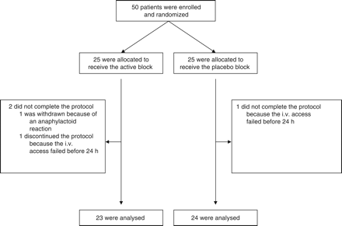
Fig 2 Flow diagram of randomization and follow-up of enrolled participants.
Notes:
Fig 2 Flow diagram of randomization and follow-up of enrolled participants.
Unless provided in the caption above, the following copyright applies to the content of this slide: © The Author [2009]. Published by Oxford University Press on behalf of the British Journal of Anaesthesia. All rights reserved. For Permissions, please email: journals.permissions@oxfordjournal.org

