Slide 1
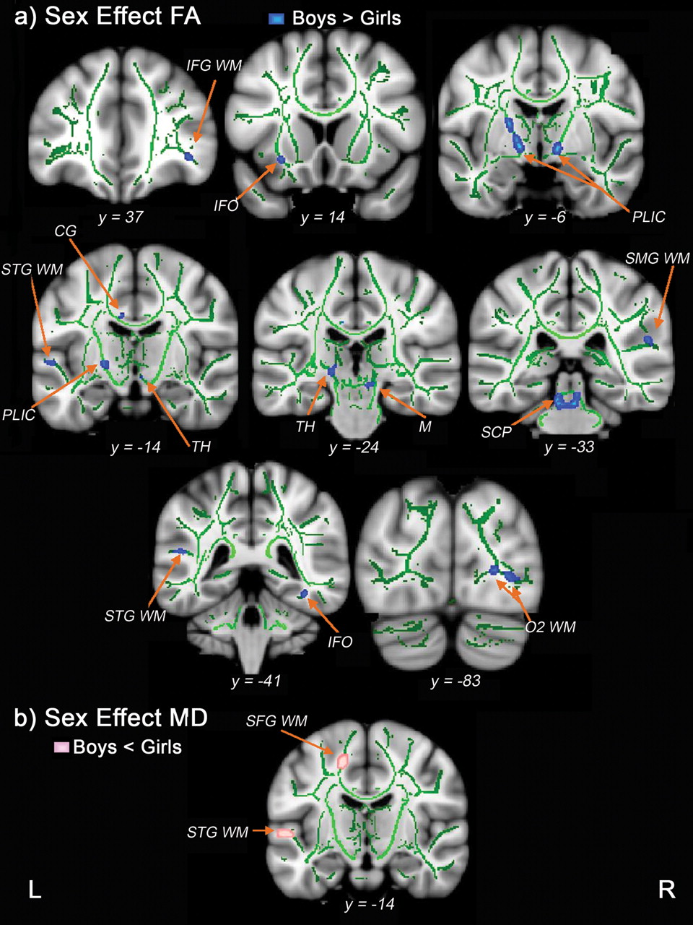
Figure 1. Sex differences in FA and MD, after controlling for age. Coronal views of differences in FA and MD, ...
Notes:
Figure 1. Sex differences in FA and MD, after controlling for age. Coronal views of differences in FA and MD, represented by t-statistic maps overlaid on the mean FA skeleton (green) and a standardized brain. (a) Sex effect for FA: Blue–Light Blue = FA is greater in boys compared with girls; (b) Sex effect for MD: Pink = MD is less in boys compared with girls. Results have been dilated for viewing purposes. Abbreviations: L, left; R, right; CG, cingulum; IFG WM, inferior frontal gyrus white matter; IFO, inferior fronto-occipital fasciculus; M, midbrain; O2 WM, middle/lateral occipital gyrus white matter; PLIC, posterior limb of the internal capsule; SCP, superior cerebellar peduncle; SFG WM, superior frontal gyrus white matter; SMG WM, supramarginal gyrus white matter; STG WM, superior temporal gyrus white matter; TH, thalamus.
Unless provided in the caption above, the following copyright applies to the content of this slide: © The Author 2011. Published by Oxford University Press. All rights reserved. For permissions, please e-mail: journals.permissions@oup.com

Slide 2
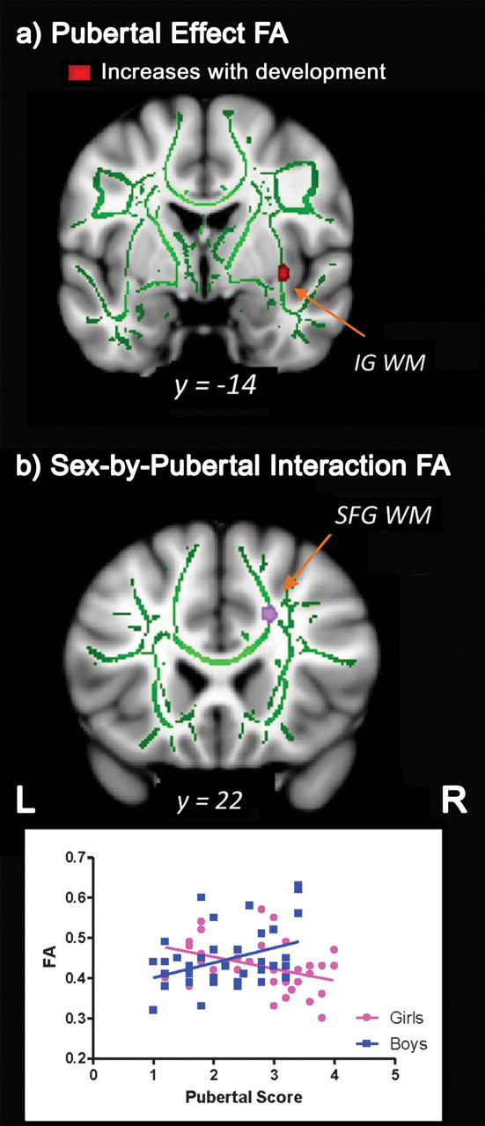
Figure 2. Pubertal relationships with FA and MD, after controlling for age. Coronal views of pubertal relationships ...
Notes:
Figure 2. Pubertal relationships with FA and MD, after controlling for age. Coronal views of pubertal relationships with FA and MD, represented by t-statistic maps overlaid on the mean FA skeleton (green) and a standardized brain. (a) Pubertal effect: Red = region where FA positively relates to pubertal status; (b) Sex-by-pubertal interaction: Purple = region where pubertal development positively relates to FA in boys but negatively relates to FA in girls. Results have been dilated for viewing purposes. Abbreviations: L, left; R, right; IG WM, insular gyrus white matter; SFG WM, superior frontal gyrus white matter.
Unless provided in the caption above, the following copyright applies to the content of this slide: © The Author 2011. Published by Oxford University Press. All rights reserved. For permissions, please e-mail: journals.permissions@oup.com

Slide 3
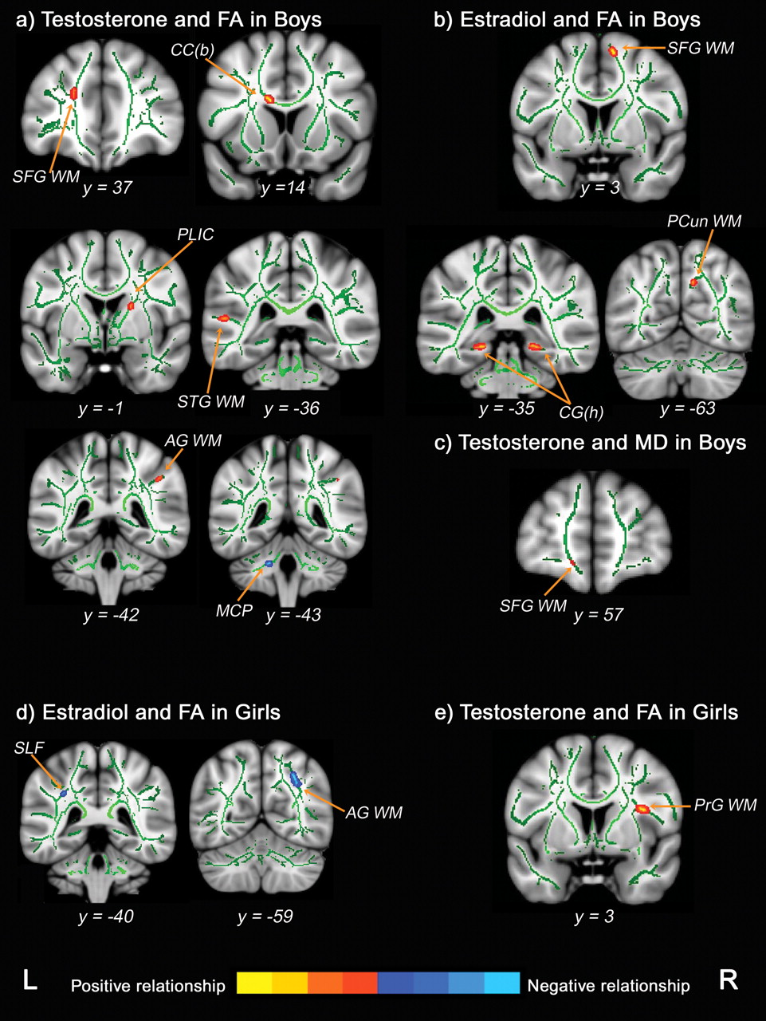
Figure 3. Unique relationships between sex hormones and FA and MD in boys and girls, after controlling for age. Coronal ...
Notes:
Figure 3. Unique relationships between sex hormones and FA and MD in boys and girls, after controlling for age. Coronal views of hormone relationships with FA and MD, represented by t-statistic maps overlaid on the mean FA skeleton (green) and a standardized brain. (a) Testosterone and FA in boys; (b) Estradiol and FA in boys; (c) Testosterone and MD in boys; (d) Estradiol and FA in girls; (e) Testosterone and FA in girls. Red–Yellow = positive relationship with sex hormones; Blue–Light Blue = negative relationship with sex hormones. Results have been dilated for viewing purposes. Abbreviations: L, left; R, right; AG WM, angular gyrus white matter; CC(b), body of the corpus callosum; CG(h), cingulum (hippocampus part); MCP, middle cerebellar peduncles; PCun WM, precuneus white matter; PLIC, posterior limb of the internal capsule; PrG WM, precentral gyrus white matter; SFG WM, superior frontal gyrus white matter; SLF, superior longitudinal fasciculus; STG WM, superior temporal gyrus white matter.
Unless provided in the caption above, the following copyright applies to the content of this slide: © The Author 2011. Published by Oxford University Press. All rights reserved. For permissions, please e-mail: journals.permissions@oup.com

