Slide 1
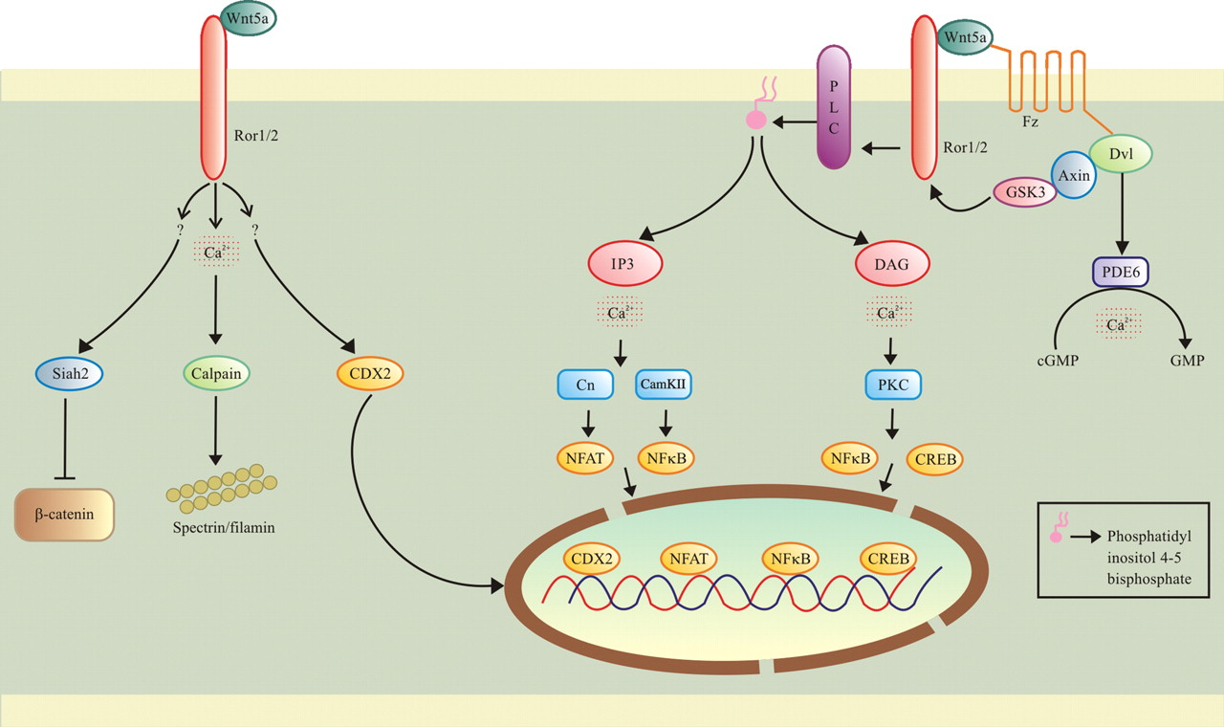
Figure 1 A schematic representation of Wnt/Ca²⁺ signaling pathway Wnt/Fz ligand receptor interaction with ...
Notes:
Figure 1 A schematic representation of Wnt/Ca2+ signaling pathway Wnt/Fz ligand receptor interaction with participating co-receptor Ror 1/2 leads to the production of IP3 and DAG from membrane-bound phospholipid phosphatidyl inositol 4,5-bisphosphate via the action of membrane-bound enzyme PLC. A tri-protein complex of Dvl–axin–GSK is formed, GSK mediates phosphorylation of Ror co-receptor. IP3 causes release of Ca2+ from ER; Cn and CamKII are activated which in turn activate NFAT and NFκB. DAG is activated by released calcium from ER, which activates PKC. PKC activates NFκB and CREB. NFAT, NFκB, and CREB translocate to the nucleus and transcribe downstream regulatory genes. Wnt/Fz receptor−ligand interaction may activate phosphodiesterase 6 (PDE6) in a calcium-dependent manner, leading to a decrease in cyclic guanosine monophosphate (cGMP). Activation of Wnt5a/Ror signaling pathway leads to the production of Siah2, calpain, CDX2. Siah2 down-regulates the level of β-catenin. Activation of calpain, in a calcium-dependent manner leads to the cleavage to cytoskeleton proteins filamin, spectrin. CDX2 may act as a transcription factor leading to the expression of downstream genes.
Unless provided in the caption above, the following copyright applies to the content of this slide: © The Author 2011. Published by ABBS Editorial Office in association with Oxford University Press on behalf of the Institute of Biochemistry and Cell Biology, Shanghai Institutes for Biological Sciences, Chinese Academy of Sciences

Slide 2
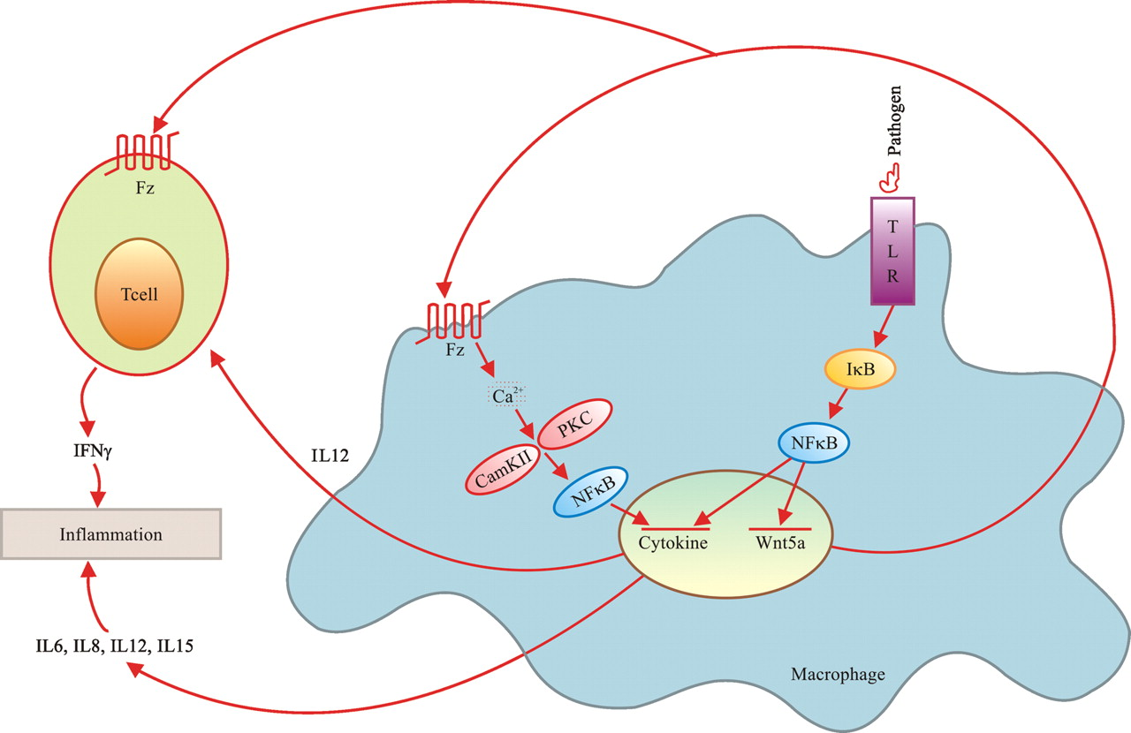
Figure 2 The molecular mechanism of co-operative activation of innate and adaptive immune response mediated by ...
Notes:
Figure 2 The molecular mechanism of co-operative activation of innate and adaptive immune response mediated by macrophage and T cell Pathogenic challenge leads to activation of TLR signaling pathway in macrophages, where NFκB acts as transcription factor. It leads to activation Wnt5a and cytokine genes. Once Wnt is expressed, it further promotes cytokine production via Wnt/Ca+ signaling pathway. Release of calcium ion activates CamKII and PKC which in turn activate NFκB. NFκB acts as transcription factor and transcribes cytokine genes. Cytokine produced by macrophage stimulates T cells, which produce IFN-γ via Wnt/Fz receptor−ligand interaction. It leads to prolonged inflammation.
Unless provided in the caption above, the following copyright applies to the content of this slide: © The Author 2011. Published by ABBS Editorial Office in association with Oxford University Press on behalf of the Institute of Biochemistry and Cell Biology, Shanghai Institutes for Biological Sciences, Chinese Academy of Sciences

