Slide 1
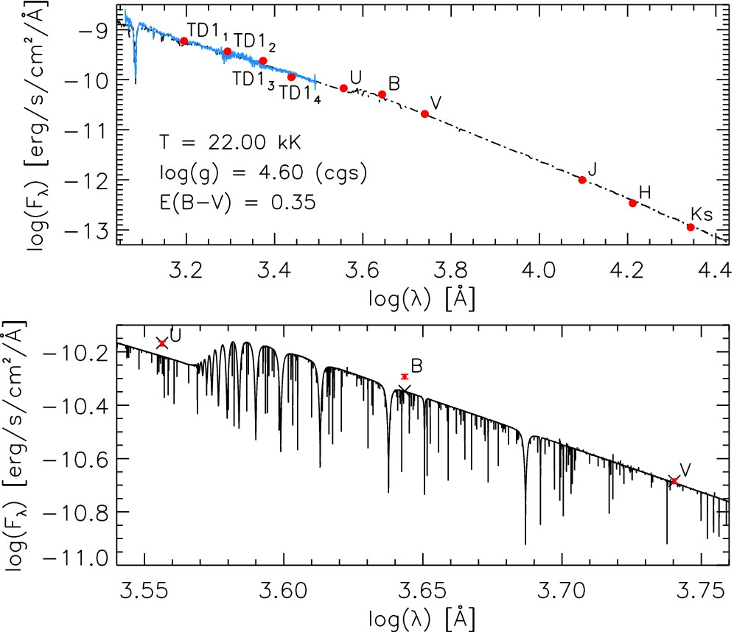
Figure 1. Top: comparing the IUE spectra (solid blue) and monochromatic fluxes (red points) with the best-fitting ...
Notes:
Figure 1. Top: comparing the IUE spectra (solid blue) and monochromatic fluxes (red points) with the best-fitting tlusty model (dashed black) convolved by a Gaussian profile to match the rebinned IUE resolution. Bottom: theoretical U, B, and V fluxes (black crosses) were calculated by convolving the unbroadened tlusty models (solid black) with the filter's associated transmission functions.
Unless provided in the caption above, the following copyright applies to the content of this slide: © 2015 The Authors Published by Oxford University Press on behalf of the Royal Astronomical Society

Slide 2
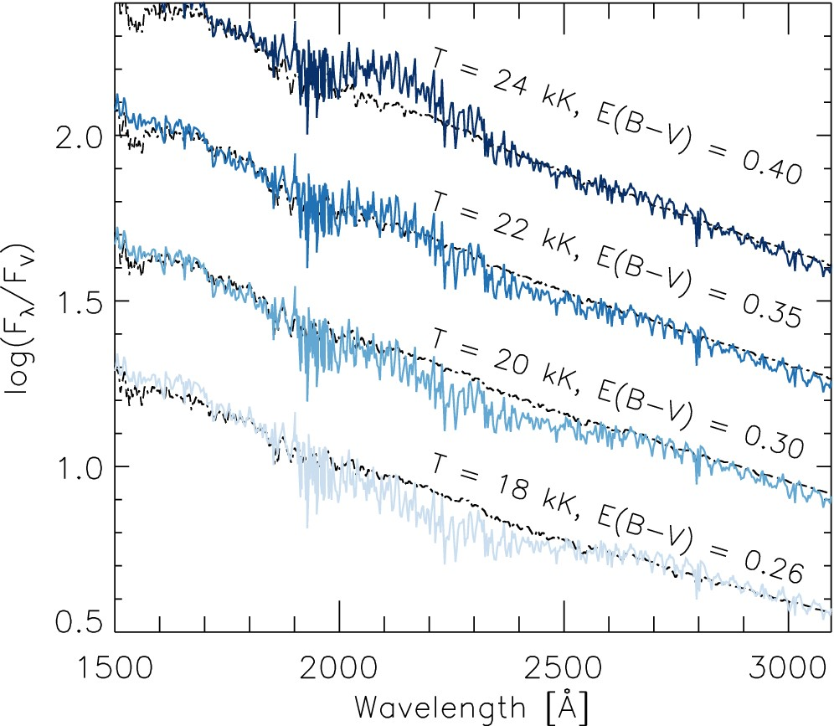
Figure 2. Comparisons between the IUE LWP spectrum (solid blue) and model SEDs (dashed black) at various effective ...
Notes:
Figure 2. Comparisons between the IUE LWP spectrum (solid blue) and model SEDs (dashed black) at various effective temperatures and colour excesses. Both the models and the observations are normalized to the V flux (FV).
Unless provided in the caption above, the following copyright applies to the content of this slide: © 2015 The Authors Published by Oxford University Press on behalf of the Royal Astronomical Society

Slide 3
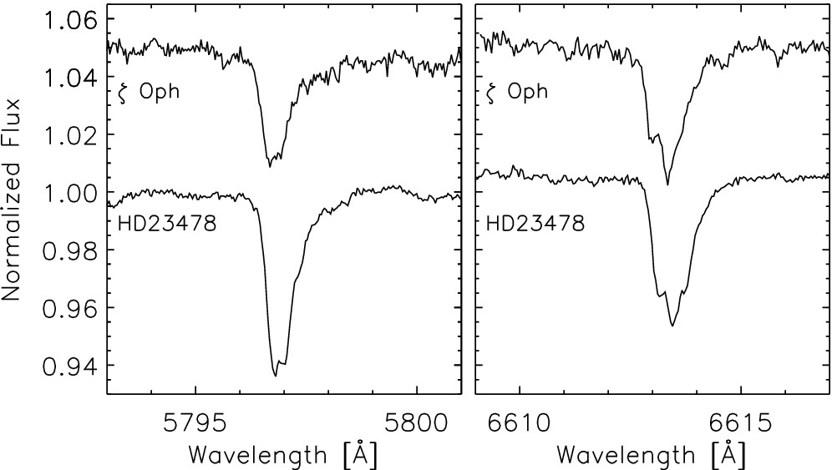
Figure 3. Comparisons between two DIBs found in the spectra of HD 23478 and ζ Oph.
Notes:
Figure 3. Comparisons between two DIBs found in the spectra of HD 23478 and ζ Oph.
Unless provided in the caption above, the following copyright applies to the content of this slide: © 2015 The Authors Published by Oxford University Press on behalf of the Royal Astronomical Society

Slide 4
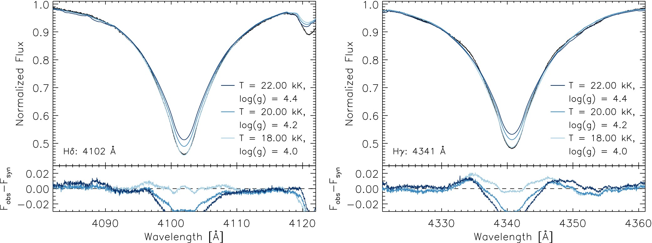
Figure 4. Comparisons between tlusty models (blue) and the averaged observed spectrum (black) for Hδ (left) and Hγ ...
Notes:
Figure 4. Comparisons between tlusty models (blue) and the averaged observed spectrum (black) for Hδ (left) and Hγ (right). The bottom frames show the residuals between the observations and the synthetic spectra (Fobs − Fsyn).
Unless provided in the caption above, the following copyright applies to the content of this slide: © 2015 The Authors Published by Oxford University Press on behalf of the Royal Astronomical Society

Slide 5
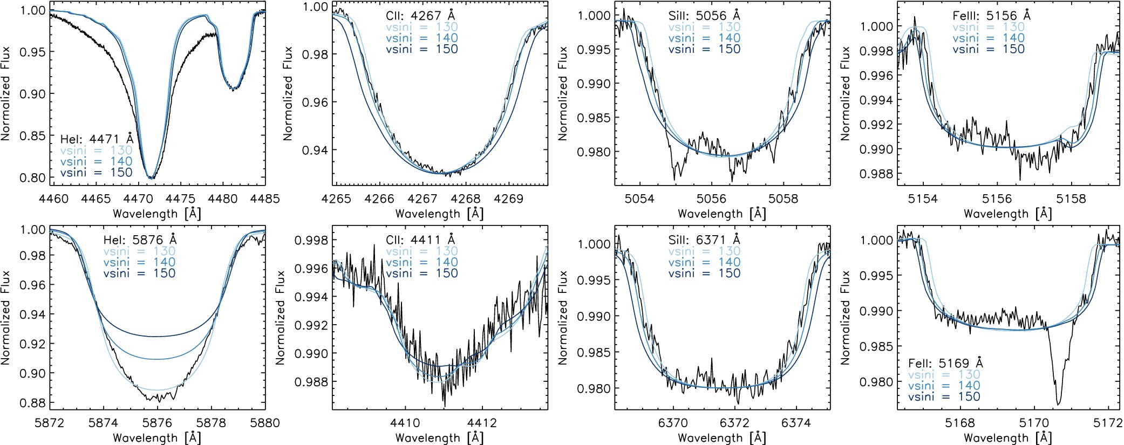
Figure 5. T_{eff} = 22 kK and log g = 4.4 tlusty models with a range of vsin i values compared with the ...
Notes:
Figure 5. Teff = 22 kK and log g = 4.4 tlusty models with a range of vsin i values compared with the averaged observed spectrum (black). The abundances of each element were adjusted in order to yield the best overall fit to the synthetic spectra. DIBs in both the Si ii λ5056 and Fe ii λ5169 lines are visible at 5055 and 5170.5 Å.
Unless provided in the caption above, the following copyright applies to the content of this slide: © 2015 The Authors Published by Oxford University Press on behalf of the Royal Astronomical Society

Slide 6
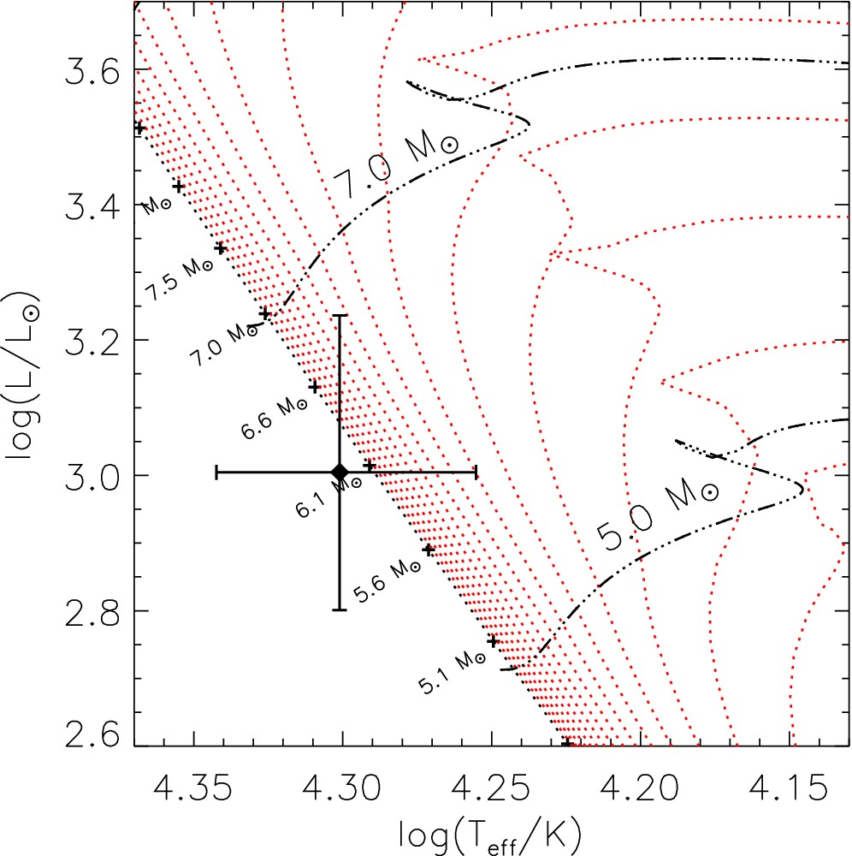
Figure 6. The position of HD 23478 is indicated by the black diamond. The evolutionary tracks (black dot–dashed lines) ...
Notes:
Figure 6. The position of HD 23478 is indicated by the black diamond. The evolutionary tracks (black dot–dashed lines) and isochrones (red dotted lines) assume a non-rotating star of solar metallicity (Ekström et al. 2012).
Unless provided in the caption above, the following copyright applies to the content of this slide: © 2015 The Authors Published by Oxford University Press on behalf of the Royal Astronomical Society

Slide 7
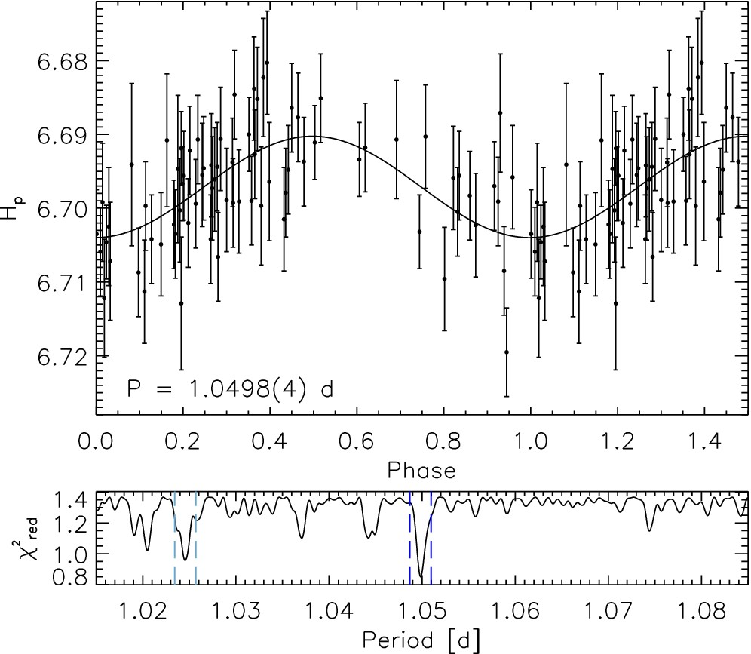
Figure 7. Top: Hipparcos Epoch Photometry phased with a period of 1.0498d. Bottom: a subsample of the full reduced ...
Notes:
Figure 7. Top: Hipparcos Epoch Photometry phased with a period of 1.0498d. Bottom: a subsample of the full reduced χ2 versus period centred on the period of the best-fitting sinusoid. The 1.0498 d minimal-χ2 solution is bounded by the dashed dark blue lines. The dashed light blue lines (Prot = 1.024 54 d) indicate the only other χ2 peak falling below our chosen 3σ threshold.
Unless provided in the caption above, the following copyright applies to the content of this slide: © 2015 The Authors Published by Oxford University Press on behalf of the Royal Astronomical Society

Slide 8
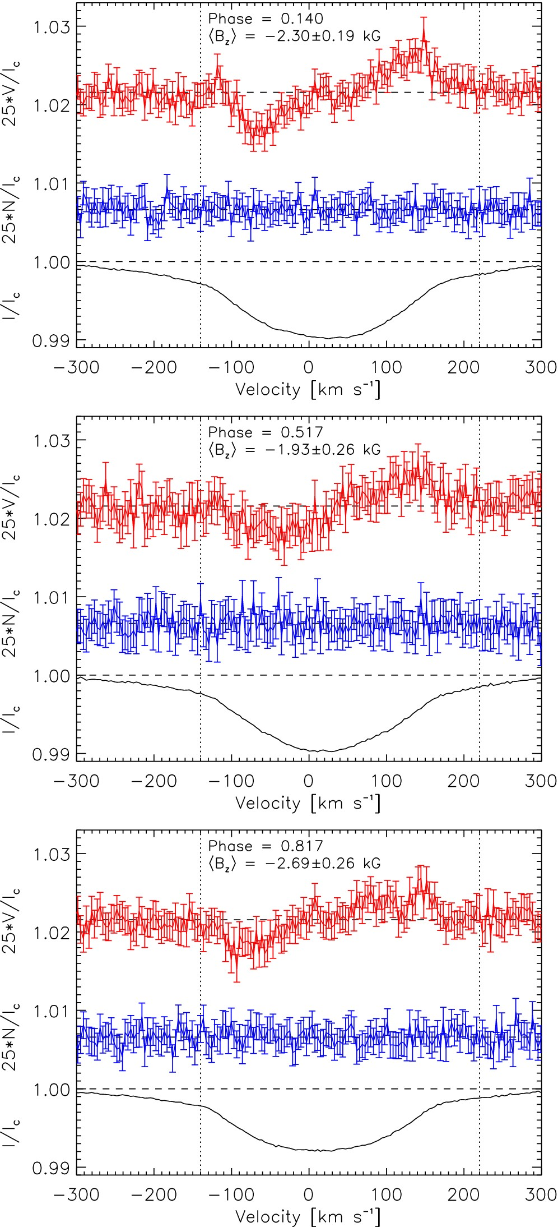
Figure 8. Examples of He+metal LSD profiles at three phases showing Zeeman signatures in Stokes V (top, red), along ...
Notes:
Figure 8. Examples of He+metal LSD profiles at three phases showing Zeeman signatures in Stokes V (top, red), along with associated Stokes I (bottom, black) and diagnostic null (middle, blue) profiles. Vertical dotted lines indicate the integration range.
Unless provided in the caption above, the following copyright applies to the content of this slide: © 2015 The Authors Published by Oxford University Press on behalf of the Royal Astronomical Society

Slide 9
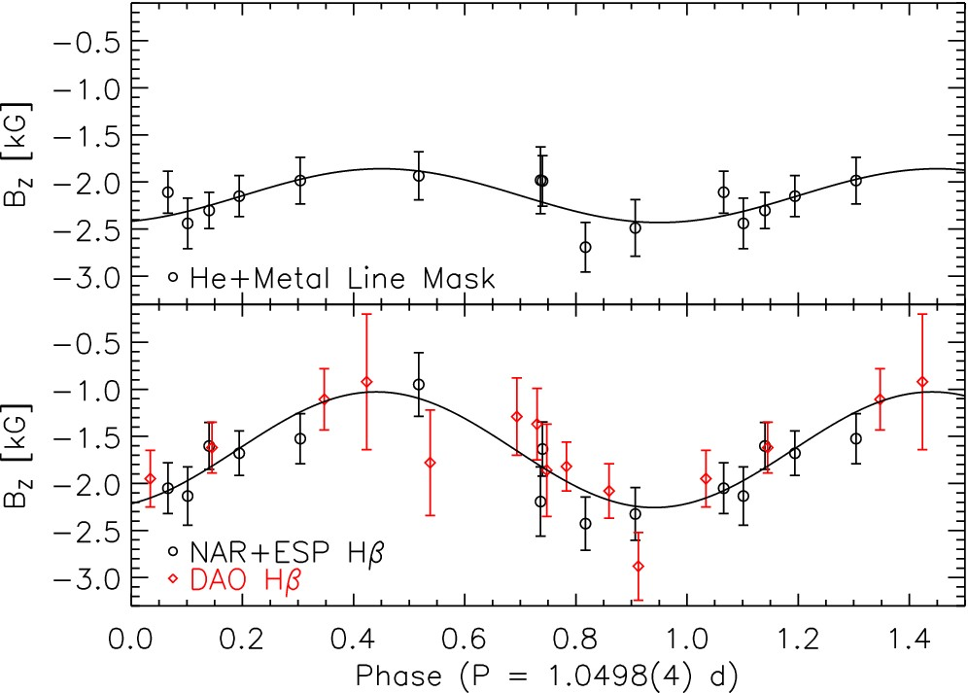
Figure 9. Longitudinal magnetic field measurements phased according to equation (1). The curves correspond to the ...
Notes:
Figure 9. Longitudinal magnetic field measurements phased according to equation (1). The curves correspond to the best-fitting sinusoids. Top: 〈Bz〉 values derived using He+metal LSD line profiles. Bottom: 〈Bz〉 values derived from Hβ Stokes V observations. Black circles correspond to measurements obtained by Narval and ESPaDOnS while red diamonds are those obtained with dimaPol.
Unless provided in the caption above, the following copyright applies to the content of this slide: © 2015 The Authors Published by Oxford University Press on behalf of the Royal Astronomical Society

Slide 10
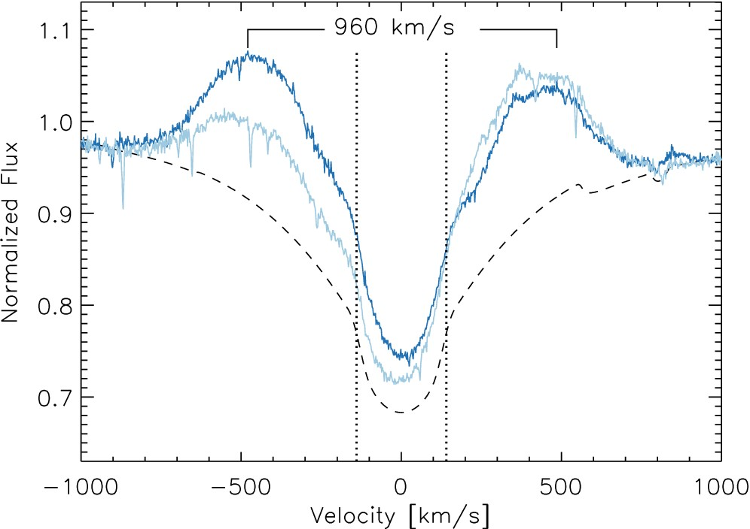
Figure 10. Maximum Hα emission (solid dark blue), as observed at a phase of 0.740, forms a double-horned peak separated ...
Notes:
Figure 10. Maximum Hα emission (solid dark blue), as observed at a phase of 0.740, forms a double-horned peak separated by a velocity of ±480 kms−1 well beyond the stellar surface indicated by the vertical dotted black lines at vsin i = ±140 kms−1. Minimum Hα (solid light blue) observed at a phase of 0.516. The dashed black curve is the Teff = 22 kK, log g = 4.4 tlusty model spectrum discussed in Section 3.2.
Unless provided in the caption above, the following copyright applies to the content of this slide: © 2015 The Authors Published by Oxford University Press on behalf of the Royal Astronomical Society

Slide 11
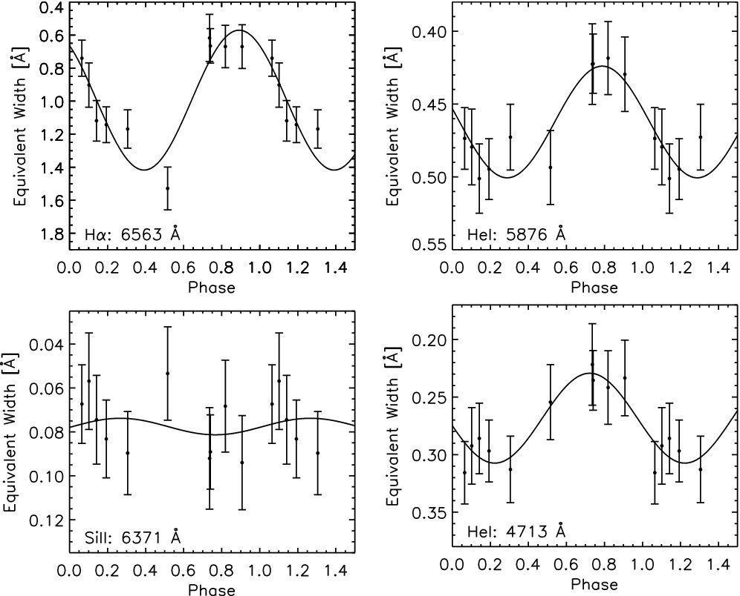
Figure 11. EWs of variable absorption lines phased with the star's rotational period of P_{rot} = 1.0498 d.
Notes:
Figure 11. EWs of variable absorption lines phased with the star's rotational period of Prot = 1.0498 d.
Unless provided in the caption above, the following copyright applies to the content of this slide: © 2015 The Authors Published by Oxford University Press on behalf of the Royal Astronomical Society

Slide 12
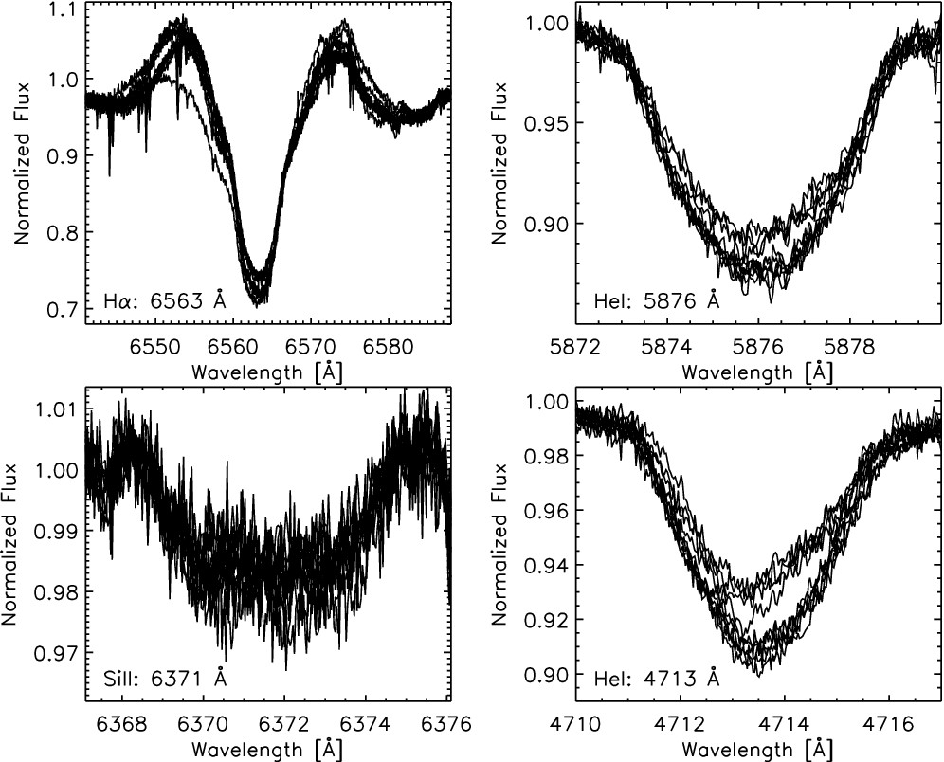
Figure 12. Overlayed line profiles associated with the EWs shown in Fig. 11 from each of the 12 measurements. ...
Notes:
Figure 12. Overlayed line profiles associated with the EWs shown in Fig. 11 from each of the 12 measurements. Significant variability was found in all identified He i lines.
Unless provided in the caption above, the following copyright applies to the content of this slide: © 2015 The Authors Published by Oxford University Press on behalf of the Royal Astronomical Society

