Slide 1
Figure 1 Device detection windows to determine VF or VT.
Notes:
Figure 1 Device detection windows to determine VF or VT.
Unless provided in the caption above, the following copyright applies to the content of this slide: Published on behalf of the European Society of Cardiology. All rights reserved. © The Author 2014. For permissions please email: journals.permissions@oup.com.

Slide 2
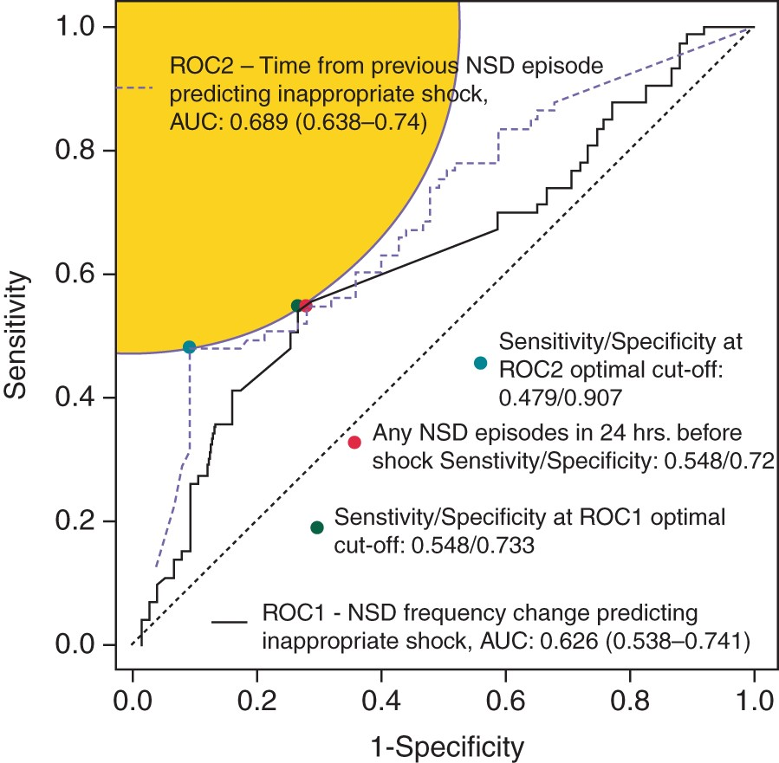
Figure 2 Receiver operator curves (ROCs) showing the relationship of change in NSD frequency to inappropriate shock ...
Notes:
Figure 2 Receiver operator curves (ROCs) showing the relationship of change in NSD frequency to inappropriate shock and time from previous NSD to inappropriate shock.
Unless provided in the caption above, the following copyright applies to the content of this slide: Published on behalf of the European Society of Cardiology. All rights reserved. © The Author 2014. For permissions please email: journals.permissions@oup.com.

Slide 3
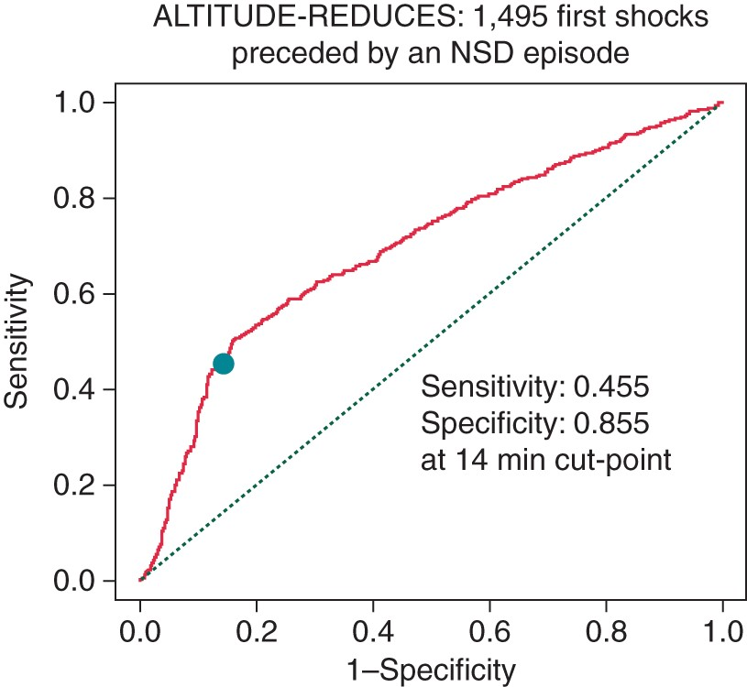
Figure 3 Receiver operator curve depicting 14 min cutoff point from NSD to inappropriate shock delivery in the ...
Notes:
Figure 3 Receiver operator curve depicting 14 min cutoff point from NSD to inappropriate shock delivery in the ALTITUDE-REDUCES Study.
Unless provided in the caption above, the following copyright applies to the content of this slide: Published on behalf of the European Society of Cardiology. All rights reserved. © The Author 2014. For permissions please email: journals.permissions@oup.com.

