Slide 1
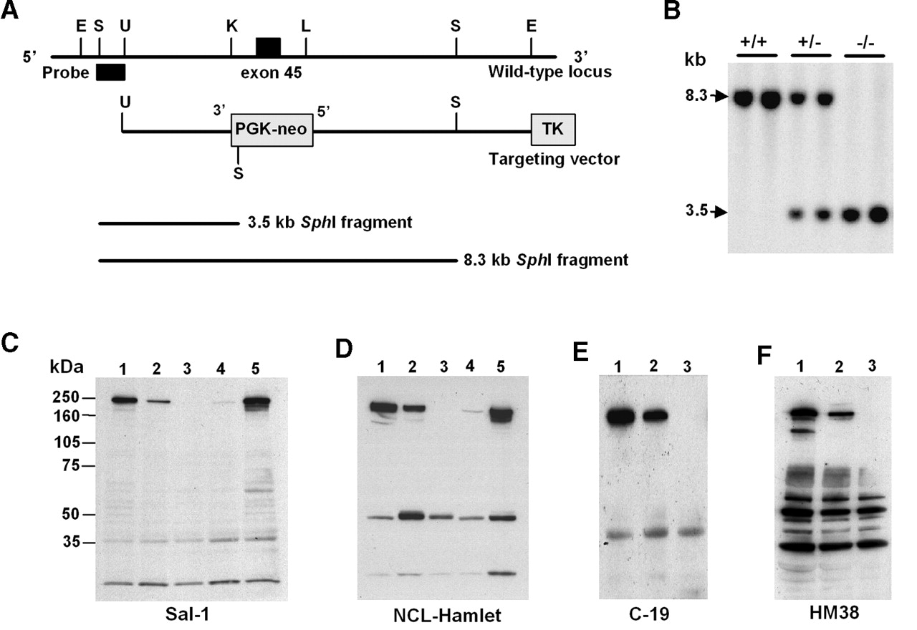
Figure 1. Generation of dysferlin-deficient mice by gene targeting. ( A ) Restriction map of wild-type ...
Notes:
Figure 1. Generation of dysferlin-deficient mice by gene targeting. ( A ) Restriction map of wild-type dysferlin locus around exon 45 (top), the targeting vector (middle) and the predicted size of Sph I fragments from the wild-type and recombinant alleles (bottom). A 1.8 kb region that encompassed exon 45 was deleted and replaced by a phosphoglycerate kinase promoter-neomycin cassette (PGK-neo) placed in the opposite transcriptional direction. The probe used in Southern blot analysis for genotyping ES cells and mice is indicated. E, Eco RI; S, Sph I; U, Stu I; K, Kpn I; L, Sal I. ( B ) Southern blot analysis of Sph I-digested genomic DNA from tail biopsy samples. Replacement of exon 45 with the PGK-neo cassette introduced a new Sph I site in the recombinant allele that yields a 3.5 kb fragment compared with the 8.3 kb fragment from the wild-type allele. +/+, wild-type; +/−, heterozygous mutant; −/−, homozygous mutant. ( C – F ) Immunoblot analysis of skeletal muscle homogenates from the wild-type (lane 1), heterozygous mutant (lane 2), homozygous mutant (lane 3), SJL (lane 4) and mdx (lane 5) mice using the following anti-dysferlin antibodies: Sal-1 (C), NCL-Hamlet (D), C-19 (E) and HM38 (F). The 237 kDa dysferlin protein was detected in the wild-type, heterozygous and mdx mice but not in the homozygous mutant mice. A trace amount of dysferlin was also detected in the SJL mice.
Unless provided in the caption above, the following copyright applies to the content of this slide: Human Molecular Genetics, Vol. 13, No. 18 © Oxford University Press 2004; all rights reserved

Slide 2
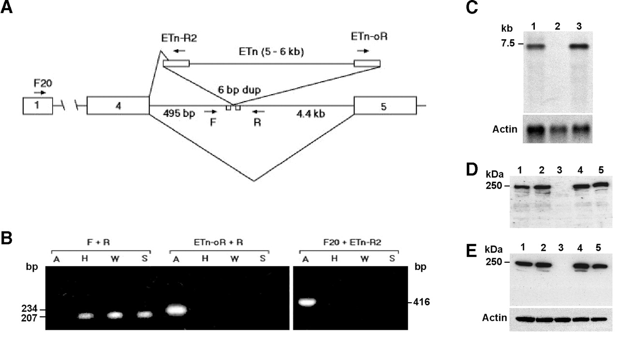
Figure 2. Identification of the dysferlin defect in the A/J mice. ( A ) Schematic representation of the ...
Notes:
Figure 2. Identification of the dysferlin defect in the A/J mice. ( A ) Schematic representation of the retrotransposon (ETn) insertion at the dysferlin locus in the A/J mice. The ETn insertion occurred within intron 4 and causes aberrant splicing of the dysferlin gene. ( B ) PCR analysis of genomic DNA isolated from the A/J (A), A/HeJ (H), A/WySnJ (W) and SJL (S) mice using the indicated primer pairs. Using the primer pair that flanks the ETn insertion (F+R), a 207 bp product was obtained from all mice except from A/J. Conversely, only genomic DNA from the A/J mice generated a PCR product when primers specific for ETn sequences were used. ( C ) Northern blot analysis of total RNA isolated from skeletal muscles of A/WySnJ (lane 1), A/J (lane 2) and C57BL6/J (lane 3). Using a 3′ murine dysferlin cDNA as probe, the ∼7.0 kb dysferlin transcript was detected in the A/WySnJ and C57BL6/J mice but not in the A/J mice. The same blot was hybridized with actin cDNA to show equal loading. ( D , E ) Immunoblot analysis of the dysferlin expression in skeletal muscle extracts from the C57BL6/J (lane 1), A/WySnJ (lane 2), A/J (lane 3), SWR/J (lane 4) and 129/SvJ (lane 5) mice. Using affinity-purified goat polyclonal antibodies, C-19 (D), or a monoclonal antibody, NCL-Hamlet (E), the dysferlin protein was detected in all the inbred mice examined except in A/J.
Unless provided in the caption above, the following copyright applies to the content of this slide: Human Molecular Genetics, Vol. 13, No. 18 © Oxford University Press 2004; all rights reserved

Slide 3
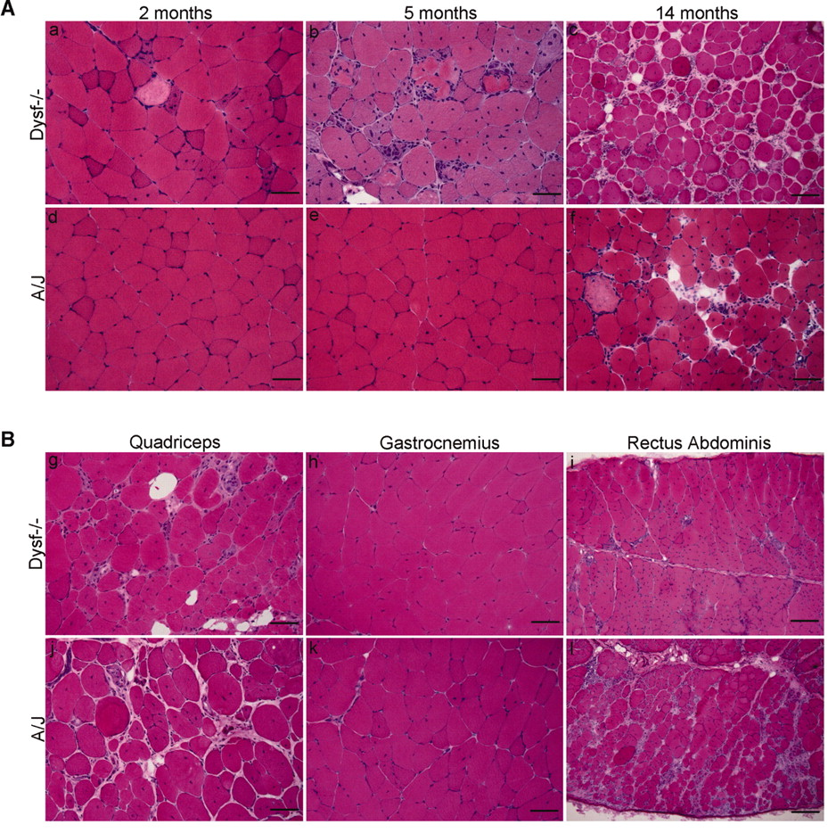
Figure 3. Histological analysis of H&E-stained muscles from the Dysf ^{−/−} and A/J mice. ( A ) ...
Notes:
Figure 3. Histological analysis of H&E-stained muscles from the Dysf −/− and A/J mice. ( A ) Comparative analysis of quadriceps femoris muscles from 2-month-, 5-month- and 14-month-old Dysf −/− (a, b, c) and A/J (d, e, f) mice. Both lines of mice developed a progressive muscular dystrophy but differ in their severity and progression. (a) Early dystrophic features in 2-month-old Dysf −/− mice consist of scattered necrotic fibers (center, pale staining) and some fibers with centrally placed nuclei. (b) Muscles from 5-month-old mice show pronounced histopathological changes that include increased necrosis and regenerated fibers, mononuclear cell infiltration, phagocytosis, hypertropic fibers, fiber splitting and fat replacement (bottom, white areas). (c) As the disease progressed, there was extensive endomysial fibrosis, fat replacement and perivascular infiltrates. (d–f) Quadriceps muscles from the A/J mice show a less severe muscle histopathology compared with the age-matched Dysf −/− mice. The earliest dystrophic feature was seen in 5-month-old A/J mice, comprising a few muscle fibers with centrally placed nuclei (e). The muscle histopathology of 14-month-old A/J mice (f) resembles that of a 9-month-old Dysf −/− mice (g), indicating a slower progression of the muscle disease in A/J compared with Dysf −/− . ( B ) Analysis of the distribution of muscle histopathology in 9-month-old Dysf −/− (g, h, i) and 11-month-old A/J (j, k, l) mice. Both lines of mice showed a similar distribution of muscle disease, with quadriceps muscles (proximal) more severely affected than the gastrocnemius (distal). Unexpectedly, the histopathology of the abdominal muscles in the A/J mice is similar to the Dysf −/− mice. Scale bar: (c, i, l) 100 µm, all other figures is 50 µm.
Unless provided in the caption above, the following copyright applies to the content of this slide: Human Molecular Genetics, Vol. 13, No. 18 © Oxford University Press 2004; all rights reserved

Slide 4
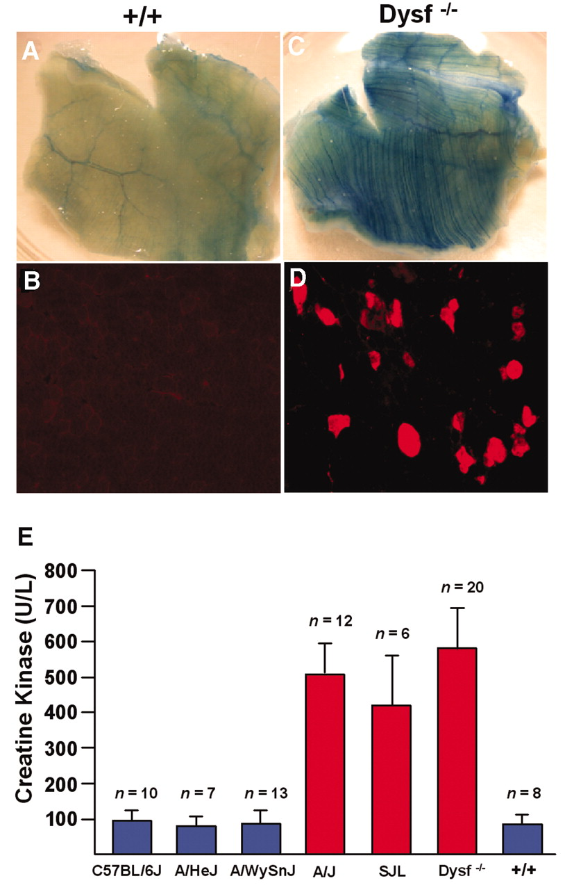
Figure 4. Evaluation of sarcolemmal integrity by vital staining with EBD and serum CK levels. Wild-type and ...
Notes:
Figure 4. Evaluation of sarcolemmal integrity by vital staining with EBD and serum CK levels. Wild-type and dysferlin-deficient mice were injected intraperitoneally with EBD, and different muscles were evaluated for dye uptake. Macroscopic examination of abdominal muscles from 20-week-old wild-type ( A ) and Dysf −/− mice ( C ) reveals prominent EBD inclusion in the dysferlin-deficient muscle but not in the wild-type muscle (+/+). Using fluorescence microscopy, EBD-containing muscle fibers show red cytoplasmic staining. There was no evidence of dye uptake in the wild-type quadriceps muscle by microscopic analysis ( B ) but EBD accumulation was seen in dysferlin-deficient quadriceps muscle ( D ). ( E ) Serum CK levels of the inbred mice and Dysf −/− mice. The CK levels of the A/J, SJL and Dysf −/− mice were 4–6-fold higher than related inbred A strains (A/HeJ and A/WySnJ) and dysferlin wild-type littermate controls (+/+), indicating there was loss of sarcolemmal integrity in dysferlin-deficient muscles. Error bars indicate the standard deviation and n refers to the number of mice analyzed in each set.
Unless provided in the caption above, the following copyright applies to the content of this slide: Human Molecular Genetics, Vol. 13, No. 18 © Oxford University Press 2004; all rights reserved

Slide 5
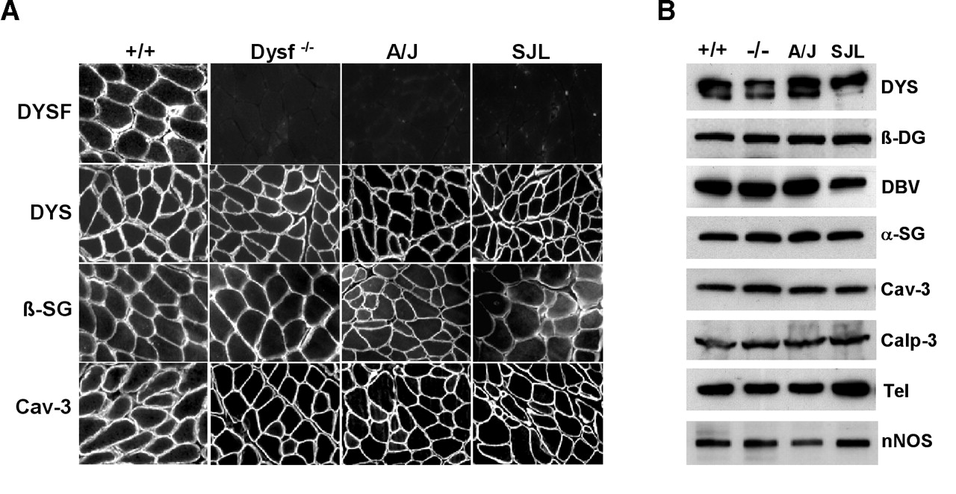
Figure 5. Immunofluorescence and immunoblot analyses of sarcolemmal proteins in the dysferlin-deficient ...
Notes:
Figure 5. Immunofluorescence and immunoblot analyses of sarcolemmal proteins in the dysferlin-deficient skeletal muscle. ( A ) Cryosections of quadriceps muscle from the wild-type (+/+), homozygous mutant (Dysf −/− ), A/J and SJL mice were stained with antibodies against dysferlin (DYSF), dystrophin (DYS), β-sarcoglycan (β-SG) and caveolin-3 (Cav-3). Dysferlin was absent from the sarcolemma of Dysf −/− , A/J and SJL mice compared with the wild-type mice but the expression and distribution of dystrophin, β-sarcoglycan and caveolin-3 were not affected. ( B ) Immunoblot analysis of quadriceps muscle homogenates from wild-type (+/+), homozygous mutant (−/−) A/J and SJL, using antibodies against dystrophin (DYS), β-dystroglycan (β-DG), dystrobrevin (DBV), α-sarcoglycan (α-SG), caveolin-3 (Cav-3), calpain-3 (Calp-3), telethonin (Tel) and neuronal nitric oxide synthase (n-NOS). The expression of these proteins was not altered in the dysferlin-deficient muscle.
Unless provided in the caption above, the following copyright applies to the content of this slide: Human Molecular Genetics, Vol. 13, No. 18 © Oxford University Press 2004; all rights reserved

Slide 6
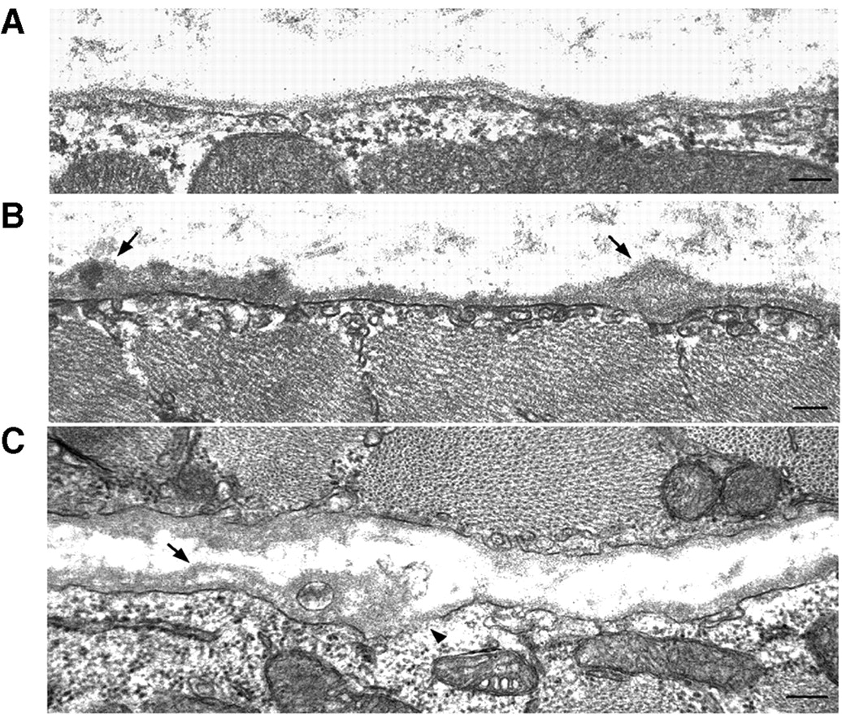
Figure 6. Ultrastructural analysis of the dysferlin-deficient muscle. Electron micrographs of quadriceps ...
Notes:
Figure 6. Ultrastructural analysis of the dysferlin-deficient muscle. Electron micrographs of quadriceps muscle from the wild-type ( A ) and two 20-week old Dysf −/− mice ( B and C ). In contrast to the wild-type muscle (A), there was marked thickening and focal duplication of the basal lamina in the dysferlin-deficient muscle (arrows, B and C). In addition, there was accumulation of vesicles near the sarcolemmal (B) as well as the isolated areas of membrane discontinuity (arrowhead, C) in the dysferlin-deficient muscle. Bar=200 nm.
Unless provided in the caption above, the following copyright applies to the content of this slide: Human Molecular Genetics, Vol. 13, No. 18 © Oxford University Press 2004; all rights reserved

