Slide 1
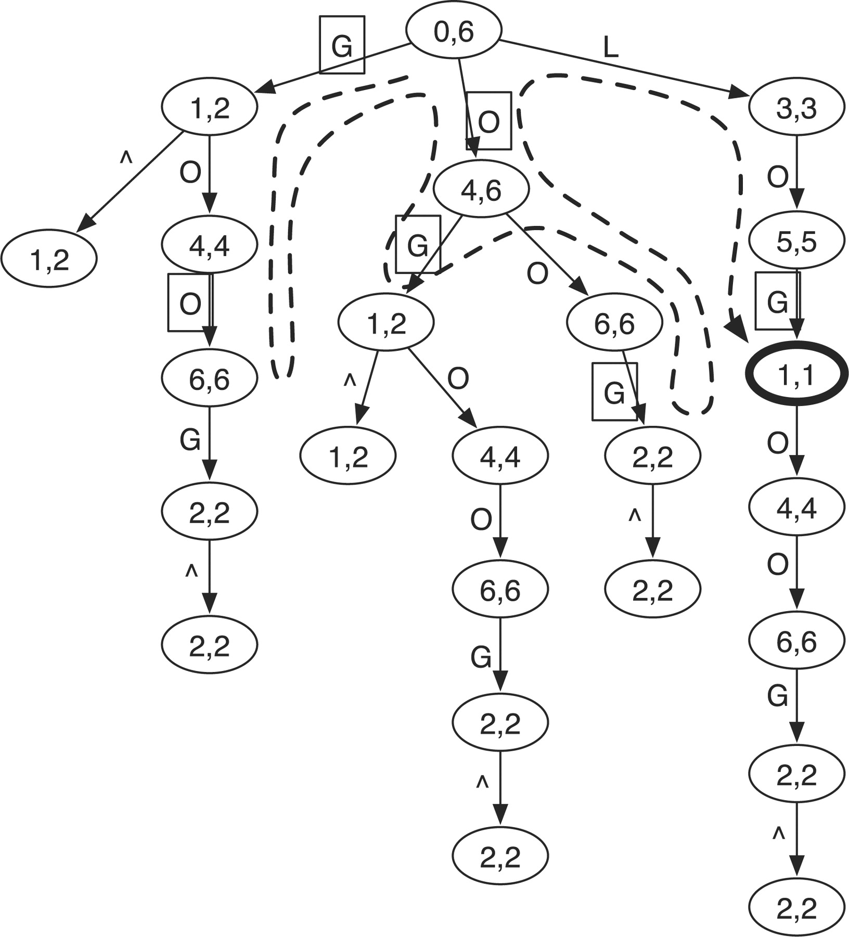
Fig. 1. Prefix trie of string ‘GOOGOL’. Symbol ∧ marks the start of the string. The two numbers in a node give the SA ...
Notes:
Fig. 1. Prefix trie of string ‘GOOGOL’. Symbol ∧ marks the start of the string. The two numbers in a node give the SA interval of the string represented by the node (see Section 2.3). The dashed line shows the route of the brute-force search for a query string ‘LOL’, allowing at most one mismatch. Edge labels in squares mark the mismatches to the query in searching. The only hit is the bold node [1, 1] which represents string ‘GOL’.
Unless provided in the caption above, the following copyright applies to the content of this slide: © 2009 The Author(s)This is an Open Access article distributed under the terms of the Creative Commons Attribution Non-Commercial License (http://creativecommons.org/licenses/by-nc/2.0/uk/) which permits unrestricted non-commercial use, distribution, and reproduction in any medium, provided the original work is properly cited.

Slide 2
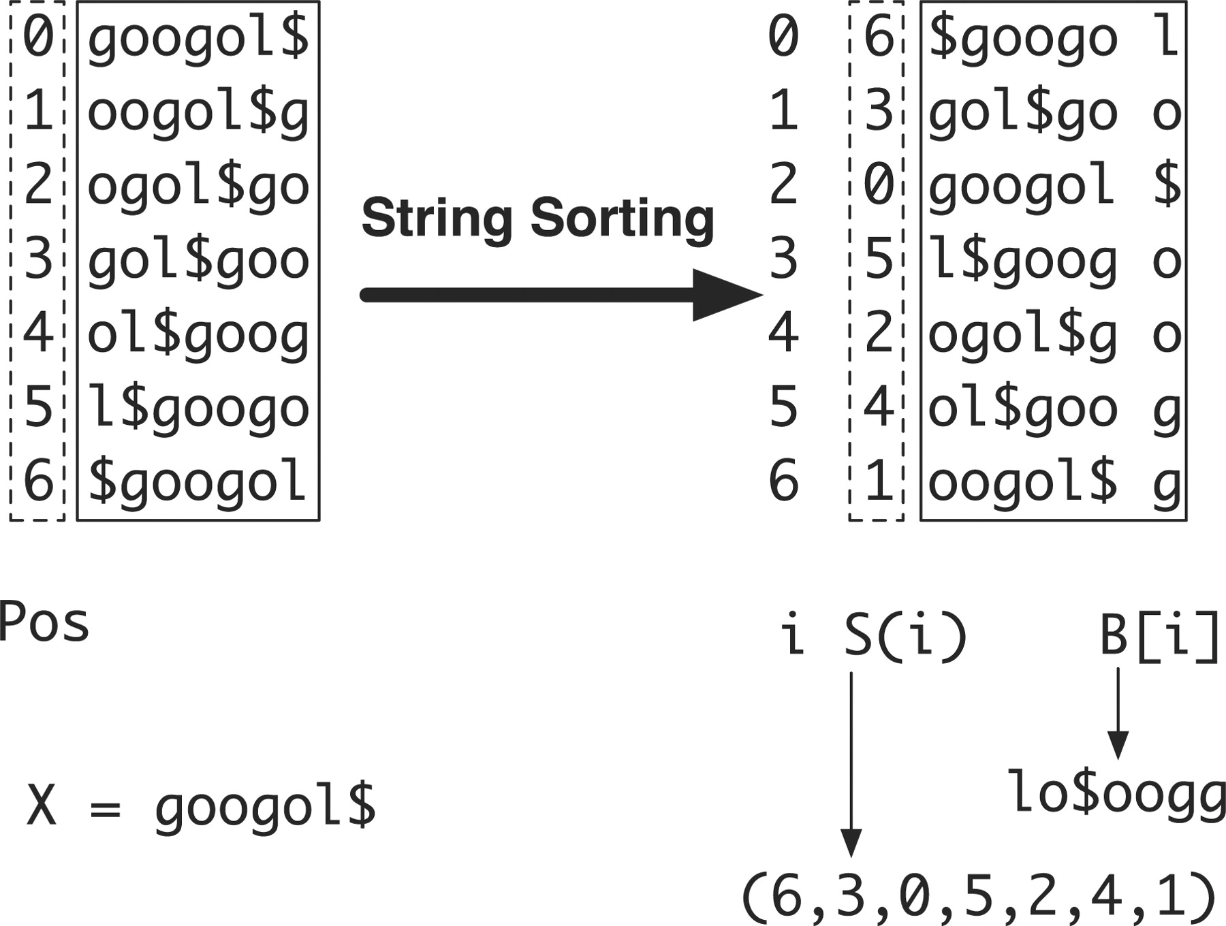
Fig. 2. Constructing suffix array and BWT string for X=googol$. String X is circulated to generate seven strings, ...
Notes:
Fig. 2. Constructing suffix array and BWT string for X=googol$. String X is circulated to generate seven strings, which are then lexicographically sorted. After sorting, the positions of the first symbols form the suffix array (6, 3, 0, 5, 2, 4, 1) and the concatenation of the last symbols of the circulated strings gives the BWT string lo$oogg.
Unless provided in the caption above, the following copyright applies to the content of this slide: © 2009 The Author(s)This is an Open Access article distributed under the terms of the Creative Commons Attribution Non-Commercial License (http://creativecommons.org/licenses/by-nc/2.0/uk/) which permits unrestricted non-commercial use, distribution, and reproduction in any medium, provided the original work is properly cited.

Slide 3
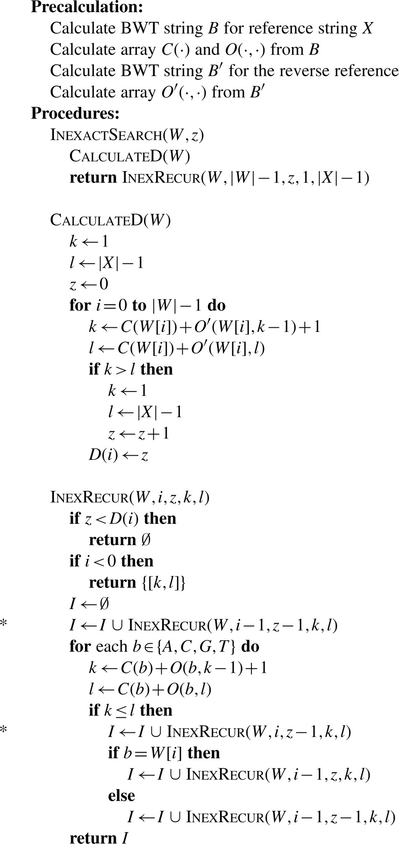
Fig. 3. Algorithm for inexact search of SA intervals of substrings that match W. Reference X is $ terminated, while W ...
Notes:
Fig. 3. Algorithm for inexact search of SA intervals of substrings that match W. Reference X is $ terminated, while W is A/C/G/T terminated. Procedure InexactSearch(W, z) returns the SA intervals of substrings that match W with no more than z differences (mismatches or gaps); InexRecur(W, i, z, k, l) recursively calculates the SA intervals of substrings that match W[0, i] with no more than z differences on the condition that suffix Wi+1 matches interval [k, l]. Lines started with asterisk are for insertions to and deletions from X, respectively. D(i) is the lower bound of the number of differences in string W[0, i].
Unless provided in the caption above, the following copyright applies to the content of this slide: © 2009 The Author(s)This is an Open Access article distributed under the terms of the Creative Commons Attribution Non-Commercial License (http://creativecommons.org/licenses/by-nc/2.0/uk/) which permits unrestricted non-commercial use, distribution, and reproduction in any medium, provided the original work is properly cited.

Slide 4
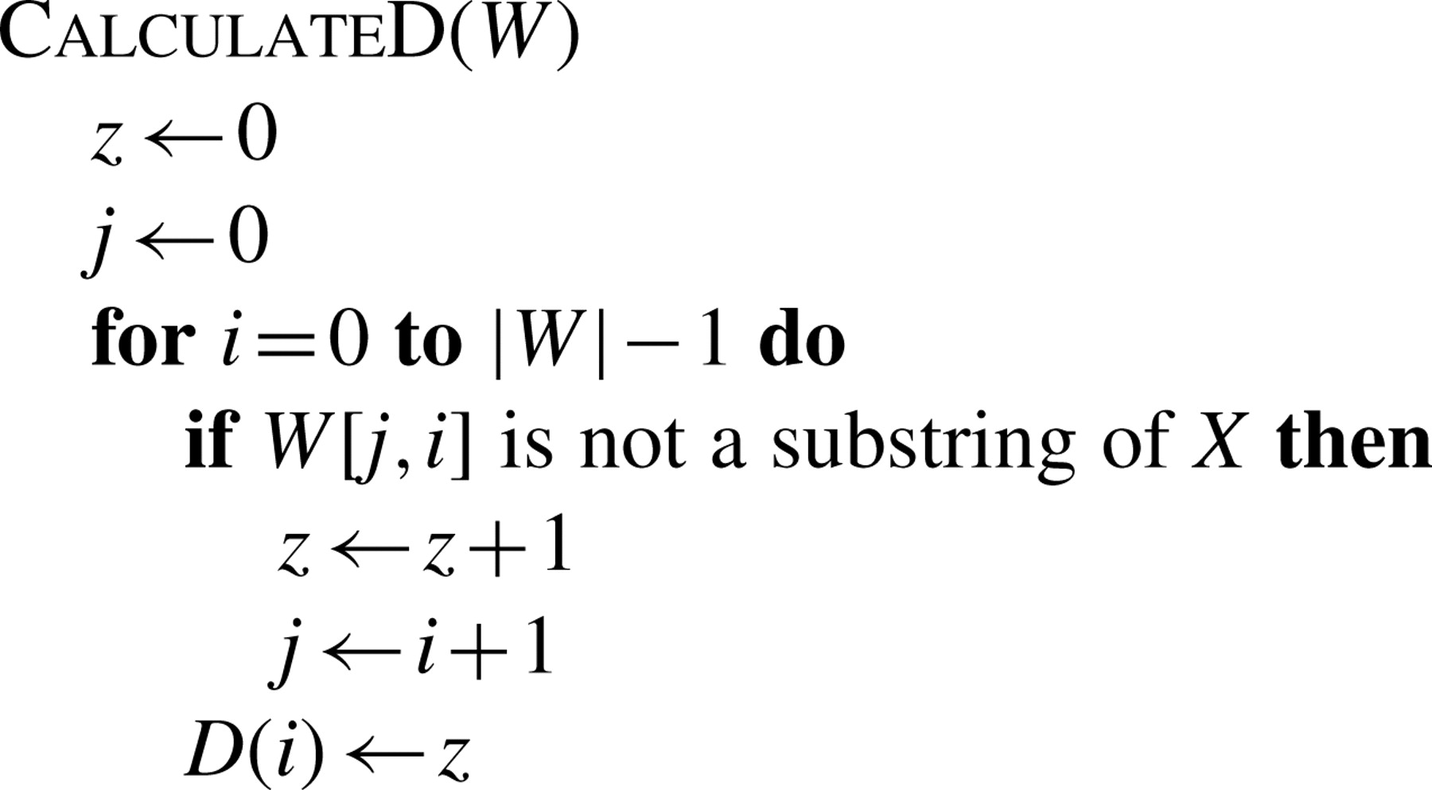
Fig. 4. Equivalent algorithm to calculate D(i).
Notes:
Fig. 4. Equivalent algorithm to calculate D(i).
Unless provided in the caption above, the following copyright applies to the content of this slide: © 2009 The Author(s)This is an Open Access article distributed under the terms of the Creative Commons Attribution Non-Commercial License (http://creativecommons.org/licenses/by-nc/2.0/uk/) which permits unrestricted non-commercial use, distribution, and reproduction in any medium, provided the original work is properly cited.

