Slide 1
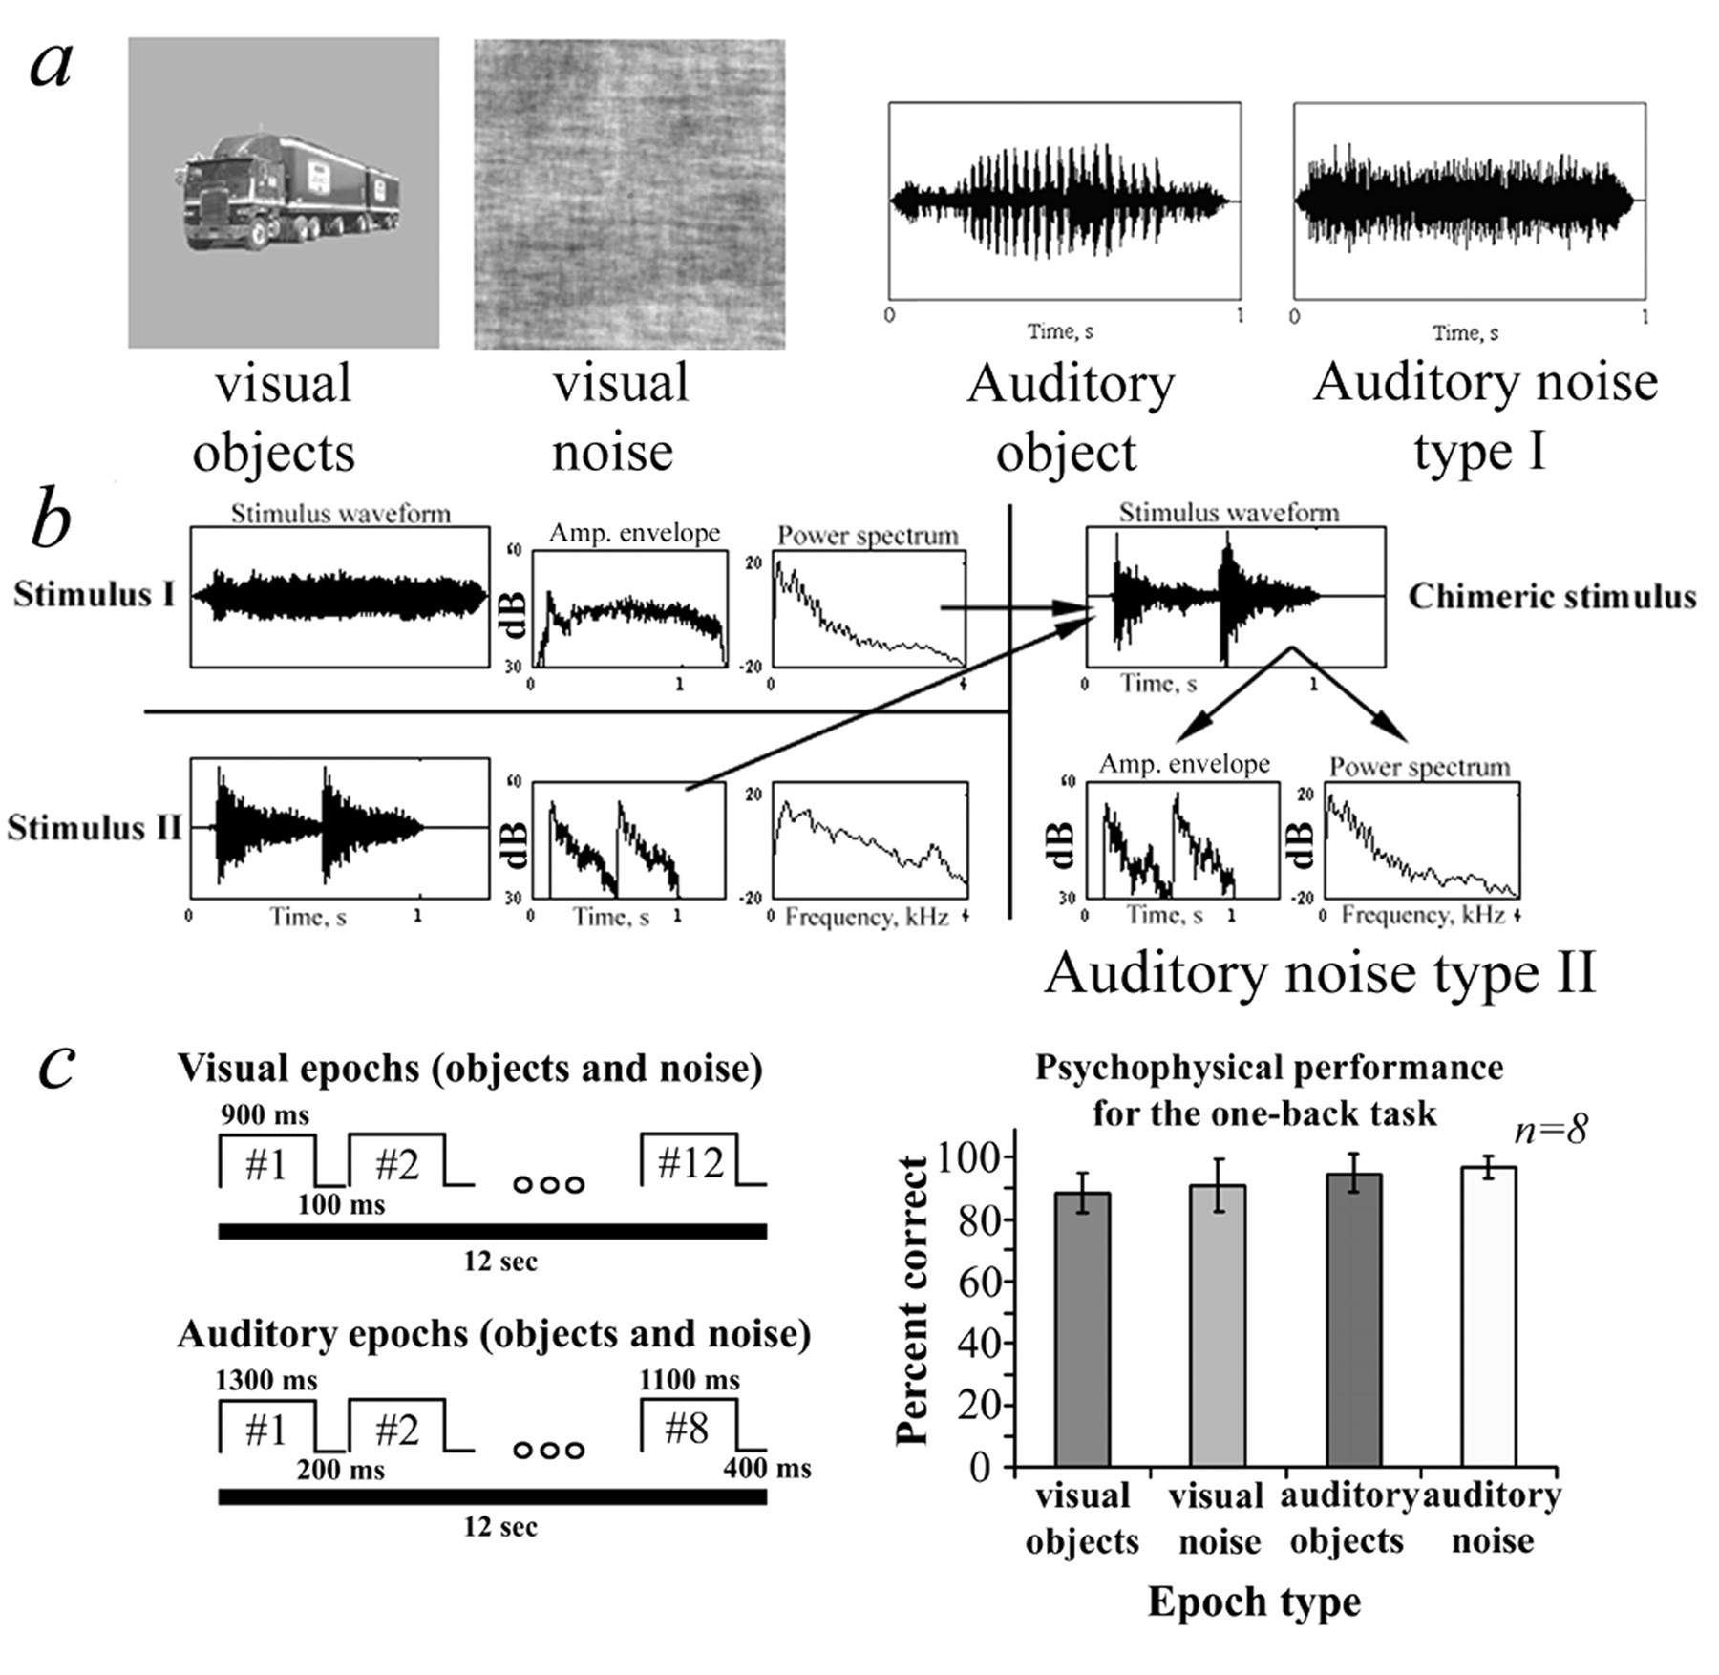
Figure 1. Methods and psychophysics. (a) Visual and auditory objects and baseline noise stimuli. Visual and auditory ...
Notes:
Figure 1. Methods and psychophysics. (a) Visual and auditory objects and baseline noise stimuli. Visual and auditory objects were selected in similar proportions from three different categories. In both modalities, baseline noise stimuli were generated in order to ensure that the activation was not a result of low-level features. The visual noise stimuli were generated by randomizing the phase of the Fourier components of the original images. Phase-randomized auditory noise stimuli were obtained from the auditory objects using the same technique. This assured that the auditory objects and noise sounds (type I) have the same power spectrum. However, they differ in their temporal waveform envelope. The amplitude waveform of an original auditory object (cricket vocalization in Fig. 1a) and the auditory noise (type I, Fig. 1a, right) are presented. (b) Generation of the auditory noise type II stimuli (‘chimera’). The leftmost two panels depict the amplitude waveform of example two auditory objects used for creating one chimeric stimulus. The middle traces depict their respective amplitude envelopes and power spectra. The chimeric stimulus shown in the right panel was created by multiplying a Gaussian noise with the power spectrum of stimulus I by the amplitude envelope of stimulus II. (Scaling of all traces is in accord with the scaling of the right panel.) (c) Epochs design and psychophysical performance. The left panel depicts the presentation rates in each modality, aimed to maximize the presentation rate and performance level. The task was to perform a one-back same/different judgment. The right panel presents average performance inside the scanner across subjects. Accurate performance was obtained in all conditions (average 93.7_±_6.1 SD), with no statistically significant difference between them. (The two types of auditory noise were grouped together since no significant difference was found between them: paired t-test across subjects: P_=_0.6.) This indicates that the auditory stimuli were perceivable without any clear masking effects by the scanner noise, and that attention demands were comparable across the conditions.
Unless provided in the caption above, the following copyright applies to the content of this slide: © Oxford University Press

Slide 2
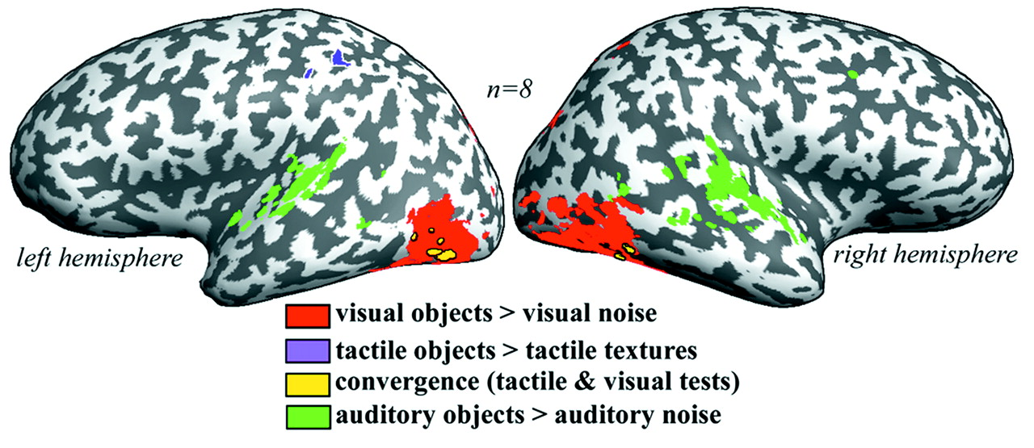
Figure 2. Object-related regions in the visual, tactile and auditory modalities. A multi-subject GLM analysis was ...
Notes:
Figure 2. Object-related regions in the visual, tactile and auditory modalities. A multi-subject GLM analysis was conducted based on data from eight subjects. The activated voxels are presented on a Talairach inflated brain of one subject. Red: regions selective for visual objects compared with phase-scrambled objects (Visual objects > Visual noise). Purple: regions selective for objects compared with textures when both are grasped haptically (Somatosensory objects > Somatosensory textures). Yellow: regions selective for both tests independently, showing visuo-haptic object-related activity. Green: regions selective for sounds defining objects compared with auditory noise controls (Auditory objects > Auditory noise). The most significant bimodal visuo-haptic object selective activation was found within the contralateral visual object-related complex LOC in the occipito-temporal cortex, delineating LOtv. Tactile object-related activation was also found in the IPS and ipsilateral LOtv. Auditory object-specific activation was found bilaterally, mainly around the superior temporal gyrus (STG) but also in the right superior temporal sulcus (STS) and the medial temporal gyrus (MTG). No auditory object-related activation was observed in contralateral LOC in general and in LOtv in specific. This suggests that LOtv is a bimodal visuo-haptic integration region rather then a general multimodal region.
Unless provided in the caption above, the following copyright applies to the content of this slide: © Oxford University Press

Slide 3
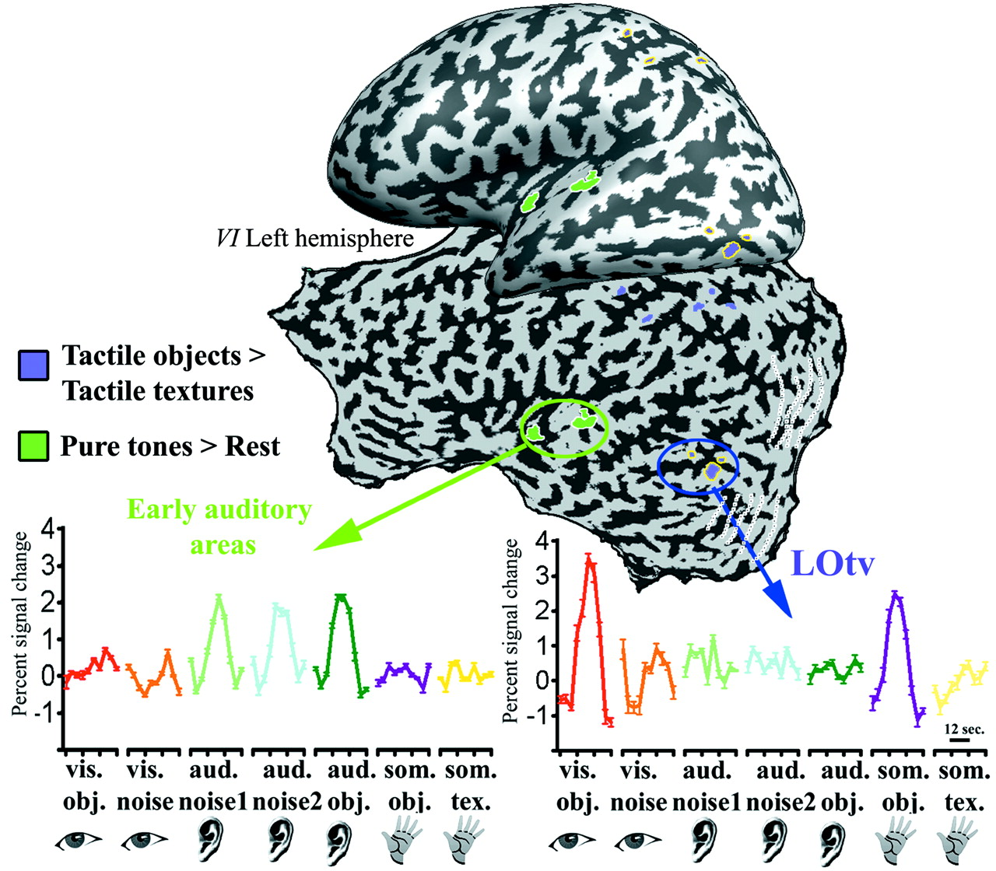
Figure 3. LOtv manifests visual and haptic object selectivity, but no significant auditory activation. Voxels ...
Notes:
Figure 3. LOtv manifests visual and haptic object selectivity, but no significant auditory activation. Voxels significantly activated by touching objects compared with textures (purple regions) are depicted on the unfolded and inflated contralateral (left) hemisphere of one subject. Two main foci of activation are seen, in the parietal cortex (in the anterior intraparietal sulcus and post central sulcus), and LOtv located in the occipito-temporal cortex, just outside the retinotopic areas (delineated in white dotted lines). The lower right panel depicts the averaged time-course of activation in the LOtv ROI (encircled in blue). The average time-course shows bimodal activation for visual and tactile objects but negligible activation to both auditory objects and auditory noise control stimuli. The second ROI was defined using a tonotopic mapping experiment, using pure tones. Voxels significantly activated by pure tones compared with rest are depicted in green on the unfolded and inflated brain. This test delineates auditory cortical regions around the planum temporale and transverse gyrus of Heschl. The time-course from this ROI, presented in the lower left panel, confirms that the auditory stimuli used were indeed effective, evoking strong cortical activation. This rules out the possibility that the lack of auditory activation in LOtv was due to an inappropriate auditory signal.
Unless provided in the caption above, the following copyright applies to the content of this slide: © Oxford University Press

Slide 4
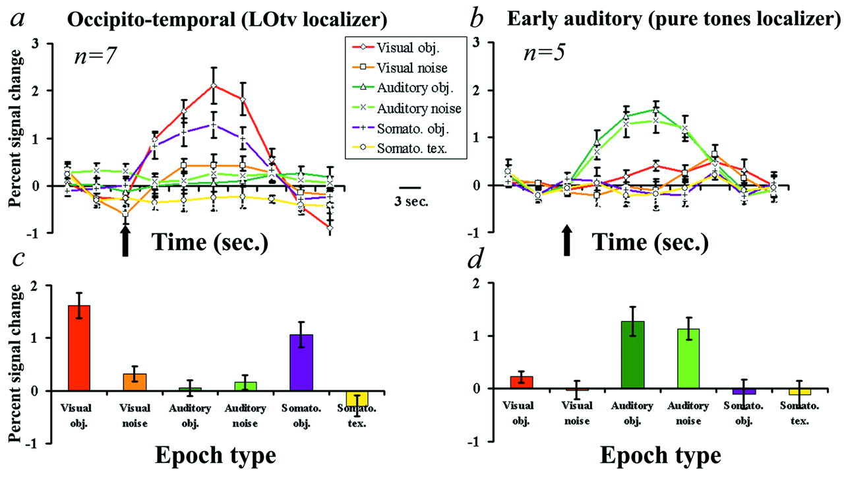
Figure 4. Average time-course of activation (across subjects) reveals object selectivity in LOtv in both visual and ...
Notes:
Figure 4. Average time-course of activation (across subjects) reveals object selectivity in LOtv in both visual and tactile modalities, but no significant auditory activation. (a) Average time-courses across all somatosensory object selective voxels in the occipito-temporal region (LOtv ROI). The dark arrow indicates the beginning of epochs. The graph shows a strong and significant response to visual objects, but negligible activation during the auditory conditions. Since no significant difference was found between the two different auditory noise conditions (type I and II), their time-courses are averaged. (c) The average percent signal change in LOtv across all subjects. (b) and (d) Activation patterns in typical auditory areas defined by significant activation for pure tones compared with rest (PT ROI). Unlike LOtv, the pure tones’ averaged time-course and averaged percent signal change showed robust activation by both auditory objects and the auditory noise stimuli.
Unless provided in the caption above, the following copyright applies to the content of this slide: © Oxford University Press

Slide 5
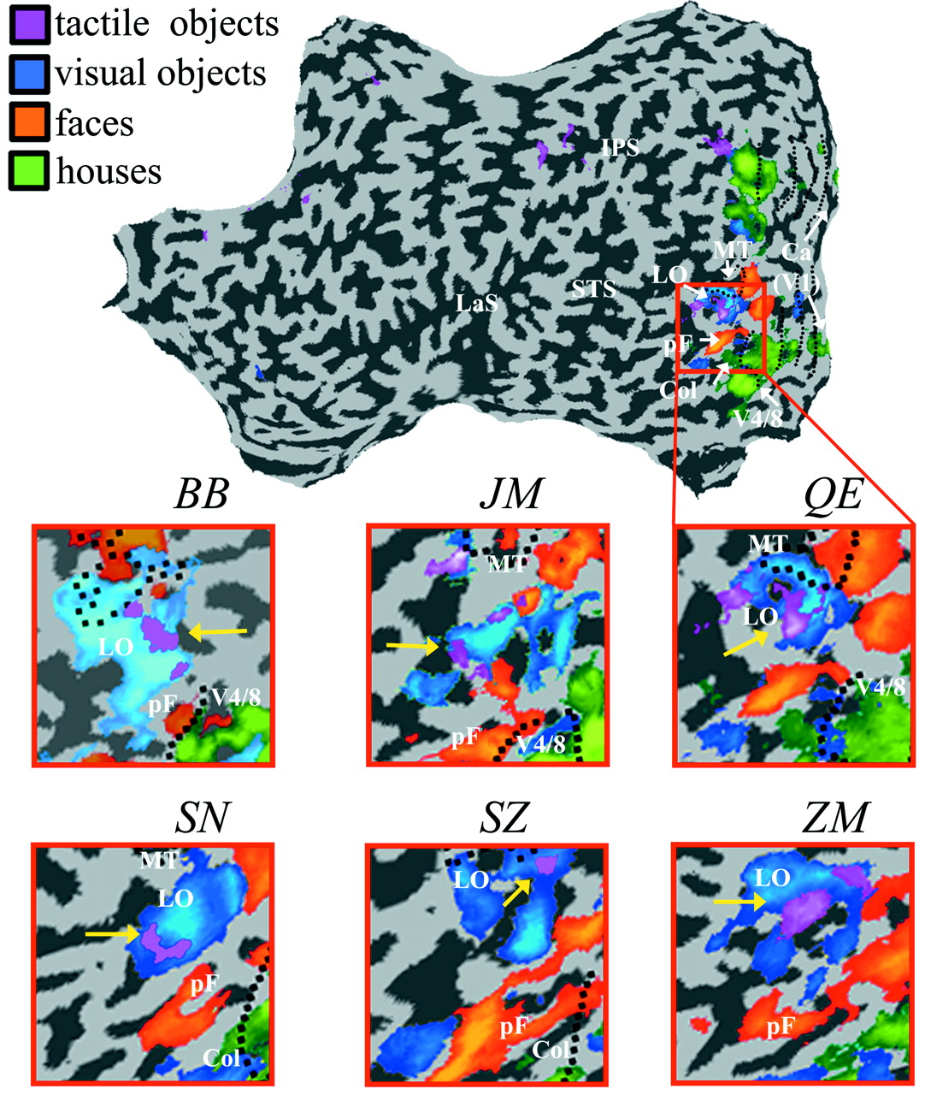
Figure 5. The anatomical correspondence between the tactile object-related activation in the lateral occipital cortex ...
Notes:
Figure 5. The anatomical correspondence between the tactile object-related activation in the lateral occipital cortex and the different functional subdivisions of LOC. The tactile object-related activation is located in the dorsal part of the LOC (i.e. LO proper). Functionally, LOC is defined by its preference for objects over textures or random images. However, different areas within LOC differ in their functional preference for object categories (for example, faces, houses and man-made tools). We show here a complete unfolded map of one subject (QE), together with a magnified view of the ventral object-related areas. The corresponding magnified view of the activation maps from five other subjects is also shown. Note that the tactile object-related activation (purple, indicated by the yellow arrow) is highly correlated anatomically with the visual object-selective region (blue), usually avoiding other areas showing face preference (orange) or house preference (green). Black dotted lines indicate the borders of the retinotopic regions. Ca, calcarine sulcus; Col, collateral sulcus; pF, posterior fusiform gyrus; LO, lateral occipital sulcus; LaS, Lateral sulcus; STS, superior temporal sulcus; IPS, intra-parietal sulcus.
Unless provided in the caption above, the following copyright applies to the content of this slide: © Oxford University Press

