Slide 1
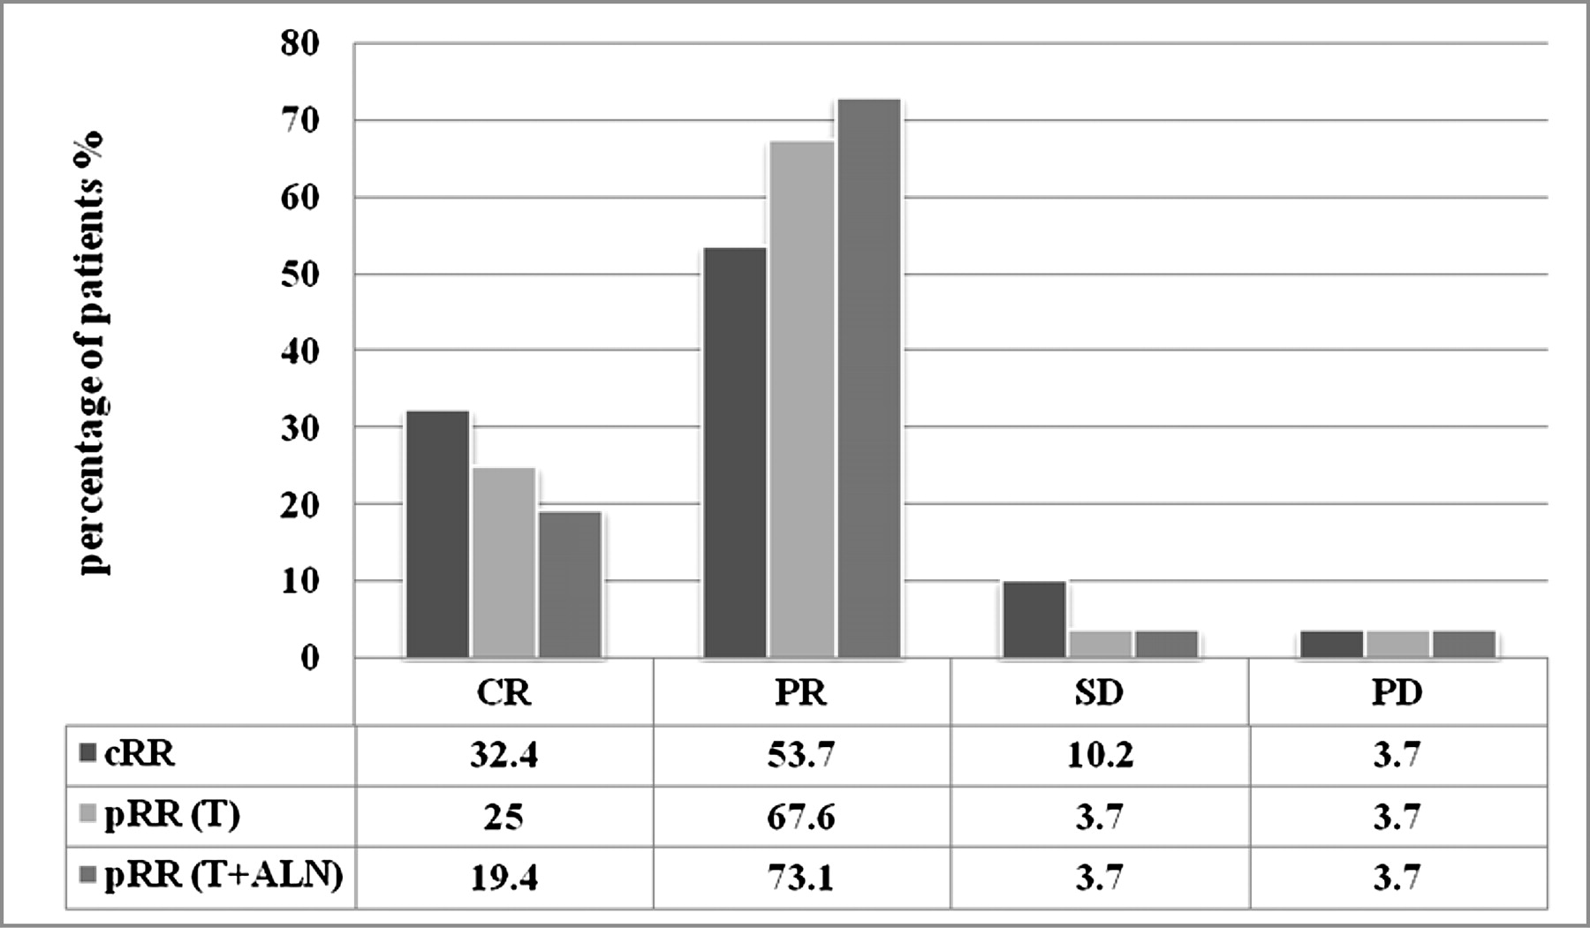
Figure 1. Clinical and pathological response. cRR, clinical response rate; pRR (T), pathological response rate in ...
Notes:
Figure 1. Clinical and pathological response. cRR, clinical response rate; pRR (T), pathological response rate in breast; ALN, axillary lymph node; pRR (T + ALN), pathological response rate in breast and ALN; CR, complete remission; PR, partial remission; SD, stable disease; PD, progression disease.
Unless provided in the caption above, the following copyright applies to the content of this slide: © The Author 2010. Published by Oxford University Press on behalf of the European Society for Medical Oncology. All rights reserved. For permissions, please email: journals.permissions@oxfordjournals.org

