Slide 1
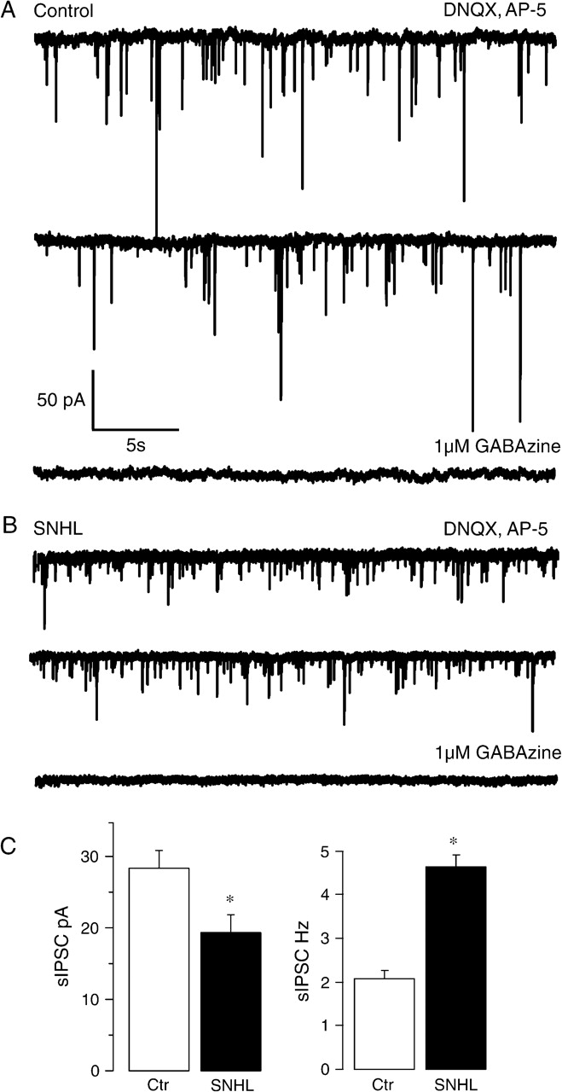
Figure 1. SNHL sIPSC amplitudes are smaller and frequency is higher. (A, B) The top panel (A) shows 2 sweeps of sIPSCs ...
Notes:
Figure 1. SNHL sIPSC amplitudes are smaller and frequency is higher. (A, B) The top panel (A) shows 2 sweeps of sIPSCs recorded in the presence of DNQX and AP-5 for 30 s each in a P17 control neuron (A) and an age-matched SNHL neuron (B) at a holding potential of −60 mV. In both cases, each recording was acquired 1 min apart. Note that amplitudes of sIPSCs in the SNHL neuron are smaller, whereas the frequency is higher. In both control as well as SNHL recordings, addition of 1 μM GABAzine eliminates sIPSCs, showing that they were mediated by the activation of GABAA receptors. (C) Bar graphs summarizing the mean amplitude and frequency of sIPSCs recorded from 11 normal and 12 SNHL neurons. Note that the amplitude of mean sIPSCs is smaller in SNHL neurons (left panel, filled bar), whereas the mean frequency of sIPSCs is greater in SNHL neurons (right panel, filled bar). In this and all subsequent figures, asterisks indicate that the differences are significant (for statistics, see Results).
Unless provided in the caption above, the following copyright applies to the content of this slide: © 2008 The AuthorsThis is an Open Access article distributed under the terms of the Creative Commons Attribution Non-Commercial License (http://creativecommons.org/licenses/by-nc/2.0/uk/) which permits unrestricted non-commercial use, distribution, and reproduction in any medium, provided the original work is properly cited.

Slide 2
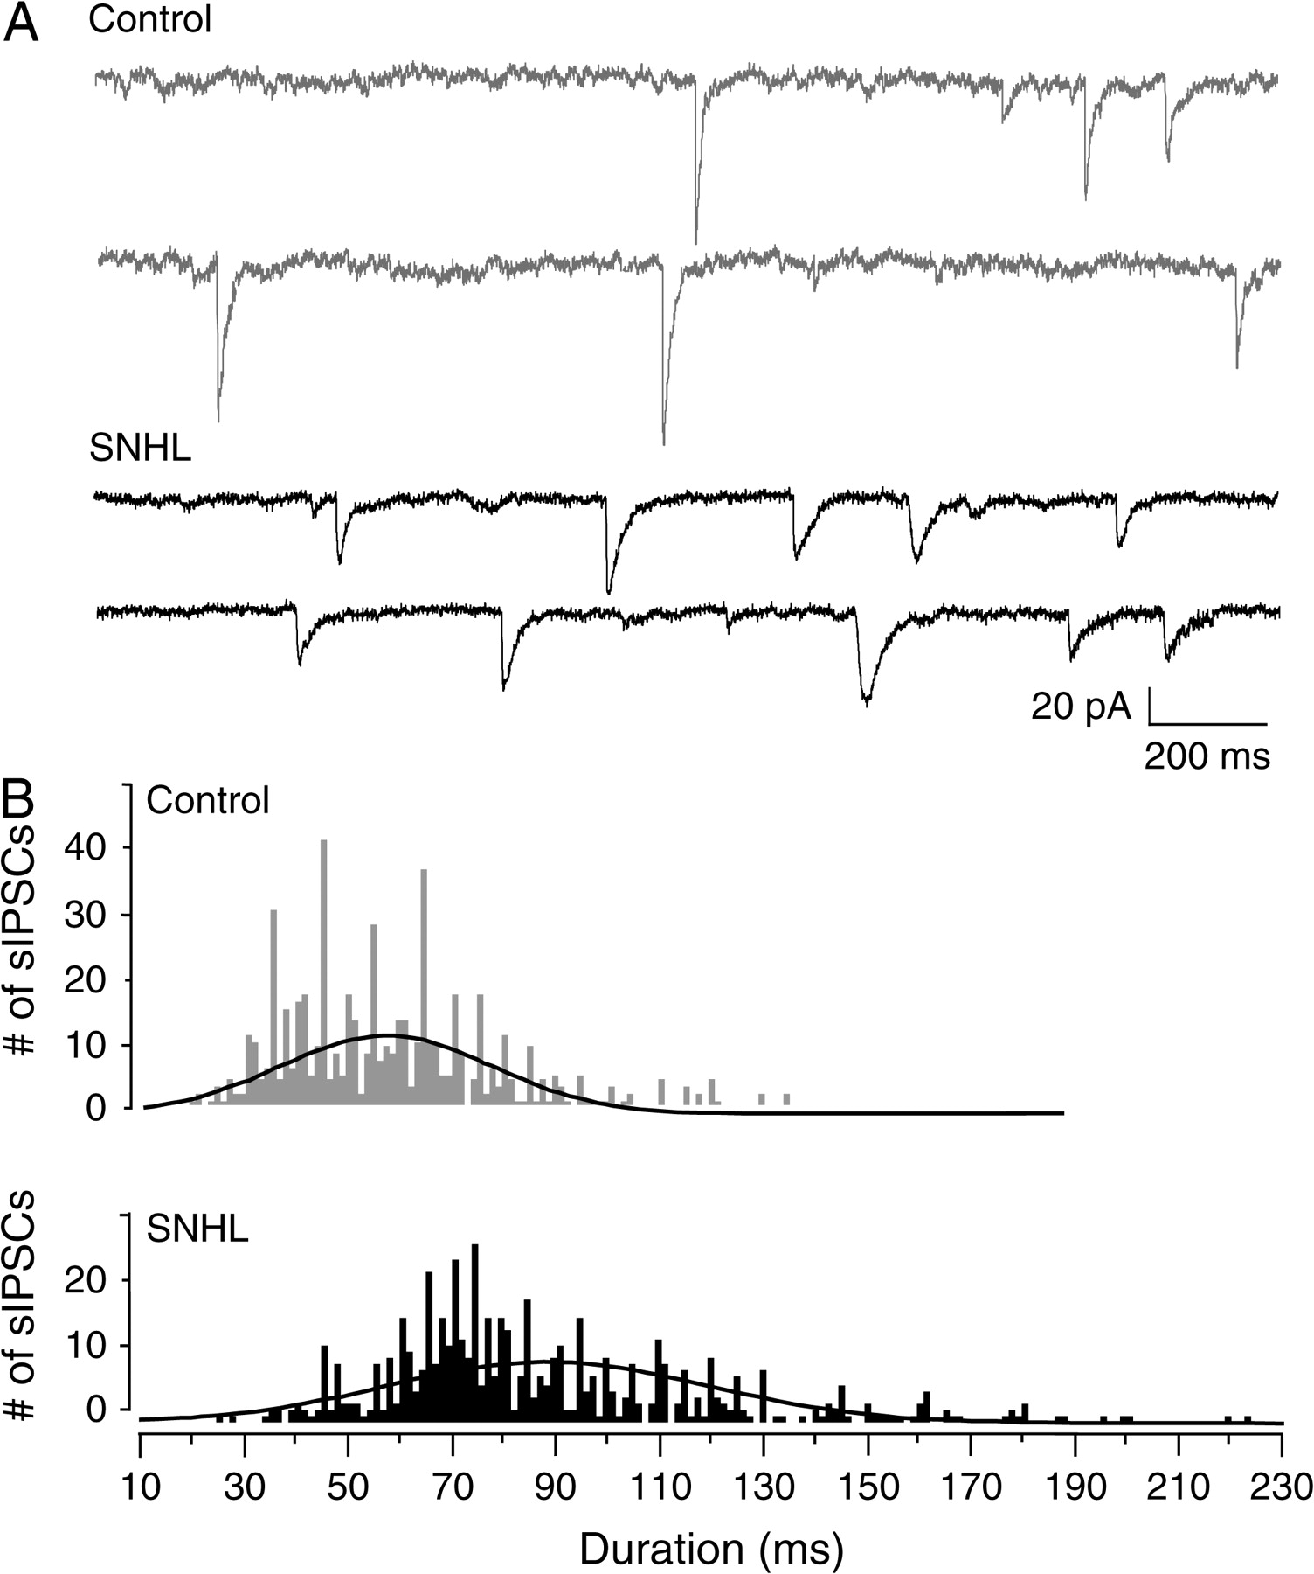
Figure 2. SNHL sIPSC durations are long. (A) Two sweeps of sIPSCs recorded for 2 s each in a P17 control (top, 2 gray ...
Notes:
Figure 2. SNHL sIPSC durations are long. (A) Two sweeps of sIPSCs recorded for 2 s each in a P17 control (top, 2 gray traces) and an age-matched SNHL neuron (bottom, black traces) at a holding potential of −60 mV. Each recording was acquired 10 s apart. Note that the durations of sIPSCs in the SNHL neuron are longer. (B) Distribution of all sIPSCs durations, 528 from 10 control neurons and 582 from 10 SNHL neurons, showing that the sIPSCs durations in SNHL neurons are significantly longer.
Unless provided in the caption above, the following copyright applies to the content of this slide: © 2008 The AuthorsThis is an Open Access article distributed under the terms of the Creative Commons Attribution Non-Commercial License (http://creativecommons.org/licenses/by-nc/2.0/uk/) which permits unrestricted non-commercial use, distribution, and reproduction in any medium, provided the original work is properly cited.

Slide 3
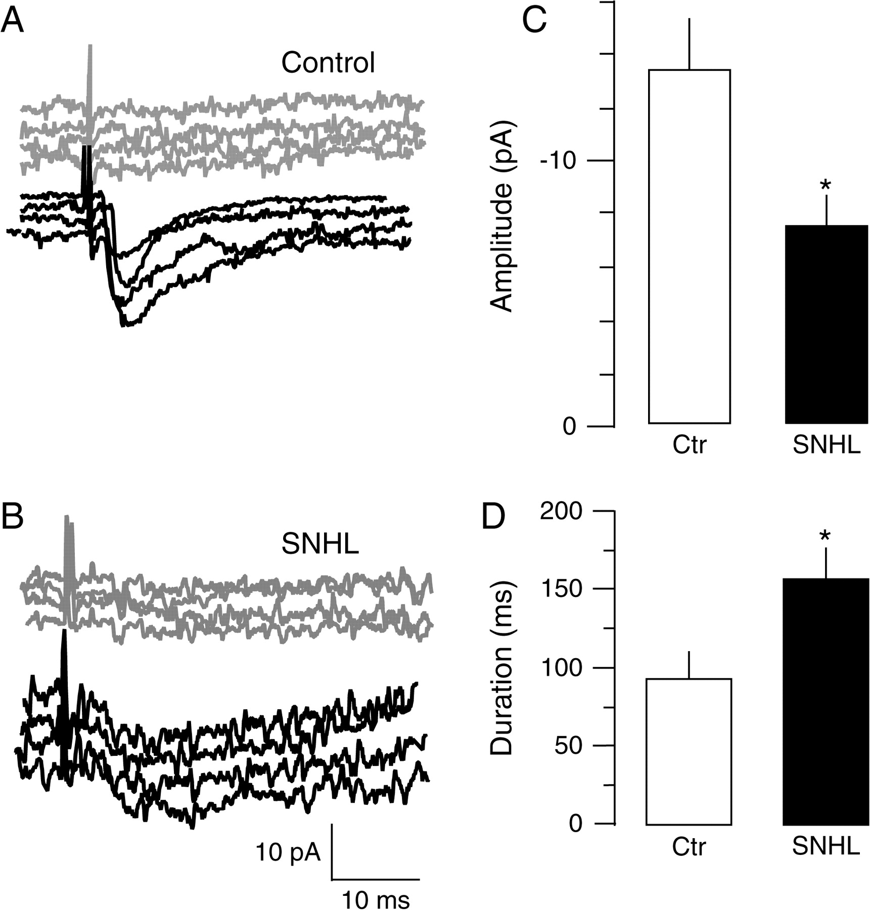
Figure 3. SNHL me-IPSC amplitudes are smaller and durations are longer. (A) Intracortical me-IPSCs were recorded in ...
Notes:
Figure 3. SNHL me-IPSC amplitudes are smaller and durations are longer. (A) Intracortical me-IPSCs were recorded in voltage clamp at VHOLD of −60mV in the presence of ionotropic glutamate receptor blockers, DNQX and AP-5. me-IPSCs were elicited by stimulating L4 approximately 100 μm away from the L2/3 recording site at incremental intensities until the failures were replaced by responses. The intensity at which minimum IPSCs were discernible from failed responses (gray traces) was then chosen for successive recordings (black traces). Such minimal stimulation intensity produced a failure rate of 50% or more. (B) With the same method, note that me-IPSCs recorded from an age-matched SNHL neuron are smaller and longer (black traces). (C, D) Bar graphs summarizing the mean amplitude and duration of me-IPSCs recorded from 10 normal and 11 SNHL neurons. The amplitude of mean me-IPSCs is smaller in SNHL neurons (top panel, right, filled bar), whereas the mean duration of near me-IPSCs is longer in SNHL neurons (bottom, right panel, filled bar).
Unless provided in the caption above, the following copyright applies to the content of this slide: © 2008 The AuthorsThis is an Open Access article distributed under the terms of the Creative Commons Attribution Non-Commercial License (http://creativecommons.org/licenses/by-nc/2.0/uk/) which permits unrestricted non-commercial use, distribution, and reproduction in any medium, provided the original work is properly cited.

Slide 4
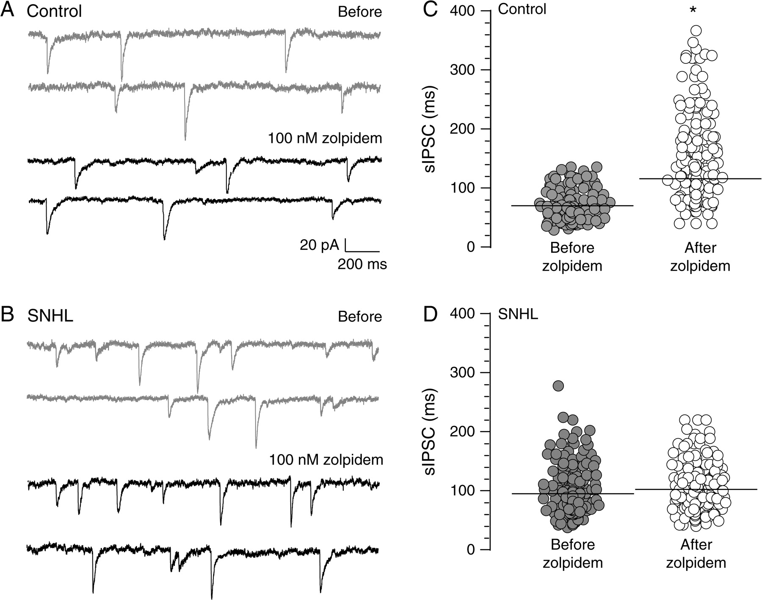
Figure 4. SNHL disrupts α1 subunit function. (A) Two sweeps of sIPSCs recorded for 2 s each in a P17 control (top, 2 ...
Notes:
Figure 4. SNHL disrupts α1 subunit function. (A) Two sweeps of sIPSCs recorded for 2 s each in a P17 control (top, 2 gray traces) at a holding potential of −60 mV. Each recording was acquired 10 s apart. Note that GABAA receptor α1 subunit–specific agonist, zolpidem, prolongs sIPSC durations (bottom, 2 black traces). (B) Note that in an age-matched SNHL neuron, zolpidem application does not produce an increase in sIPSC durations. (C, D) Distribution of all sIPSCs durations, 470 from 5 control neurons and 572 from 5 SNHL neurons, showing that the sIPSCs durations are significantly prolonged by zolpidem treatment in control neurons but not in SNHL neurons. Horizontal bars indicate mean sIPSC durations.
Unless provided in the caption above, the following copyright applies to the content of this slide: © 2008 The AuthorsThis is an Open Access article distributed under the terms of the Creative Commons Attribution Non-Commercial License (http://creativecommons.org/licenses/by-nc/2.0/uk/) which permits unrestricted non-commercial use, distribution, and reproduction in any medium, provided the original work is properly cited.

Slide 5
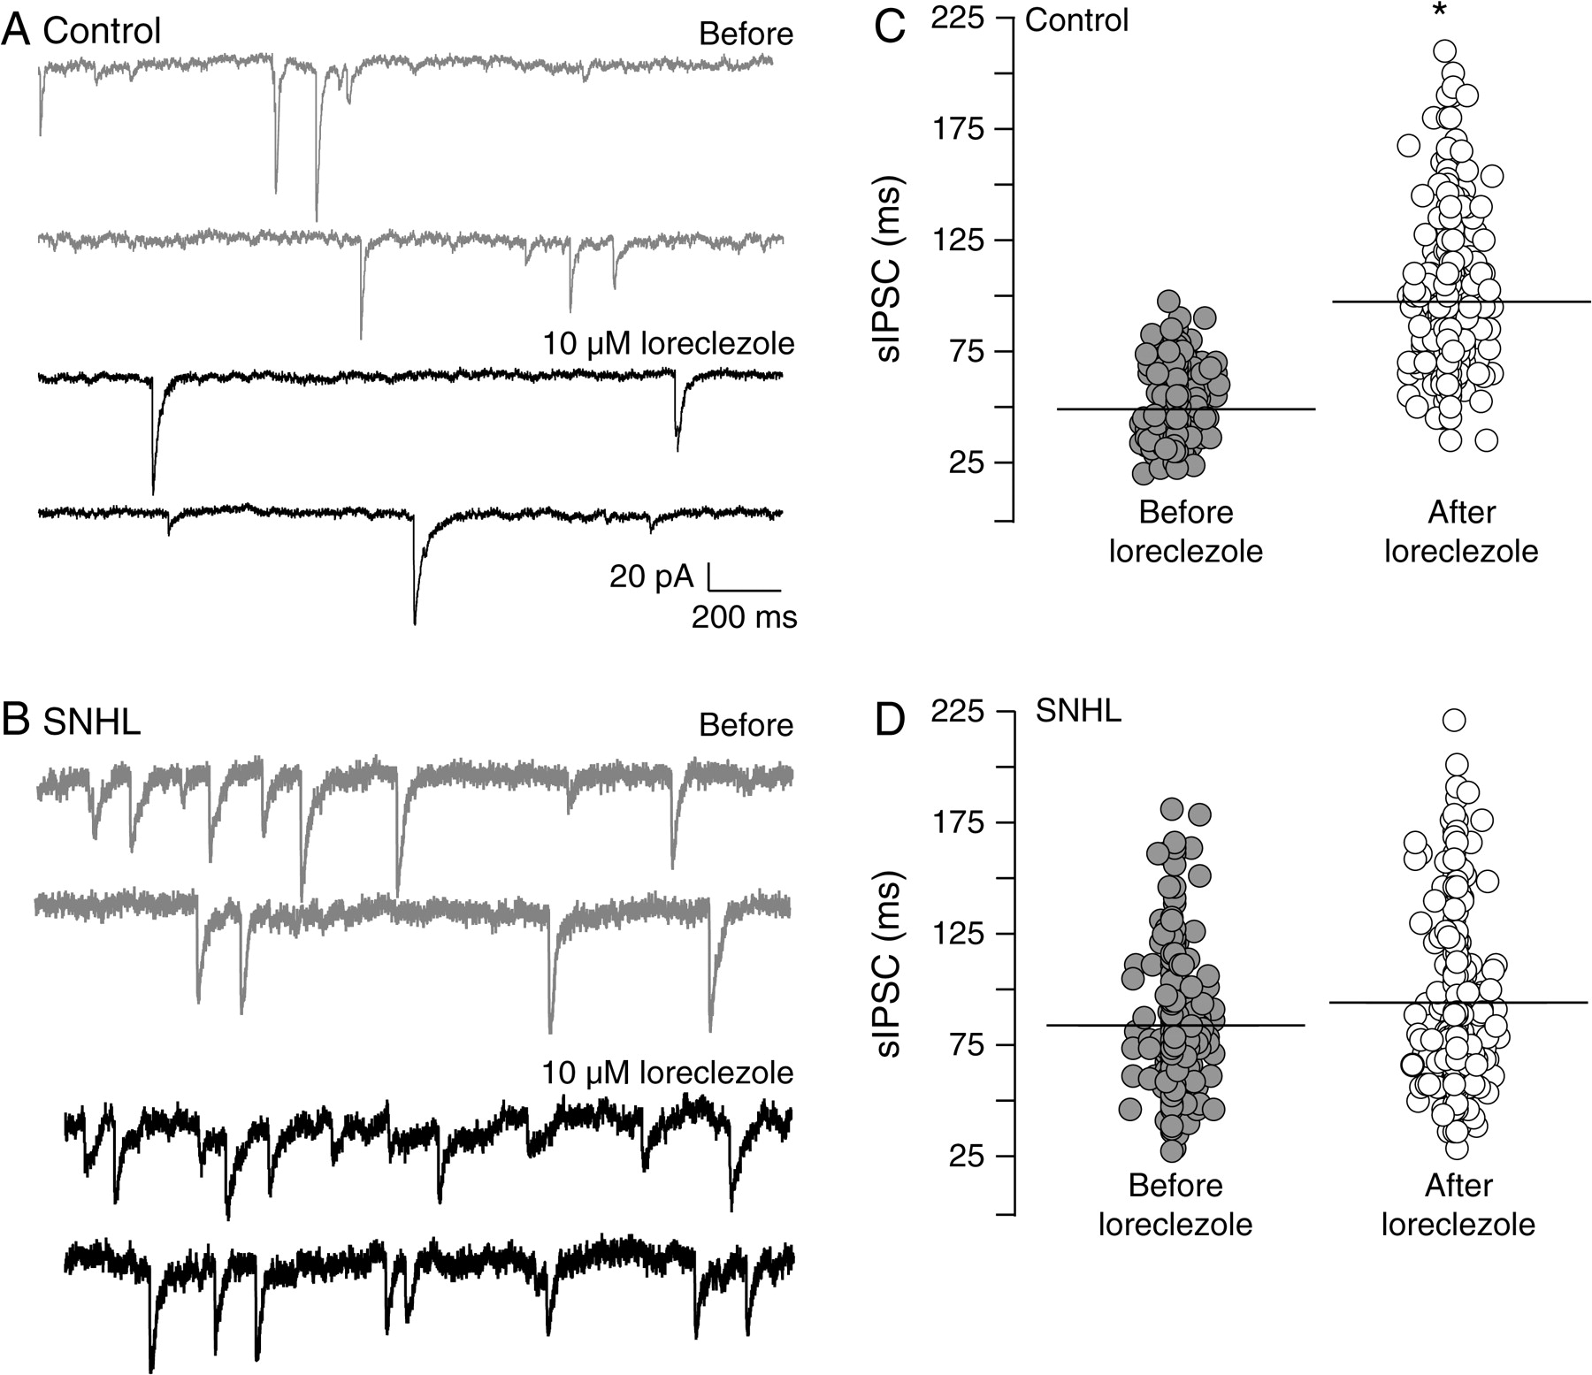
Figure 5. SNHL disrupts β2/3 subunit function. (A) Two sweeps of sIPSCs recorded for 2 s each in a P17 control (top, 2 ...
Notes:
Figure 5. SNHL disrupts β2/3 subunit function. (A) Two sweeps of sIPSCs recorded for 2 s each in a P17 control (top, 2 gray traces) at a holding potential of −60 mV. Each recording was acquired 10 s apart. Note that GABAA receptor β2/3 subunit–specific agonist, loreclezole, prolongs sIPSC durations (bottom, 2 black traces). (B) Note that in an age-matched SNHL neuron, loreclezole application does not produce an increase in sIPSC durations. (C, D) Distribution of all sIPSCs durations, 564 from 5 control neurons and 608 from 5 SNHL neurons, showing that the sIPSCs durations are significantly prolonged by loreclezole application in control neurons but not in SNHL neurons. Horizontal bars indicate mean sIPSC durations.
Unless provided in the caption above, the following copyright applies to the content of this slide: © 2008 The AuthorsThis is an Open Access article distributed under the terms of the Creative Commons Attribution Non-Commercial License (http://creativecommons.org/licenses/by-nc/2.0/uk/) which permits unrestricted non-commercial use, distribution, and reproduction in any medium, provided the original work is properly cited.

Slide 6
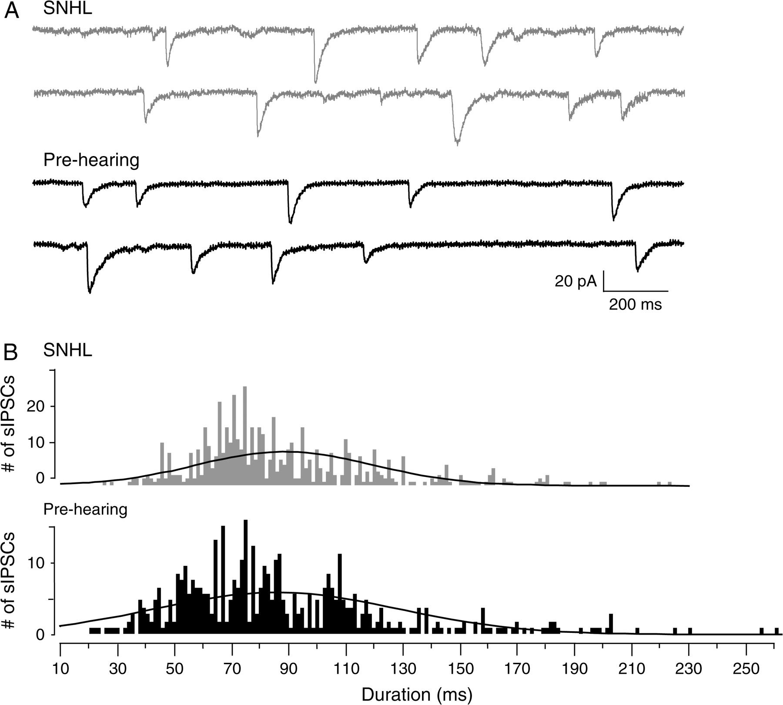
Figure 6. Prehearing IPSC durations are long. (A) Two sweeps of sIPSCs recorded for 2 s each in a P17 SNHL (top, 2 gray ...
Notes:
Figure 6. Prehearing IPSC durations are long. (A) Two sweeps of sIPSCs recorded for 2 s each in a P17 SNHL (top, 2 gray traces, taken from Figure 2) and a P10 prehearing neuron (bottom, 2 black traces) at a holding potential of −60 mV. Each recording was acquired 10 s apart. Note that the durations of sIPSCs in the prehearing neuron are long as in the SNHL neuron. (B) Distribution of all sIPSCs durations, 582 from 10 SNHL neurons and 469 from 8 prehearing neurons, showing the close resemblance between the sIPSC durations of prehearing and SNHL neurons. For comparison, see control sIPSC durations in Figure 2.
Unless provided in the caption above, the following copyright applies to the content of this slide: © 2008 The AuthorsThis is an Open Access article distributed under the terms of the Creative Commons Attribution Non-Commercial License (http://creativecommons.org/licenses/by-nc/2.0/uk/) which permits unrestricted non-commercial use, distribution, and reproduction in any medium, provided the original work is properly cited.

Slide 7
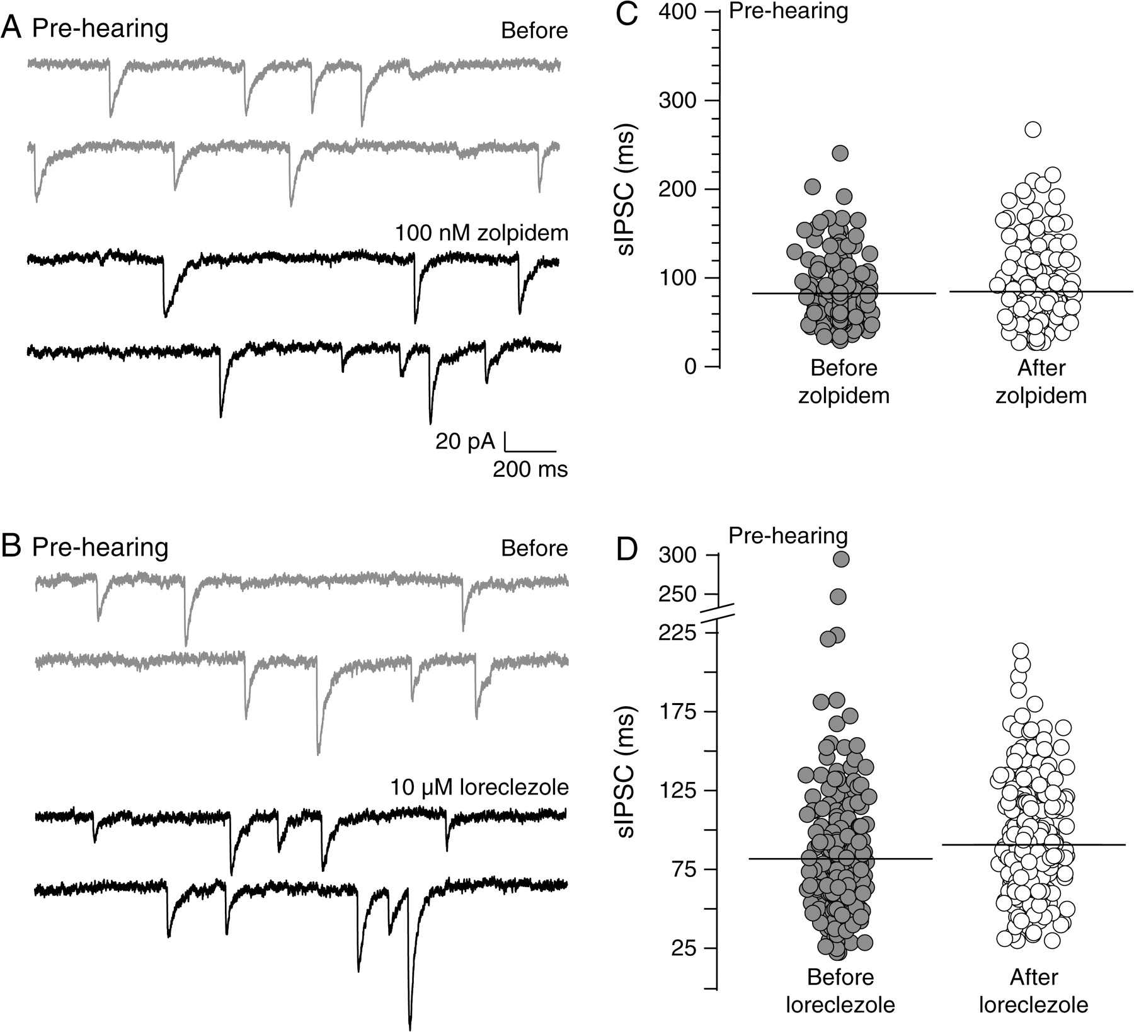
Figure 7. Prehearing IPSC durations are insensitive to α1 and β2/3 subunit agonists. (A) Two sweeps of sIPSCs recorded ...
Notes:
Figure 7. Prehearing IPSC durations are insensitive to α1 and β2/3 subunit agonists. (A) Two sweeps of sIPSCs recorded for 2 s each in a P10 prehearing neuron (top, 2 gray traces) at a holding potential of −60 mV. Each recording was acquired 10 s apart. Note that the GABAA receptor α1 subunit–specific agonist, zolpidem, does not prolong sIPSC durations (2 black traces). (B) Note that in another age-matched prehearing neuron, the application of the β2/3 agonist, loreclezole, does not prolong sIPSC durations. (C, D) Distribution of all sIPSC durations, from all prehearing neurons showing that the sIPSCs durations are not prolonged by zolpidem (581 sIPSCs from 4 neurons) or loreclezole (544 sIPSCs from 4 neurons). This result is similar to that obtained for SNHL neurons (see Figs 4 and 5).
Unless provided in the caption above, the following copyright applies to the content of this slide: © 2008 The AuthorsThis is an Open Access article distributed under the terms of the Creative Commons Attribution Non-Commercial License (http://creativecommons.org/licenses/by-nc/2.0/uk/) which permits unrestricted non-commercial use, distribution, and reproduction in any medium, provided the original work is properly cited.

Slide 8
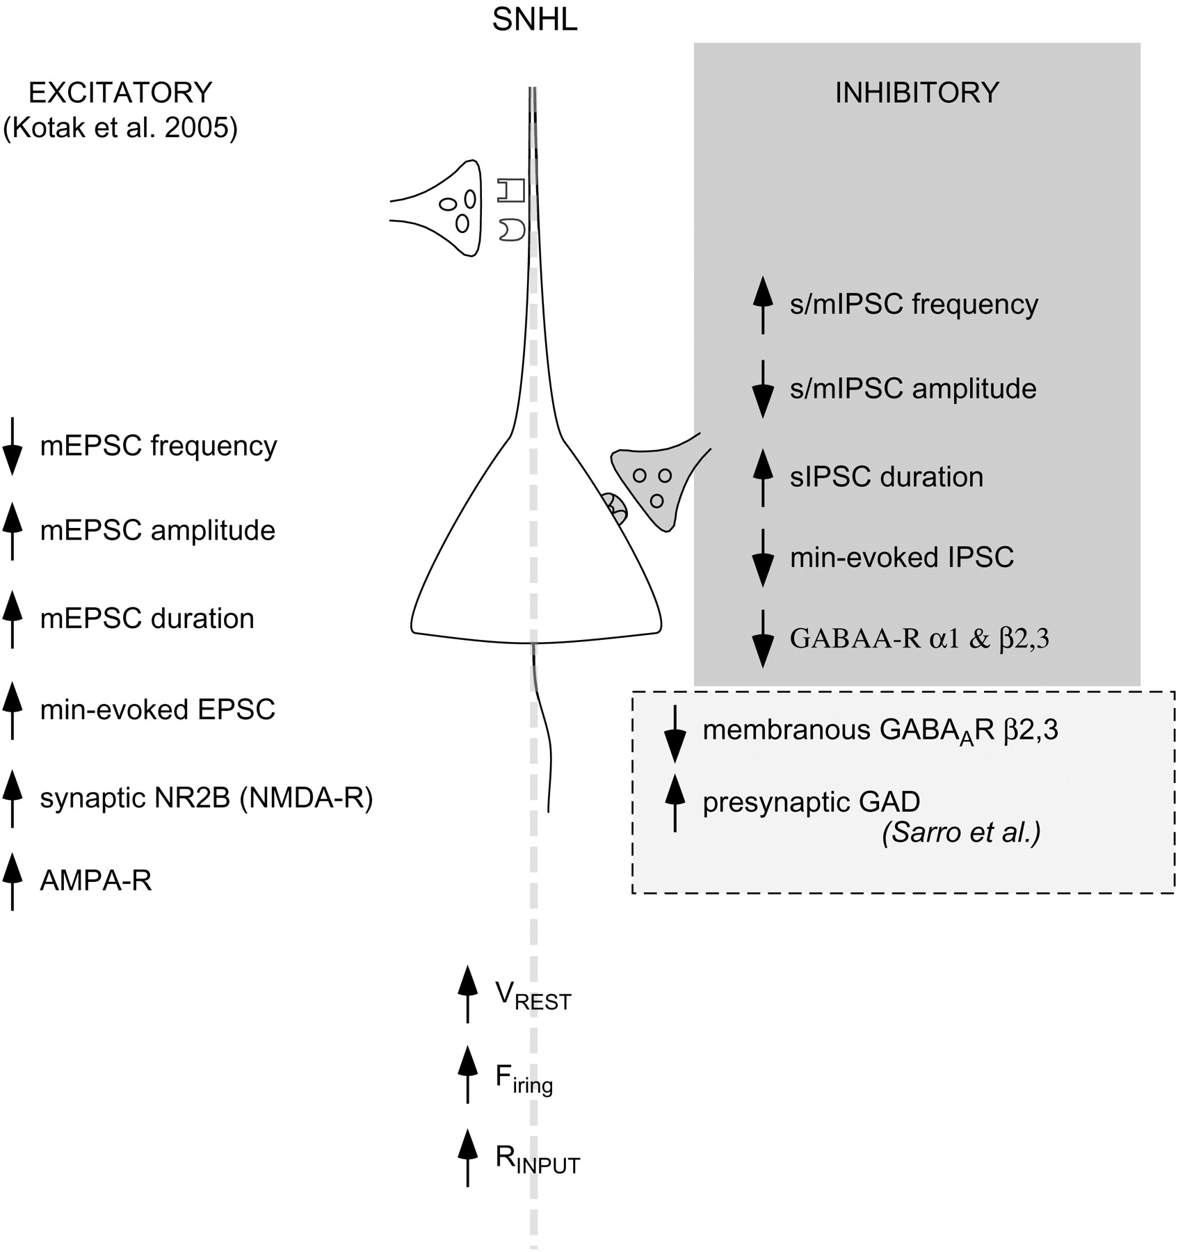
Figure 8. Summary sketch of a L2/3 SNHL pyramidal neuron. This sketch highlights the present findings that hearing loss ...
Notes:
Figure 8. Summary sketch of a L2/3 SNHL pyramidal neuron. This sketch highlights the present findings that hearing loss leads to alterations in inhibitory synaptic properties (top right panel, gray). Further, they accompany coadjustments in the passive and active intrinsic (bottom panel) and excitatory synaptic properties (bottom left panel). An upward arrow indicates increased whereas a downward arrow indicates decreased function. For example, SNHL caused a rise in resting membrane potential (VREST), firing properties, and input resistance (RINPUT; bottom panel; Kotak et al. 2005). For thalamocortical synapses, SNHL decreased the release probability (mEPSC frequency), whereas increasing mEPSC and thalamically evoked minimum-EPSC amplitudes and enhancing current carried by the NR2B subunits of the NMDA receptor (left panel). In contrast, the present study shows increased GABA release probability (higher sIPSCs and mIPSCs frequency) is accompanied by a decrease in sIPSC and me-IPSC amplitudes. Further, an inability of α1 and β2/3 subunit–specific agonists to alter sIPSCs recorded from SNHL and prehearing neurons sugests an arrest in the maturation of GABAergic transmission. The bottom right panel (dashed box) displays an observation derived from EM-immunocytochemistry (Sarro E, Kotak VC, Sanes DH, Aoki C, unpublished data) that postsynaptic β2/3 subunit distribution is disrupted. In addition, the presynaptic terminals may synthesize/release more GABA. The cumulative outcome of such robust homeostatic alterations following hearing loss may adjust the cortical network at a new set point in anticipation that peripheral activity will be restored.
Unless provided in the caption above, the following copyright applies to the content of this slide: © 2008 The AuthorsThis is an Open Access article distributed under the terms of the Creative Commons Attribution Non-Commercial License (http://creativecommons.org/licenses/by-nc/2.0/uk/) which permits unrestricted non-commercial use, distribution, and reproduction in any medium, provided the original work is properly cited.

