Slide 1
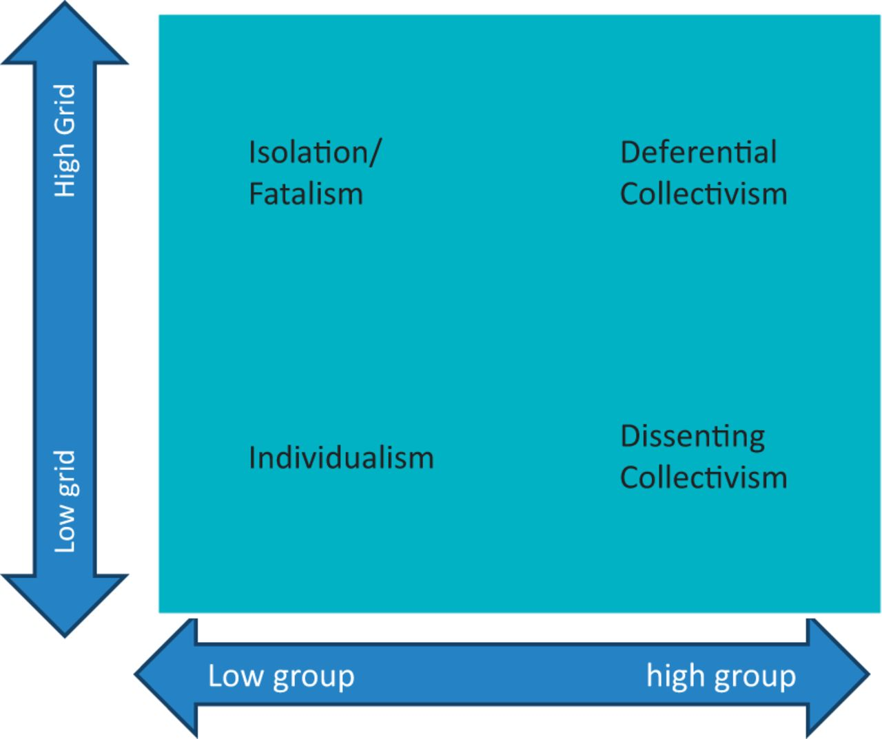
Figure 1 Variations in cultural bias
Notes:
Figure 1 Variations in cultural bias
Unless provided in the caption above, the following copyright applies to the content of this slide: © The Author 2013. Published by Oxford University Press. All rights reserved. For permissions, please e-mail: journals.permissions@oup.com

