Slide 1
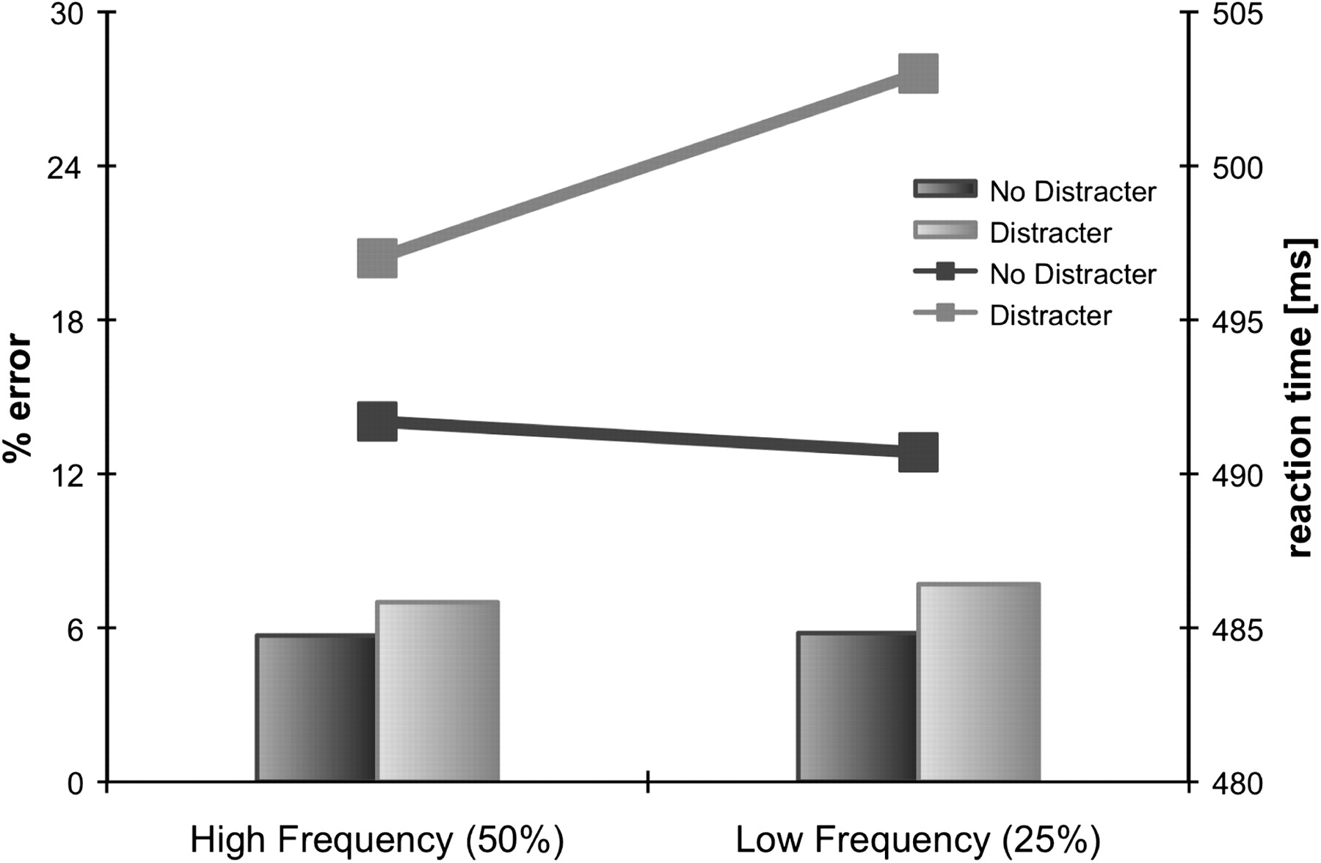
Figure 1. Reaction times (lines) and error rates (bars) as a function of Distracter Presence and Distracter Frequency.
Notes:
Figure 1. Reaction times (lines) and error rates (bars) as a function of Distracter Presence and Distracter Frequency.
Unless provided in the caption above, the following copyright applies to the content of this slide: © The Author 2011. Published by Oxford University Press. All rights reserved. For permissions, please e-mail: journals.permissions@oup.com

Slide 2
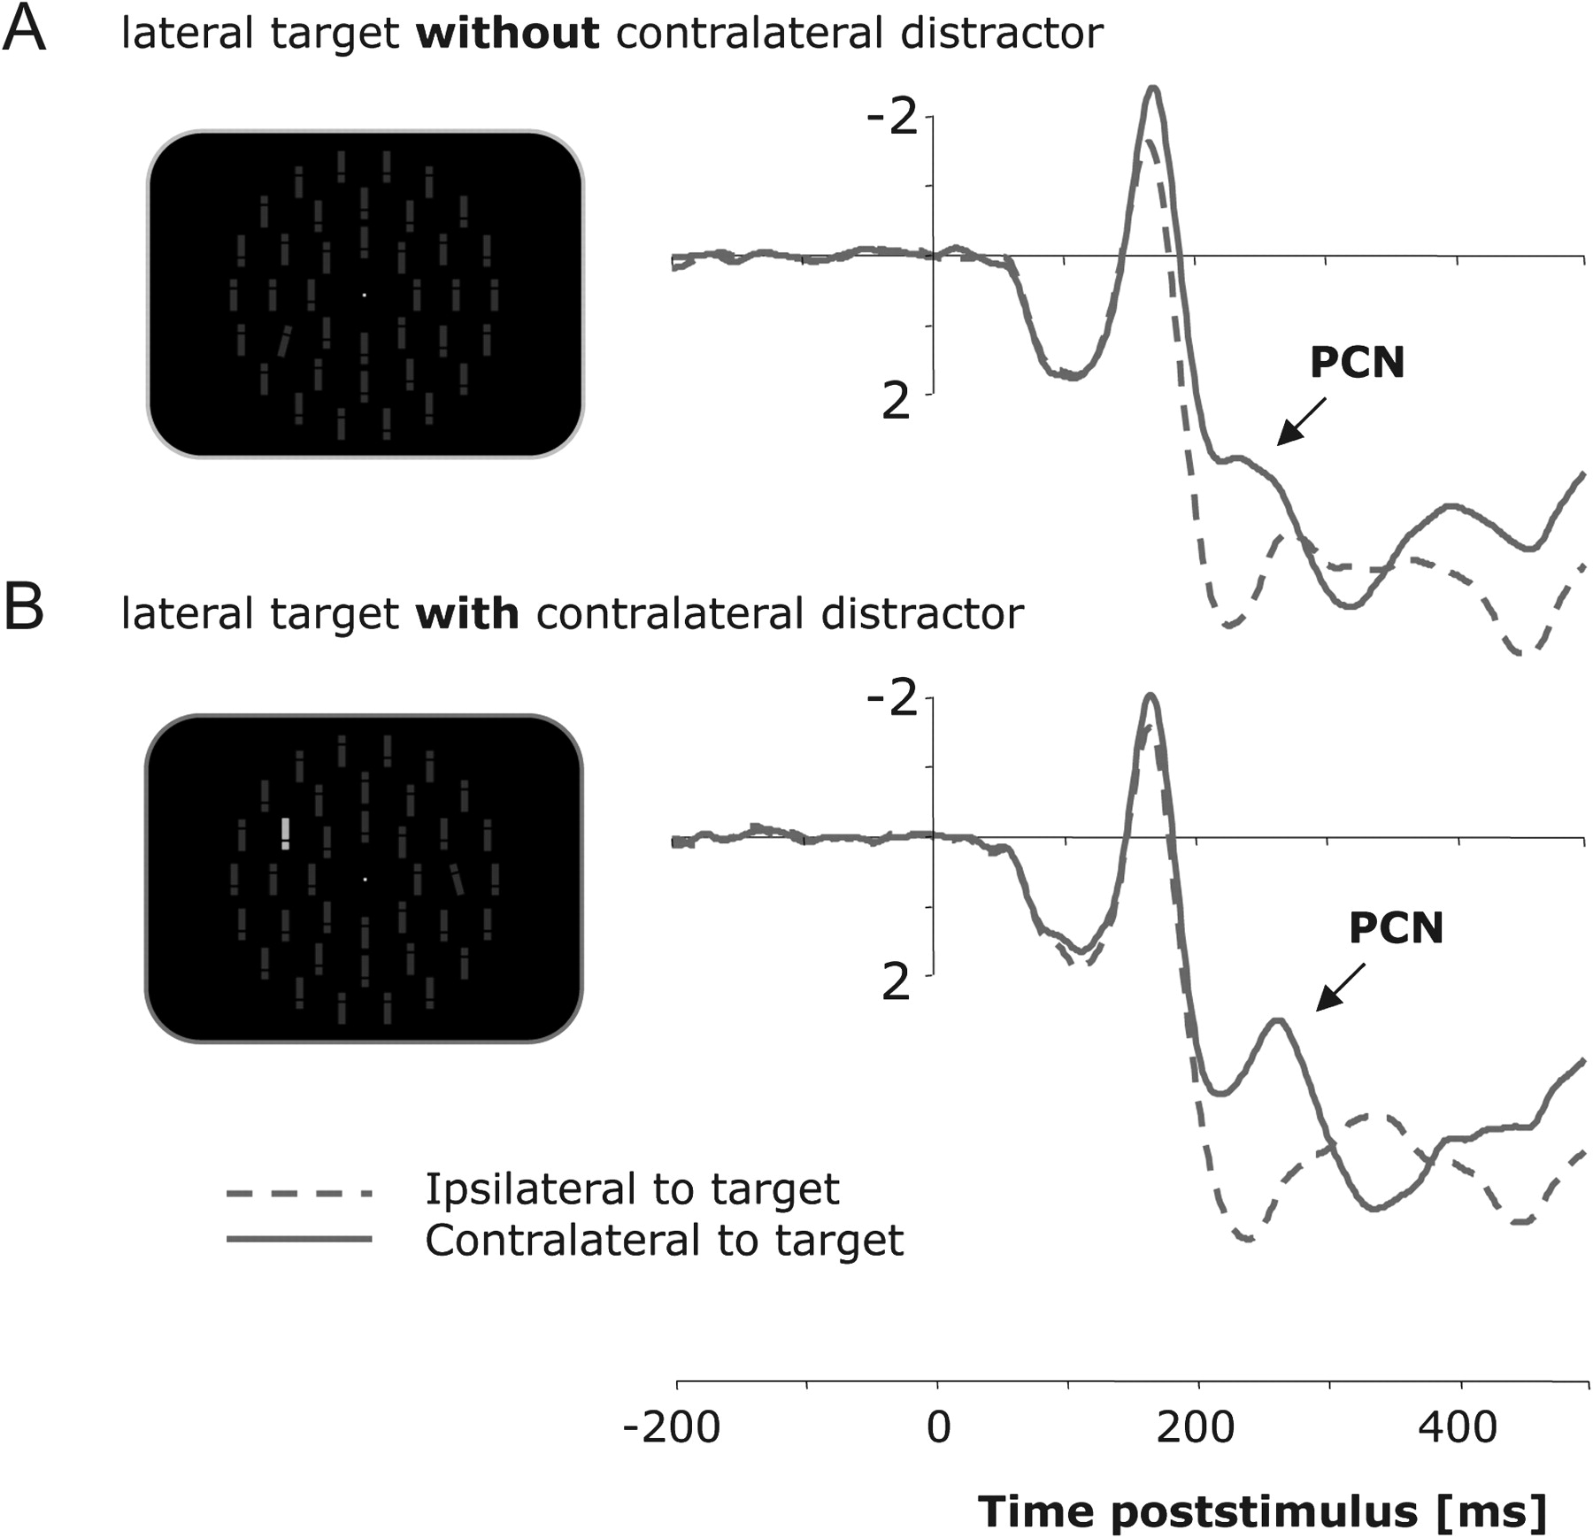
Figure 2. Grand-averaged event-related brain potentials elicited contra- and ipsilateral to the target location at ...
Notes:
Figure 2. Grand-averaged event-related brain potentials elicited contra- and ipsilateral to the target location at electrodes PO7/PO8 in the 500-ms interval following stimulus onset, relative to a 200-ms prestimulus baseline. (A) Grand-averaged ERPs elicited by search arrays that contained a lateral target and no distracter singleton. (B) Grand-averaged ERPs elicited by search arrays that contained a lateral target and a contralateral distracter singleton.
Unless provided in the caption above, the following copyright applies to the content of this slide: © The Author 2011. Published by Oxford University Press. All rights reserved. For permissions, please e-mail: journals.permissions@oup.com

Slide 3
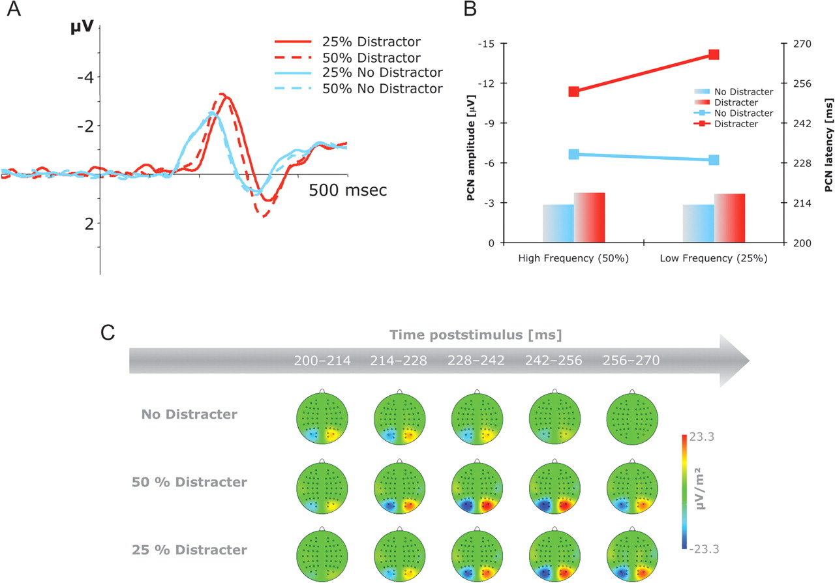
Figure 3. Grand-averaged PCN difference waveforms as a function of Distracter Presence and Distracter Frequency. (A) ...
Notes:
Figure 3. Grand-averaged PCN difference waveforms as a function of Distracter Presence and Distracter Frequency. (A) PCN difference waves obtained by subtracting ipsilateral from contralateral activity at electrodes PO7/PO8 in the 500-m interval following stimulus onset, relative to a 200-ms prestimulus baseline. (B) PCN latencies (lines) and PCN amplitudes (bars). (C) Topographical maps of PCN scalp distributions in the 200 to 270-ms interval following stimulus onset. These maps were computed by mirroring the contra-ipsilateral difference waves to obtain symmetrical voltage values for both hemispheres (using spherical spline interpolation).
Unless provided in the caption above, the following copyright applies to the content of this slide: © The Author 2011. Published by Oxford University Press. All rights reserved. For permissions, please e-mail: journals.permissions@oup.com

Slide 4
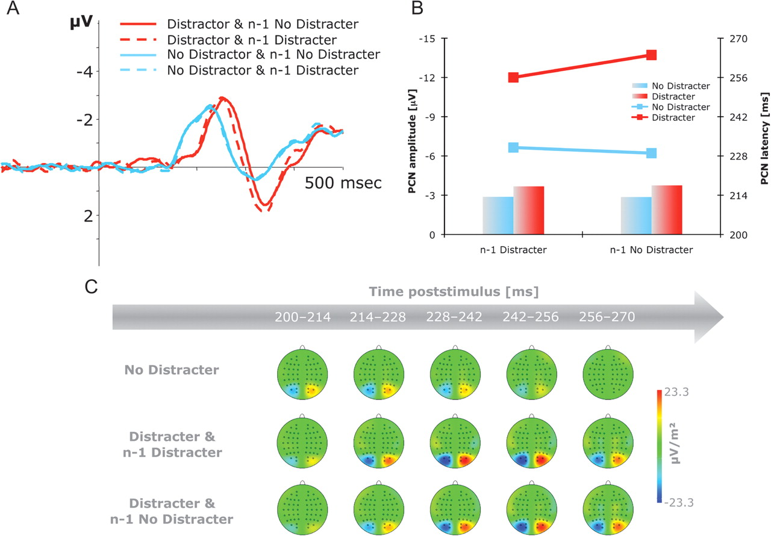
Figure 4. Grand-averaged PCN difference waveforms as a function of Distracter Presence and n-1 Distracter Presence. (A) ...
Notes:
Figure 4. Grand-averaged PCN difference waveforms as a function of Distracter Presence and n-1 Distracter Presence. (A) PCN difference waves obtained by subtracting ipsilateral from contralateral activity at electrodes PO7/PO8 in the 500-ms interval following stimulus onset, relative to a 200-ms prestimulus baseline. (B) PCN latencies (lines) and PCN amplitudes (bars). (C) Topographical maps of PCN scalp distributions in the 200 to 270-ms interval following stimulus onset. These maps were computed by mirroring the contra-ipsilateral difference waves to obtain symmetrical voltage values for both hemispheres (using spherical spline interpolation).
Unless provided in the caption above, the following copyright applies to the content of this slide: © The Author 2011. Published by Oxford University Press. All rights reserved. For permissions, please e-mail: journals.permissions@oup.com

Slide 5
Figure 5. Grand-averaged event-related brain potentials elicited at electrodes PO7/PO8 in the 400-ms interval following ...
Notes:
Figure 5. Grand-averaged event-related brain potentials elicited at electrodes PO7/PO8 in the 400-ms interval following stimulus onset, relative to a 200-ms prestimulus baseline, for fast (black lines) and slow (gray lines) distracter-present trials, respectively. Left panel: Contra- and ipsilateral waveforms elicited by the fast RT group. Central panel: Contra- and ipsilateral waveforms elicited by the slow RT group. Right panel: PCN difference waveforms obtained by subtracting ipsilateral from contralateral activity for both fast and slow distracter trials.
Unless provided in the caption above, the following copyright applies to the content of this slide: © The Author 2011. Published by Oxford University Press. All rights reserved. For permissions, please e-mail: journals.permissions@oup.com

