Slide 1
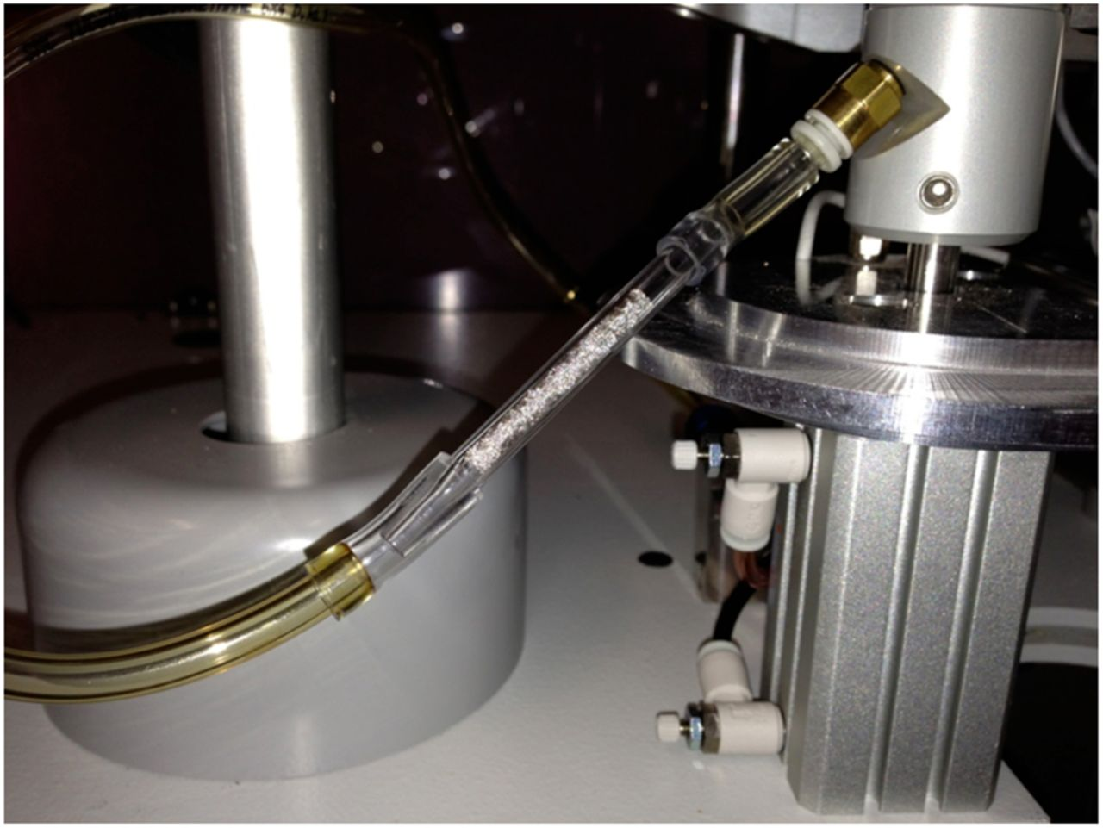
Figure 1. A Pt trap used for quantitative determination of Cd breakthrough is shown placed in tandem with a glass fiber ...
Notes:
Figure 1. A Pt trap used for quantitative determination of Cd breakthrough is shown placed in tandem with a glass fiber filter pad attachment on a rotary smoking machine.
Unless provided in the caption above, the following copyright applies to the content of this slide: Published by Oxford University Press 2014. This work is written by (a) US Government employee(s) and is in the public domain in the US.

Slide 2
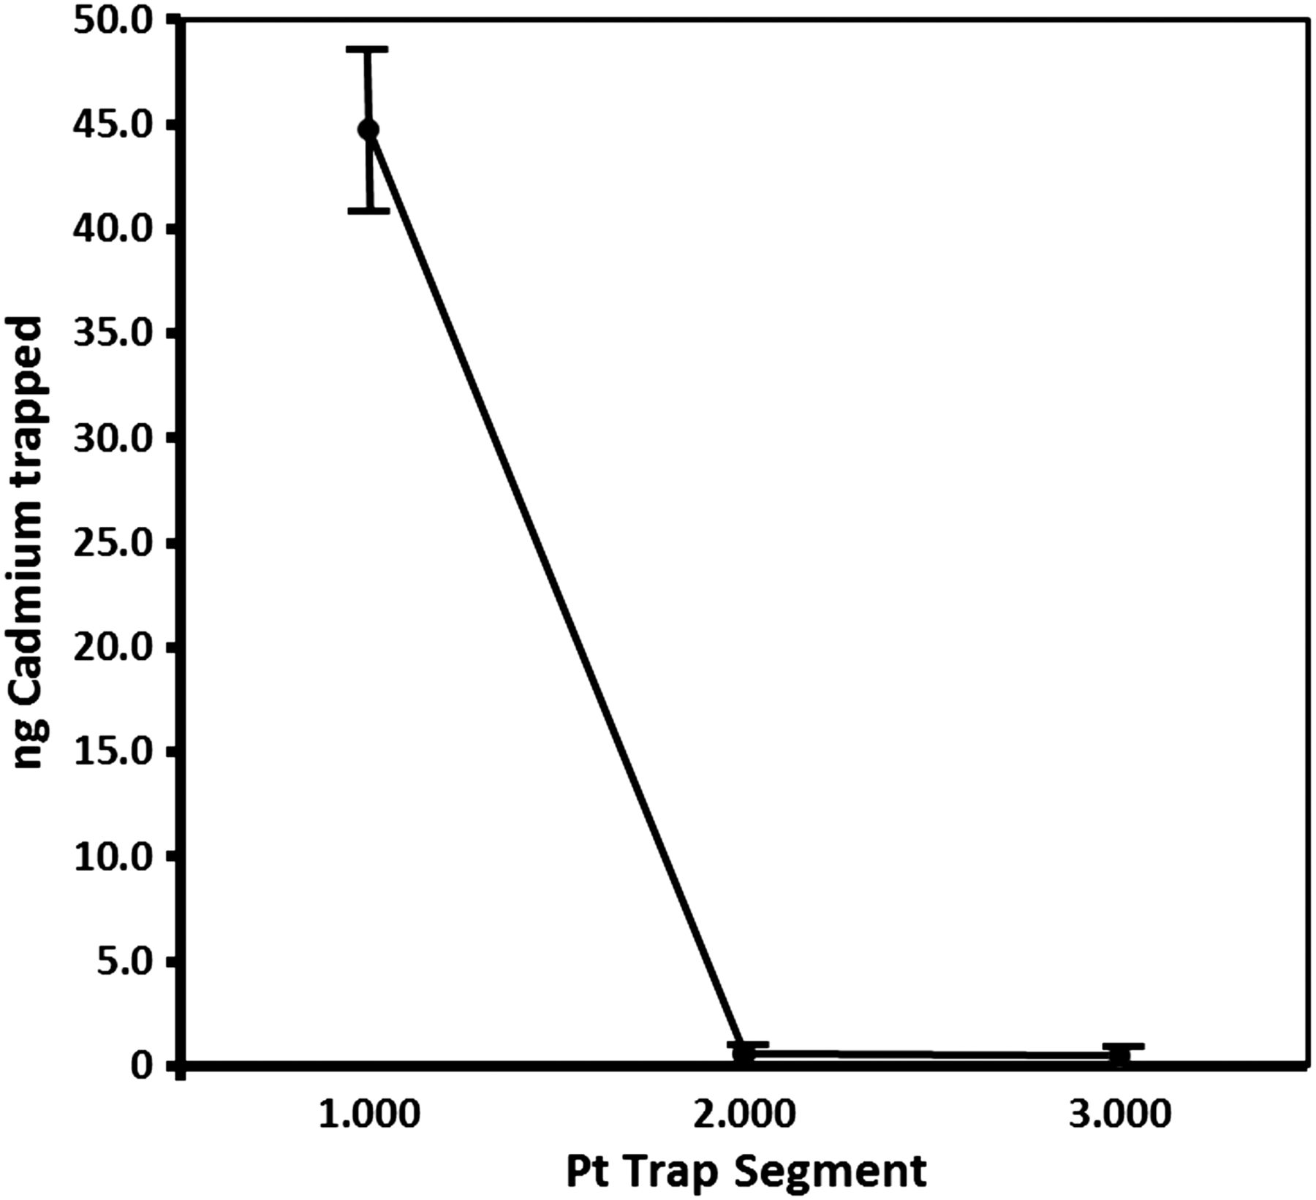
Figure 2. Analyses of Cd trapped on individual Pt trap segments shows that trapping was quantitative with three Pt ...
Notes:
Figure 2. Analyses of Cd trapped on individual Pt trap segments shows that trapping was quantitative with three Pt gauze segments per trap. Data are from mean of 10 individual segment analyses of cadmium from a commercial cigarette that freely passed through a 44 mm glass fiber filter used with a linear smoking machine.
Unless provided in the caption above, the following copyright applies to the content of this slide: Published by Oxford University Press 2014. This work is written by (a) US Government employee(s) and is in the public domain in the US.

Slide 3
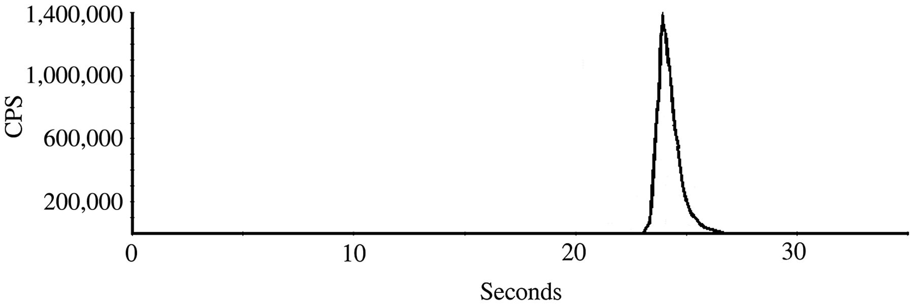
Figure 3. ETV-ICP-MS confers very high signal intensity on a few nanograms of ¹¹¹Cd even without a reactive ...
Notes:
Figure 3. ETV-ICP-MS confers very high signal intensity on a few nanograms of 111Cd even without a reactive gas that would have further enhanced sensitivity.
Unless provided in the caption above, the following copyright applies to the content of this slide: Published by Oxford University Press 2014. This work is written by (a) US Government employee(s) and is in the public domain in the US.

Slide 4
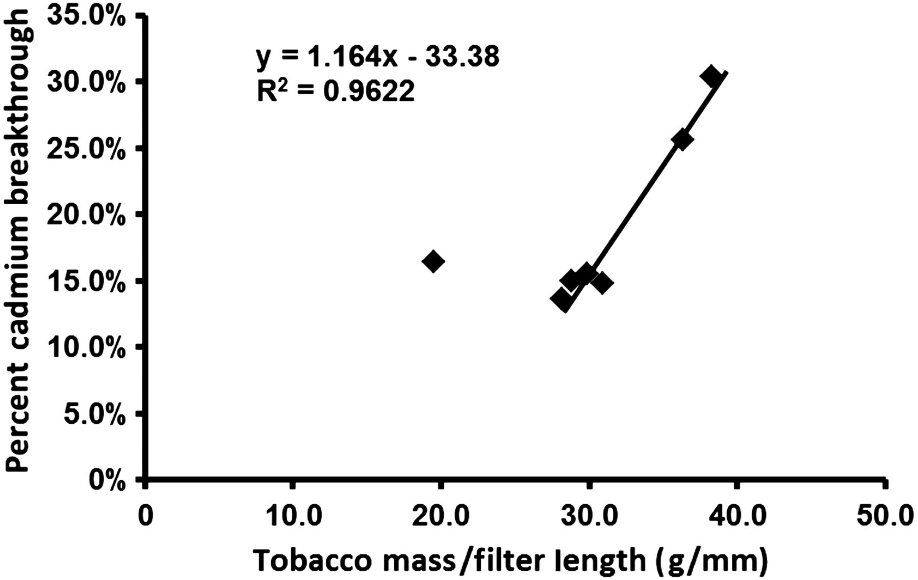
Figure 4. Plot of percent cadmium breakthrough from 44 mm filters versus cigarette tobacco filler mass normalized to ...
Notes:
Figure 4. Plot of percent cadmium breakthrough from 44 mm filters versus cigarette tobacco filler mass normalized to filter length.
Unless provided in the caption above, the following copyright applies to the content of this slide: Published by Oxford University Press 2014. This work is written by (a) US Government employee(s) and is in the public domain in the US.

