Slide 1
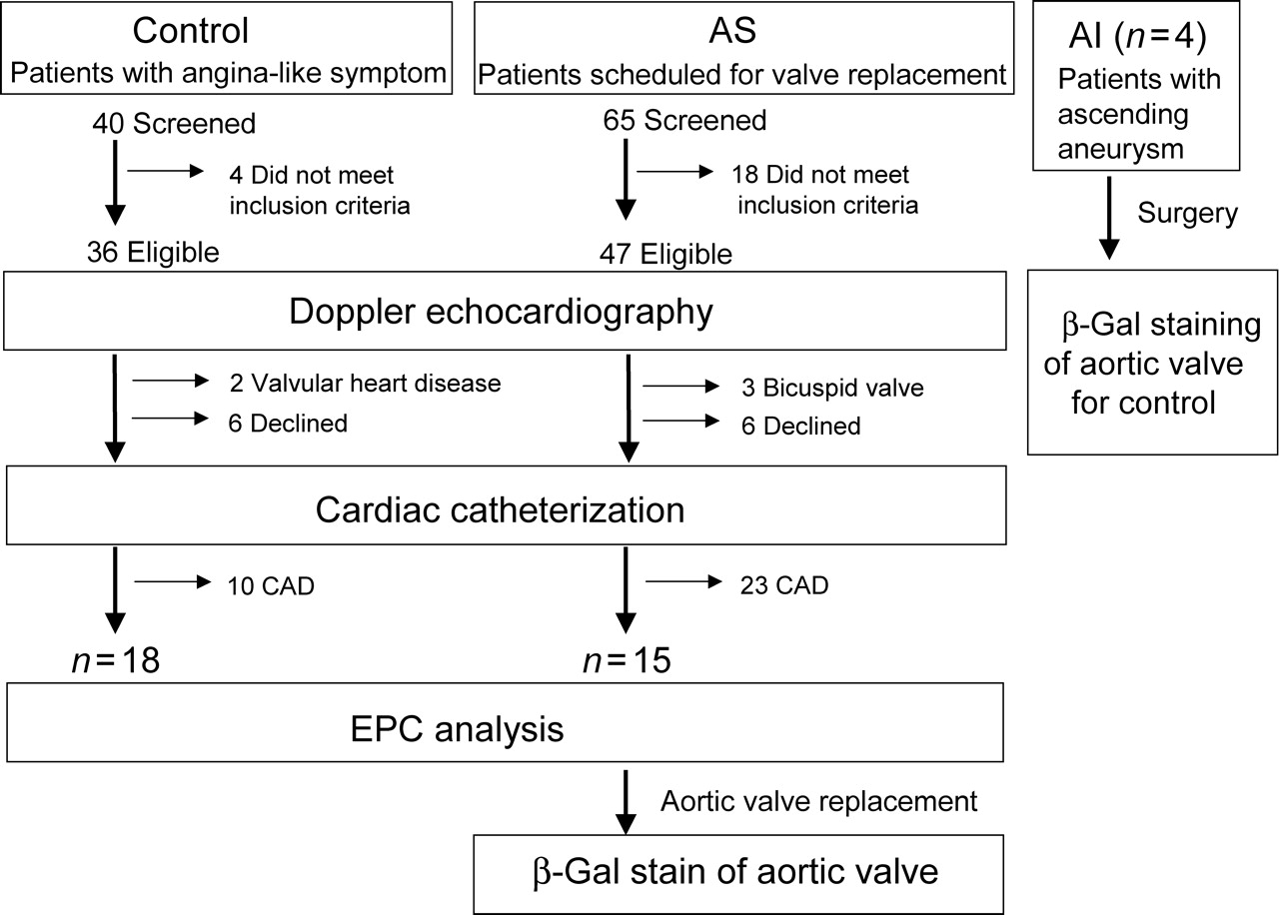
Figure 1 Flow chart of the study. AS, AI, and CAD indicate aortic valve stenosis, aortic valve insufficiency, and ...
Notes:
Figure 1 Flow chart of the study. AS, AI, and CAD indicate aortic valve stenosis, aortic valve insufficiency, and coronary artery disease, respectively.
Unless provided in the caption above, the following copyright applies to the content of this slide: Published on behalf of the European Society of Cardiology. All rights reserved. © The Author 2008. For permissions please email: journals.permissions@oxfordjournals.org

Slide 2
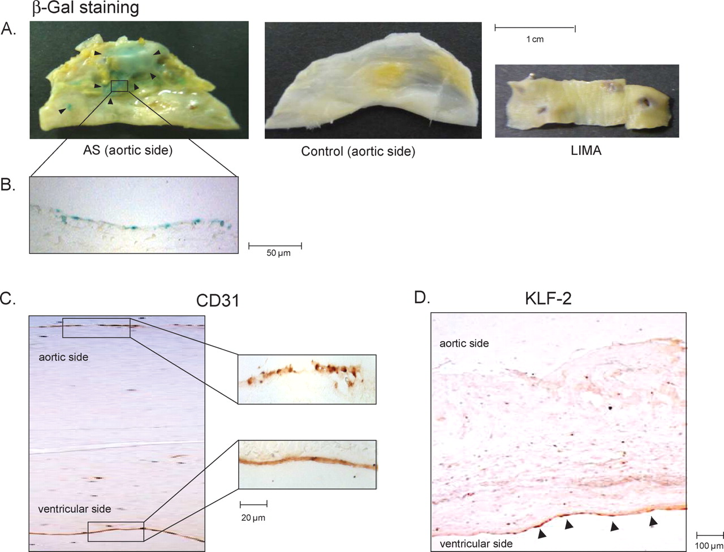
Figure 2 Histological and immunohistological detection of β-galactosidase (β-gal)-positive cells and the expression ...
Notes:
Figure 2 Histological and immunohistological detection of β-galactosidase (β-gal)-positive cells and the expression of CD31 and Krüppel-like factor-2. Explanted aortic valve (AV) leaflets, control aortic valve, and left internal mammary artery (LIMA) were examined for senescence-associated β-galactosidase staining. Macroscopic analysis ( A ) shows remarkable β-galactosidase activity (blue colour) on the aortic side of the valve leaflet, whereas no β-galactosidase activity is observed in the control aortic valve and left internal mammary artery. Microscopic analysis ( B ) demonstrates that β-galactosidase-positive cells are localized on the surface of the leaflet at the aortic side. Immunohistochemistry for CD31 ( C ) and Krüppel-like factor-2 ( D ) in thin sections from the explanted aortic valve.
Unless provided in the caption above, the following copyright applies to the content of this slide: Published on behalf of the European Society of Cardiology. All rights reserved. © The Author 2008. For permissions please email: journals.permissions@oxfordjournals.org

Slide 3
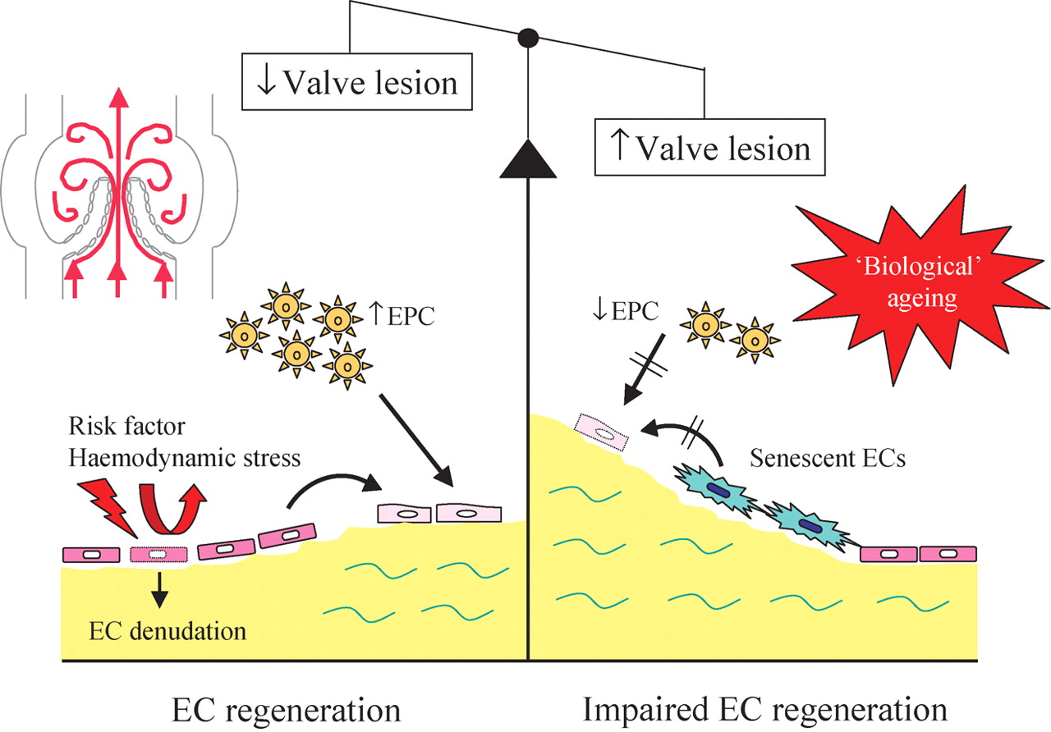
Figure 6 Working model to explain the impaired regeneration of the endothelial cell (EC) layer in patients with aortic ...
Notes:
Figure 6 Working model to explain the impaired regeneration of the endothelial cell (EC) layer in patients with aortic valve stenosis based on our findings. Constant haemodynamic stress or risk factors can induce valvular endothelial cell denudation. Under normal physiological conditions, the endothelial cell layer is kept intact after injury either by the division of mature endothelial cells or by restoration with circulating endothelial progenitor cells (EPCs). Under pathological conditions related to ‘biological’ ageing, endothelial cell denudation is no longer replaced owing to an insufficient number and the function of circulating endothelial progenitor cells as well as the presence of senescent valvular endothelial cells. All together, these processes may lead to impaired regeneration of valvular endothelial cells and advanced valve lesion.
Unless provided in the caption above, the following copyright applies to the content of this slide: Published on behalf of the European Society of Cardiology. All rights reserved. © The Author 2008. For permissions please email: journals.permissions@oxfordjournals.org

Slide 4
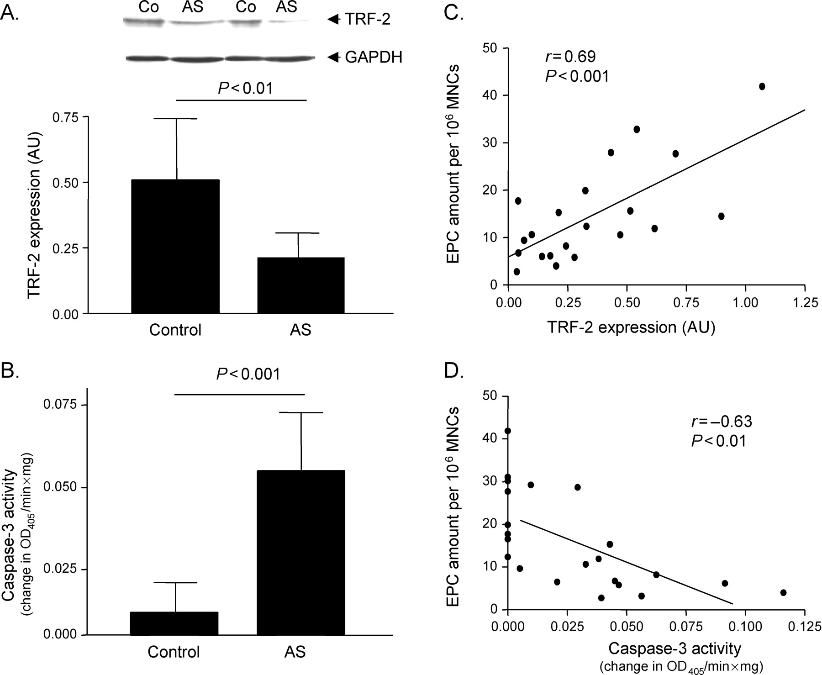
Figure 5 Quantitative analysis of telomere-repeating factor-2 (TRF-2) expression ( A ) and caspase-3 activity ( B ) ...
Notes:
Figure 5 Quantitative analysis of telomere-repeating factor-2 (TRF-2) expression ( A ) and caspase-3 activity ( B ) in endothelial progenitor cells (EPCs) isolated from controls and patients with aortic valve stenosis (AS). The values for telomere-repeating factor-2 expression are depicted as ratio over the expression of GAPDH. A representative western blot is shown on top of the quantitative evaluation. In addition, a correlation analysis between the amount of circulating endothelial progenitor cells and the expression of telomere-repeating factor-2 ( C ) and caspase-3 activity ( D ) are shown. Results are expressed as mean ± SD.
Unless provided in the caption above, the following copyright applies to the content of this slide: Published on behalf of the European Society of Cardiology. All rights reserved. © The Author 2008. For permissions please email: journals.permissions@oxfordjournals.org

Slide 5
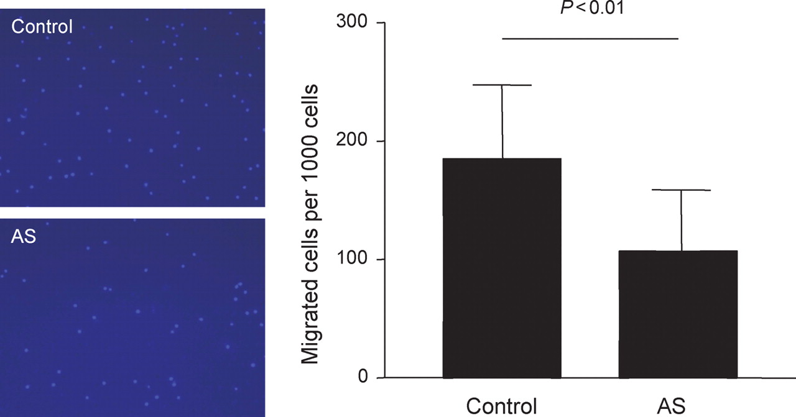
Figure 4 Evaluation of the migratory capacity of endothelial progenitor cells from controls and patients with aortic ...
Notes:
Figure 4 Evaluation of the migratory capacity of endothelial progenitor cells from controls and patients with aortic valve stenosis (AS). Cultured endothelial progenitor cells were assayed in a modified Boyden chamber for the capacity to migrate along an SDF-1 gradient. Representative examples of a Hoechst 33342-stained membrane of a Boyden chamber are depicted. For quantitative analysis, the amount of migrated cells is calculated for 1000 cells added into the Boyden chamber. Results are expressed as mean ± SD.
Unless provided in the caption above, the following copyright applies to the content of this slide: Published on behalf of the European Society of Cardiology. All rights reserved. © The Author 2008. For permissions please email: journals.permissions@oxfordjournals.org

Slide 6
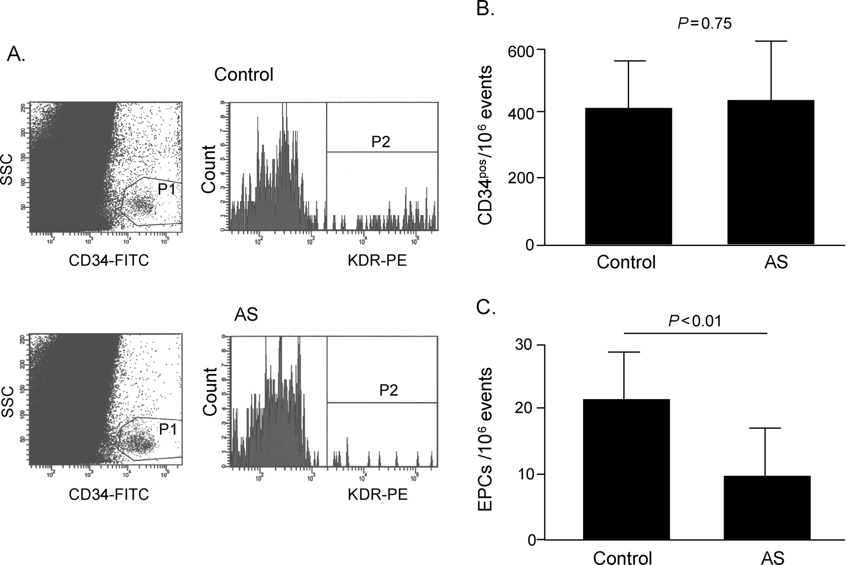
Figure 3 FACS analysis of CD34 ^{pos} cells and endothelial progenitor cells in patients with aortic valve ...
Notes:
Figure 3 FACS analysis of CD34 pos cells and endothelial progenitor cells in patients with aortic valve stenosis (AS) and controls. A representative example of a FACS analysis for the quantification of CD34 pos cells and endothelial progenitor cells is shown ( A ). P1, cells positive for CD34; P2, cells positive for CD34 and KDR. For quantitative analysis ( B ), the amount of CD34 pos cells or endothelial progenitor cells is calculated per 10 6 events measured. Results are expressed as mean ± SD.
Unless provided in the caption above, the following copyright applies to the content of this slide: Published on behalf of the European Society of Cardiology. All rights reserved. © The Author 2008. For permissions please email: journals.permissions@oxfordjournals.org

