Slide 1
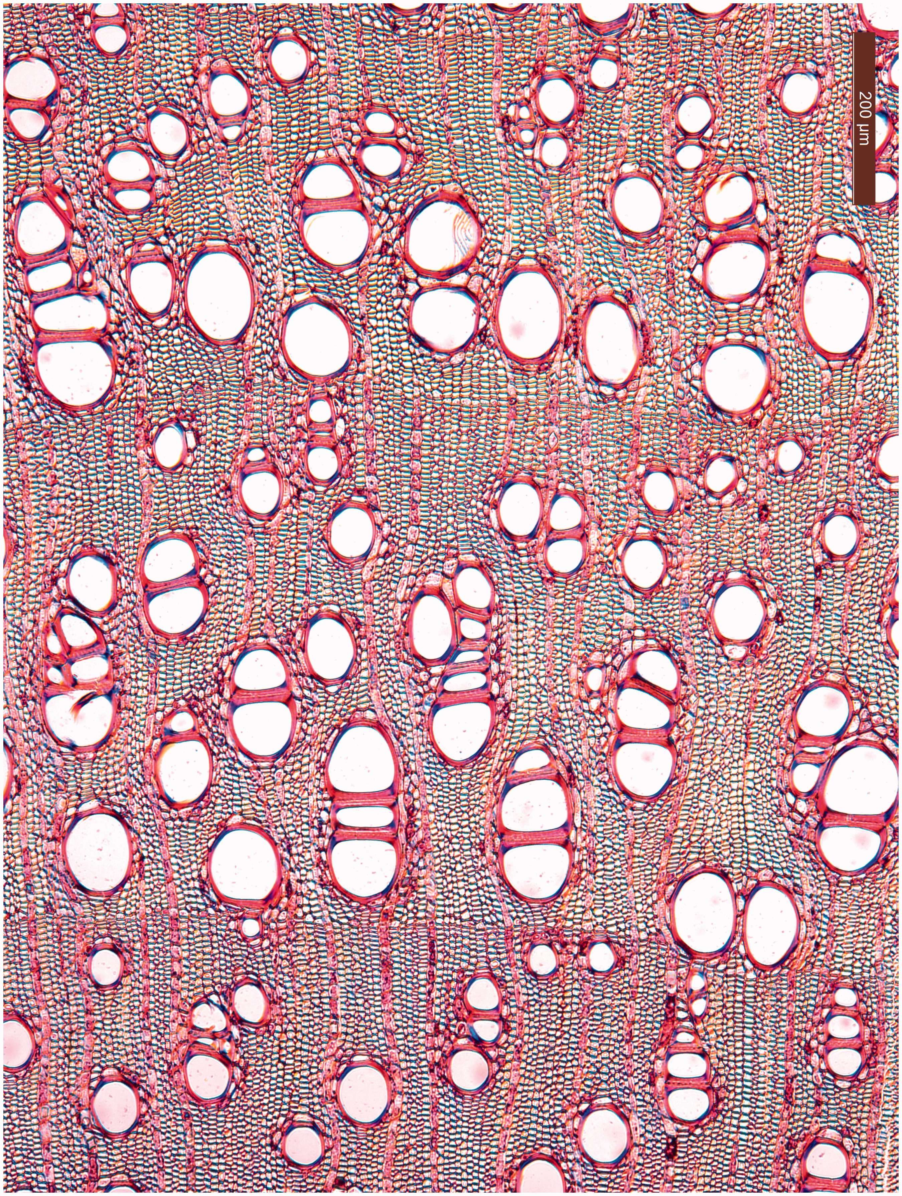
Fig. 1. Transverse thin section of Ziziphus spina-christi (Christ’s thorn) wood stained with Safranin and viewed in ...
Notes:
Fig. 1. Transverse thin section of Ziziphus spina-christi (Christ’s thorn) wood stained with Safranin and viewed in polarized transmitted light using a Leitz Aristomet optical microscope. Image: C. R. Cartwright.
Unless provided in the caption above, the following copyright applies to the content of this slide: © The Author 2015. Published by Oxford University Press on behalf of the Annals of Botany Company. All rights reserved. For Permissions, please email: journals.permissions@oup.com

Slide 2
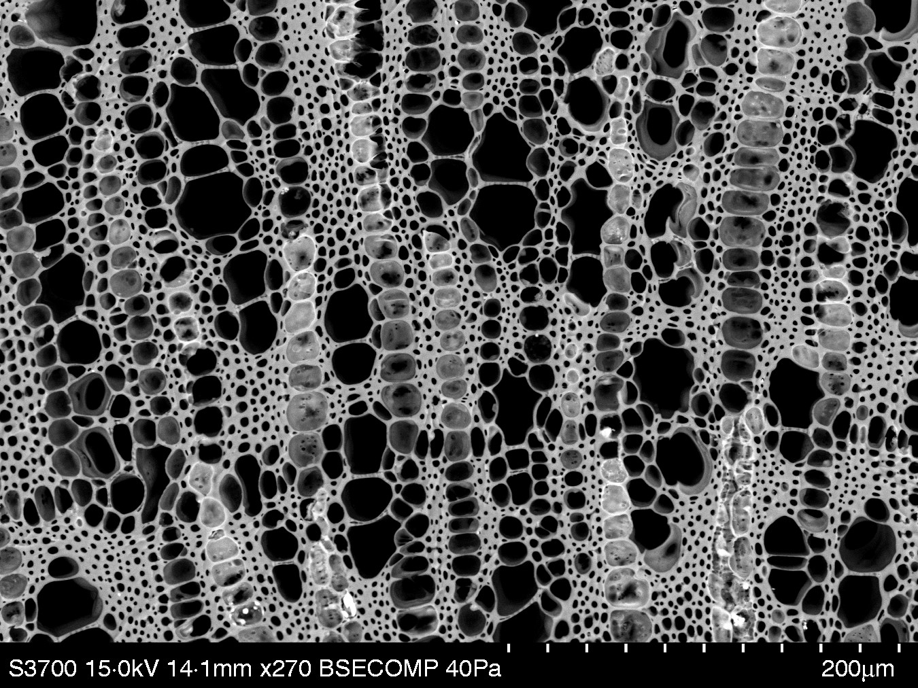
Fig. 2. Variable pressure scanning electron microscope image of a transverse section of Olea europaea subsp. africana ...
Notes:
Fig. 2. Variable pressure scanning electron microscope image of a transverse section of Olea europaea subsp. africana (African wild olive) charcoal from the archaeological site of Diepkloof Rock Shelter (South Africa), showing that the vessel outlines have been altered by the temperature involved in the burning of the wood. Image: C. R. Cartwright.
Unless provided in the caption above, the following copyright applies to the content of this slide: © The Author 2015. Published by Oxford University Press on behalf of the Annals of Botany Company. All rights reserved. For Permissions, please email: journals.permissions@oup.com

Slide 3
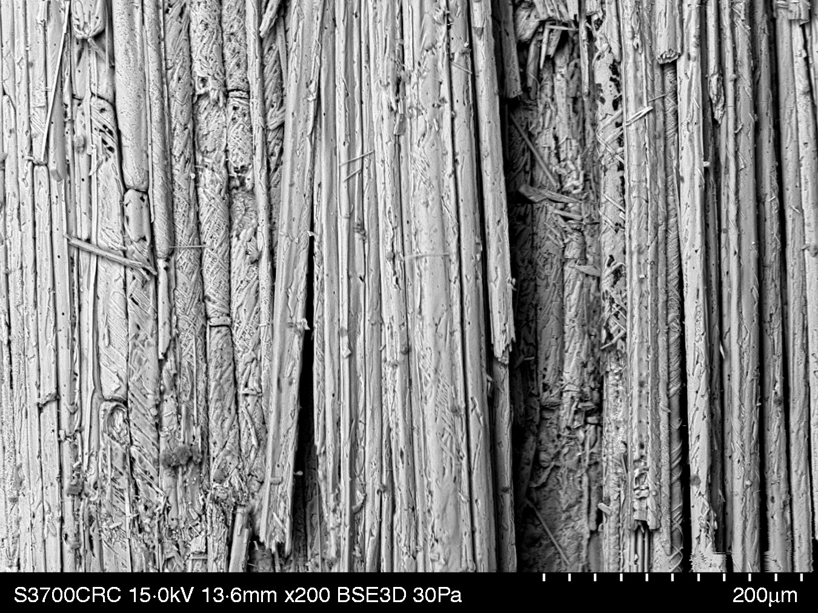
Fig. 15. Variable pressure scanning electron microscope image of a tangential longitudinal section of mineral-replaced ...
Notes:
Fig. 15. Variable pressure scanning electron microscope image of a tangential longitudinal section of mineral-replaced wood associated with an Iron Age cauldron from Chiseldon (Wiltshire, UK) showing the difficulty of achieving an identification when anatomical traces may be vestigial and incomplete, often surviving as negative or positive casts of certain features only. Image: C. R. Cartwright, © The Trustees of the British Museum.
Unless provided in the caption above, the following copyright applies to the content of this slide: © The Author 2015. Published by Oxford University Press on behalf of the Annals of Botany Company. All rights reserved. For Permissions, please email: journals.permissions@oup.com

Slide 4
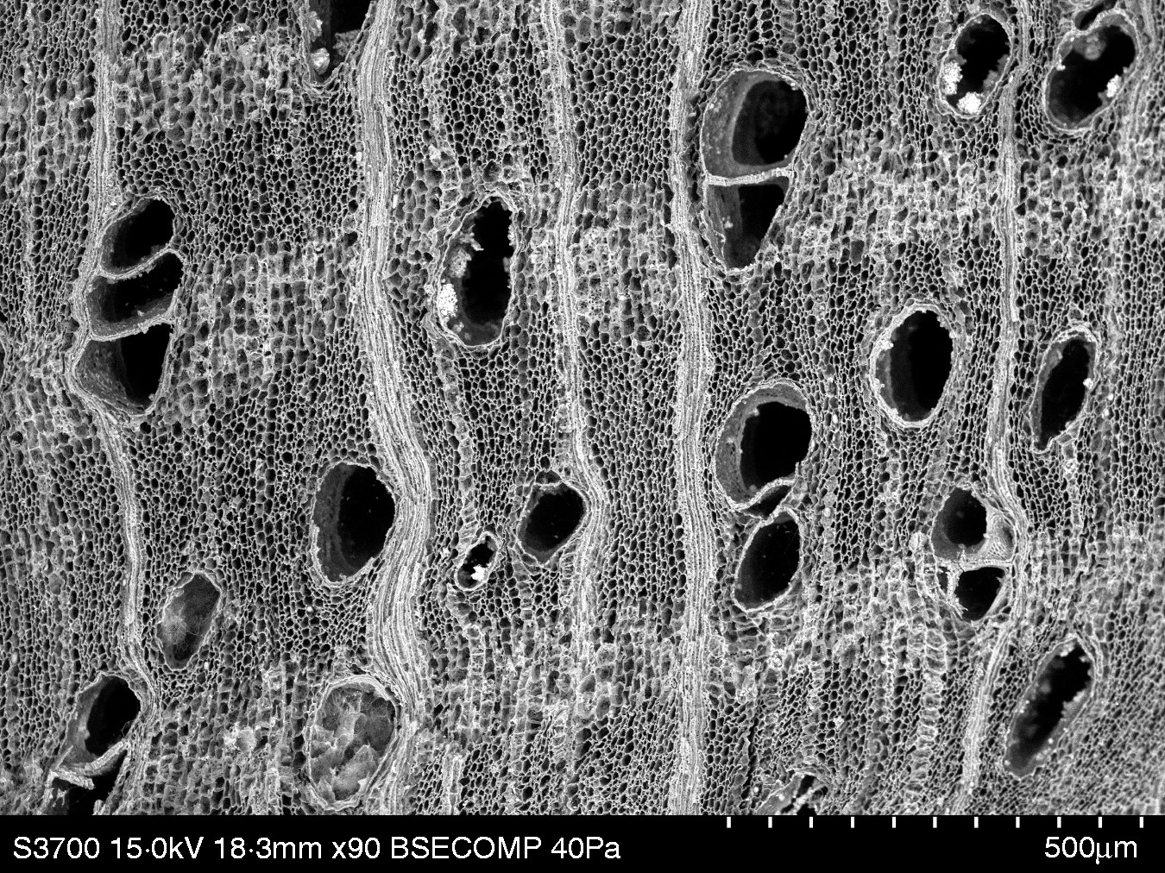
Fig. 14. Variable pressure scanning electron microscope image of a transverse section of desiccated Ficus sycomorus ...
Notes:
Fig. 14. Variable pressure scanning electron microscope image of a transverse section of desiccated Ficus sycomorus (sycomore fig) wood from a 1200 BC funerary object in the Amara West cemetery (Sudan), showing the distortion of vessels and rays brought about by rapid drying of the wood. Image: C. R. Cartwright, © The Trustees of the British Museum.
Unless provided in the caption above, the following copyright applies to the content of this slide: © The Author 2015. Published by Oxford University Press on behalf of the Annals of Botany Company. All rights reserved. For Permissions, please email: journals.permissions@oup.com

Slide 5
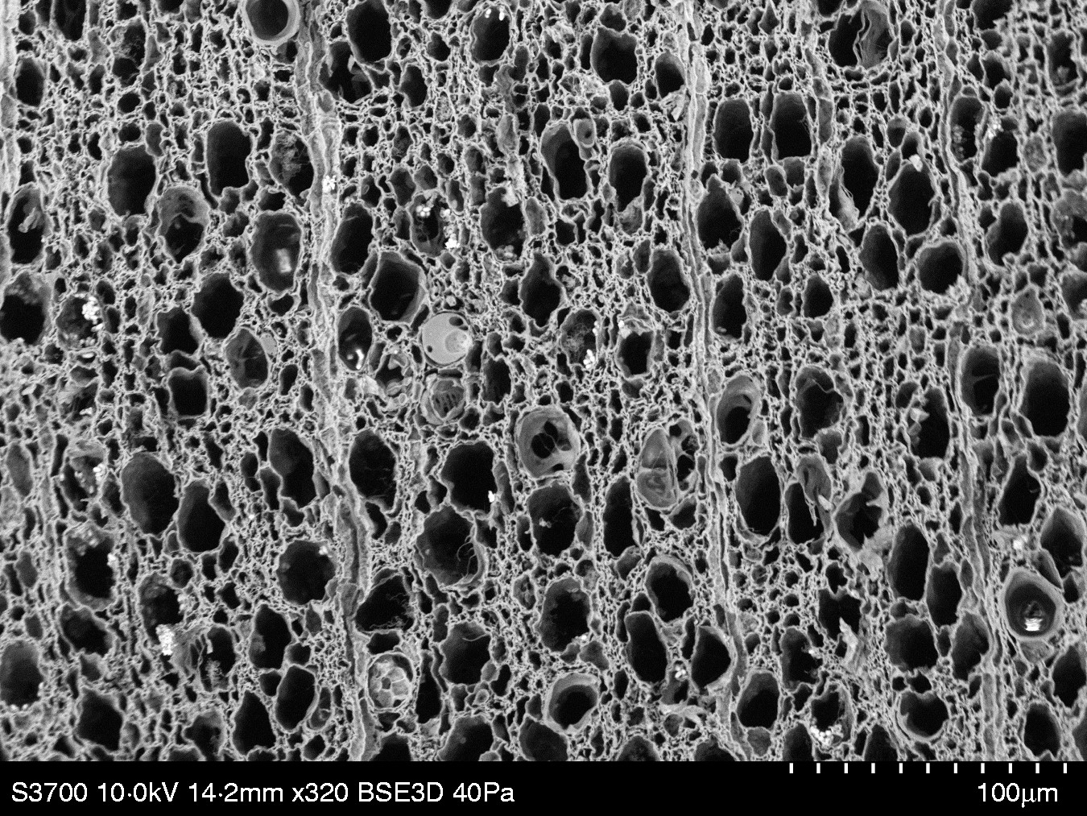
Fig. 13. Variable pressure scanning electron microscope image of a transverse section of desiccated wood from a ...
Notes:
Fig. 13. Variable pressure scanning electron microscope image of a transverse section of desiccated wood from a funerary object in a Jericho Bronze Age tomb, showing how the rapid deterioration to the wood that occurred on opening the sealed environment of the tombs resulted in marked deformation of vessels, ray parenchyma, axial parenchyma and fibres. Image: C. R. Cartwright, © The Trustees of the British Museum.
Unless provided in the caption above, the following copyright applies to the content of this slide: © The Author 2015. Published by Oxford University Press on behalf of the Annals of Botany Company. All rights reserved. For Permissions, please email: journals.permissions@oup.com

Slide 6
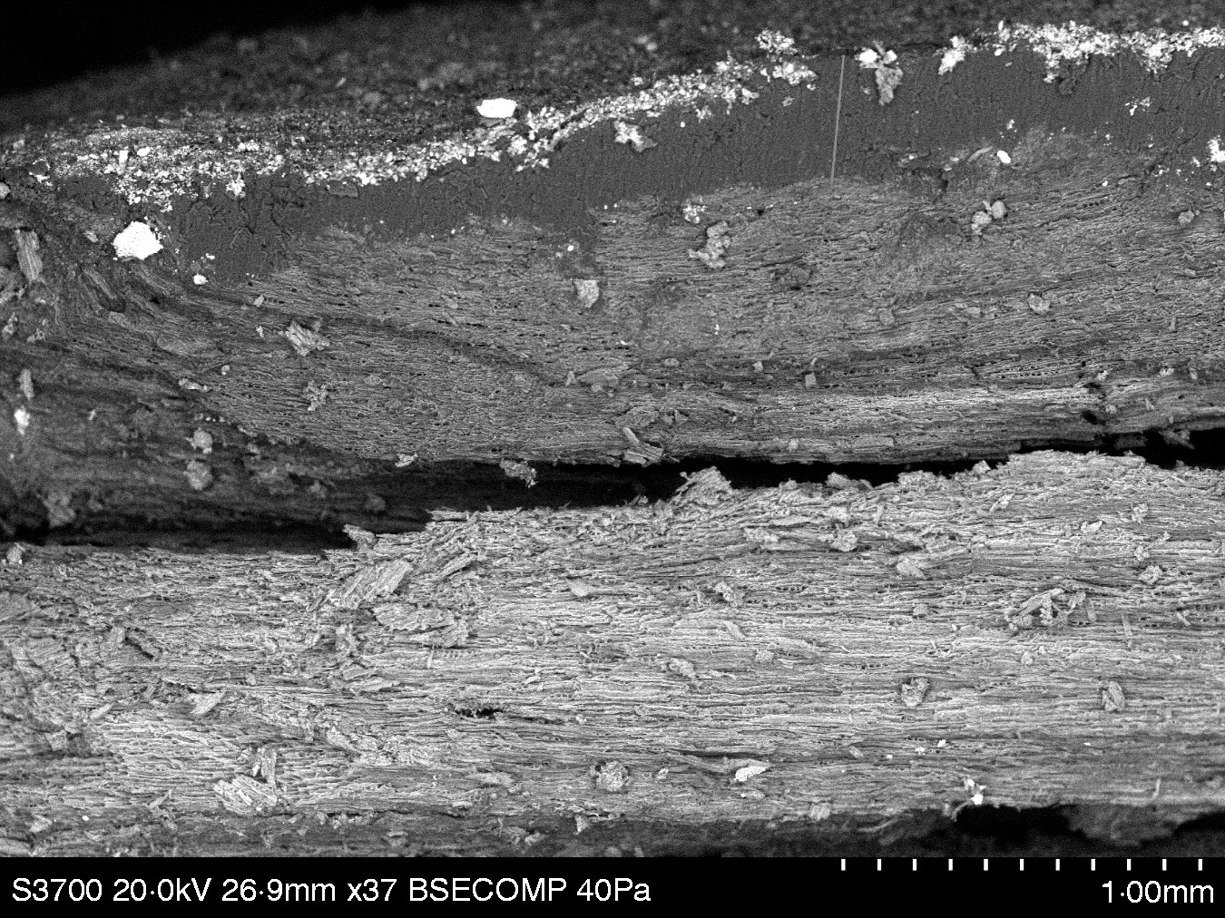
Fig. 12. Variable pressure scanning electron microscope image of a tangential longitudinal section of desiccated wood ...
Notes:
Fig. 12. Variable pressure scanning electron microscope image of a tangential longitudinal section of desiccated wood from a funerary table in a Jericho Bronze Age tomb showing the layer of paraffin wax applied to the surface (in 1952) in order to consolidate the object, and the partial penetration of wax into the cellular structure. The uppermost surface also shows a crusting of soil particles adhering to the wax. This view alone does not provide sufficient anatomical information for genus or species identification, but other sample sections from the same table, examined at higher magnifications, permitted the identification of Cedrus libani (cedar of Lebanon). Image: C. R. Cartwright, © The Trustees of the British Museum.
Unless provided in the caption above, the following copyright applies to the content of this slide: © The Author 2015. Published by Oxford University Press on behalf of the Annals of Botany Company. All rights reserved. For Permissions, please email: journals.permissions@oup.com

Slide 7
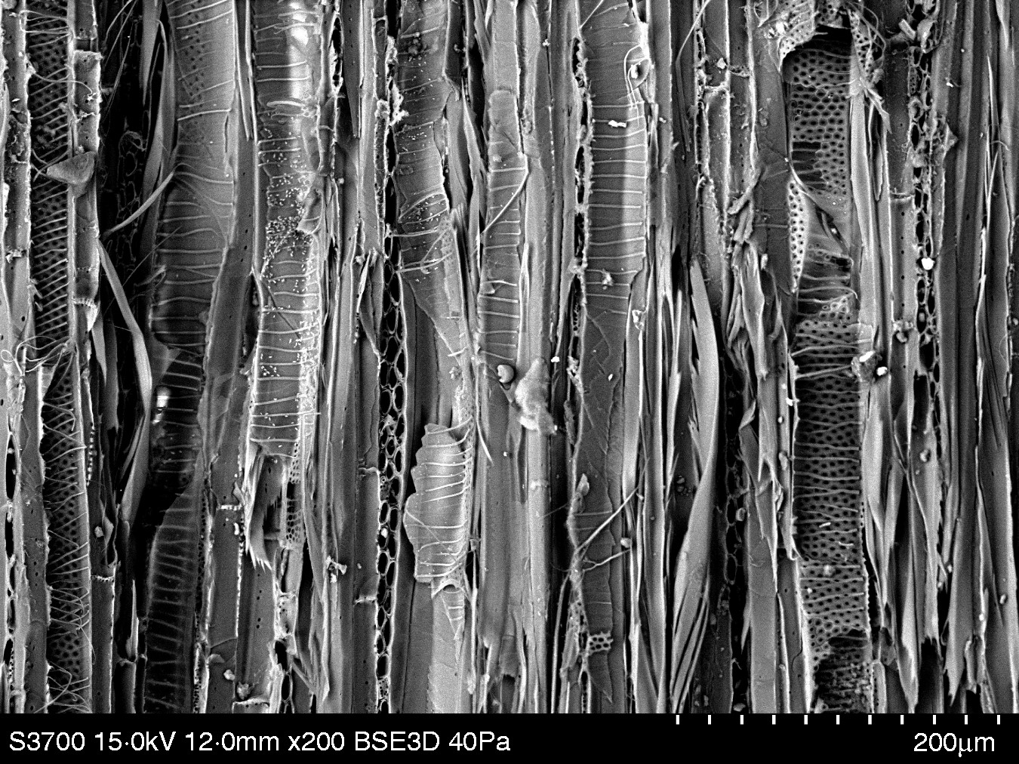
Fig. 11. Variable pressure scanning electron microscope image of a tangential longitudinal section of Tilia sp. ...
Notes:
Fig. 11. Variable pressure scanning electron microscope image of a tangential longitudinal section of Tilia sp. (linden, lime) wood from a gilded Roman period mummy portrait of a woman (found at er-Rubayat, Egypt), British Museum accession number EA 65346. Although around AD 160–170 in date, the wood is well preserved and shows a number of key anatomical features including helical thickenings in the vessels, alternate intervessel pits (some of which appear polygonal), and non-septate fibres that have simple to minutely bordered pits. Image: C. R. Cartwright, © The Trustees of the British Museum.
Unless provided in the caption above, the following copyright applies to the content of this slide: © The Author 2015. Published by Oxford University Press on behalf of the Annals of Botany Company. All rights reserved. For Permissions, please email: journals.permissions@oup.com

Slide 8
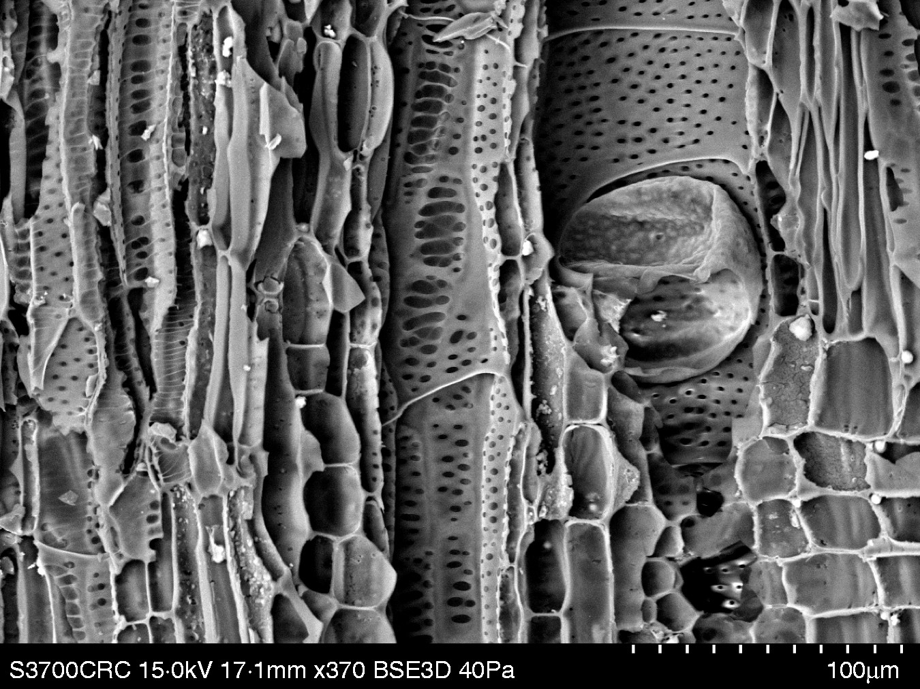
Fig. 10. Variable pressure scanning electron microscope image of a radial longitudinal section of Celtis africana ...
Notes:
Fig. 10. Variable pressure scanning electron microscope image of a radial longitudinal section of Celtis africana (white stinkwood) charcoal from the site of Elands Bay Cave (South Africa). Whilst the use of the backscatter detector inevitably results in a softer focus image (compared with the sharp, crisp image produced by use of the secondary electron detector), nonetheless vital anatomical details (such as helical thickenings in narrow vessels, wide vessel tylosis, heterocellular rays, non-septate fibres, vessel-ray pits with much reduced borders to apparently simple, horizontal vessel-ray pits that are scalariform or gash-like with some that are vertical in a palisade arrangement) are clearly visible in this friable archaeological specimen that is >20 000 years old. Image: C. R. Cartwright.
Unless provided in the caption above, the following copyright applies to the content of this slide: © The Author 2015. Published by Oxford University Press on behalf of the Annals of Botany Company. All rights reserved. For Permissions, please email: journals.permissions@oup.com

Slide 9
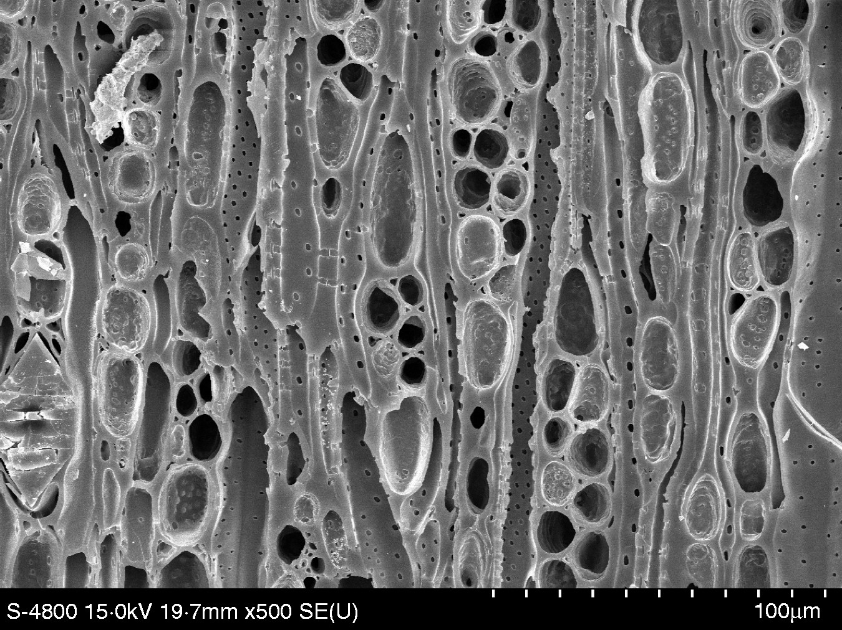
Fig. 9. Field emission scanning electron microscope image of a tangential longitudinal section of Cassine peragua ...
Notes:
Fig. 9. Field emission scanning electron microscope image of a tangential longitudinal section of Cassine peragua (forest spoonwood) charcoal from the archaeological site of Diepkloof Rock Shelter (South Africa). The use of only the upper secondary electron detector for imaging this charcoal fragment has maximized the diagnostic anatomical features by enhancing the edges of cell walls and pits. Image: C. R. Cartwright.
Unless provided in the caption above, the following copyright applies to the content of this slide: © The Author 2015. Published by Oxford University Press on behalf of the Annals of Botany Company. All rights reserved. For Permissions, please email: journals.permissions@oup.com

Slide 10
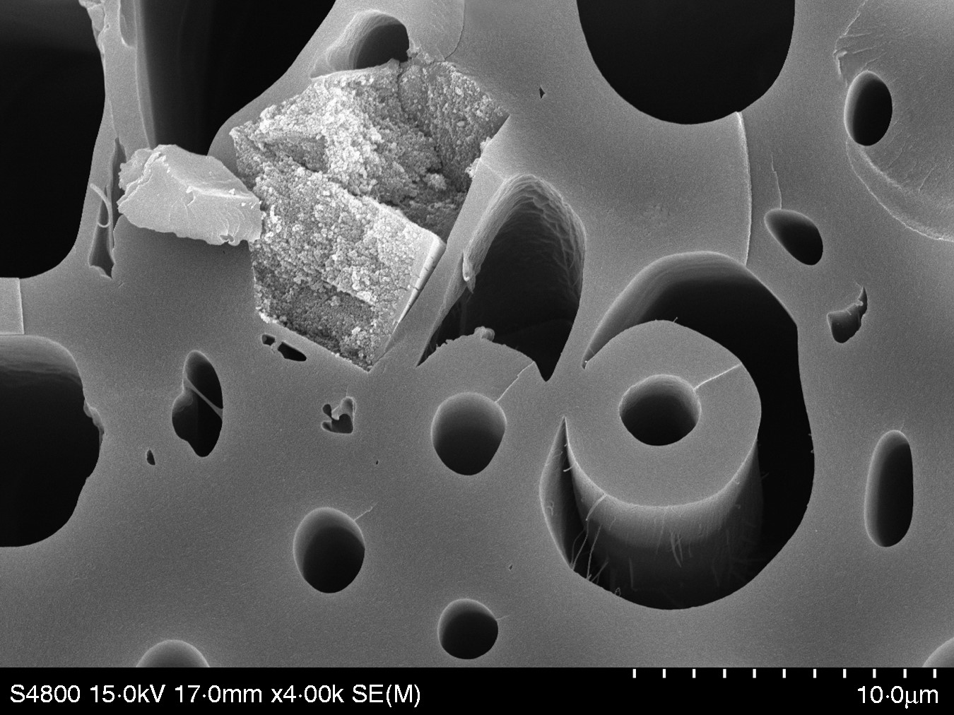
Fig. 8. Field emission scanning electron microscope image of details of a transverse section of Mimosa tenuiflora ...
Notes:
Fig. 8. Field emission scanning electron microscope image of details of a transverse section of Mimosa tenuiflora (jurema preta) charcoal (Pernambuco, Brazil) showing completely amorphous cell walls of fibres and gelatinous fibres, and a degraded calcium oxalate crystal with a granular structure in an axial parenchyma cell. Image: C. R. Cartwright.
Unless provided in the caption above, the following copyright applies to the content of this slide: © The Author 2015. Published by Oxford University Press on behalf of the Annals of Botany Company. All rights reserved. For Permissions, please email: journals.permissions@oup.com

Slide 11
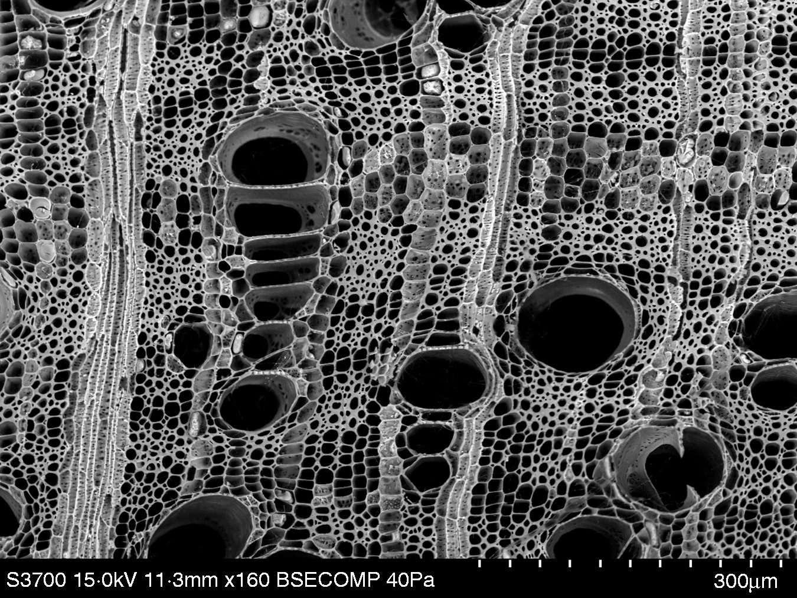
Fig. 5. Variable pressure scanning electron microscope image of a transverse section of Ficus cordata (Namaqua ...
Notes:
Fig. 5. Variable pressure scanning electron microscope image of a transverse section of Ficus cordata (Namaqua rock-fig) charcoal from the archaeological site of Elands Bay Cave (South Africa). Image: C. R. Cartwright.
Unless provided in the caption above, the following copyright applies to the content of this slide: © The Author 2015. Published by Oxford University Press on behalf of the Annals of Botany Company. All rights reserved. For Permissions, please email: journals.permissions@oup.com

Slide 12
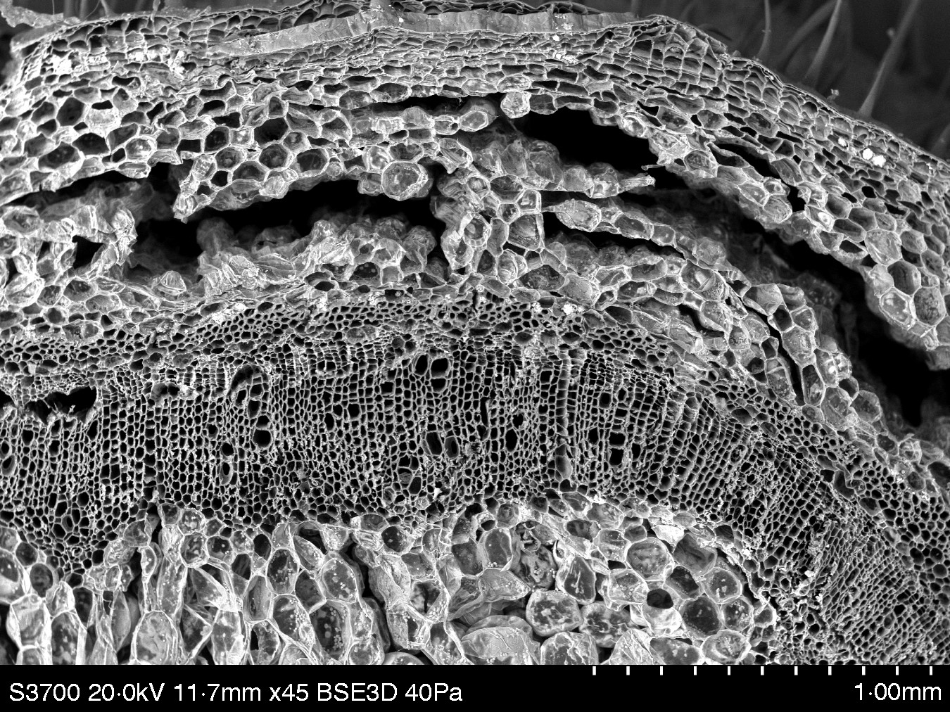
Fig. 4. Variable pressure scanning electron microscope image of a transverse section of Pelargonium graveolens (rose ...
Notes:
Fig. 4. Variable pressure scanning electron microscope image of a transverse section of Pelargonium graveolens (rose geranium) wood. A cold stage was used here in the variable pressure scanning electron microscope for this moist, but not fully waterlogged wood specimen. Image: C. R. Cartwright.
Unless provided in the caption above, the following copyright applies to the content of this slide: © The Author 2015. Published by Oxford University Press on behalf of the Annals of Botany Company. All rights reserved. For Permissions, please email: journals.permissions@oup.com

Slide 13
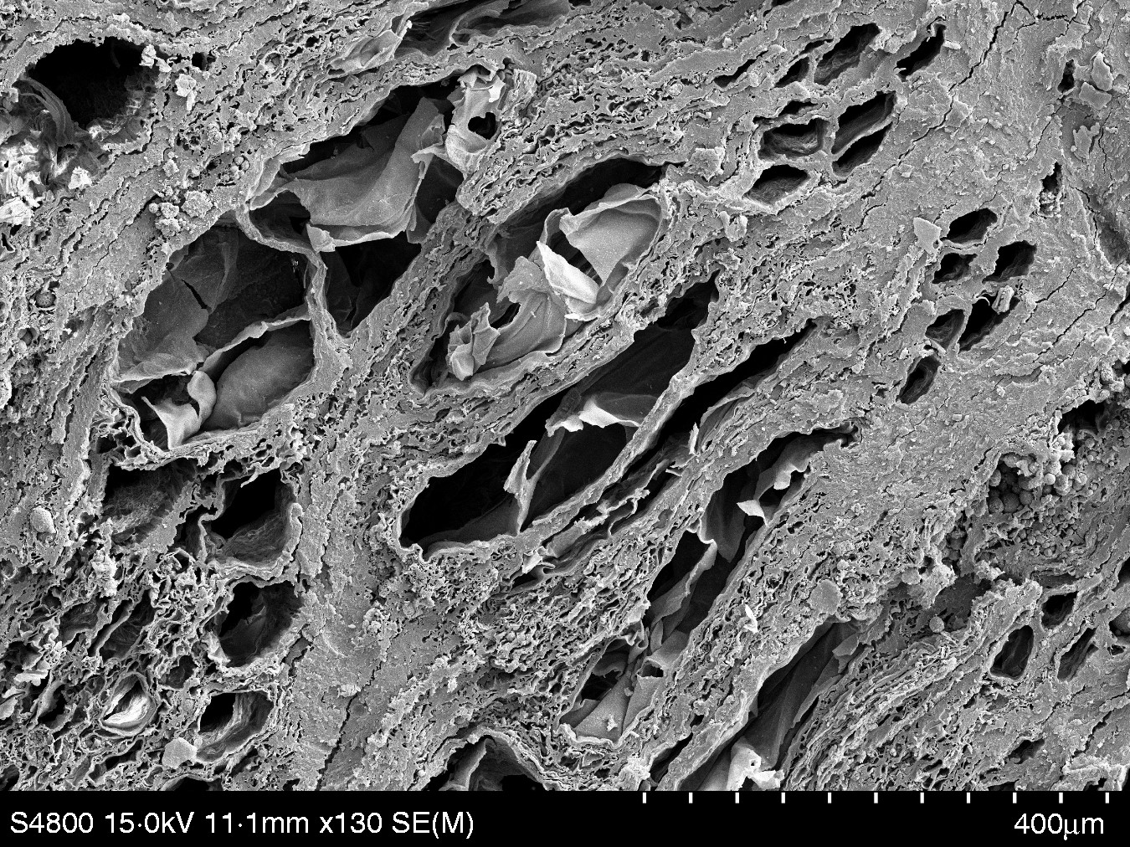
Fig. 3. Variable pressure scanning electron microscope image of a transverse section of Quercus sp. (oak) waterlogged ...
Notes:
Fig. 3. Variable pressure scanning electron microscope image of a transverse section of Quercus sp. (oak) waterlogged wood from a 17th century shipwreck in Salcombe Bay (Devon, UK) whose vessel sizes and shapes (along with parenchyma and fibres) have been severely distorted after rapid drying out following removal from the marine environment. Image: C. R. Cartwright, © The Trustees of the British Museum.
Unless provided in the caption above, the following copyright applies to the content of this slide: © The Author 2015. Published by Oxford University Press on behalf of the Annals of Botany Company. All rights reserved. For Permissions, please email: journals.permissions@oup.com

Slide 14
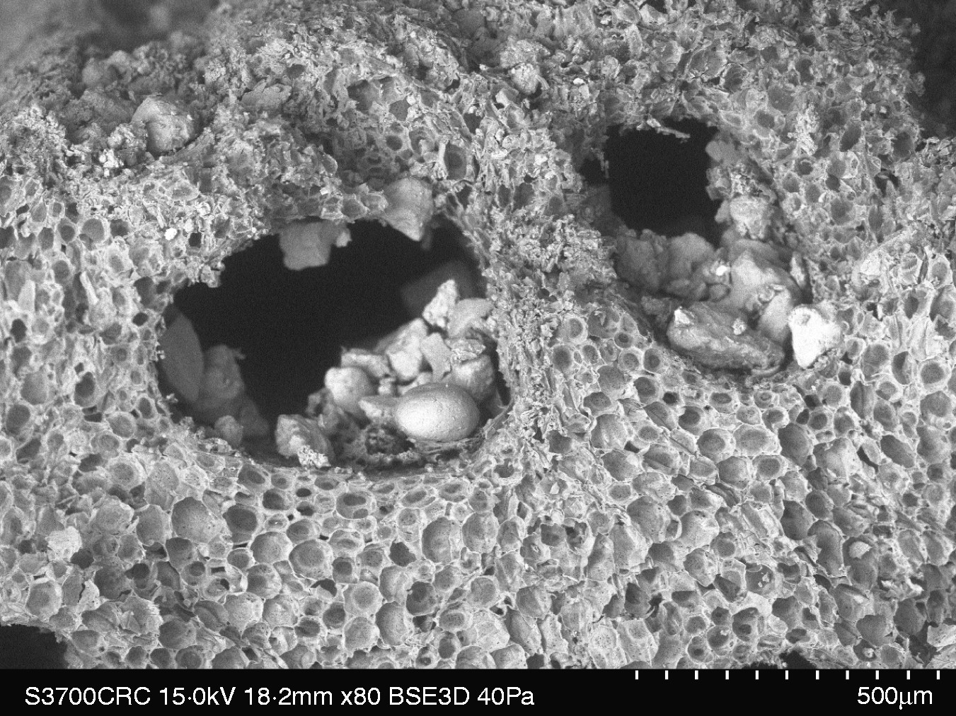
Fig. 16. Variable pressure scanning electron microscope image of a transverse section of desiccated, mineral-preserved ...
Notes:
Fig. 16. Variable pressure scanning electron microscope image of a transverse section of desiccated, mineral-preserved wood in which much of the cellular structure has been replaced by calcium carbonate. Identification was possible for this example from the Amara West cemetery (Sudan) because specimens of the same taxon, Hyphaene thebaica (dom palm), were available for comparison in well-preserved charcoal form. Image: C. R. Cartwright, © The Trustees of the British Museum.
Unless provided in the caption above, the following copyright applies to the content of this slide: © The Author 2015. Published by Oxford University Press on behalf of the Annals of Botany Company. All rights reserved. For Permissions, please email: journals.permissions@oup.com

Slide 15
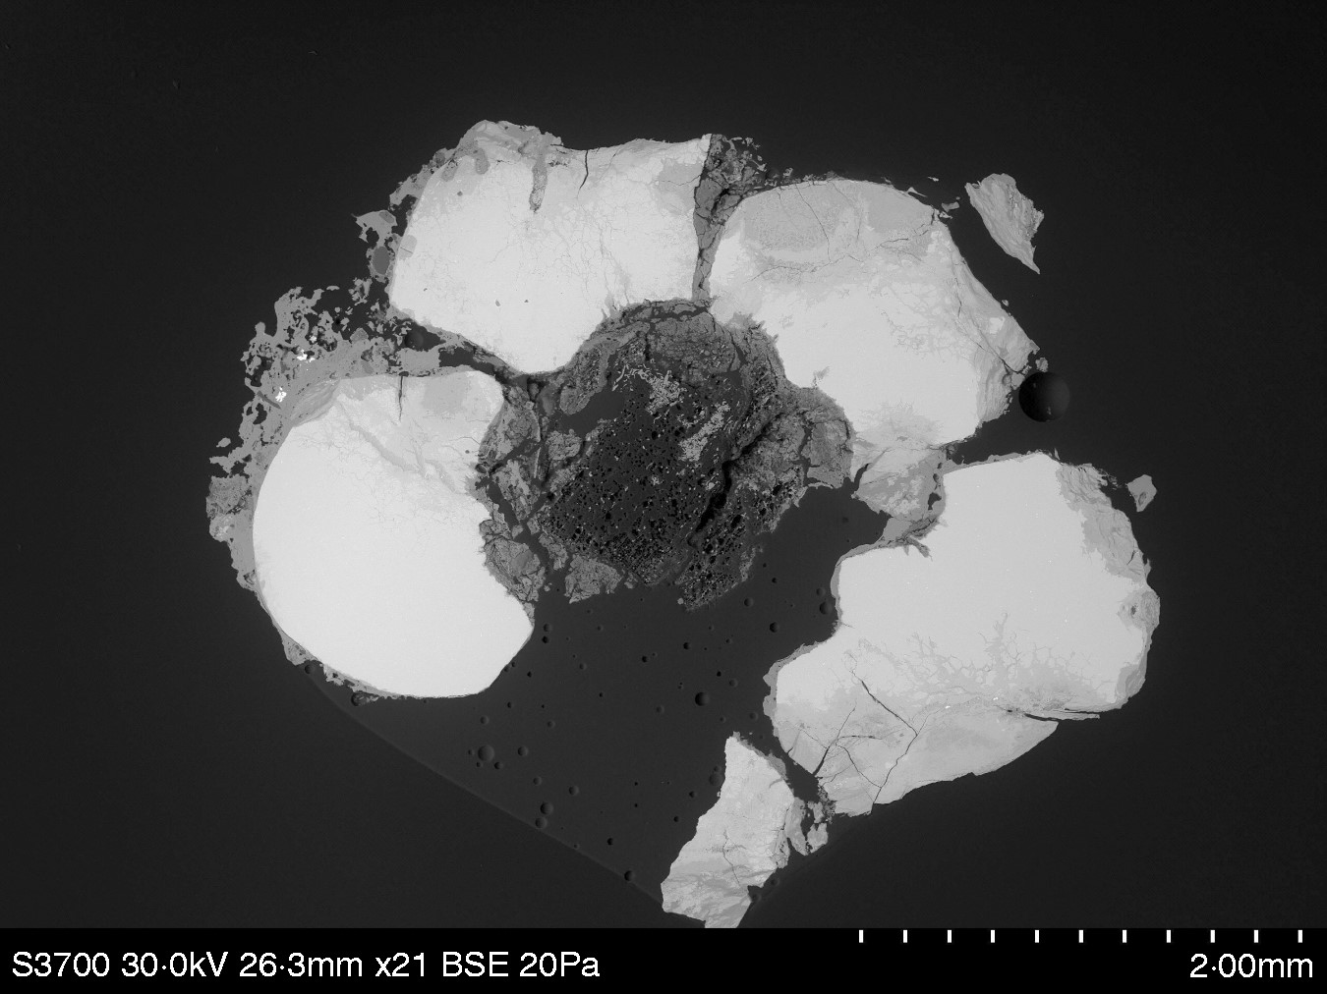
Fig. 7. Variable pressure scanning electron microscope image of a section through one of the Iron Age twisted wire ...
Notes:
Fig. 7. Variable pressure scanning electron microscope image of a section through one of the Iron Age twisted wire torcs from Snettisham (Norfolk, UK) showing how the central wooden core had been preserved in situ and protected by the enclosing metal wires of the torc. Image: N. Meeks, © The Trustees of the British Museum.
Unless provided in the caption above, the following copyright applies to the content of this slide: © The Author 2015. Published by Oxford University Press on behalf of the Annals of Botany Company. All rights reserved. For Permissions, please email: journals.permissions@oup.com

Slide 16
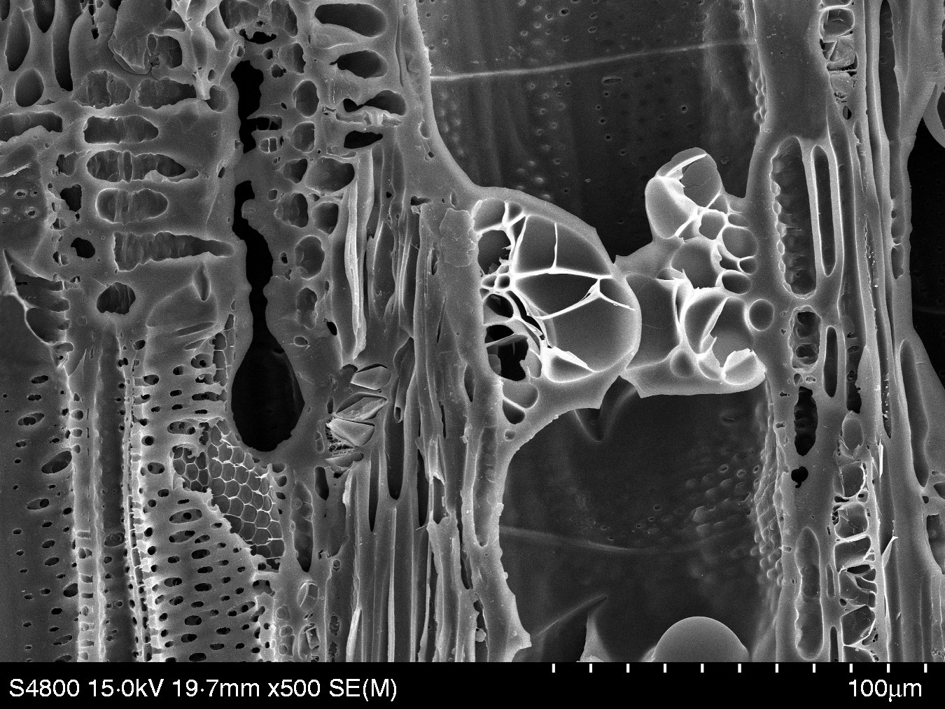
Fig. 6. Field emission scanning electron microscope image of a radial longitudinal section of Mimosa ophthalmocentra ...
Notes:
Fig. 6. Field emission scanning electron microscope image of a radial longitudinal section of Mimosa ophthalmocentra (jurema de imbira) charcoal from Pernambuco (Brazil) showing (amongst other anatomical details) how the gum in a vessel has formed bubbles (which resemble tyloses). Image: C. R. Cartwright.
Unless provided in the caption above, the following copyright applies to the content of this slide: © The Author 2015. Published by Oxford University Press on behalf of the Annals of Botany Company. All rights reserved. For Permissions, please email: journals.permissions@oup.com

