Slide 1
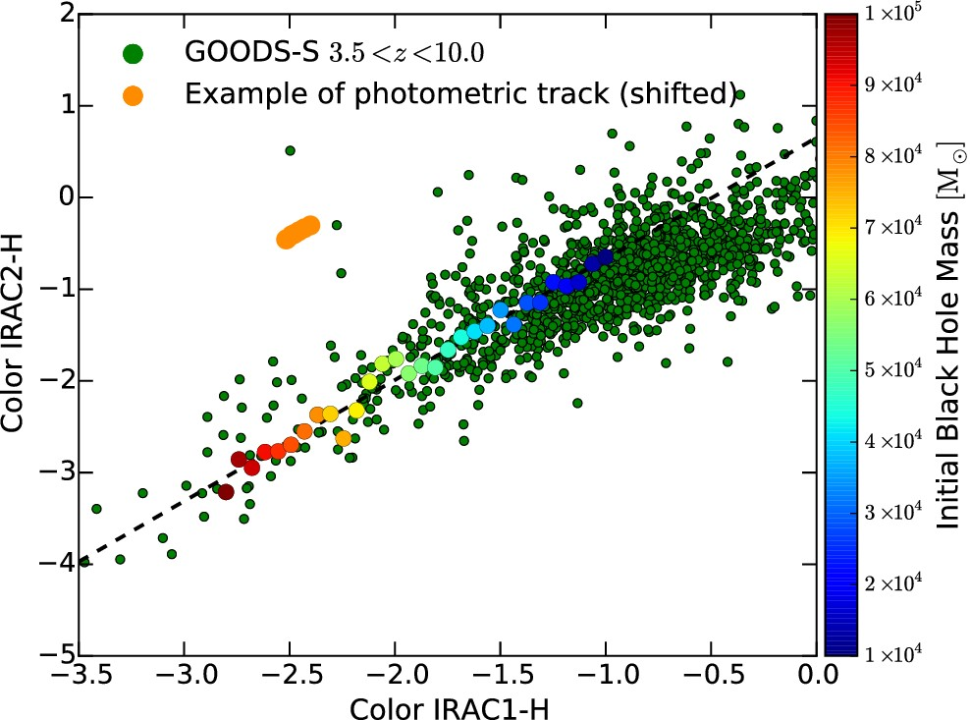
Figure 1. Colour–colour diagram for the infrared filters H, IRAC1, and IRAC2. GOODS-S objects, brighter than the 27th ...
Notes:
Figure 1. Colour–colour diagram for the infrared filters H, IRAC1, and IRAC2. GOODS-S objects, brighter than the 27th magnitude in the H band (H < 27) and with 3.5 ≲ z ≲ 10, are shown with green points. Numerical predictions for the colours of DCBHs are shown, at z ∼ 7, with filled circles, whose colour depends on the initial mass of the seed (see the colour bar). Larger black hole masses are associated with redder spectra (i.e. more negative colours). All colours are observed quantities. An example of a photometric track (see Section 4.1) for a DCBH of initial mass ∼8 × 104 M⊙ is shown in orange. Its position has been shifted vertically to avoid information overload.
Unless provided in the caption above, the following copyright applies to the content of this slide: © 2016 The Authors Published by Oxford University Press on behalf of the Royal Astronomical Society

Slide 2
Figure 2. H-band images with X-ray contours (1–4 keV) of the two GOODS-S sources selected as DCBH candidates. X-ray ...
Notes:
Figure 2. H-band images with X-ray contours (1–4 keV) of the two GOODS-S sources selected as DCBH candidates. X-ray contours are from the Chandra 7 Ms field, in square root scale, from 2σ to 10σ. H-band counterparts are circled. On the right, probability distribution functions (taken from Giallongo et al. 2015) for the photometric redshifts of the same objects, along with their optical/infrared spectra, fitted from their photometry.
Unless provided in the caption above, the following copyright applies to the content of this slide: © 2016 The Authors Published by Oxford University Press on behalf of the Royal Astronomical Society

Slide 3
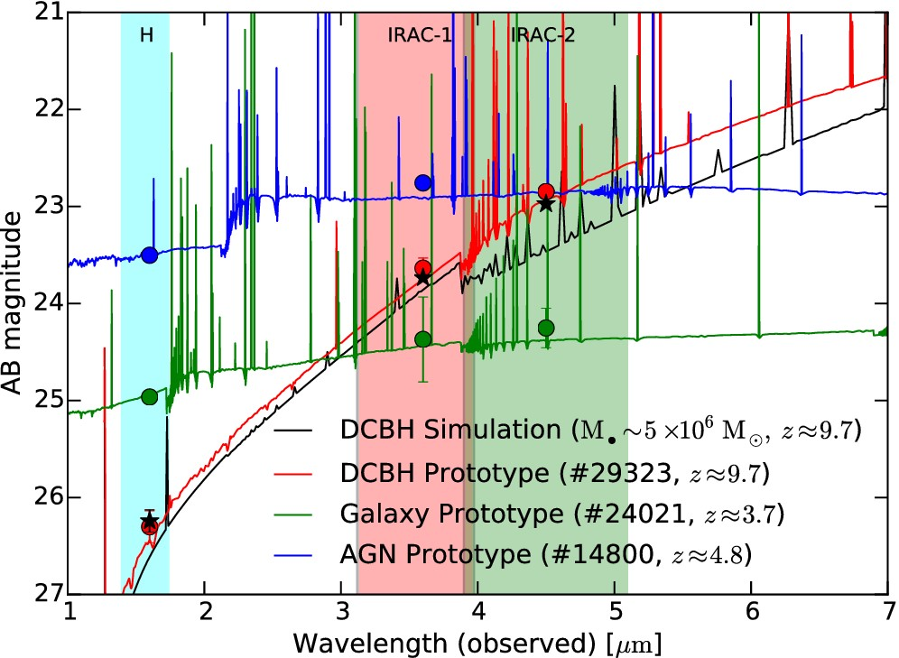
Figure 3. Comparison between the stellar SEDs of three GOODS-S objects with the computed SED of ...
Notes:
Figure 3. Comparison between the stellar SEDs of three GOODS-S objects with the computed SED of a ∼5 × 106 M⊙ black hole, born out of a DCBH with initial mass around ∼105 M⊙. The three photometric bands employed in our work are shown as shaded regions. Filled circles (observations) and stars (numerical simulations) show the magnitudes in the three filters, with error bars. Objects 29323 and 14800 have X-ray counterparts (i.e. they are likely associated with a black hole), while 24021 has not (i.e. it is likely a normal galaxy). Moreover, object 29323 is characterized by very negative colours (i.e. its infrared SED is very steep, as we predict for DCBHs), while objects 14800 and 24021 are not. The steepness of the SED and the infrared magnitudes for the object 29323 are well fitted by the spectrum predicted for a ∼5 × 106 M⊙ black hole. In the computed SED for a DCBH, the He ii line (0.164 μm rest-frame) is visible and it is marginally inside the H-band at z ≈ 9.7.
Unless provided in the caption above, the following copyright applies to the content of this slide: © 2016 The Authors Published by Oxford University Press on behalf of the Royal Astronomical Society

Slide 4
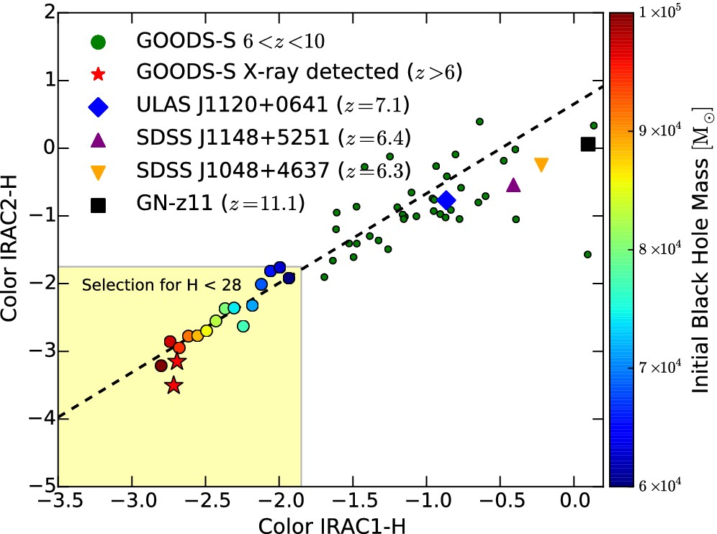
Figure 4. Colour–colour diagram for objects at z ≳ 6. The yellow-shaded area indicates the region in the diagram where ...
Notes:
Figure 4. Colour–colour diagram for objects at z ≳ 6. The yellow-shaded area indicates the region in the diagram where we expect SEDs compatible with the ones predicted for DCBHs, and observable with current surveys. Green points are GOODS-S objects without an X-ray counterpart, while red stars are GOODS-S objects detected in the X-ray and likely powered by accretion on to a collapsed object. Filled circles are, as in Fig. 1, DCBH simulations. In addition, we report the position in the colour–colour plot of several z > 6 sources. ULAS J1120+0641 (Mortlock et al. 2011; Barnett et al. 2015) is the most distant-known QSO (z ≈ 7.1). SDSS J1148+5251 (Fan et al. 2003) and SDSS J1048+4637 (Maiolino et al. 2004) are two highly obscured and dusty QSOs at z ≈ 6.4 and z ≈ 6.3, respectively. GN-z11 (Oesch et al. 2016) is the highest redshift galaxy discovered to date (z ≈ 11.1).
Unless provided in the caption above, the following copyright applies to the content of this slide: © 2016 The Authors Published by Oxford University Press on behalf of the Royal Astronomical Society

Slide 5
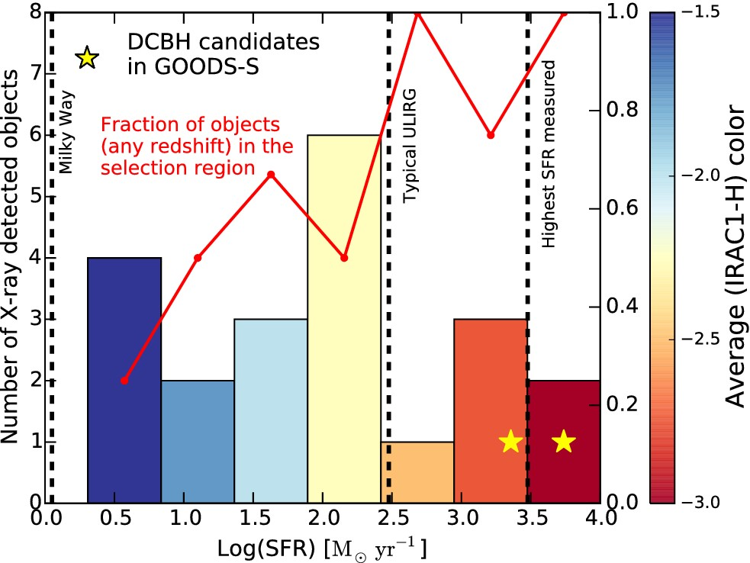
Figure 5. Distribution of star formation rates of the X-ray detected objects in GOODS-S (excluding object 28476, whose ...
Notes:
Figure 5. Distribution of star formation rates of the X-ray detected objects in GOODS-S (excluding object 28476, whose X-ray detection is still debated). Each column of the histogram is coloured according to the average (IRAC1–H) colour index of the objects falling within the SFR bin, as shown in the colour bar. SFRs for the Milky Way (Robitaille & Whitney 2010), a typical ULIRG (Le Floc'h et al. 2005) and for a massive maximum-starburst galaxy at z = 6.34 (Riechers et al. 2013) are shown for comparison. The fraction of objects in each bin, at any redshift, falling into our selection region is shown as a red line, on the right vertical axis. The two DCBH candidates selected by our method are shown with yellow stars.
Unless provided in the caption above, the following copyright applies to the content of this slide: © 2016 The Authors Published by Oxford University Press on behalf of the Royal Astronomical Society

