Slide 1
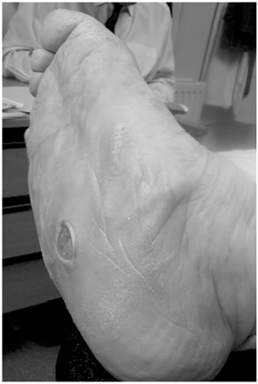
Figure 1. The Charcot foot.
Notes:
Figure 1. The Charcot foot.
Unless provided in the caption above, the following copyright applies to the content of this slide: © The Author 2008. Published by Oxford University Press on behalf of the Association of Physicians. All rights reserved. For Permissions, please email: journals.permissions@oxfordjournals.org

Slide 2
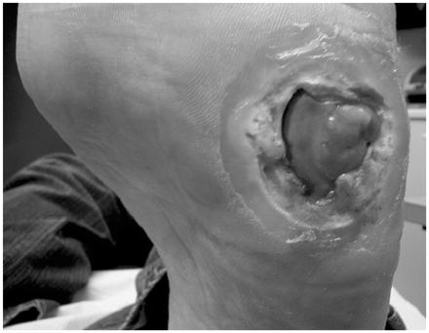
Figure 2. Neuropathic foot ulcer.
Notes:
Figure 2. Neuropathic foot ulcer.
Unless provided in the caption above, the following copyright applies to the content of this slide: © The Author 2008. Published by Oxford University Press on behalf of the Association of Physicians. All rights reserved. For Permissions, please email: journals.permissions@oxfordjournals.org

Slide 3
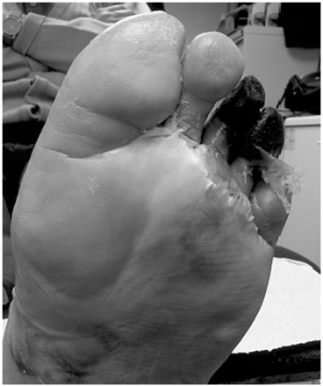
Figure 3. Ischaemic foot ulcer.
Notes:
Figure 3. Ischaemic foot ulcer.
Unless provided in the caption above, the following copyright applies to the content of this slide: © The Author 2008. Published by Oxford University Press on behalf of the Association of Physicians. All rights reserved. For Permissions, please email: journals.permissions@oxfordjournals.org

