Slide 1
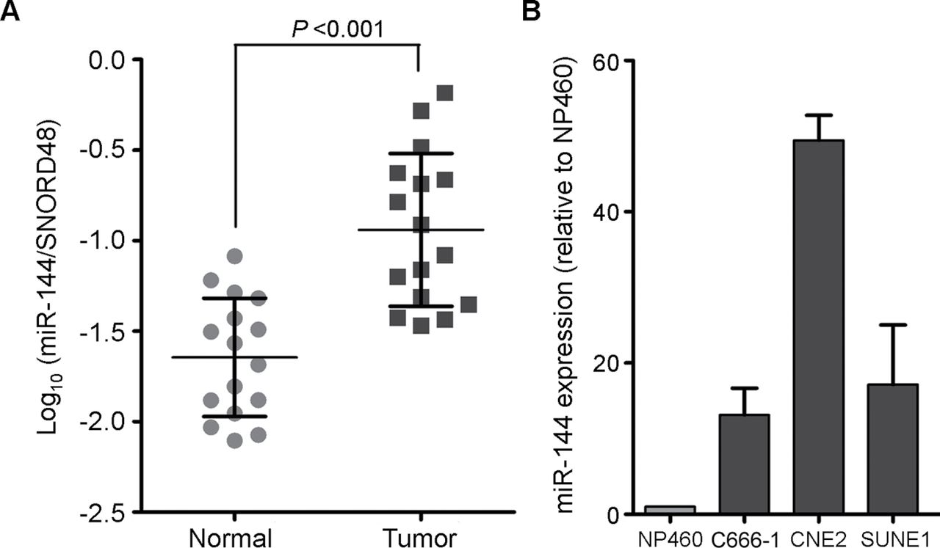
Fig. 1. miR-144 was upregulated in NPC clinical specimens and human NPC cell lines. ( A ) Log ₁₀ average ...
Notes:
Fig. 1. miR-144 was upregulated in NPC clinical specimens and human NPC cell lines. ( A ) Log 10 average expression of miR-144 in NPC tissues (tumor) and their corresponding non-tumor tissues (normal) ( n = 16). miR-144 abundance was normalized to SNORD48 RNA. P < 0.001. ( B ) Relative expression of miR-144 in three NPC cell lines (C666-1, CNE2 and SUNE1) compared with immortalized nasopharyngeal epithelium cell line NP460.
Unless provided in the caption above, the following copyright applies to the content of this slide: © Crown copyright 2012

Slide 2
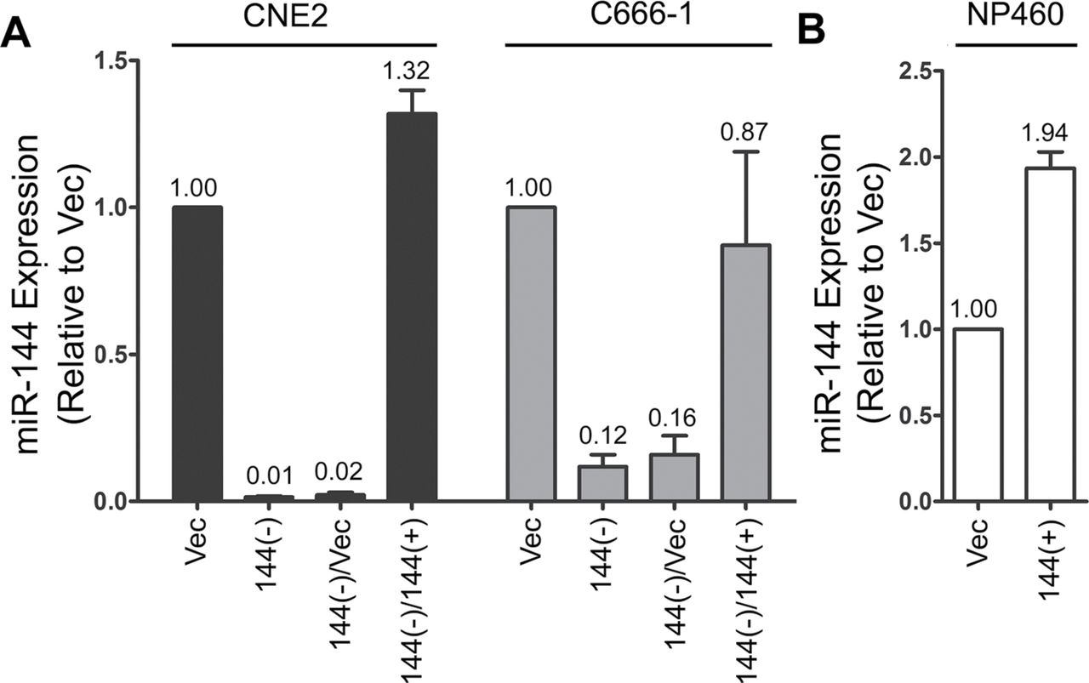
Fig. 2. Relative expression of miR-144 in anti-miR-144-repressed cells [CNE2/C666-144(−)], pre-miR-144-restored ...
Notes:
Fig. 2. Relative expression of miR-144 in anti-miR-144-repressed cells [CNE2/C666-144(−)], pre-miR-144-restored cells [CNE2/C666-144(−)/144(+)] ( A ) and overexpressed cells [NP460-144(+)] ( B ) was confirmed by qPCR. 144(−), anti-miR-144-transfected cells; 144(+), pre-miR-144-transfected cells; Vec, empty vector transfected control cells.
Unless provided in the caption above, the following copyright applies to the content of this slide: © Crown copyright 2012

Slide 3
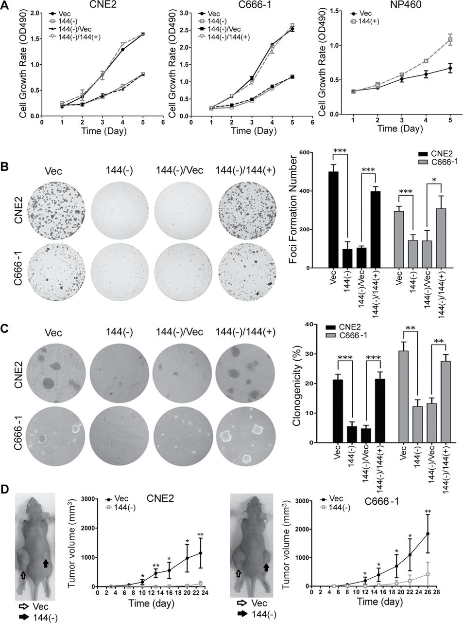
Fig. 3. miR-144 promotes NPC cell growth in vitro and in vivo . ( A ) Effect of miR-144 on cell proliferation was ...
Notes:
Fig. 3. miR-144 promotes NPC cell growth in vitro and in vivo . ( A ) Effect of miR-144 on cell proliferation was measured by XTT assay in anti-miR-144-repressed NPC cells [CNE2/C666-144(−)] and pre-miR-144-restored NPC cells [CNE2/C666-144(−)/144(+)] or transfected NP460 cells [NP460-144(+)]. Empty vector transfected NPC cells [CNE2/C666-Vec and CNE2/C666-144(−)/Vec] or NP cells (NP460-Vec) were used as controls. Each data point represents the mean ± SD of triplicate determinations. Representative pictures of foci formation assay ( B ) and colony formation assay ( C ) in miR-144-repressed and miR-144-restored NPC cells (left). Quantitative analyses of foci or colony numbers (right). Columns, mean of at least three independent experiments; bars, SD. * P < 0.05; ** P < 0.01; *** P < 0.001 versus controls by using the Student’s t -test. ( D ) Repression of miR-144 significantly inhibits tumor growth in nude mice compared with empty vector transfected CNE2 and C666-1 cells. CNE2 and C666-1 cells infected with empty vector or anti-miR-144 were injected subcutaneously into nude mice [left: CNE2/C666-Vec; right: CNE2/C666-144(−)]. Three weeks after implantation, anti-miR-144-treated cells formed smaller tumors than control cells. Each data point represents the mean ± SD of five nude mice. * P < 0.05; ** P < 0.01 compared with control.
Unless provided in the caption above, the following copyright applies to the content of this slide: © Crown copyright 2012

Slide 4
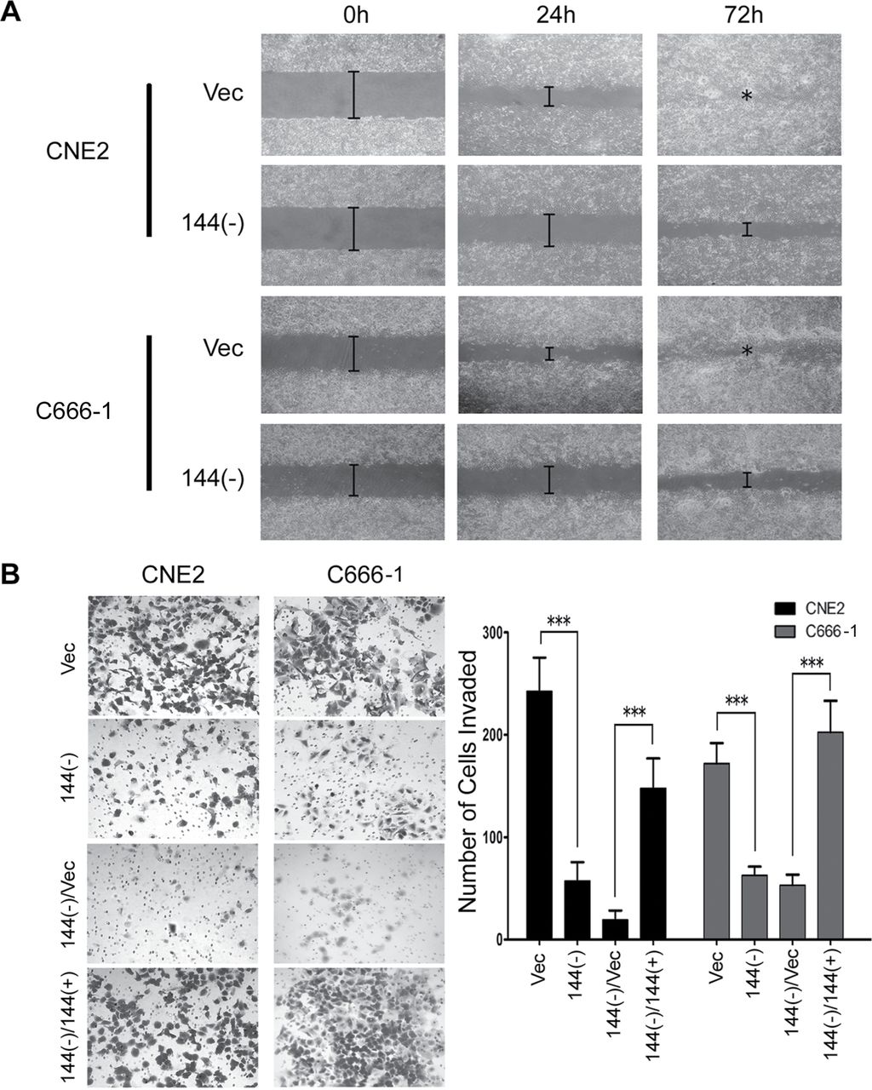
Fig. 4. miR-144 enhances NPC cell migration and invasion. ( A ) Representative pictures of wound-healing assay were ...
Notes:
Fig. 4. miR-144 enhances NPC cell migration and invasion. ( A ) Representative pictures of wound-healing assay were obtained at indicated time points following initiation of the scratch in CNE2/C666-144(−) and CNE2/C666-Vec. ( B ) Representative pictures showed the anti-miR-144-repressed cells [CNE2/C666-144(−)] and pre-miR-144-restored cells [CNE2/C666-144(−)/144(+)] that invaded through the matrigel (left). Number of invaded tumor cells was quantified in the bottom panel (right). Empty vector transfected NPC cells [CNE2/C666-Vec and CNE2/C666-144(−)/Vec] were used as controls. *** P < 0.001 compared with control.
Unless provided in the caption above, the following copyright applies to the content of this slide: © Crown copyright 2012

Slide 5
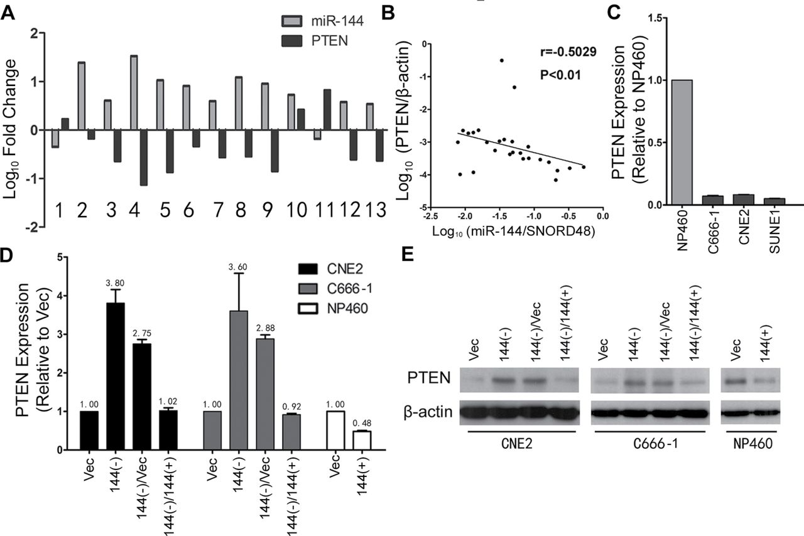
Fig. 5. miR-144 directly targets PTEN in NPC cells. ( A ) Log ₁₀ fold change of miR-144 and PTEN mRNA ...
Notes:
Fig. 5. miR-144 directly targets PTEN in NPC cells. ( A ) Log 10 fold change of miR-144 and PTEN mRNA expression in 13 NPC specimens and their non-tumor counterparts. ( B ) miR-144 was significantly inversely correlated with PTEN mRNA levels in NPC specimens (Spearman’s correlation analysis, r = −0.5029; P < 0.01). ( C ) Relative mRNA expression of PTEN in three NPC cell lines compared with immortalized nasopharyngeal epithelium cell line NP460. Relative mRNA expression ( D ) and protein expression ( E ) of PTEN in anti-miR-144-repressed NPC cells [CNE2/C666-144(−)] and pre-miR-144-restored NPC cells [CNE2/C666-144(−)/144(+)] or transfected NP cells [NP460-144(+)]. Empty vector transfected NPC cells [CNE2/C666-Vec and CNE2/C666-144(−)/Vec] or NP cells (NP460-Vec) were used as controls.
Unless provided in the caption above, the following copyright applies to the content of this slide: © Crown copyright 2012

Slide 6
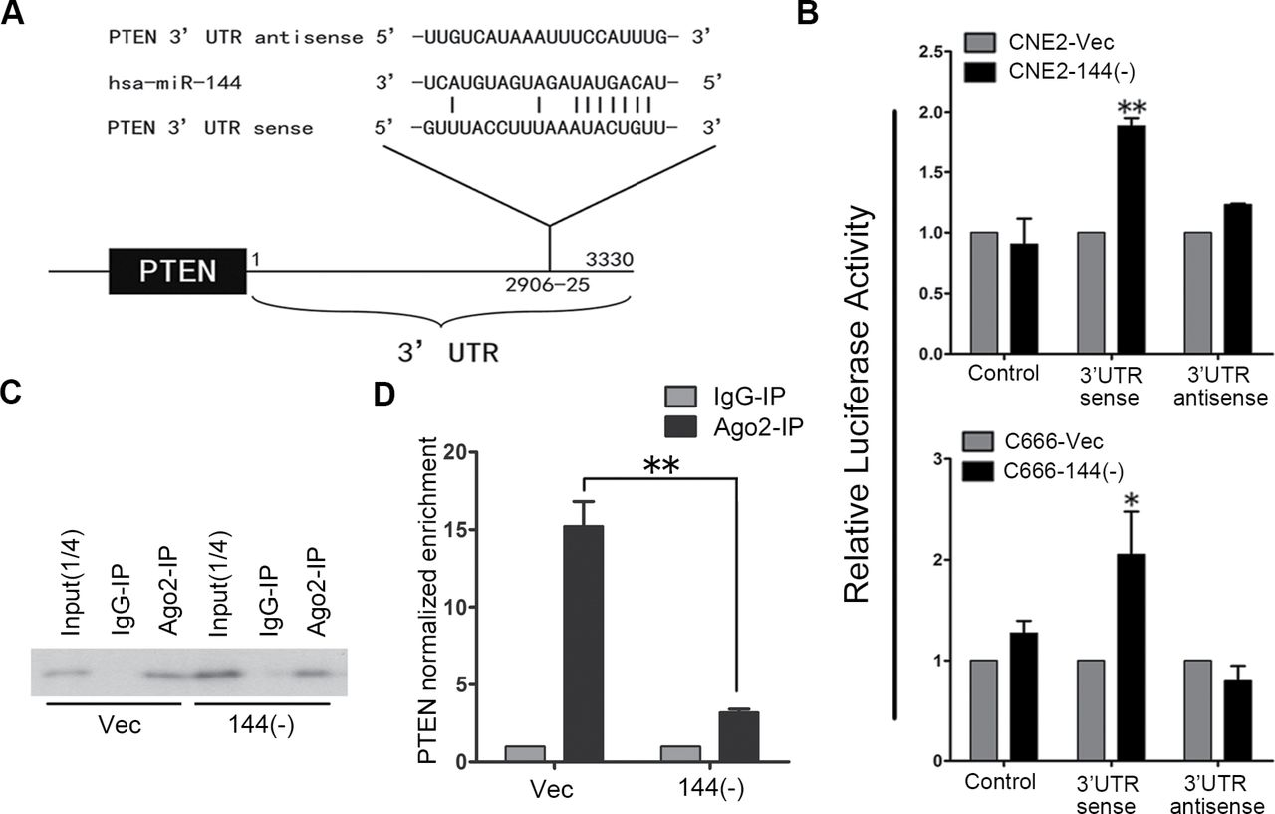
Fig. 6. ( A ) Sequence alignment between miR-144 and the 3′-UTR of PTEN. ( B ) Luciferase reporter assays in ...
Notes:
Fig. 6. ( A ) Sequence alignment between miR-144 and the 3′-UTR of PTEN. ( B ) Luciferase reporter assays in CNE2/C666-144(−) and CNE2/C666-Vec control cells, with transfection of pGL3-sense 3′-UTR or pGL3-antisense 3′-UTR as indicated. * P < 0.05; ** P < 0.01 compared with control cells. ( C ) Immunoprecipitation and input products (2.5 µl of precleared cell lysates) analyzed by western blotting with anti-Ago2 antibody. Immunoprecipitations were performed on miR-144 knockdown cells CNE2-144(−) and control cells CNE2-Vec. As expected, Ago2 proteins were immunoprecipitated with anti-Ago2, but not with mouse IgG in both cells. ( D ) RNA was isolated from the immunoprecipitation fractions and real-time RT–PCR used to demonstrate the significant enrichment for PTEN in the immunoprecipitates of miR-144 loaded RISC. Data shown here are mean ± SD of PTEN normalized enrichment in the various Ago2-immunoprecipitations. The average value of RISC-associated GAPDH, B2M and GUSB was used for normalization. ** P < 0.01 compared with control cells.
Unless provided in the caption above, the following copyright applies to the content of this slide: © Crown copyright 2012

Slide 7
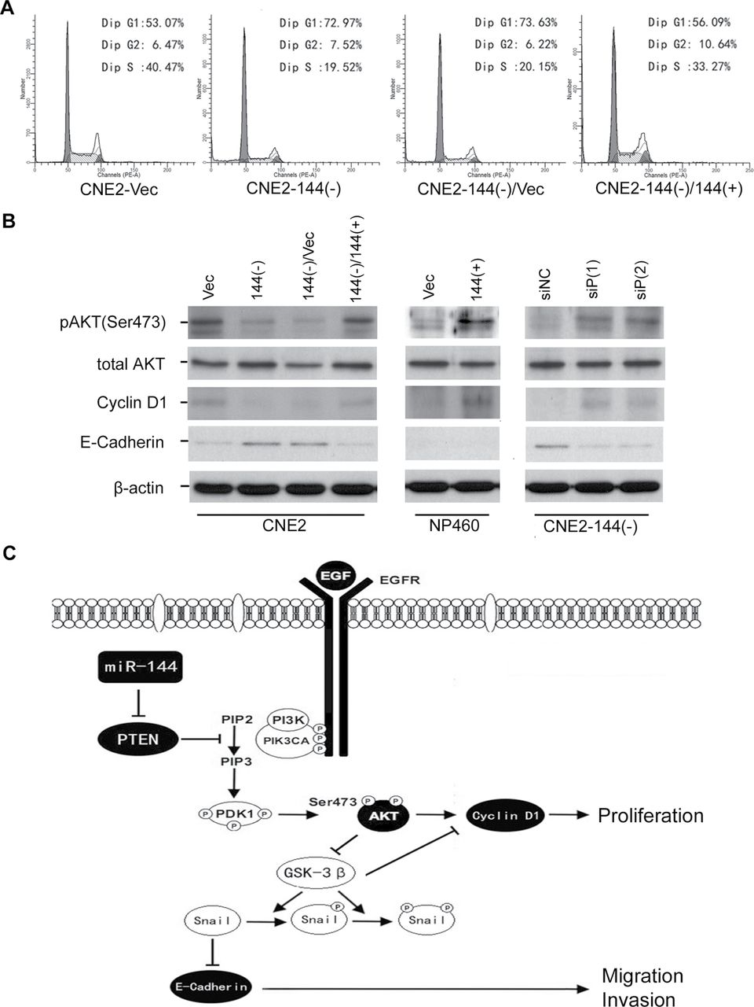
Fig. 7. miR-144 promotes NPC cell proliferation, migration and invasion mainly via activating the PI3K/Akt signaling ...
Notes:
Fig. 7. miR-144 promotes NPC cell proliferation, migration and invasion mainly via activating the PI3K/Akt signaling pathway. ( A ) Representative charts for cell-cycle distribution in anti-miR-144-repressed [144(−)] and pre-miR-144-restored [144(−)/144(+)] CNE2 cells. CNE2-Vec or CNE2-144(−)/Vec cells were used as control. ( B ) Western blotting for p-Akt (Ser473), total Akt, cyclin D1, E-cadherin and loading control β-actin in CNE2 [CNE2-Vec, CNE2-144(−), CNE2-144(−)/Vec and CNE2-144(−)/144(+)], NP460 [NP460-Vec and NP460-144(+)] and CNE2-144(−) [CNE2-144(−)/siNC, CNE2-144(−)/siP1 and CNE2-144(−)/siP2] cells. ( C ) Schematic diagram of activation of PTEN-dependent PI3K/Akt signaling pathway by miR-144 in NPC. miR-144 suppressed PTEN expression to promote NPC cell proliferation by increasing pAkt and cyclin D1, whereas to promote NPC cell migration and invasion by decreasing E-cadherin.
Unless provided in the caption above, the following copyright applies to the content of this slide: © Crown copyright 2012

