Slide 1
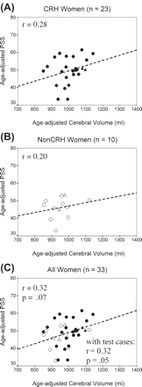
Fig. 4 Scatterplots and regression lines showing the relationship between age-adjusted PSS and age-adjusted cerebral ...
Notes:
Fig. 4 Scatterplots and regression lines showing the relationship between age-adjusted PSS and age-adjusted cerebral volume. (A) CRH women, (B) non-CRH women and (C) all women. Correlations and regression lines do not include the plotted test cases. Regression equations are (for age-adjusted scores): (A) PSS = 0.03 cerebral volume + 17; (B) PSS = 0.02 cerebral volume + 31; (C) PSS = 0.03 cerebral volume + 17. Closed circle = CRH; open circle = non-CRH; test cases: closed triangle = CRH (n = 2); open triangle = non-CRH (n = 2). Dashed regression lines indicate that r is not statistically significant but may reflect insufficient power.
Unless provided in the caption above, the following copyright applies to the content of this slide: © The Author (2005). Published by Oxford University Press on behalf of the Guarantors of Brain. All rights reserved. For Permissions, please email: journals.permissions@oxfordjournals.org

Slide 2
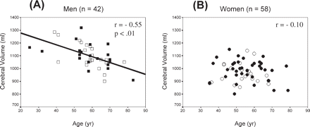
Fig. 1 Scatterplots showing the relationship between cerebral volume and age in (A) men and in (B) women. Regression ...
Notes:
Fig. 1 Scatterplots showing the relationship between cerebral volume and age in (A) men and in (B) women. Regression equations are: (A) Cerebral volume = −4.62 age + 1371; and (B) Cerebral volume = −0.78 age + 1020. Men: closed square = CRH; open square = non-CRH; women: closed circle = CRH; open circle = non-CRH.
Unless provided in the caption above, the following copyright applies to the content of this slide: © The Author (2005). Published by Oxford University Press on behalf of the Guarantors of Brain. All rights reserved. For Permissions, please email: journals.permissions@oxfordjournals.org

Slide 3
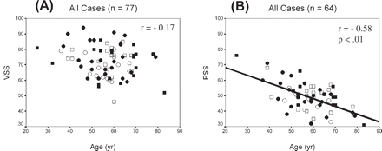
Fig. 2 Scatterplots showing the relationship of age with (A) VSS and (B) PSS for the total sample. Regression ...
Notes:
Fig. 2 Scatterplots showing the relationship of age with (A) VSS and (B) PSS for the total sample. Regression equations are: (A) VSS = −0.16 cerebral volume + 81 and (B) PSS = −0.50 cerebral volume + 78. Men: closed square = CRH; open square = non-CRH; women: closed circle = CRH; open circle = non-CRH.
Unless provided in the caption above, the following copyright applies to the content of this slide: © The Author (2005). Published by Oxford University Press on behalf of the Guarantors of Brain. All rights reserved. For Permissions, please email: journals.permissions@oxfordjournals.org

Slide 4
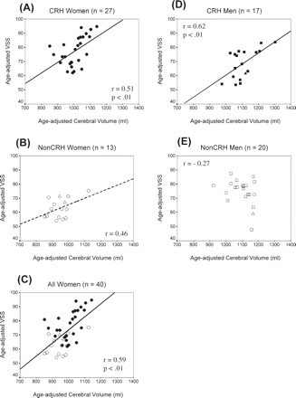
Fig. 3 Scatterplots and regression lines showing the relationship between age-adjusted VSS and age-adjusted cerebral ...
Notes:
Fig. 3 Scatterplots and regression lines showing the relationship between age-adjusted VSS and age-adjusted cerebral volume. (A) CRH women, (B) non-CRH women, (C) all women, (D) CRH men and (E) non-CRH men. Correlations and regression lines do not include the plotted test cases. Regression equations are (for age-adjusted scores): (A) VSS = 0.07 cerebral volume + 2; (B) VSS = 0.04 cerebral volume + 20; (C) VSS = 0.09 cerebral volume − 19; (D) VSS = 0.08 cerebral volume − 18; (E) VSS = −0.03 cerebral volume + 113. Women: closed circle = CRH; open circle = non-CRH; men: closed square = CRH; open square = non-CRH. Test cases: closed triangle = CRH (n = 1), open triangle = Non-CRH (n = 3). Dashed regression line indicates that r is not statistically significant but may reflect insufficient power.
Unless provided in the caption above, the following copyright applies to the content of this slide: © The Author (2005). Published by Oxford University Press on behalf of the Guarantors of Brain. All rights reserved. For Permissions, please email: journals.permissions@oxfordjournals.org

Slide 5
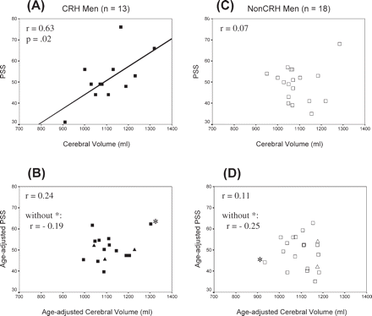
Fig. 5 Scatterplots and regression lines showing the relationship between PSS and cerebral volume. (A) CRH men, (B) ...
Notes:
Fig. 5 Scatterplots and regression lines showing the relationship between PSS and cerebral volume. (A) CRH men, (B) CRH men with age controlled, (C) non-CRH men, (D) non-CRH men with age controlled. Asterisk (*) denotes influential cases. Correlations do not include the plotted test cases. closed square = CRH; open square = non-CRH. Test cases shown in (B) and (D): closed triangle = CRH (n = 3); open triangle = non-CRH (n = 2).
Unless provided in the caption above, the following copyright applies to the content of this slide: © The Author (2005). Published by Oxford University Press on behalf of the Guarantors of Brain. All rights reserved. For Permissions, please email: journals.permissions@oxfordjournals.org

