Slide 1
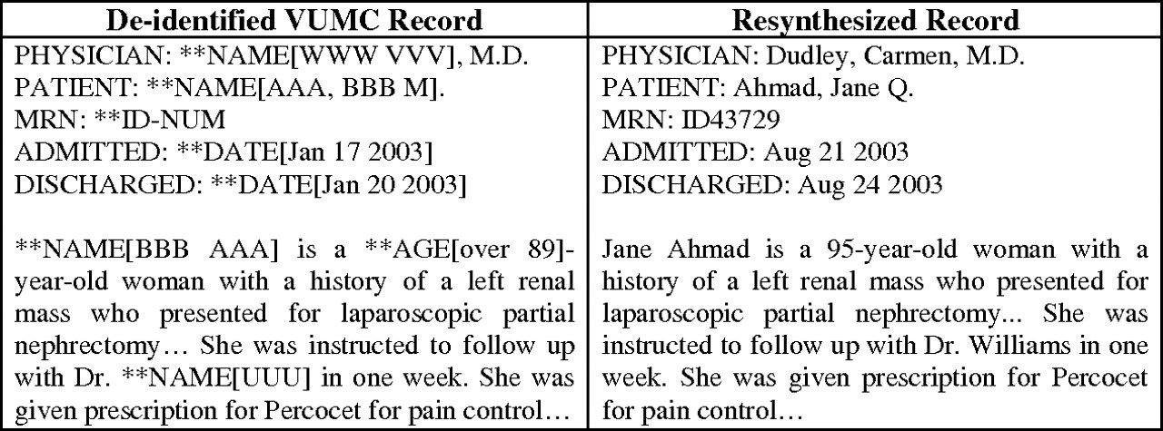
Figure 1 Left: DE-ID annotation. Right: resynthesized version of a partial Vanderbilt University Medical Center (VUMC) ...
Notes:
Figure 1 Left: DE-ID annotation. Right: resynthesized version of a partial Vanderbilt University Medical Center (VUMC) medical record.
Unless provided in the caption above, the following copyright applies to the content of this slide: © 2010, Published by the BMJ Publishing Group Limited For permission to use, (where not already granted under a licence) please go to http://group.bmj.com/group/rights-licensing/permissions.

Slide 2
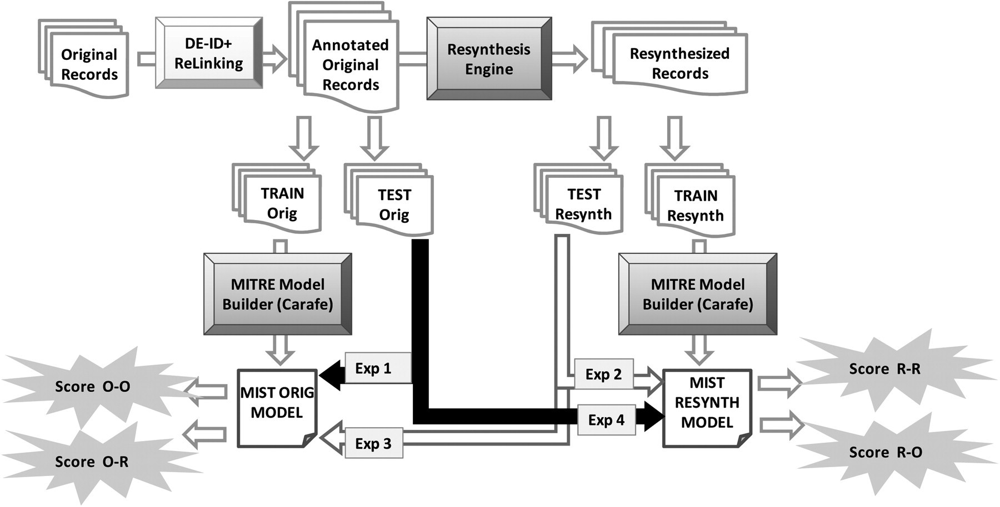
Figure 2 Training and testing framework for text de-identification with resynthesis.
Notes:
Figure 2 Training and testing framework for text de-identification with resynthesis.
Unless provided in the caption above, the following copyright applies to the content of this slide: © 2010, Published by the BMJ Publishing Group Limited For permission to use, (where not already granted under a licence) please go to http://group.bmj.com/group/rights-licensing/permissions.

Slide 3
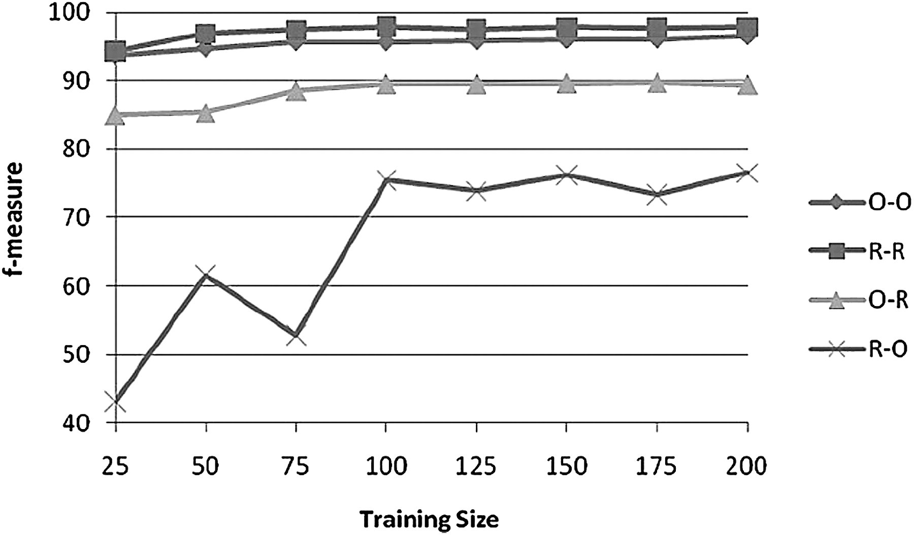
Figure 3 Impact of number of training documents on F-measure for discharge records.
Notes:
Figure 3 Impact of number of training documents on F-measure for discharge records.
Unless provided in the caption above, the following copyright applies to the content of this slide: © 2010, Published by the BMJ Publishing Group Limited For permission to use, (where not already granted under a licence) please go to http://group.bmj.com/group/rights-licensing/permissions.

Slide 4
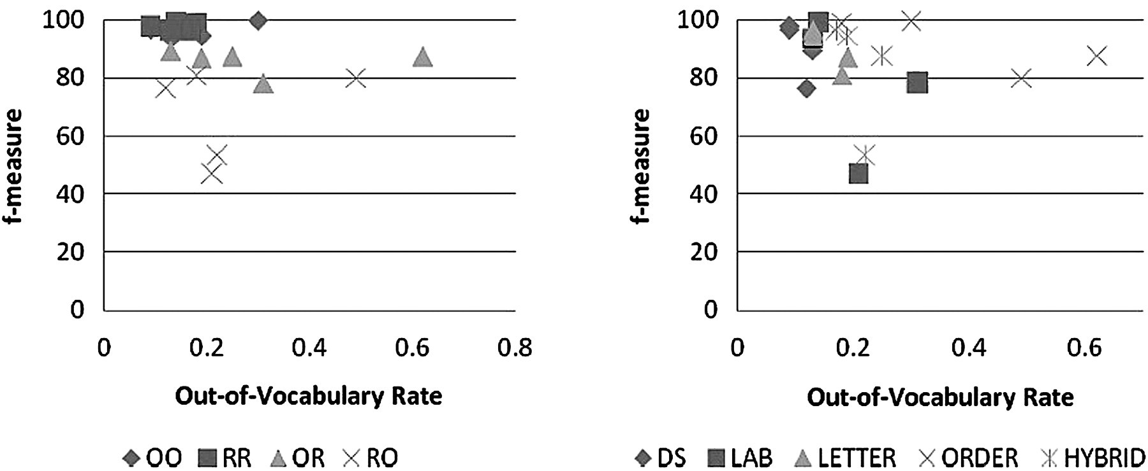
Figure 4 Relative change in F-measure as a function of out-of-vocabulary rate. The scores are grouped by (left) ...
Notes:
Figure 4 Relative change in F-measure as a function of out-of-vocabulary rate. The scores are grouped by (left) experiment type and (right) document type.
Unless provided in the caption above, the following copyright applies to the content of this slide: © 2010, Published by the BMJ Publishing Group Limited For permission to use, (where not already granted under a licence) please go to http://group.bmj.com/group/rights-licensing/permissions.

Slide 5
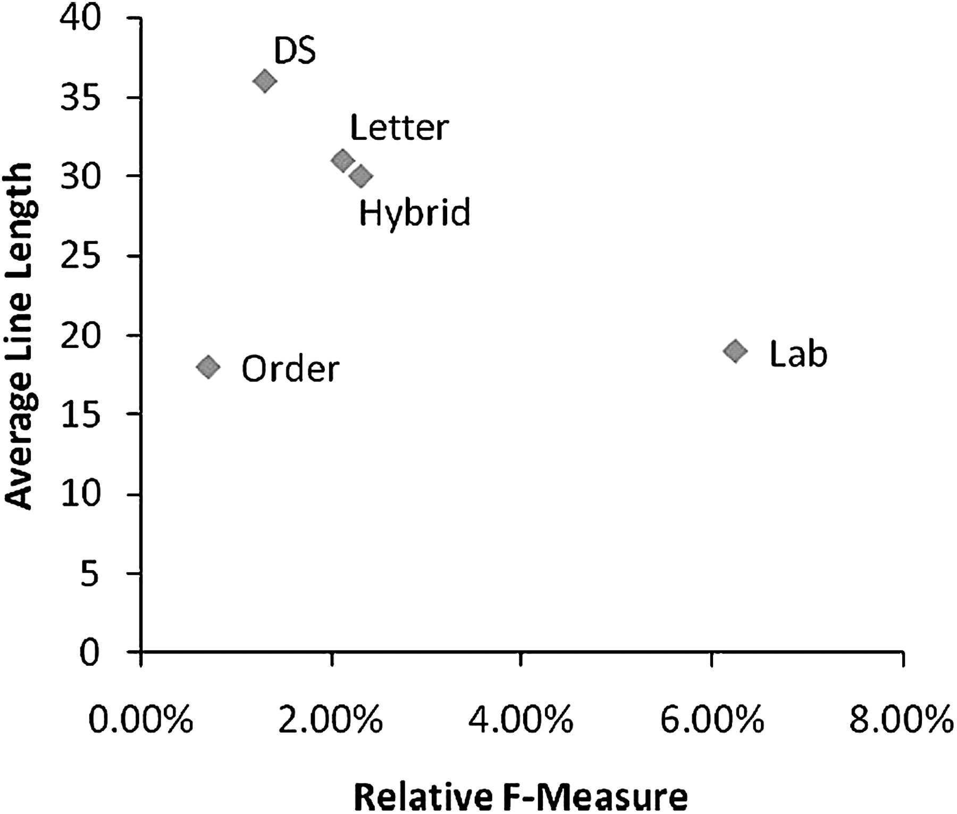
Figure 5 Normalized difference in the F-measures of the results in O⇒O and R⇒R experiments for protected health ...
Notes:
Figure 5 Normalized difference in the F-measures of the results in O⇒O and R⇒R experiments for protected health information tokens.
Unless provided in the caption above, the following copyright applies to the content of this slide: © 2010, Published by the BMJ Publishing Group Limited For permission to use, (where not already granted under a licence) please go to http://group.bmj.com/group/rights-licensing/permissions.

