Slide 1
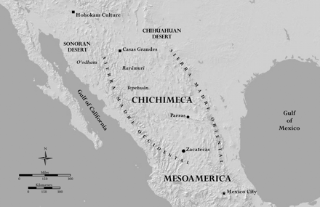
Figure 1 Northern New Spain Location and Relief Map. Credit: Cartography by Jeffrey A. Erbig, Jr.
Notes:
Figure 1 Northern New Spain Location and Relief Map. Credit: Cartography by Jeffrey A. Erbig, Jr.
Unless provided in the caption above, the following copyright applies to the content of this slide: © 2011 The Author. Published by Oxford University Press on behalf of the American Society for Environmental History and the Forest History Society. All rights reserved. For Permissions, please email: journals.permissions@oup.com

Slide 2
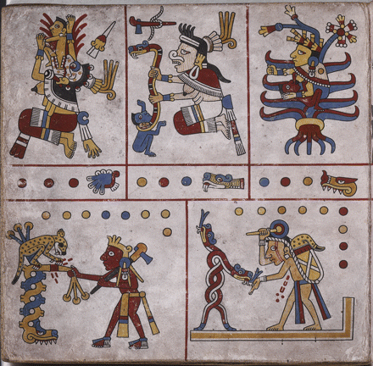
Figure 2 In the upper portion of this illustration from Códice Fejérváry-Mayer, a pre-Hispanic book of moral codes ...
Notes:
Figure 2 In the upper portion of this illustration from Códice Fejérváry-Mayer, a pre-Hispanic book of moral codes from the Nahua culture of central Mexico, the agave plant appears in the guise of Mayahuel, one of the patrons of childbirth, as she nurses a child. Credit: Códice Fejérváry-Mayer, Plate 28. National Museums, Liverpool, M/12014. The Codex was published in Ferdinand Anders, Maarten Jansen, and Luis Reyes García, eds. El libro de Tezcatlipoca, Señor del Tiempo. Libro explicativo del llamado Códice Fejérváry-Mayer. (Austria: Akademische Druck-und Verlagsanstalt, México: Fondo de Cultura Económica, 1994), I: 76–77.
Unless provided in the caption above, the following copyright applies to the content of this slide: © 2011 The Author. Published by Oxford University Press on behalf of the American Society for Environmental History and the Forest History Society. All rights reserved. For Permissions, please email: journals.permissions@oup.com

Slide 3
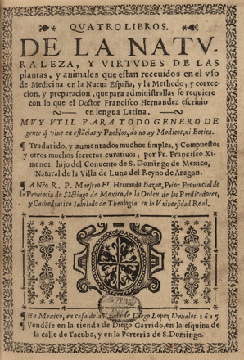
Figure 3 Title page for Fr. Francisco Ximénez, Quatro Libros de la Naturaleza y virtudes de las plantas, y animales ...
Notes:
Figure 3 Title page for Fr. Francisco Ximénez, Quatro Libros de la Naturaleza y virtudes de las plantas, y animales que están recevidos en el uso de Medicina en la Nueva España … con lo que el Doctor Francisco Hernández escribió en lengua Latina (Mexico City, 1615). This abridged translation of Francisco Hernández's Natural History of New Spain made it available to a wider reading audience in Mexico, where it was published, and in Europe. The original multi-volume work was written in Latin and unpublished. Credit: The John Carter Brown Library at Brown University.
Unless provided in the caption above, the following copyright applies to the content of this slide: © 2011 The Author. Published by Oxford University Press on behalf of the American Society for Environmental History and the Forest History Society. All rights reserved. For Permissions, please email: journals.permissions@oup.com

Slide 4
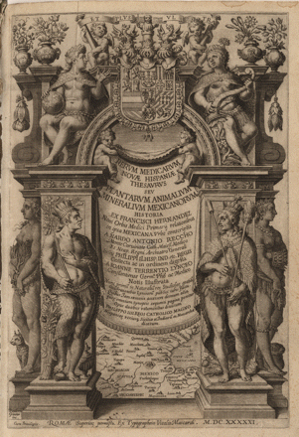
Figure 4 Title page for Nardo Antonio Reccho, Rerum medicarum novae hispaniae thesaurus seu plantarum animalium ...
Notes:
Figure 4 Title page for Nardo Antonio Reccho, Rerum medicarum novae hispaniae thesaurus seu plantarum animalium mineralium mexicanorum (Rome, 1651). Note the Habsburg dynastic shield hanging above the banner that contains the book's title, and the map of central Mexico enclosed between the columns at the lower center of the edifice. The book introduced the medical knowledge of New Spain to the world through Spain's overseas empire. Credit: The John Carter Brown Library at Brown University.
Unless provided in the caption above, the following copyright applies to the content of this slide: © 2011 The Author. Published by Oxford University Press on behalf of the American Society for Environmental History and the Forest History Society. All rights reserved. For Permissions, please email: journals.permissions@oup.com

Slide 5
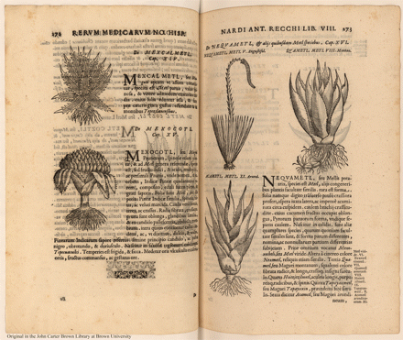
Figure 5 These botanical drawings depict five varieties of metl, the agave family of plants, which were named and ...
Notes:
Figure 5 These botanical drawings depict five varieties of metl, the agave family of plants, which were named and classified by Francisco Hernández, and are shown in Table 1 of this article. The drawings offer detailed images of individual plants' leaves, stems, roots and, for the nequametl, its seeded inflorescence. Nardo Antonio Reccho, Rerum medicarum novae hispaniae thesaurus (Rome, 1651): 272–273. Credit: The John Carter Brown Library at Brown University.
Unless provided in the caption above, the following copyright applies to the content of this slide: © 2011 The Author. Published by Oxford University Press on behalf of the American Society for Environmental History and the Forest History Society. All rights reserved. For Permissions, please email: journals.permissions@oup.com

