Slide 1
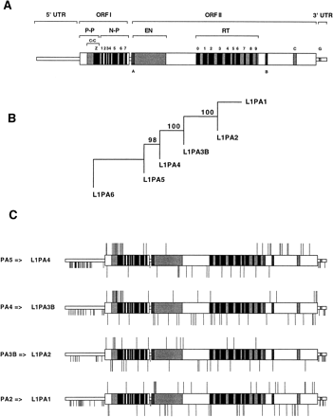
Fig. 1.—Differences among L1 families. (A) Structure of a human full-length element. A typical full-length ...
Notes:
Fig. 1.—Differences among L1 families. (A) Structure of a human full-length element. A typical full-length element has a 5′ untranslated region (5′UTR), two open-reading frames (ORFI and ORFII), and a 3′UTR (for a review, see Furano 2000 ). The 5′UTR has a regulatory function. ORFI encodes a 40-kDa protein with an N-terminal domain involved in protein-protein interaction (P-P) and a C-terminal domain with nucleic-acid binding and chaperone activity (N-P) (Martin, Li, and Weisz 2000 ; Martin and Bushman 2001 ). The N-terminal domain contains a potential coiled coil domain (C-C) and a leucine-zipper domain (Z). The C-terminal domain contains seven (1–7 in fig. 1 ) regions that are highly conserved among human, rat, mouse, and rabbit L1 (Hohjoh and Singer 1996 ). ORFII encodes endonuclease (EN) and reverse transcriptase (RT) domains and a Cys-rich region (C). The RT domain contains 10 (0–9) regions that are highly conserved among most non-LTR retrotransposons (Malik, Burke, and Eickbush 1999 ). In addition, the transcript of ORFII contains two regions (A and B) to which ORFIp is thought to bind (Hohjoh and Singer 1997 ). The 3′UTR contains a conserved G-rich motif (G) (Howell and Usdin 1997 ). (B) Maximum-likelihood tree built on the consensus sequences of the 3′UTR of six L1 families. The tree is rooted with L1PA6. The numbers above the nodes indicate the percentages of the time the labeled node was present in 1,000 bootstrap replicates of the data. (C) Nucleotide substitutions among L1 families, from L1PA5 to L1PA1. Each bar represents a substitution in the indicated pairwise comparison. Bars above the ORFs represent nonsynonymous substitutions, bars below the ORFs represent synonymous substitutions. Short bars represent substitutions located in noncoding regions
Unless provided in the caption above, the following copyright applies to the content of this slide:

Slide 2
Fig. 2.—Structure of the coiled coil domain of L1PA5 and L1PA1. Heptads are numbered I to XI and amino acid ...
Notes:
Fig. 2.—Structure of the coiled coil domain of L1PA5 and L1PA1. Heptads are numbered I to XI and amino acid positions within each heptads are indicated a to g. Only amino acids at position a and d (in bold) and amino acids that differ between L1PA5 and L1PA1 are shown. Conservative changes for polarity (see text) are represented by + and radical changes by −
Unless provided in the caption above, the following copyright applies to the content of this slide:

