Slide 1
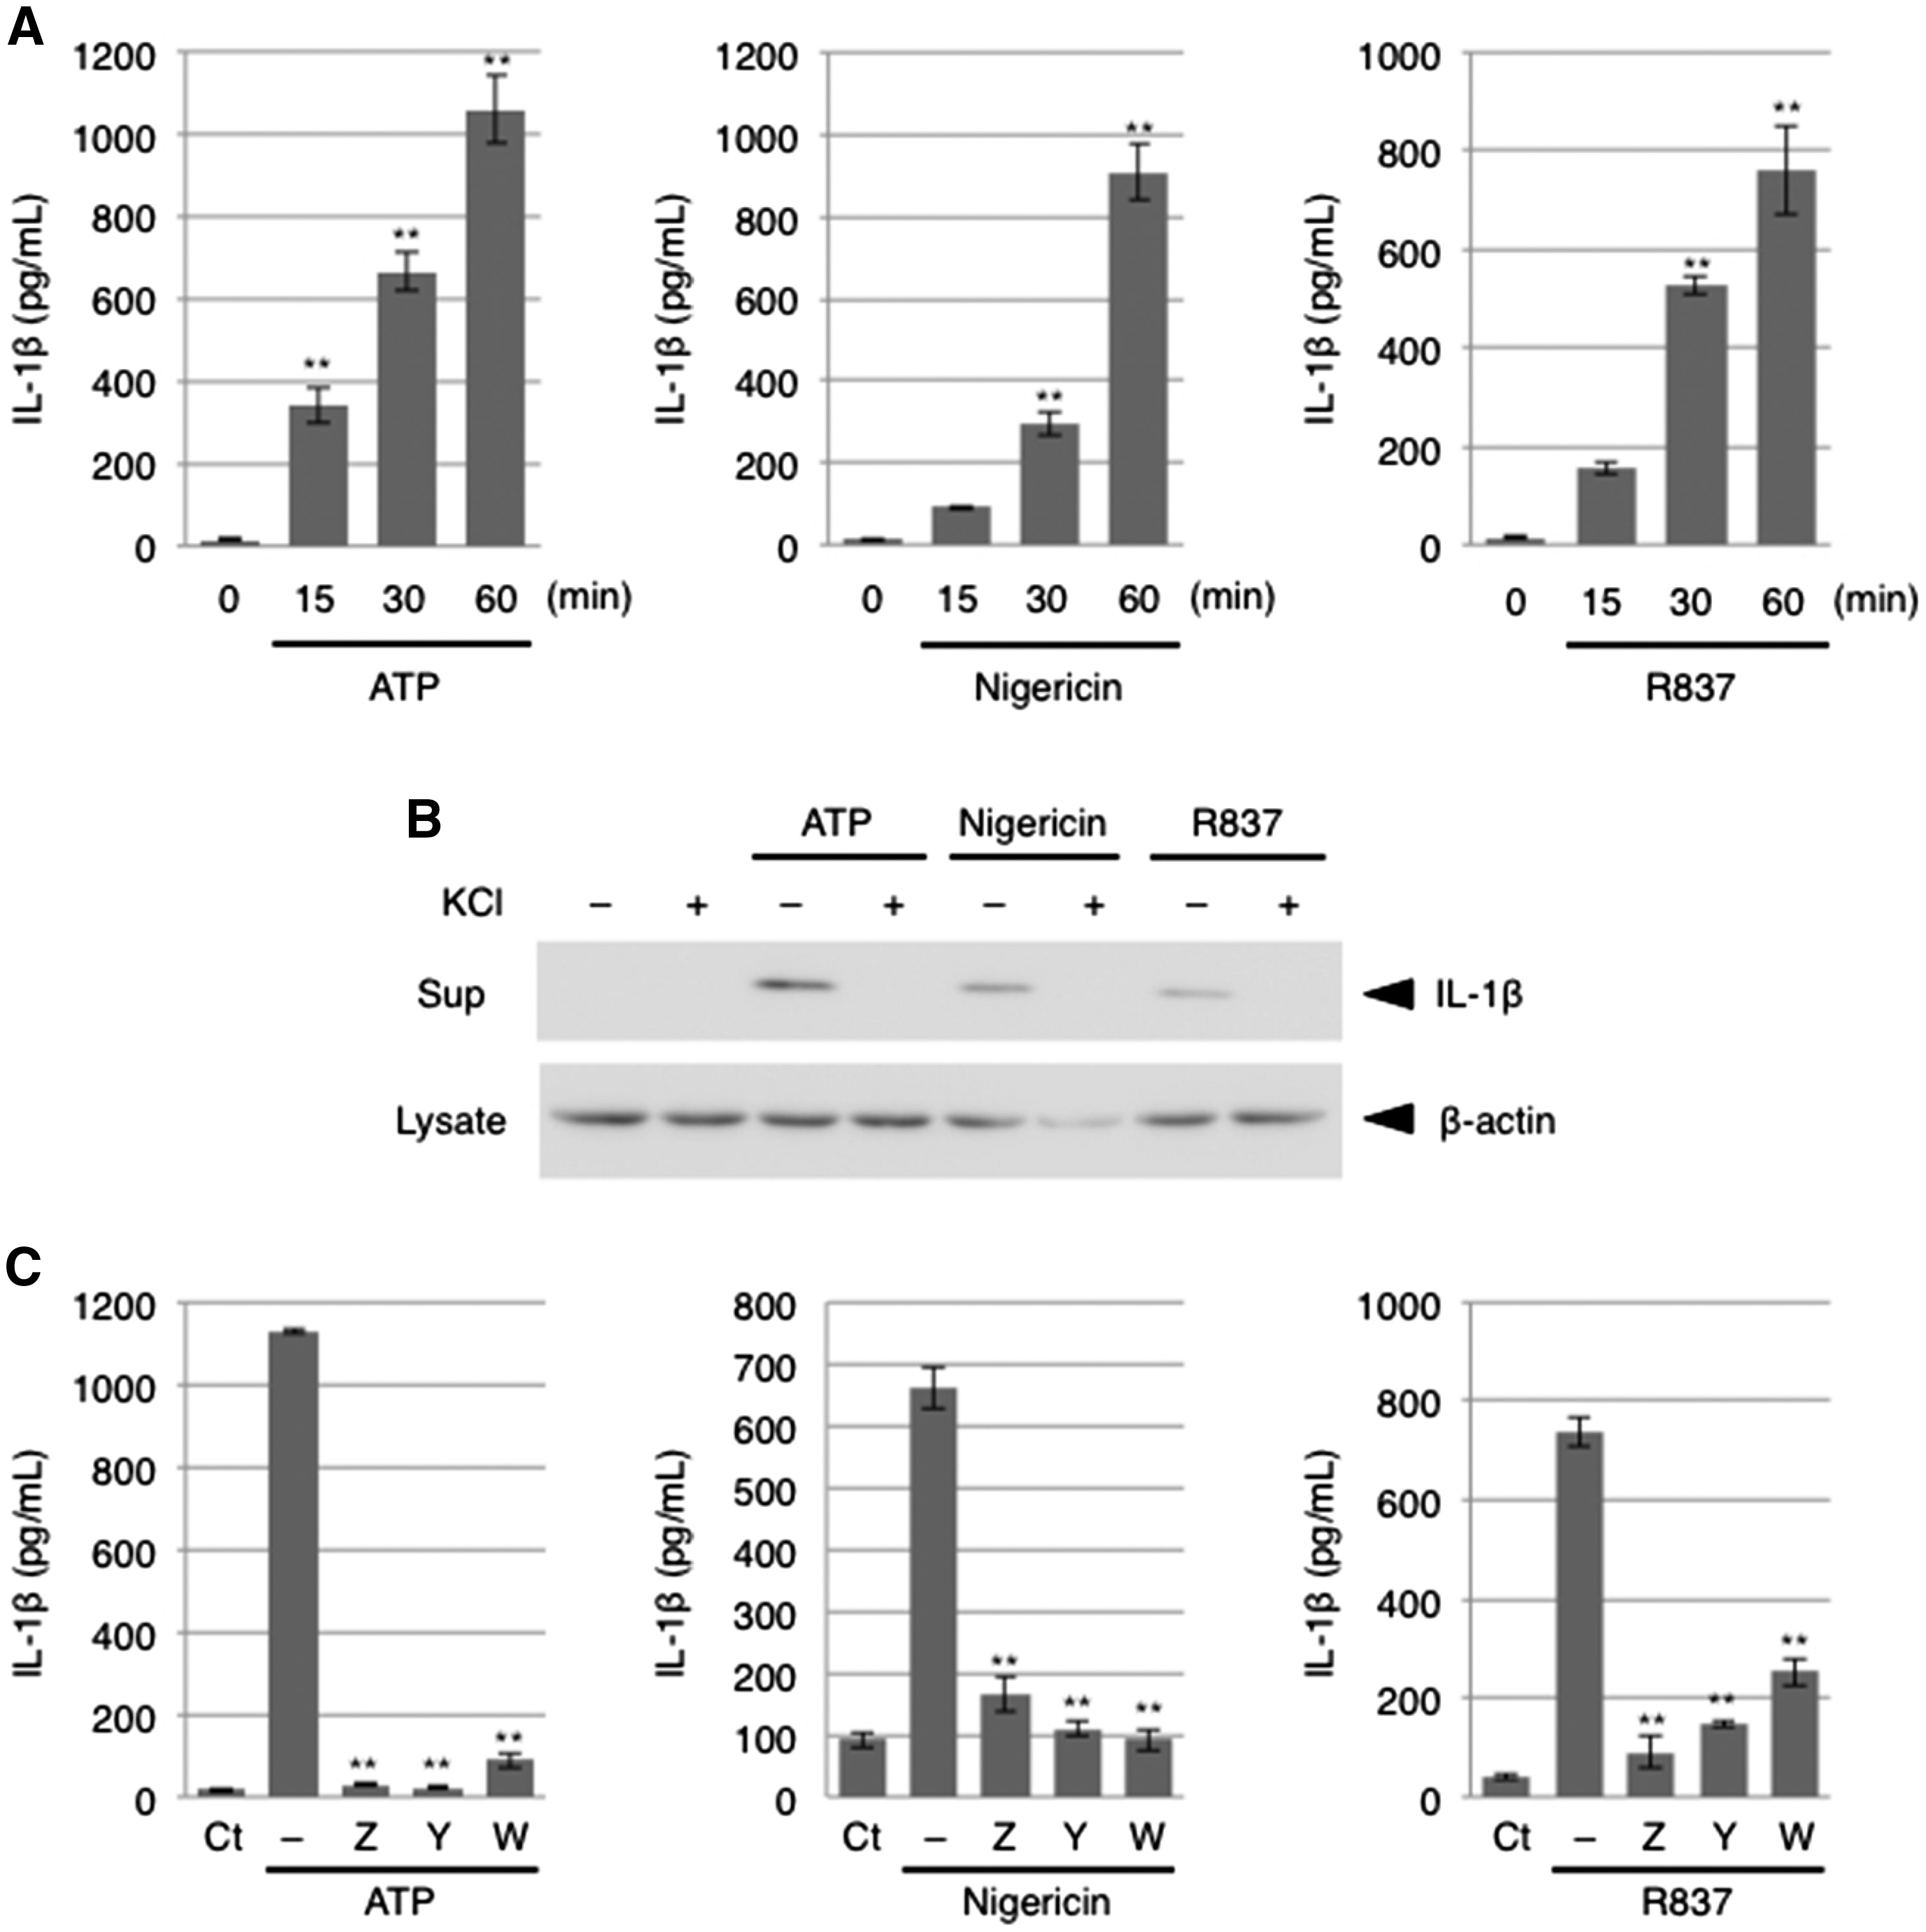
Fig. 1 ATP, nigericin and R837 similarly induce IL-1β release from BMDMs in an NLRP3 inflammasome-dependent manner. ...
Notes:
Fig. 1 ATP, nigericin and R837 similarly induce IL-1β release from BMDMs in an NLRP3 inflammasome-dependent manner. (A) BMDMs were treated with 5 mM ATP, 5 μM nigericin or 20 μg/ml R837 for the indicated periods. The culture supernatants were subjected to an IL-1β ELISA. Data are shown as the mean ± SEM (n = 3). **P < 0.01, Dunnett’s multiple comparison test, compared with untreated cells. (B) BMDMs were pretreated with 60 mM KCl for 15 min and then treated with 5 mM ATP, 5 μM nigericin or 20 μg/ml R837 for 60 min. The culture supernatants (Sup) and cell lysates were subjected to immunoblot analysis. (C) BMDMs were pretreated with 10 μM Z-VAD-FMK (Z), 10 μM Ac-YVAD-CMK (Y), or 10 μM Ac-WEHD-CHO (W) for 15 min and then treated with 5 mM ATP, 5 μM nigericin or 20 μg/ml R837 for 15 min. The culture supernatants were subjected to an IL-1β ELISA. Data are shown as the mean ± SEM (n = 3). **P < 0.01, Dunnett’s multiple comparison test, compared with ATP-treated cells not exposed to an inhibitor.
Unless provided in the caption above, the following copyright applies to the content of this slide: © The Authors 2017. Published by Oxford University Press on behalf of the Japanese Biochemical Society. All rights reserved

Slide 2
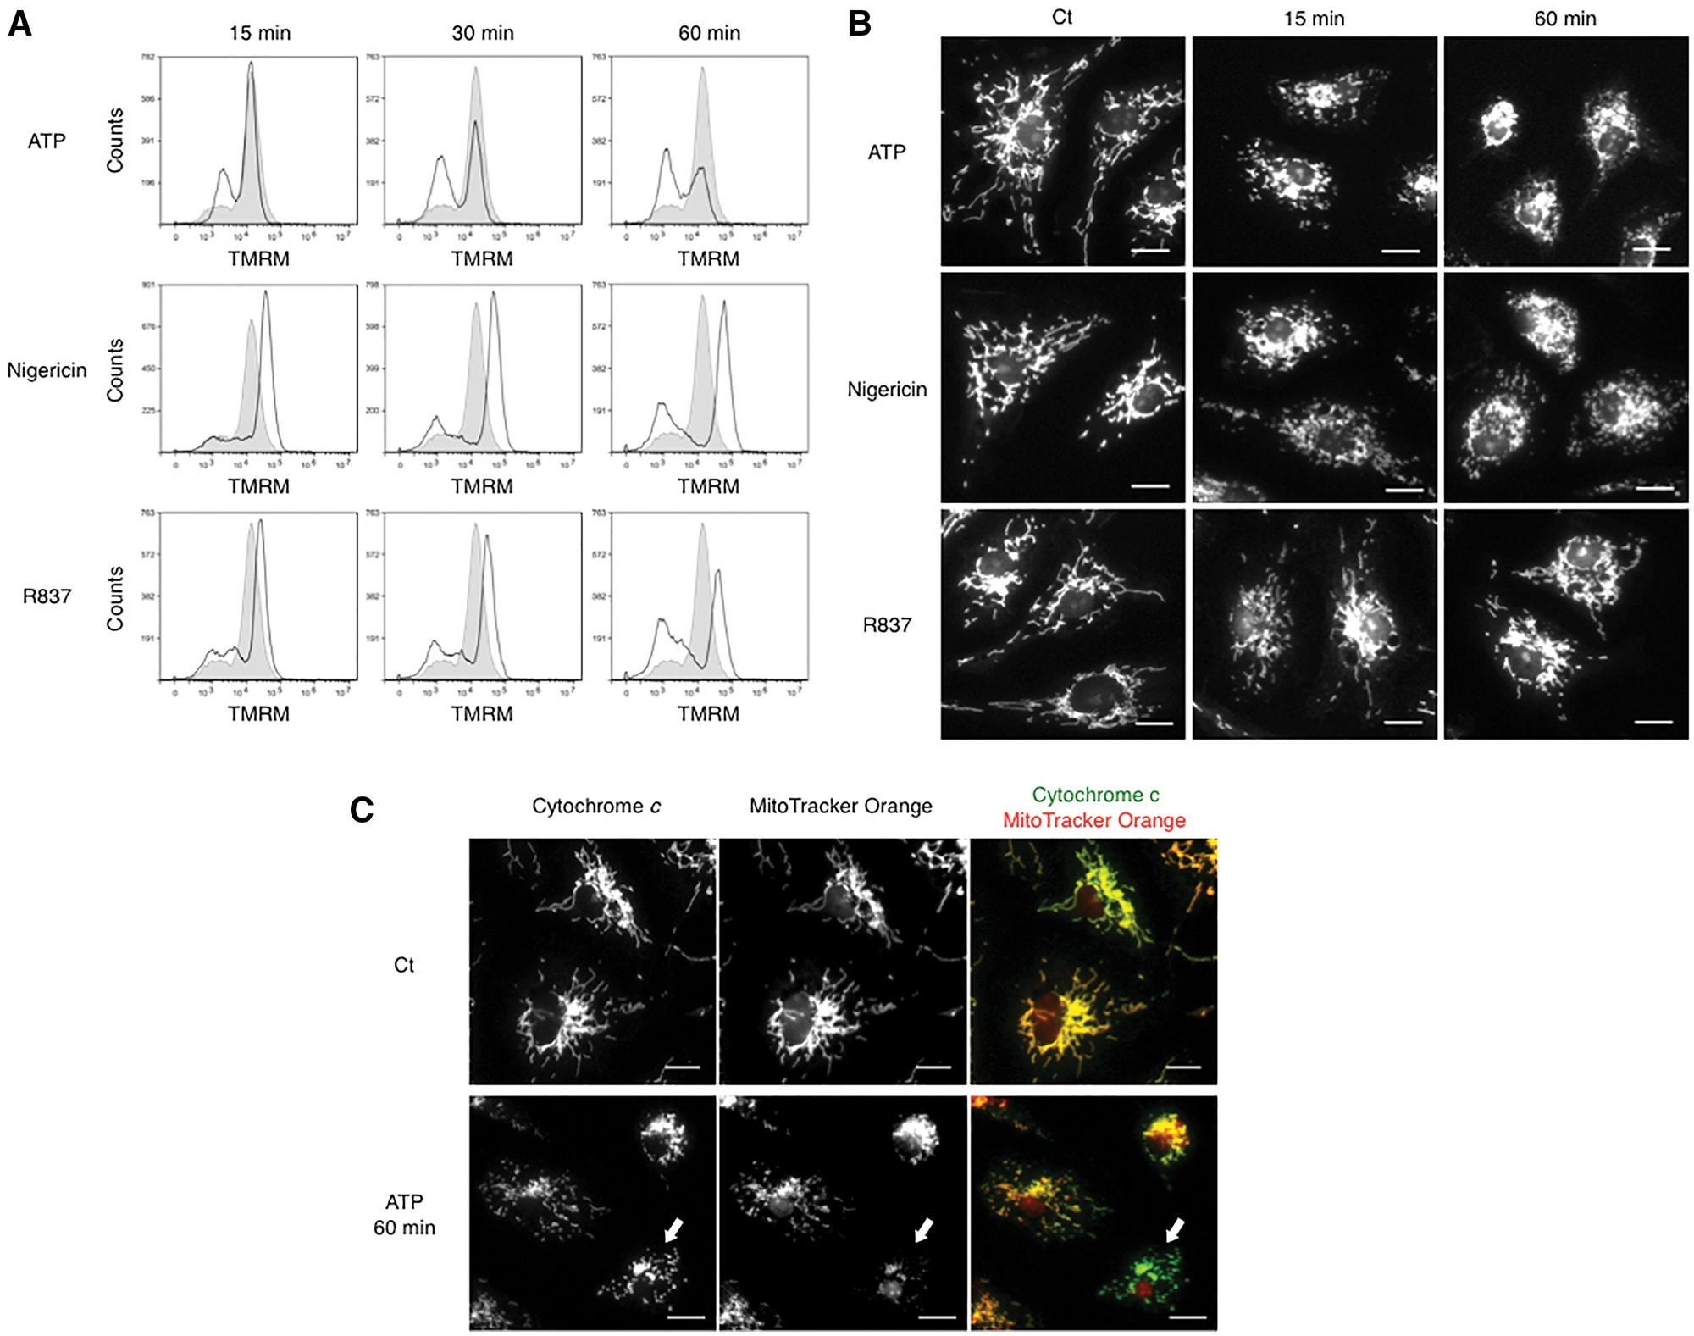
Fig. 2 ATP, nigericin and R837 exert different effects on mitochondrial membrane potential and mitochondrial ...
Notes:
Fig. 2 ATP, nigericin and R837 exert different effects on mitochondrial membrane potential and mitochondrial morphology in BMDMs. BMDMs were treated with 5 mM ATP, 5 μM nigericin or 20 μg/ml R837 for the indicated periods. (A) Cells were stained with 250 nM TMRM for 15 min before harvest and then subjected to flow cytometric analysis. Gray and black histograms indicate control and stimulated cells, respectively. (B) Cells were stained with 250 nM MitoTracker Orange CMTMRos for 15 min before fixation, followed by microscopic observation. Scale bars: 10 μm. (C) Cells treated with or without 5 mM ATP for 60 min were co-stained with anti-cytochrome c antibody and MitoTracker Orange, followed by microscopic observation. Scale bars: 10 μm. Arrows indicate a cell in which Δψm is reduced.
Unless provided in the caption above, the following copyright applies to the content of this slide: © The Authors 2017. Published by Oxford University Press on behalf of the Japanese Biochemical Society. All rights reserved

Slide 3
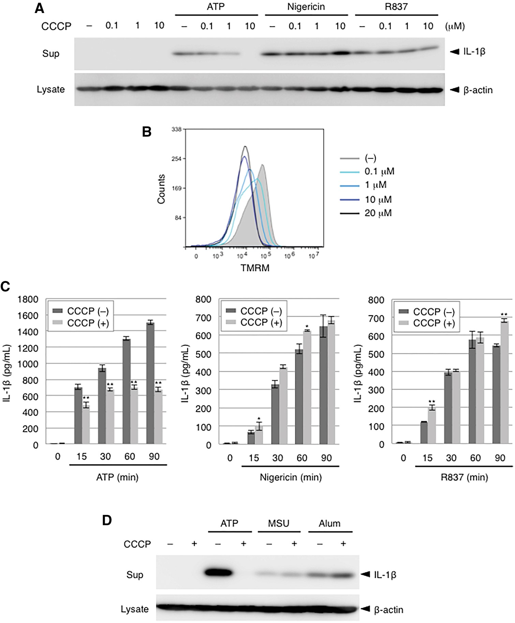
Fig. 3 CCCP inhibits IL-1β release from BMDMs induced by ATP but not by other stimuli. (A) BMDMs were pretreated ...
Notes:
Fig. 3 CCCP inhibits IL-1β release from BMDMs induced by ATP but not by other stimuli. (A) BMDMs were pretreated with the indicated doses of CCCP for 15 min and then treated with 5 mM ATP, 5 μM nigericin or 20 μg/mL R837 for 60 min. The culture supernatants (Sup) and cell lysates were subjected to immunoblot analysis. (B) BMDMs were treated with the indicated doses of CCCP and 250 nM TMRM for 15 min and then subjected to flow cytometric analysis. (C) BMDMs were pretreated with or without 10 μM CCCP for 15 min and then treated with 5 mM ATP, 5 μM nigericin or 20 μg/ml R837 for 60 min. The culture supernatants were subjected to an IL-1β ELISA. Data are shown as the mean ± SEM (n = 3). *P < 0.05, **P < 0.01, Student’s t test, compared with the respective cells that were not treated with CCCP. (D) BMDMs were treated with 0.4 mg/ml MSU or Alum for 6 hr and with 10 μM CCCP for the last 2 h. As a positive control, BMDMs were pretreated with 10 μM CCCP for 15 min and then treated with 5 mM ATP for 60 min. The culture supernatants (Sup) and cell lysates were subjected to immunoblot analysis.
Unless provided in the caption above, the following copyright applies to the content of this slide: © The Authors 2017. Published by Oxford University Press on behalf of the Japanese Biochemical Society. All rights reserved

Slide 4
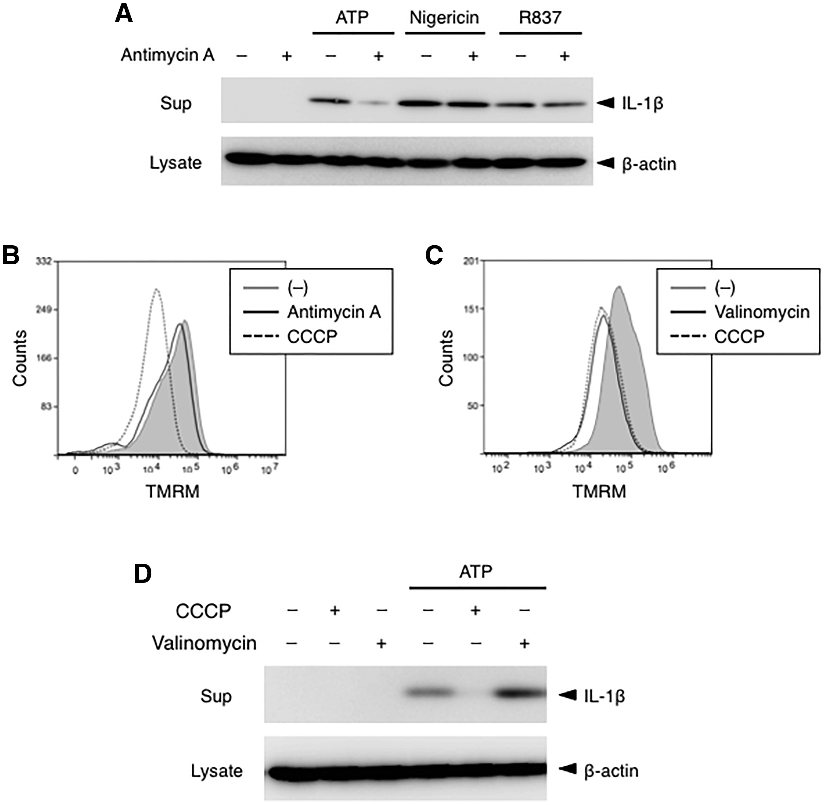
Fig. 4 Antimycin A, but not valinomycin, inhibits ATP-induced IL-1β release from BMDMs. (A) BMDMs were pretreated ...
Notes:
Fig. 4 Antimycin A, but not valinomycin, inhibits ATP-induced IL-1β release from BMDMs. (A) BMDMs were pretreated with 10 μM antimycin A for 15 min and then treated with 5 mM ATP, 5 μM nigericin or 20 μg/ml R837 for 60 min. The culture supernatants (Sup) and cell lysates were subjected to immunoblot analysis. (B, C) BMDMs were treated with 10 μM CCCP, 10 μM antimycin A (B), or 1 μM valinomycin (C) and 250 nM TMRM for 15 min and then subjected to flow cytometric analysis. (D) BMDMs were pretreated with 10 μM CCCP or 1 μM valinomycin for 15 min and then treated with 5 mM ATP for 60 min. The culture supernatants (Sup) and cell lysates were subjected to immunoblot analysis.
Unless provided in the caption above, the following copyright applies to the content of this slide: © The Authors 2017. Published by Oxford University Press on behalf of the Japanese Biochemical Society. All rights reserved

Slide 5
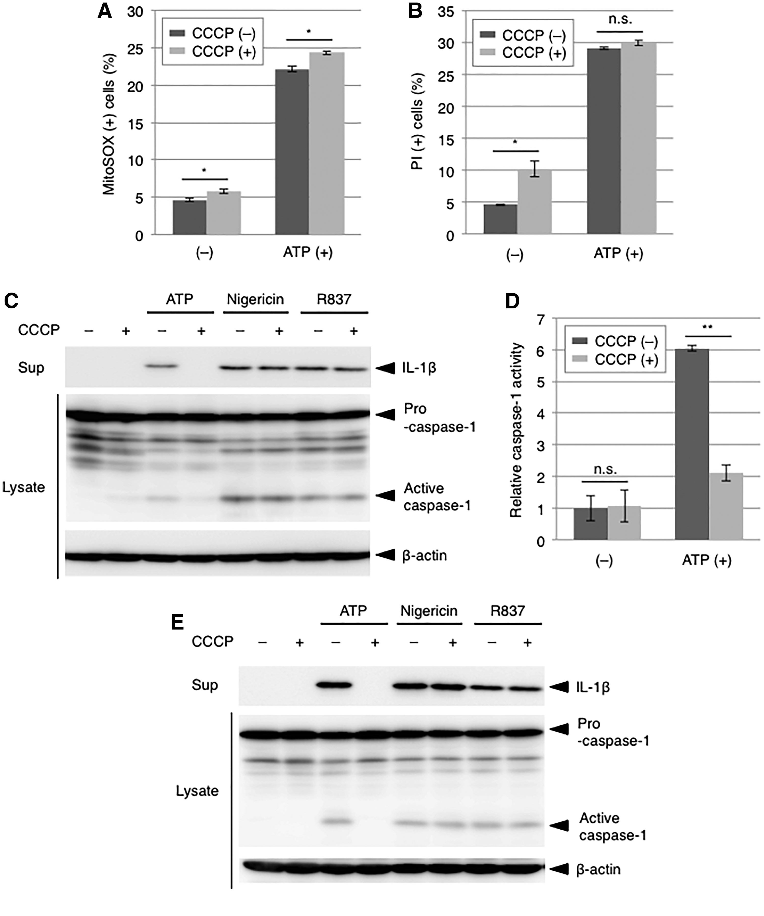
Fig. 5 CCCP inhibits ATP-induced activation of the NLRP3 inflammasome in BMDMs and PECs. (A, B) BMDMs were ...
Notes:
Fig. 5 CCCP inhibits ATP-induced activation of the NLRP3 inflammasome in BMDMs and PECs. (A, B) BMDMs were pretreated with or without 10 μM CCCP for 15 min and then treated with 5 mM ATP for 60 min. Cells were stained with 2.5 μM MitoSOX Red for 15 min (A) or with 2 μg/ml PI for 10 min (B) before harvest and then subjected to flow cytometric analysis. Data are shown as the mean ± SEM (n = 3). *P < 0.05, n.s. (not significant), Student’s t test. (C) BMDMs were pretreated with 10 μM CCCP for 15 min and then treated with 5 mM ATP, 5 μM nigericin or 20 μg/ml R837 for 60 min. The culture supernatants (Sup) and cell lysates were subjected to immunoblot analysis. (D) BMDMs were pretreated with or without 10 μM CCCP for 15 min and then treated with 5 mM ATP for 60 min. Caspase-1 activity was measured in cell lysates using the fluorometric peptide substrate Ac-YVAD-AFC. Data are shown as the mean ± SEM (n = 3). **P < 0.01, n.s. (not significant), Student’s t test. (E) PECs were treated as in (C). The culture supernatants (Sup) and cell lysates were subjected to immunoblot analysis.
Unless provided in the caption above, the following copyright applies to the content of this slide: © The Authors 2017. Published by Oxford University Press on behalf of the Japanese Biochemical Society. All rights reserved

