Slide 1
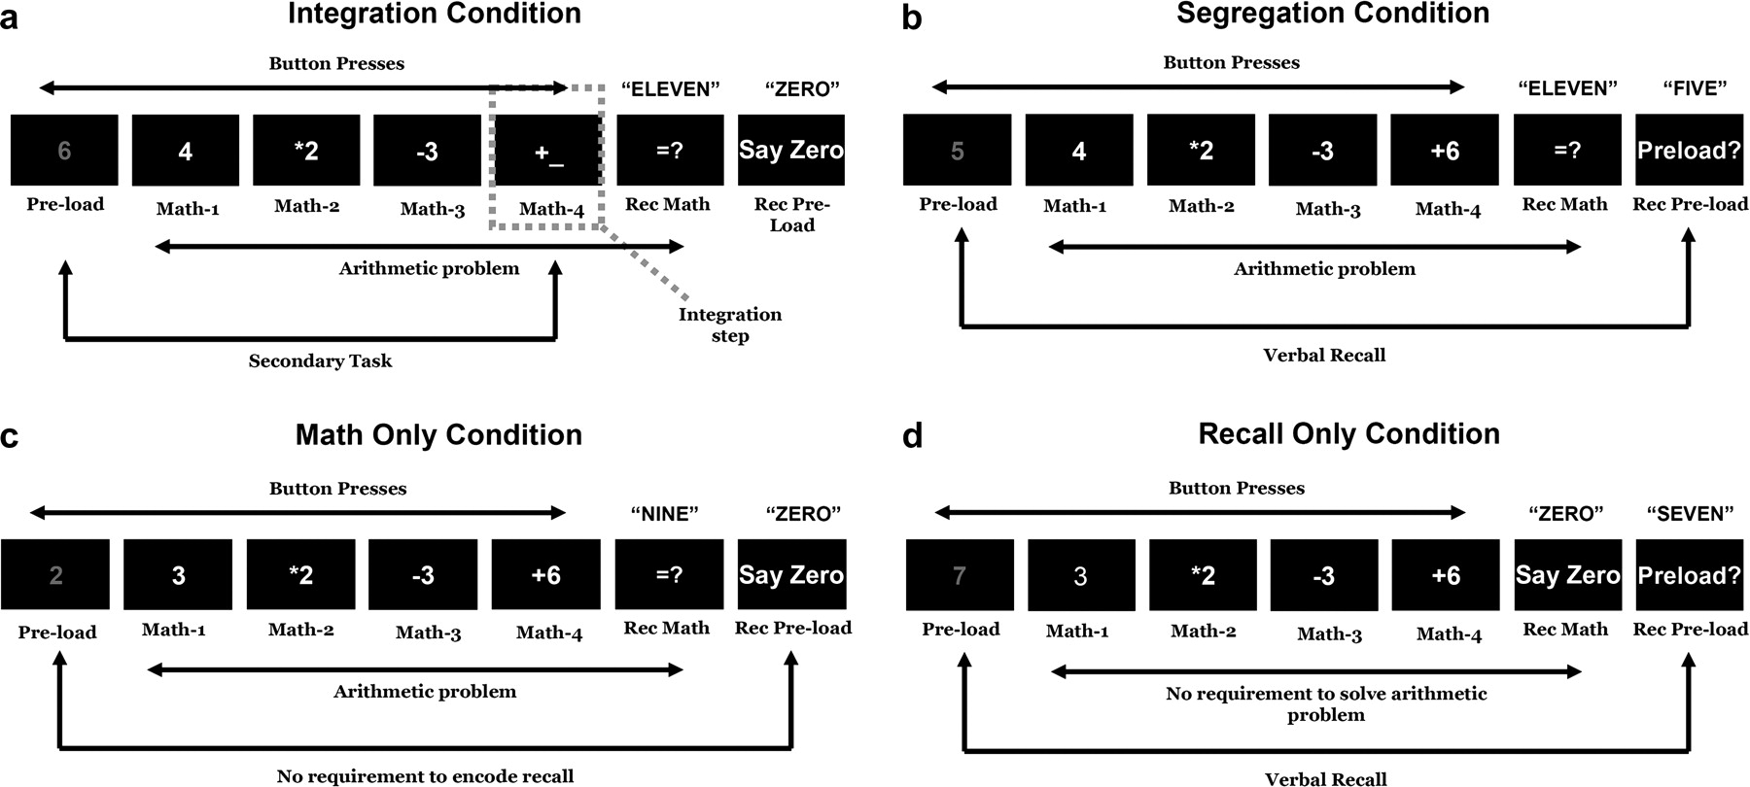
Figure 1. Task design. Participants performed digit processing tasks under 4 different block conditions. In 3 of the 4 ...
Notes:
Figure 1. Task design. Participants performed digit processing tasks under 4 different block conditions. In 3 of the 4 conditions, the primary task involved solving a 4-step mental arithmetic problem, presented sequentially in a frame-by-frame manner, in which each step (after the first, described later) consisted of single digits and mathematical operators (MATH-1 to MATH-4). Participants indicated when they were finished with each step of the computation with a button-press response. Following the presentation of each problem, a prompt appeared which instructed the participant to give a verbal report of the final total (REC-MATH). In addition to the mental arithmetic problem, an extra digit was presented as the first frame of the trial (PRELOAD), presented in a different color from math problem digits. In the IN condition, the preload had to be incorporated into the math problem as part of the last arithmetic frame. There was no requirement to verbally report the preload digit, but participants always said “zero” when the last frame of the trial (REC-PRELOAD) appeared, following the report of the math problem answer (a). In the SG condition, the initial digit was completely unrelated to the math problem but had to be reported verbally on the REC-PRELOAD frame (b). In the MO condition, although participants were presented with the identical series of frames on each trial, there was no requirement to store the preload, only participants responded by saying “zero” when the REC-PRELOAD frame appeared (c). Finally, in the RO participants were only required to encode and store the preload digit but were not asked to perform the mental arithmetic problem (d).
Unless provided in the caption above, the following copyright applies to the content of this slide: © The Author 2006. Published by Oxford University Press. All rights reserved. For permissions, please e-mail: journals.permissions@oxfordjournals.org

Slide 2
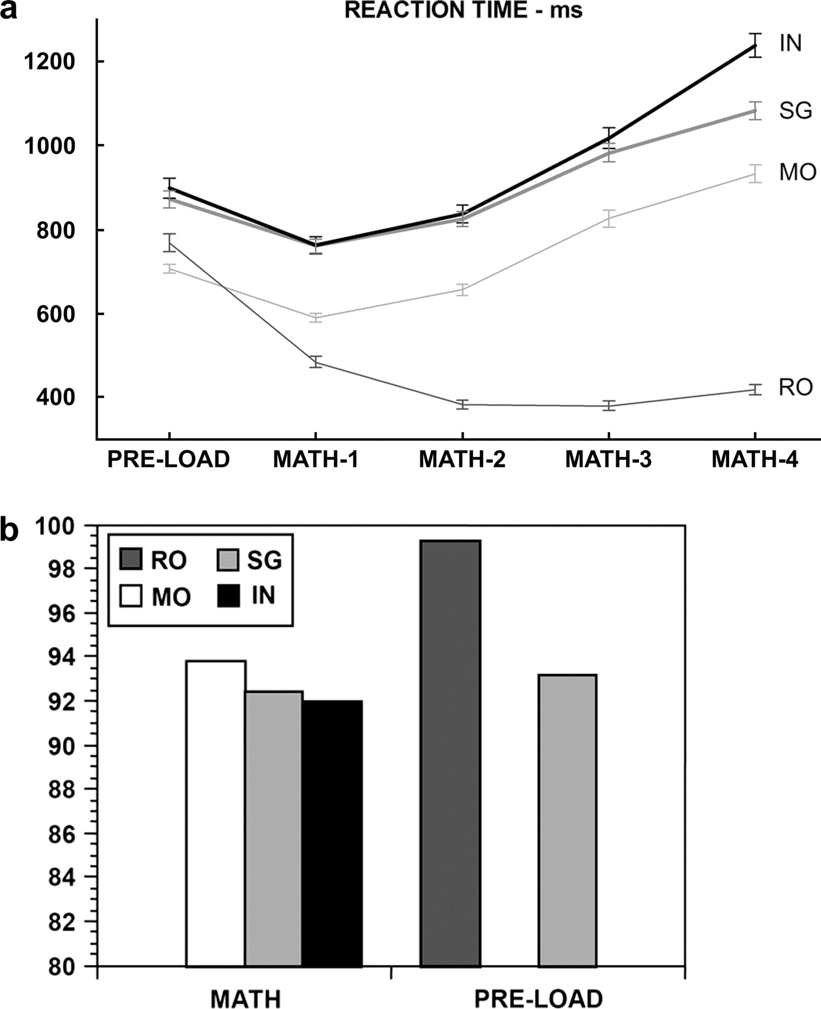
Figure 2. (a) RTs in the different conditions and in the frames from PRELOAD to MATH-4 both of behavioral and ...
Notes:
Figure 2. (a) RTs in the different conditions and in the frames from PRELOAD to MATH-4 both of behavioral and neuroimaging participants. (b) Accuracy in the different conditions for behavioral participants.
Unless provided in the caption above, the following copyright applies to the content of this slide: © The Author 2006. Published by Oxford University Press. All rights reserved. For permissions, please e-mail: journals.permissions@oxfordjournals.org

Slide 3
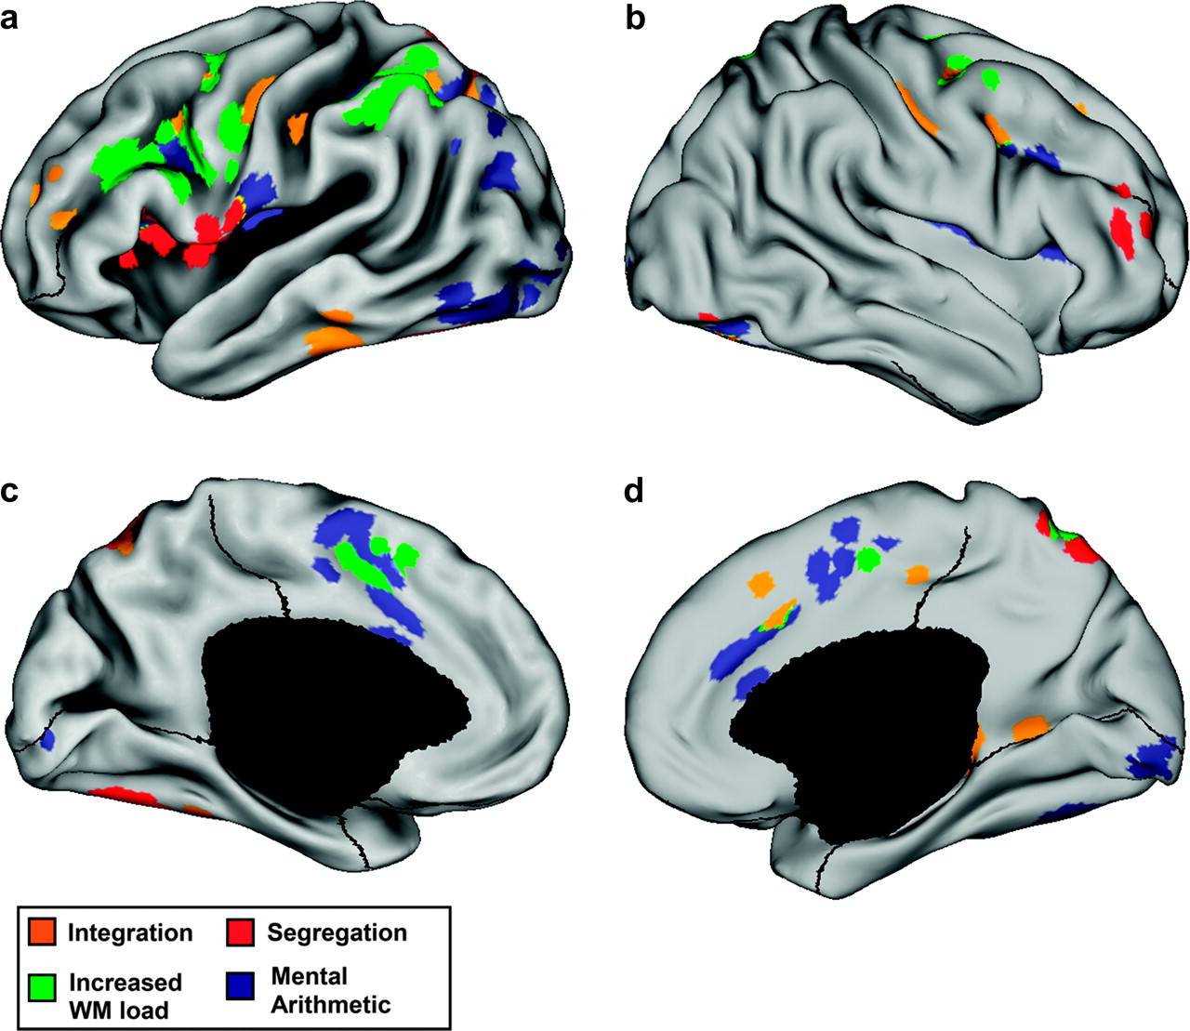
Figure 3. Lateral and medial brain views of 4 different contrasts, explained in the main text. Regions colored in ...
Notes:
Figure 3. Lateral and medial brain views of 4 different contrasts, explained in the main text. Regions colored in orange, green, dark blue, and red are those showing significantly greater BOLD activation respectively in the integration, increased WM load, mental arithmetic, and segregation condition.
Unless provided in the caption above, the following copyright applies to the content of this slide: © The Author 2006. Published by Oxford University Press. All rights reserved. For permissions, please e-mail: journals.permissions@oxfordjournals.org

Slide 4
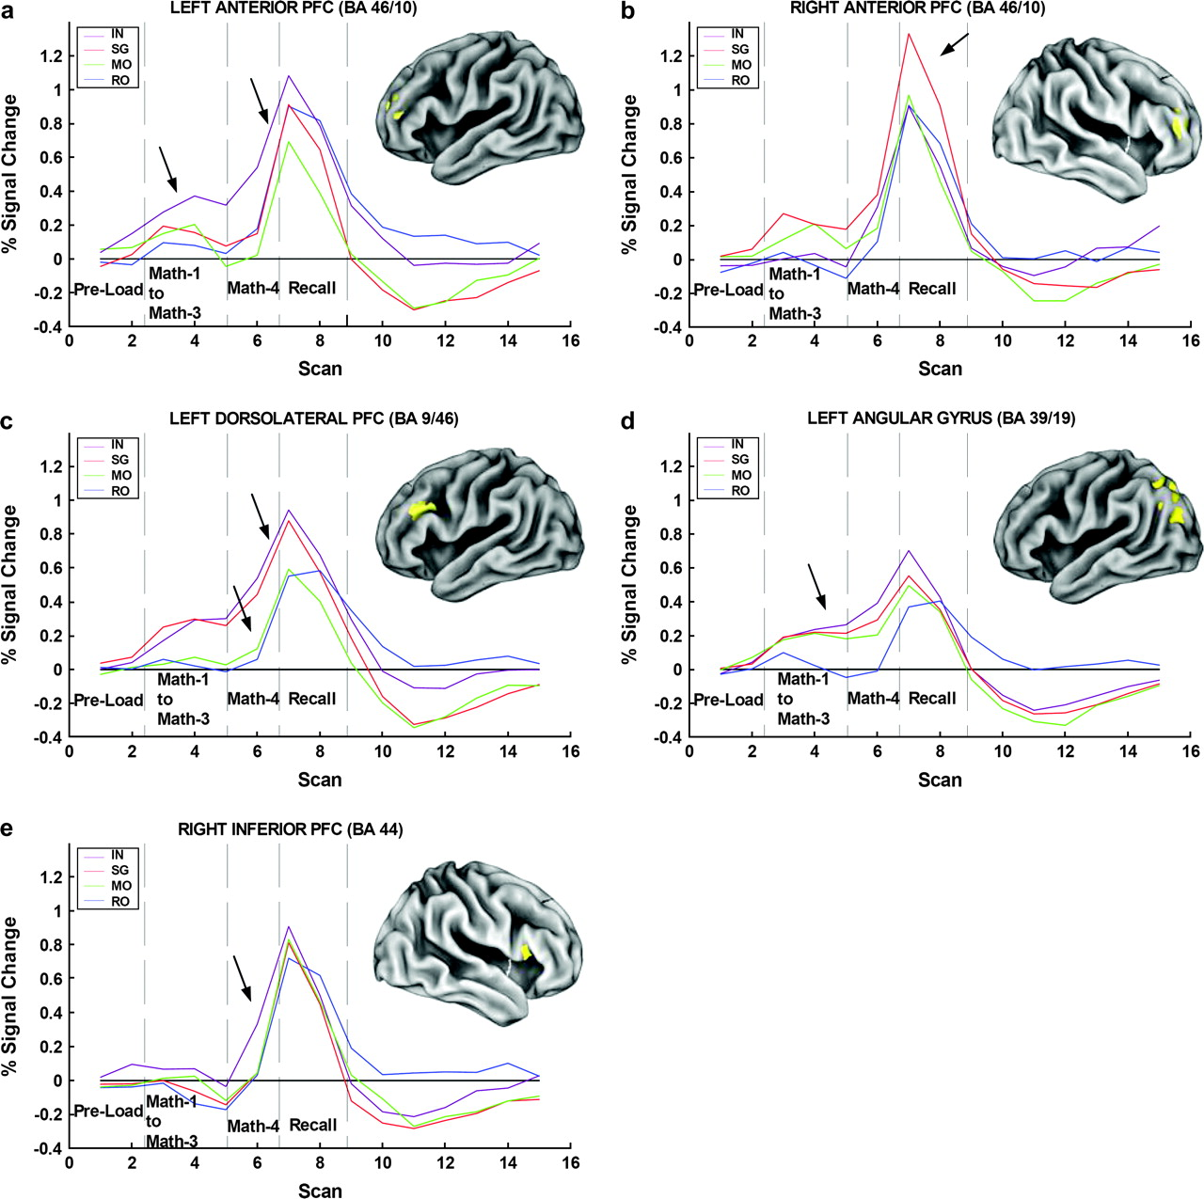
Figure 4. Hemodynamic responses in 5 key cortical regions, in particular, the left anterior PFC, sensitive to ...
Notes:
Figure 4. Hemodynamic responses in 5 key cortical regions, in particular, the left anterior PFC, sensitive to integration maximally at integration step, but also prior to it, suggesting that activation may have preparatory component (a); the right anterior PFC, sensitive to segregation demands, where activation specifically during recall phase suggests a role in interference prevention or WM retrieval functions (b); the left dorsolateral PFC, sensitive to increased WM load, but mental arithmetic alone does not activate region or integration compared with segregation (c); the left angular gyrus, where there is no effect of secondary load during math problem computations (d); the right inferior PFC, where the integration-related increased activity is transient and specific to the integration step (Math-4) (e).
Unless provided in the caption above, the following copyright applies to the content of this slide: © The Author 2006. Published by Oxford University Press. All rights reserved. For permissions, please e-mail: journals.permissions@oxfordjournals.org

