Slide 1
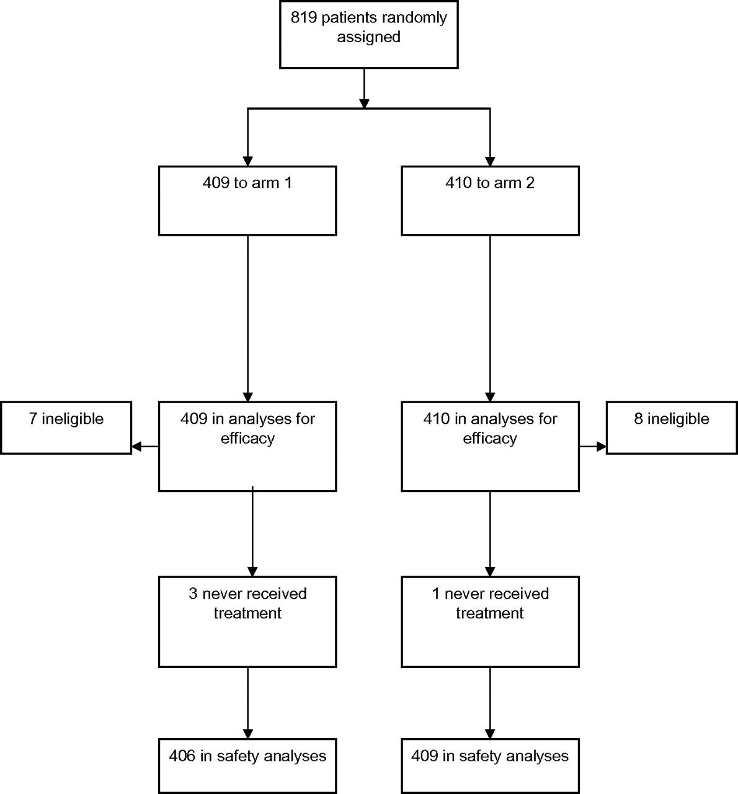
Figure 1 Consolidated Standards of Reporting Trials diagram.
Notes:
Figure 1 Consolidated Standards of Reporting Trials diagram.
Unless provided in the caption above, the following copyright applies to the content of this slide: © The Author 2010. Published by Oxford University Press.

Slide 2
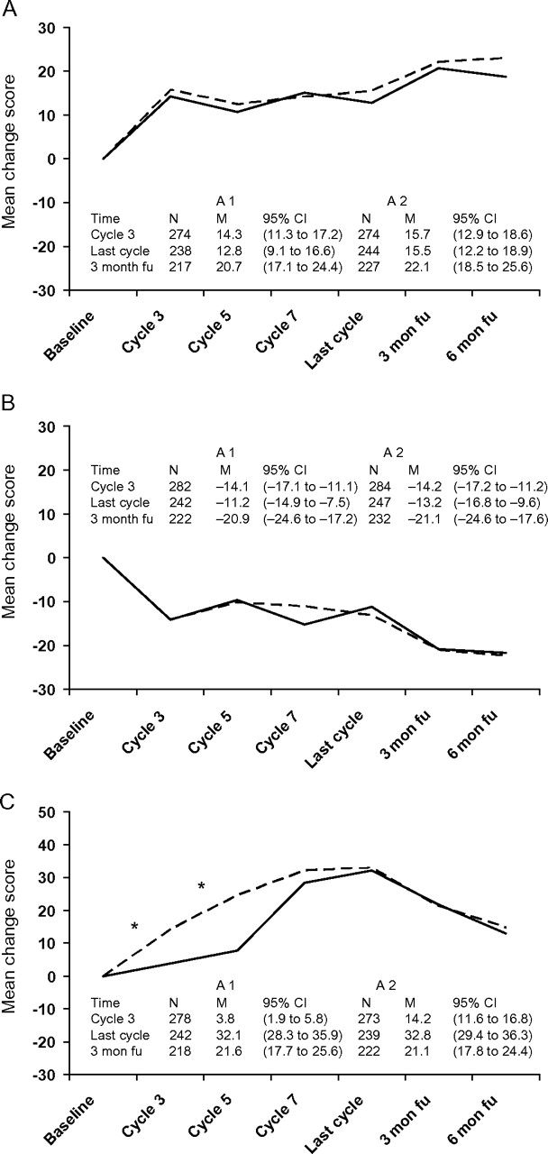
Figure 2 Change in quality-of-life measures from baseline over time by treatment arms. Patients completed ...
Notes:
Figure 2 Change in quality-of-life measures from baseline over time by treatment arms. Patients completed questionnaires (European Organization for Research and Treatment of Cancer–quality-of-life questionnaires C30 and OV28 module) at baseline, day 1 on cycles 3, 5, and 7, at the end of the last cycle, and then 3 and 6 months after the end of protocol therapy. The mean change scores from baseline is plotted. In each graph, arm 1 is indicated by a solid line and arm 2 is indicated by a dashed line . Panels are as follows: A) global quality of life, B) fatigue, and C) peripheral neuropathy. In panel A, positive change indicates improvement, but in panels B and C, negative change indicates improvement. N = number of patients with quality-of-life measurements; M = mean change score, with 95% confidence interval in parentheses; fu = follow-up. The asterisks in panel C indicate a statistical significant difference between the treatment arms ( P < .001, by a two-sided Wilcoxon rank sum test).
Unless provided in the caption above, the following copyright applies to the content of this slide: © The Author 2010. Published by Oxford University Press.

Slide 3
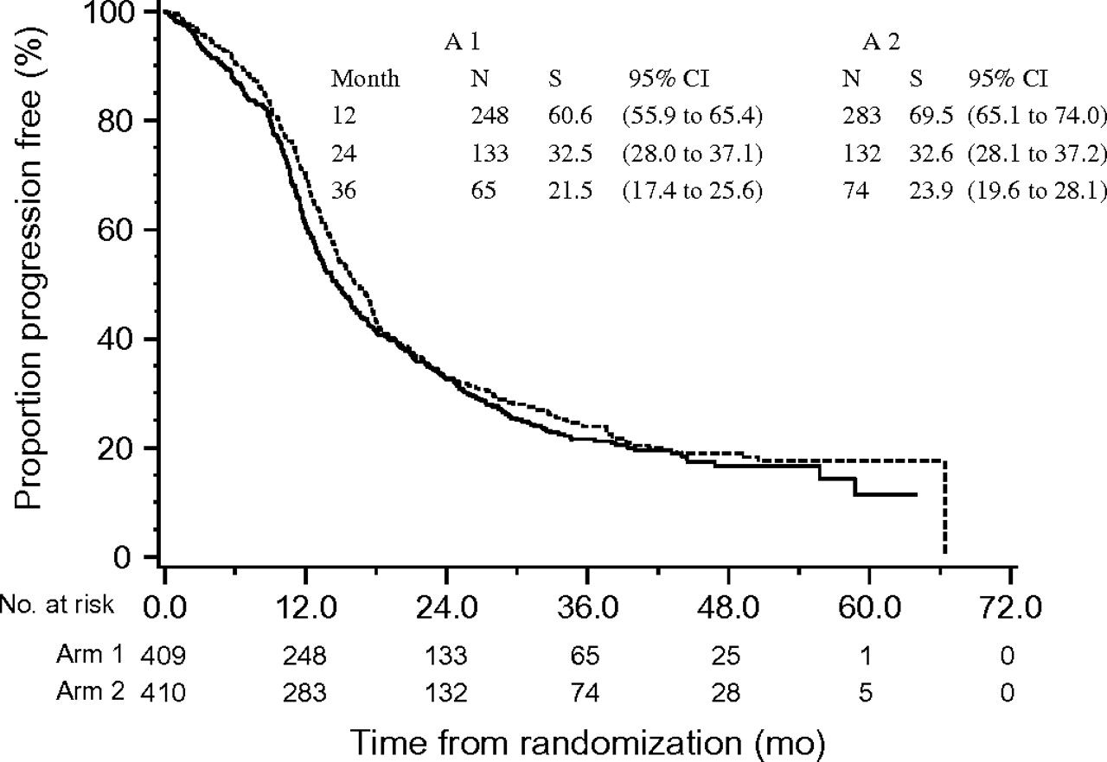
Figure 3 Kaplan–Meier curves for progression-free survival. An event is defined as disease progression or death ...
Notes:
Figure 3 Kaplan–Meier curves for progression-free survival. An event is defined as disease progression or death without progression. In each graph, arm 1 is indicated by a solid line and arm 2 is indicated by a dashed line . No significant differences were found between the treatment arms. N = number at risk; S = survival percent, with 95% confidence interval in parentheses.
Unless provided in the caption above, the following copyright applies to the content of this slide: © The Author 2010. Published by Oxford University Press.

Slide 4
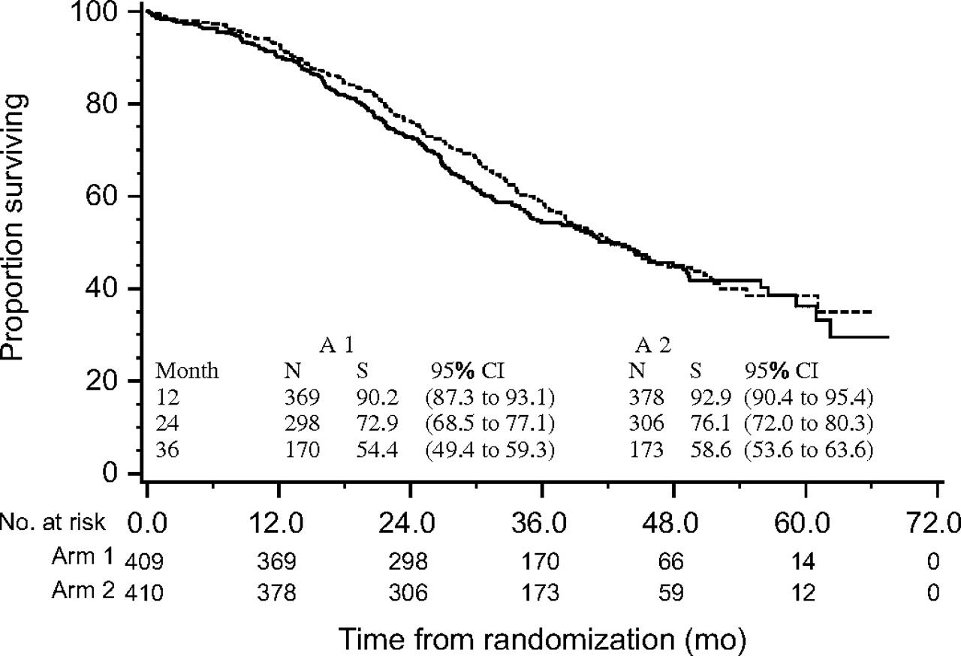
Figure 4 Kaplan–Meier curves for overall survival. An event is defined as death from any cause. In each graph, arm 1 ...
Notes:
Figure 4 Kaplan–Meier curves for overall survival. An event is defined as death from any cause. In each graph, arm 1 is indicated by a solid line and arm 2 is indicated by a dashed line . No significant differences were found between the treatment arms. N = number at risk; S = survival percent, with 95% confidence interval in parentheses.
Unless provided in the caption above, the following copyright applies to the content of this slide: © The Author 2010. Published by Oxford University Press.

