Slide 1
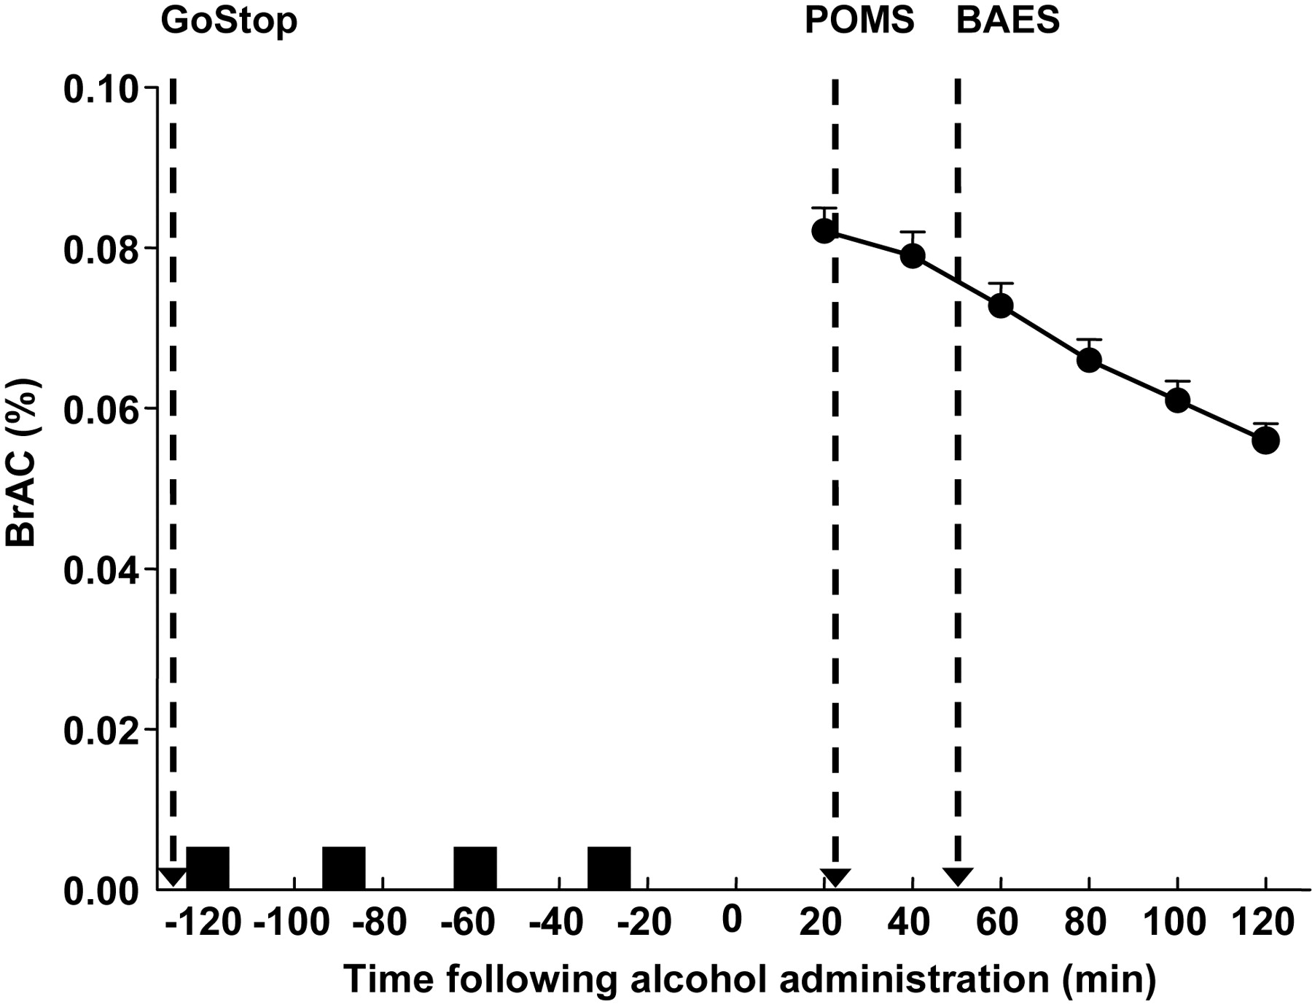
Fig. 1. Timeline of drink administration in relation to the measurements of impulsivity and subjective effects. Also ...
Notes:
Fig. 1. Timeline of drink administration in relation to the measurements of impulsivity and subjective effects. Also shown is the mean (± SEM) BrAC curve following 0.8-g/kg 95% alcohol administered in a binge-like fashion (four drinks over 2 h). Arrows indicate times the GoStop Impulsivity Paradigm, the POMS and the BAES were completed by the participants. Black squares indicate times of alcohol drink administration.
Unless provided in the caption above, the following copyright applies to the content of this slide: © The Author 2010. Published by Oxford University Press on behalf of the Medical Council on Alcohol. All rights reserved

Slide 2
Fig. 2. Significant linear regressions between performance on the response-inhibition task and (A) self-reported ...
Notes:
Fig. 2. Significant linear regressions between performance on the response-inhibition task and (A) self-reported stimulation as measured by the BAES; (B) self-reported sedation as measured by the BAES; and (C) self-reported arousal as measured by the POMS following alcohol consumption. Statistical significance was defined as P < 0.05.
Unless provided in the caption above, the following copyright applies to the content of this slide: © The Author 2010. Published by Oxford University Press on behalf of the Medical Council on Alcohol. All rights reserved

