Slide 1
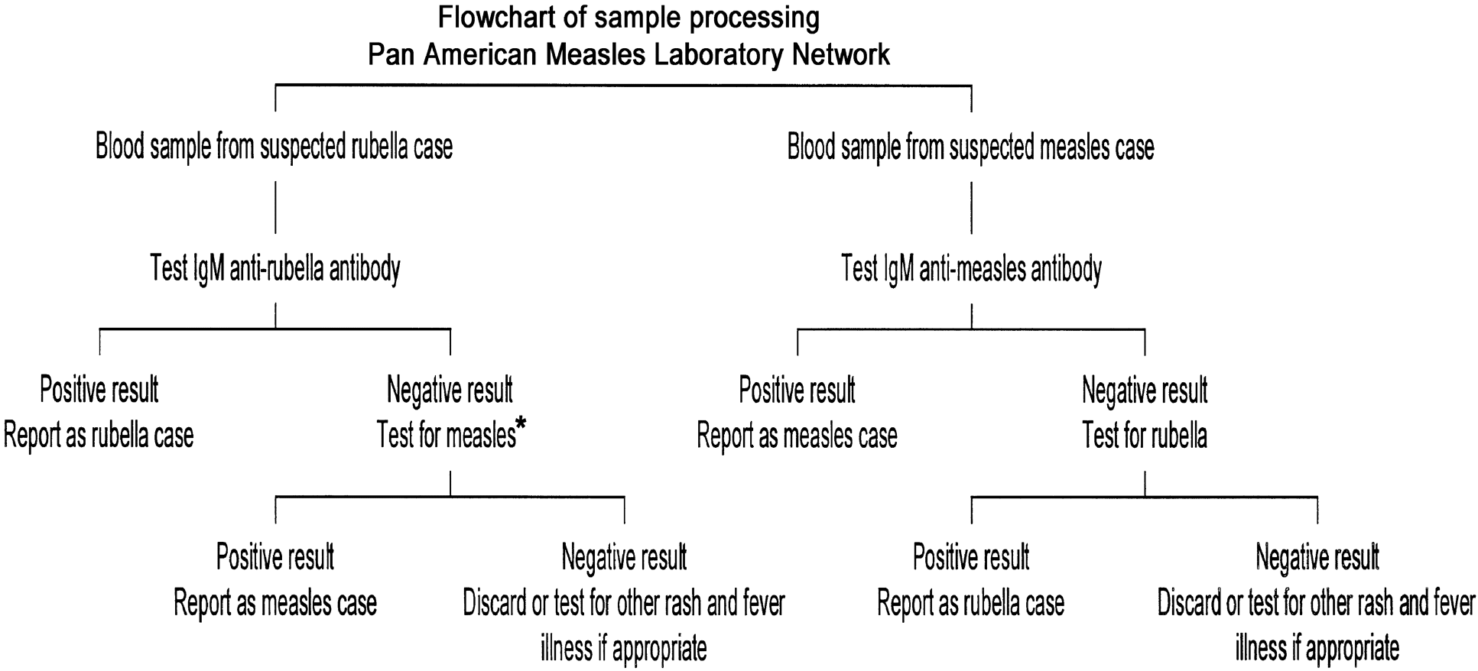
Figure 1. Flowchart of sample processing by the Pan American Measles Laboratory Network. *, In Brazil, differential ...
Notes:
Figure 1. Flowchart of sample processing by the Pan American Measles Laboratory Network. *, In Brazil, differential diagnosis is used to determine whether to test for rubella antibodies.
Unless provided in the caption above, the following copyright applies to the content of this slide: © 2003 by the Infectious Diseases Society of America

Slide 2
Table 1. Number of specimens processed by the Pan American Measles Laboratory Network, 1999–2000.
Notes:
Table 1. Number of specimens processed by the Pan American Measles Laboratory Network, 1999–2000.
Unless provided in the caption above, the following copyright applies to the content of this slide: © 2003 by the Infectious Diseases Society of America

Slide 3
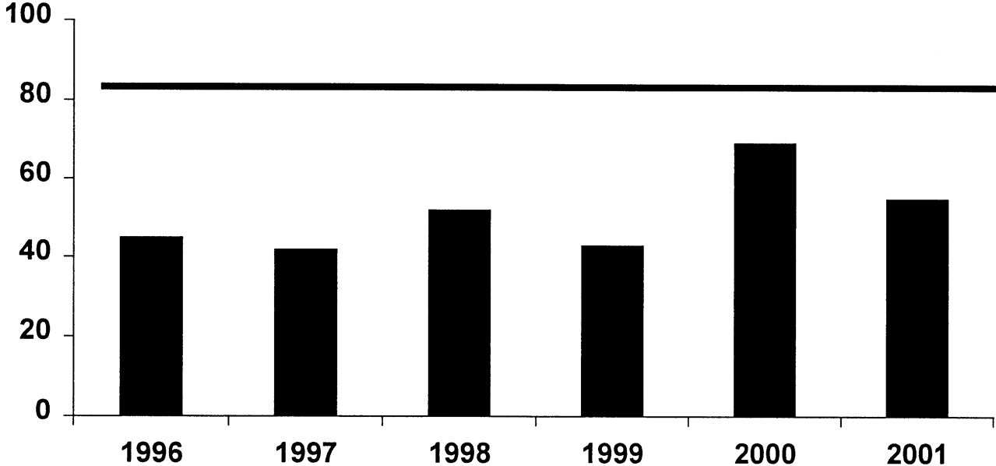
Figure 2. Percentage of laboratory specimens received in <6 days, Region of the Americas, 1996–2001. Horizontal rule ...
Notes:
Figure 2. Percentage of laboratory specimens received in <6 days, Region of the Americas, 1996–2001. Horizontal rule represents the program goal of having ⩾80% of blood samples from laboratories arrive in <5 days. Data are as of 6 October 2001.
Unless provided in the caption above, the following copyright applies to the content of this slide: © 2003 by the Infectious Diseases Society of America

Slide 4
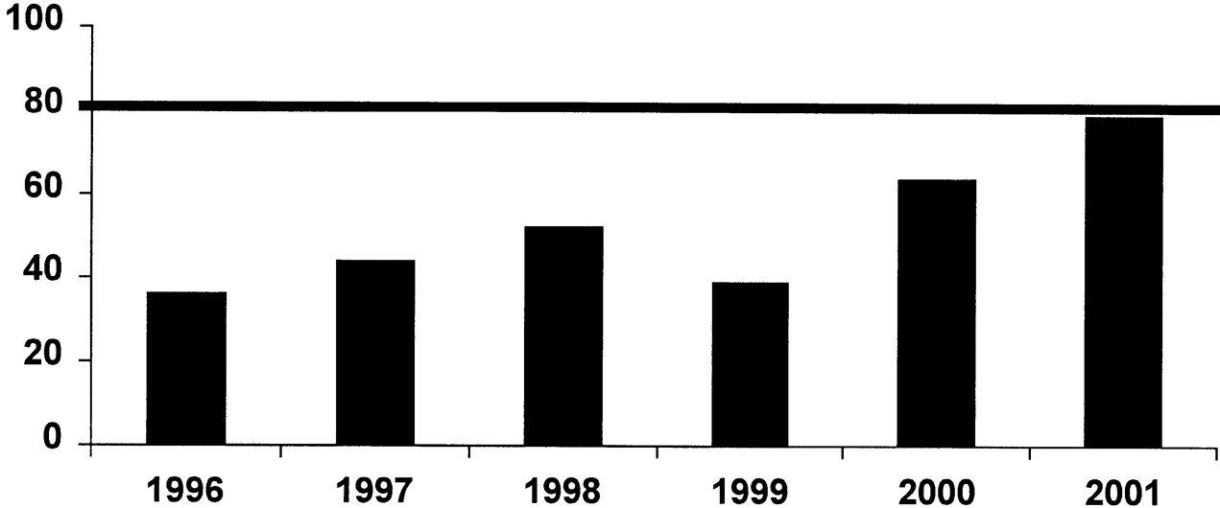
Figure 3. Percentage of serum samples processed in ⩽4 days, Region of the Americas, 1996–2001. Data are as of 6 October ...
Notes:
Figure 3. Percentage of serum samples processed in ⩽4 days, Region of the Americas, 1996–2001. Data are as of 6 October 2001.
Unless provided in the caption above, the following copyright applies to the content of this slide: © 2003 by the Infectious Diseases Society of America

