Slide 1
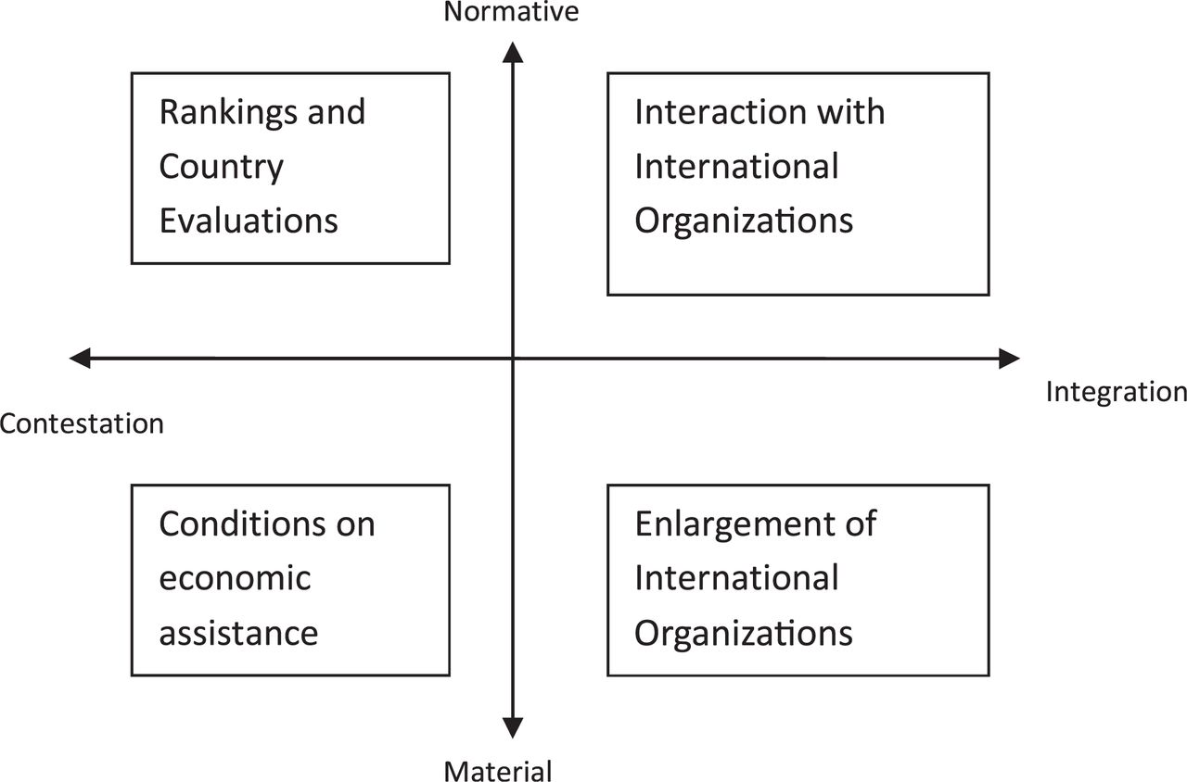
1 Dimensions of IO Power and Means Used to Influence Domestic Institutions
Notes:
1 Dimensions of IO Power and Means Used to Influence Domestic Institutions
Unless provided in the caption above, the following copyright applies to the content of this slide: © 2012 International Studies Association

Slide 2
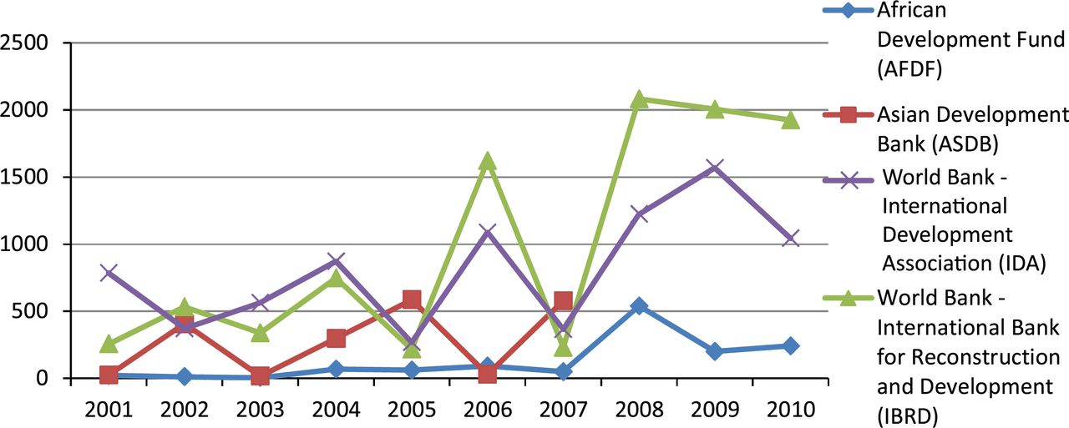
2 IO Aid for Strengthening Governance, 2001–2010 Source. aiddata.org. Constant (2000) prices, commitments, in ...
Notes:
2 IO Aid for Strengthening Governance, 2001–2010 Source. aiddata.org. Constant (2000) prices, commitments, in USD millions.
Unless provided in the caption above, the following copyright applies to the content of this slide: © 2012 International Studies Association

Slide 3
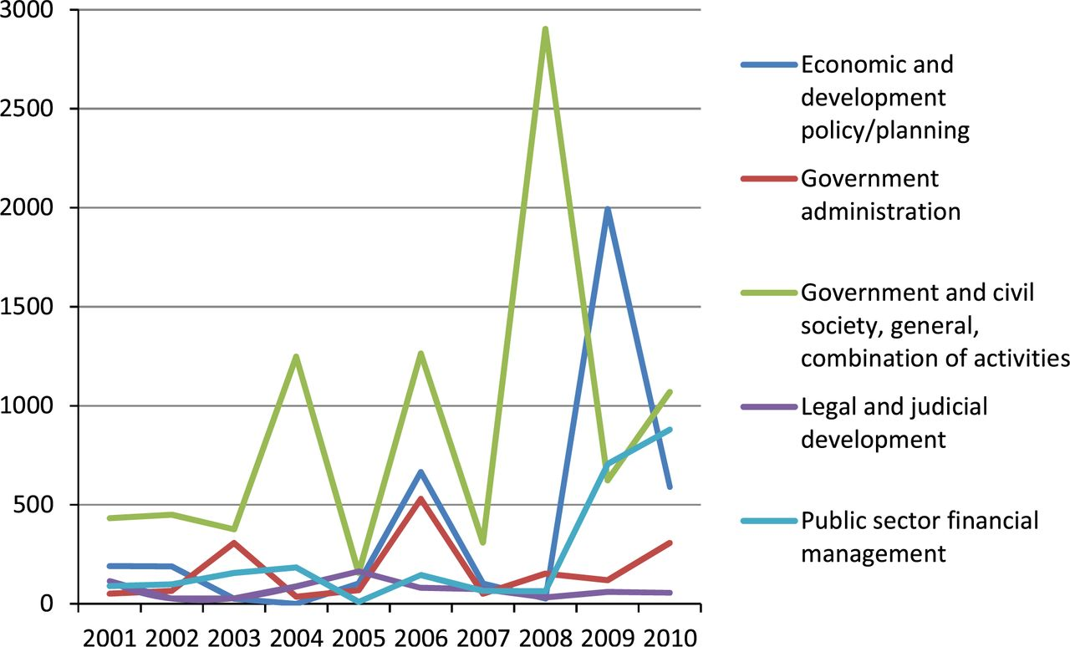
3 World Bank Aid for Strengthening Governance, 2001–2010 Source. aiddata.org. Constant (2000) prices, ...
Notes:
3 World Bank Aid for Strengthening Governance, 2001–2010 Source. aiddata.org. Constant (2000) prices, commitments, in USD millions.
Unless provided in the caption above, the following copyright applies to the content of this slide: © 2012 International Studies Association

Slide 4
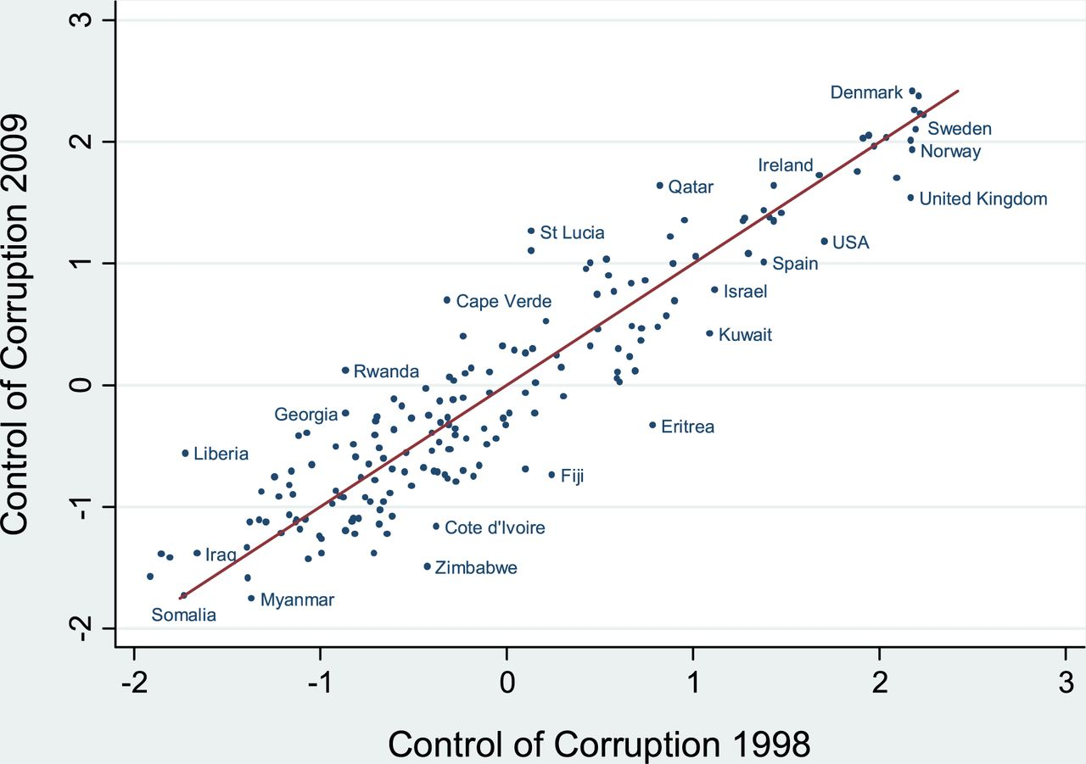
4 Change in corruption levels from 1998 to 2009. The figure shows the change in corruption levels using the ...
Notes:
4 Change in corruption levels from 1998 to 2009. The figure shows the change in corruption levels using the World Bank Governance Indicators for 1998 and 2009 (Kaufmann et al. 2009). The line is reference line and indicates no change in the level of corruption. R2=.85. Data accessed through Teorell, Jan, Marcus Samanni, Sören Holmberg and Bo Rothstein (2011). The Quality of Government (QoG) Dataset, version 6 April 11. University of Gothenburg: The QoG Institute, http://www.qog.pol.gu.se
Unless provided in the caption above, the following copyright applies to the content of this slide: © 2012 International Studies Association

Slide 5
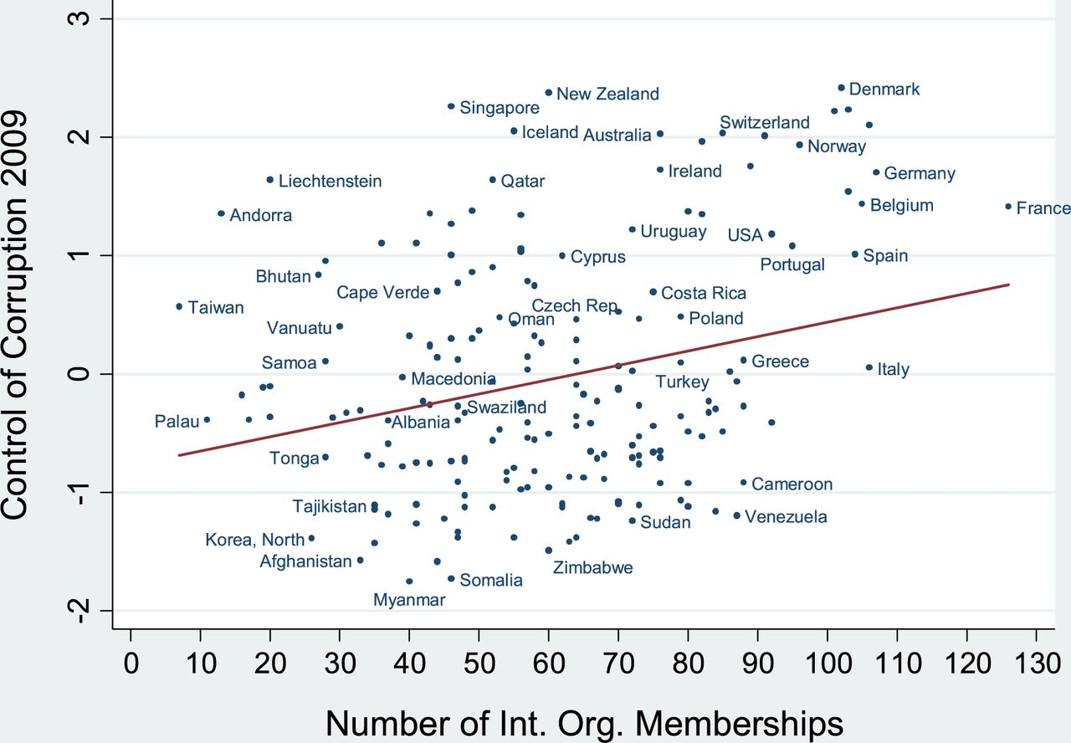
6 The relationship between number of IO membership and control of corruption 2009. The figure shows the ...
Notes:
6 The relationship between number of IO membership and control of corruption 2009. The figure shows the relationship between number of IO memberships and levels of control of corruption in 2009 using the World Bank Governance Indicators (Kaufmann et al. 2009, accessed through Teorell, Jan, Marcus Samanni, Sören Holmberg and Bo Rothstein 2011. The Quality of Government (QoG) Dataset, version 6 April 2011. University of Gothenburg: The QoG Institute, http://www.qog.pol.gu.se.). Data on IO memberships from http://www.correlatesofwar.org/
Unless provided in the caption above, the following copyright applies to the content of this slide: © 2012 International Studies Association

Slide 6
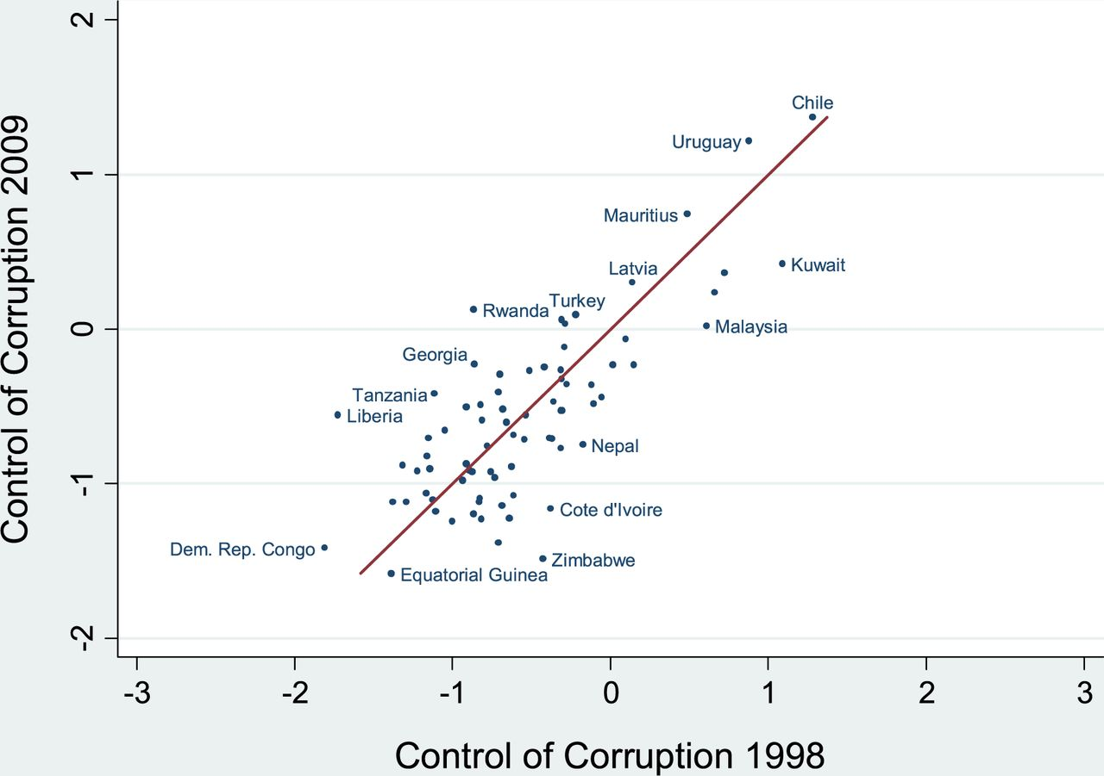
5 Change in corruption levels from 1998 to 2009 for countries receiving anti-corruption aid. The figure shows ...
Notes:
5 Change in corruption levels from 1998 to 2009 for countries receiving anti-corruption aid. The figure shows the change in corruption levels among countries receiving anti-corruption aid from 2000 to 2010 using the World Bank Governance Indicators for 1998 and 2009 (Kaufmann et al. 2009). The line is reference line and indicates no change in the level of corruption. R2=.60. Data on control of corruption accessed through Teorell, Jan, Marcus Samanni, Sören Holmberg and Bo Rothstein (2011). The Quality of Government (QoG) Dataset, version 6 April 2011. University of Gothenburg: The QoG Institute, http://www.qog.pol.gu.se. Data on anti-corruption aid accessed through aiddata.org
Unless provided in the caption above, the following copyright applies to the content of this slide: © 2012 International Studies Association

