Slide 1
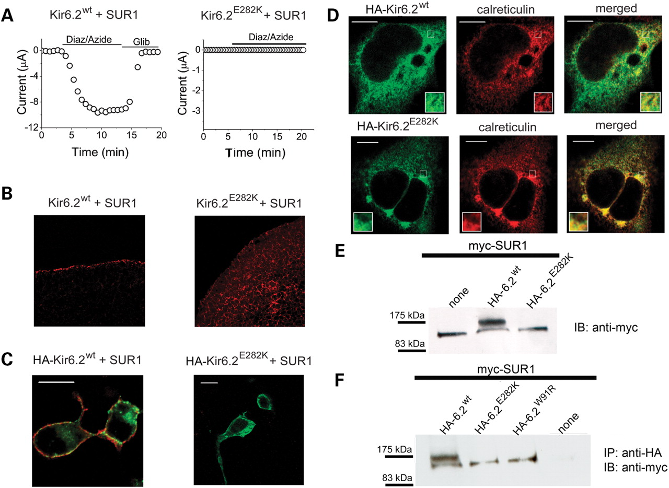
Figure 1. The CHI causing E282K mutation in Kir6.2 prevents ER exit and thus the surface expression of the ...
Notes:
Figure 1. The CHI causing E282K mutation in Kir6.2 prevents ER exit and thus the surface expression of the KATP channel. (A) K+ currents measured from Xenopus oocytes injected with cRNA for SUR1 and the FLAG-tagged wild-type (WT) or mutant Kir6.2 subunits. Currents through the WT, but not the mutant channels were activated by the application of a mixture of azide (3 mm) and diazoxide (200 µm) and blocked with 1 µm glibenclamide (indicated with horizontal bars); representative data shown. (B) Immunofluorescent staining of sections of oocytes (from which currents were recorded) using anti-FLAG antibodies and Cy3 conjugated secondary antibodies. (C) HEK293-MSRII cells co-transfected with HA (extracellular)-tagged WT or mutant Kir6.2 plus SUR1 were immunostained first for the surface (red) and then for internal (green) channels (see Materials and Methods). (D) Cells transfected as in (C) were permeabilized and immunostained for HA-Kir6.2 (red) and for the ER marker protein, calreticulin (green); merged images show co-localization of HA-Kir6.2 with calreticulin (yellow). (E) Western blotting of protein extracts from cells transfected with myc-tagged SUR1 alone or together with WT or mutant Kir6.2, using anti-myc antibodies. (F) Cells were transfected with myc-SUR1 either alone, or together with the indicated HA-tagged Kir6.2 clones, lysed, immunoprecipitated with anti-HA antibodies and the precipitates subjected to western blotting with anti-myc antibodies. Scale bars in (C) and (D), 10 µm.
Unless provided in the caption above, the following copyright applies to the content of this slide: © The Author 2009. Published by Oxford University Press. All rights reserved. For Permissions, please email: journals.permissions@oxfordjournals.org

Slide 2
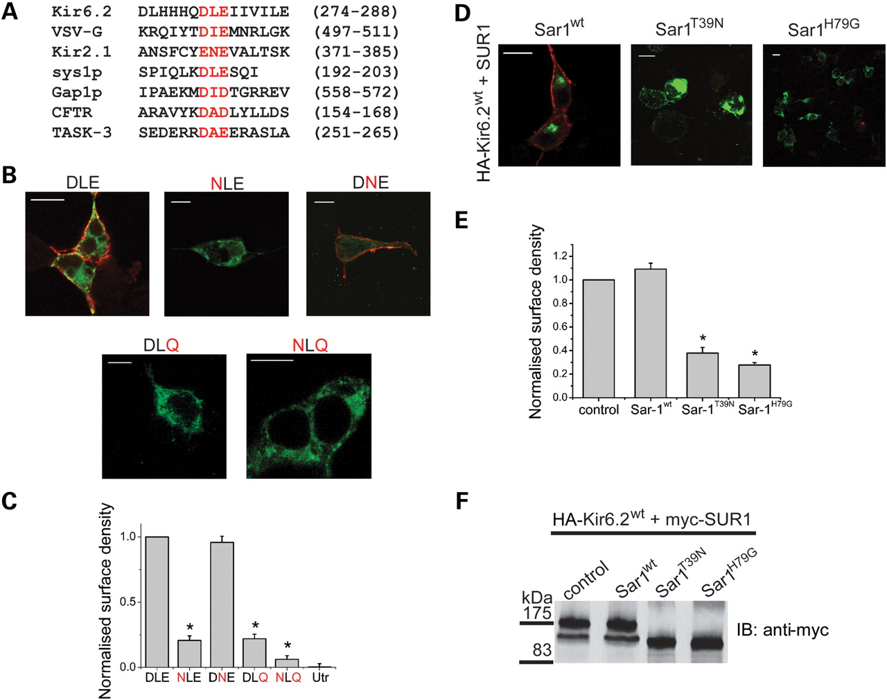
Figure 2. E282 in Kir6.2 is part of the di-acidic ER exit motif required for the Sar1 GTPase-dependent ER exit of ...
Notes:
Figure 2. E282 in Kir6.2 is part of the di-acidic ER exit motif required for the Sar1 GTPase-dependent ER exit of KATP channels. (A) Alignment of the partial Kir6.2 C-terminal amino acid sequence with proteins containing the di-acidic ER exit motif (highlighted in red); numbers refer to positions in primary sequence. (B and C) Mutation of the conserved acidic residues in the ER exit motif (DLE) of Kir6.2 prevents surface expression. HEK293-MSRII cells were transfected with SUR1 and the indicated mutants (mutations shown in red) of the motif; in (B), surface channels are stained in red and internal channels in green as in Figure 1C; in (C), surface densities were estimated by chemiluminescence (see Materials and Methods) and expressed relative to the wild-type channel (DLE). (D–F) Surface expression of KATP channels requires Sar1 GTPase activity. Cells were co-transfected with SUR1 [myc-SUR1 in (F)] plus HA-Kir6.2 with or without (control) the indicated Sar1 WT or dominant negative constructs. In (D), cells were immunostained for surface (red) and internal (green) channels as in Figure 1C; in (E), surface density was quantified by chemiluminescence; in (F), cell lysates were subjected to western blotting for SUR1 (top band, mature; bottom band, immature) with anti-myc antibodies. Scale bars in (B) and (D), 10 µm; stars in (C) and (E) represent P < 0.005 (n = 3).
Unless provided in the caption above, the following copyright applies to the content of this slide: © The Author 2009. Published by Oxford University Press. All rights reserved. For Permissions, please email: journals.permissions@oxfordjournals.org

Slide 3
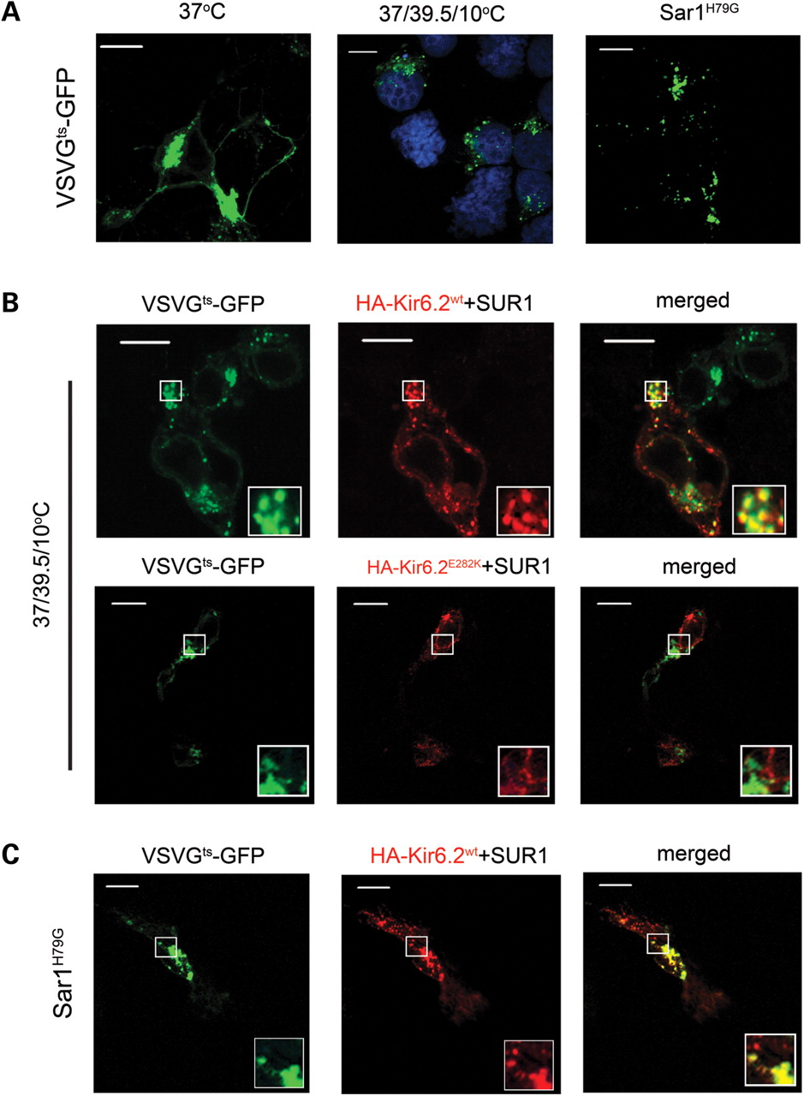
Figure 3. K_{ATP} channels enter the ERES. (A) Labelling the ER exit sites with the temperature sensitive ...
Notes:
Figure 3. KATP channels enter the ERES. (A) Labelling the ER exit sites with the temperature sensitive VSVG045ts-GFP. VSVG045ts-GFP reaches the cell surface at 37°C, but is retained at the ERES (visible as puncta) when first allowed to mis-fold at 39.5°C and then cooled to 10°C or when the COPII vesicle formation was blocked with the dominant negative Sar1H79G mutant at 37°C. Nuclei were stained with DAPI in the middle (B) WT, but not the E282K mutant, KATP channels enter the ERES. Cells were co-transfected with the indicated channel subunits plus the VSVG045ts-GFP marker clone. The 37/39.5/10°C treatment resulted in significant co-localization of WT, but not the E282K mutant, channel with VSVG045ts-GFP at the ER exit sites. (C) Blocking the COPII vesicle release at 37°C with Sar1H79G mutant also results in co-localization of WT KATP channels with VSVG045ts-GFP at the ERES. Scale bars, 10 µm.
Unless provided in the caption above, the following copyright applies to the content of this slide: © The Author 2009. Published by Oxford University Press. All rights reserved. For Permissions, please email: journals.permissions@oxfordjournals.org

Slide 4
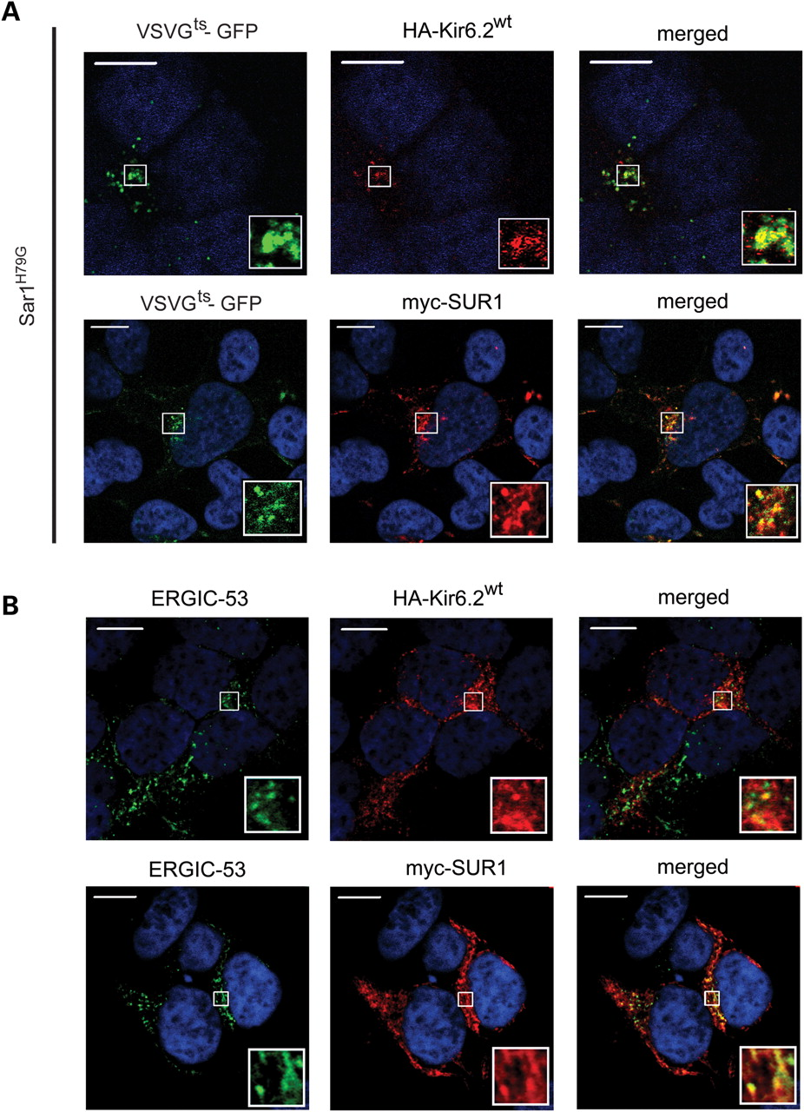
Figure 4. Kir6.2 and SUR1 subunits can enter ERES and ERGIC independently. (A) Co-expression of Sar1^{H79G} ...
Notes:
Figure 4. Kir6.2 and SUR1 subunits can enter ERES and ERGIC independently. (A) Co-expression of Sar1H79G results in co-localization of both HA-Kir6.2 and myc-SUR1 subunits with VSVG045ts-GFP at the ERES. (B) Co-localization of individually expressed HA-Kir6.2 and myc-SUR1 subunits (green) with ERGIC-53 (red). Kir6.2 and SUR1 were stained with anti-HA and anti-myc antibodies, respectively, and ERGIC-53 with a monoclonal antibody. Merged images show co-localization (yellow). Scale bars, 10 µm.
Unless provided in the caption above, the following copyright applies to the content of this slide: © The Author 2009. Published by Oxford University Press. All rights reserved. For Permissions, please email: journals.permissions@oxfordjournals.org

Slide 5
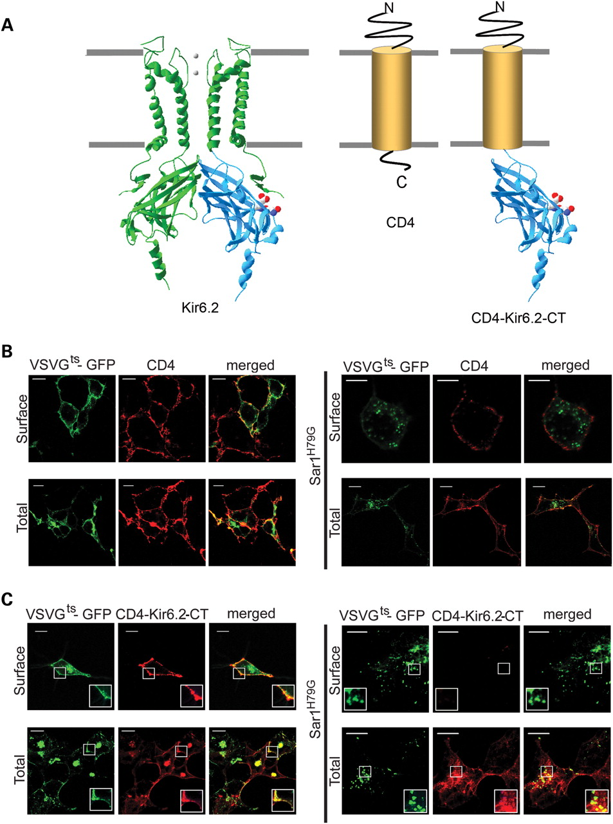
Figure 5. The DXE motif on Kir6.2 is responsible for entry of K_{ATP} channels into ERES. (A) Structural model ...
Notes:
Figure 5. The DXE motif on Kir6.2 is responsible for entry of KATP channels into ERES. (A) Structural model of Kir6.2, schematic of CD4 and CD4-Kir6.2-CT containing the transplanted C-terminus of Kir6.2 (shown in blue); DLE residues are in CPK; gray lines represent hypothetical membrane borders. (B) Surface expression of CD4 is unaffected by Sar1H79G. Cells were transfected with CD4, VSVG045ts-GFP plus or minus Sar1H79G and immunostained (red) with an antibody to the extracellular domain of CD4 without (surface CD4) and with permeabilization (total cellular CD4). (C) The C-terminus of Kir6.2 confers the ability to enter the ERES on CD4. Cells were transfected and stained as in (B), except that CD4-Kir6.2-CT, instead of CD4, was co-expressed. Sar1H79G prevented cell surface expression of CD4-Kir6.2-CT by retaining the channel in ERES as judged by its co-localization with VSVG045ts-GFP at the ERES (merged images). Scale bars, 10 µm.
Unless provided in the caption above, the following copyright applies to the content of this slide: © The Author 2009. Published by Oxford University Press. All rights reserved. For Permissions, please email: journals.permissions@oxfordjournals.org

Slide 6
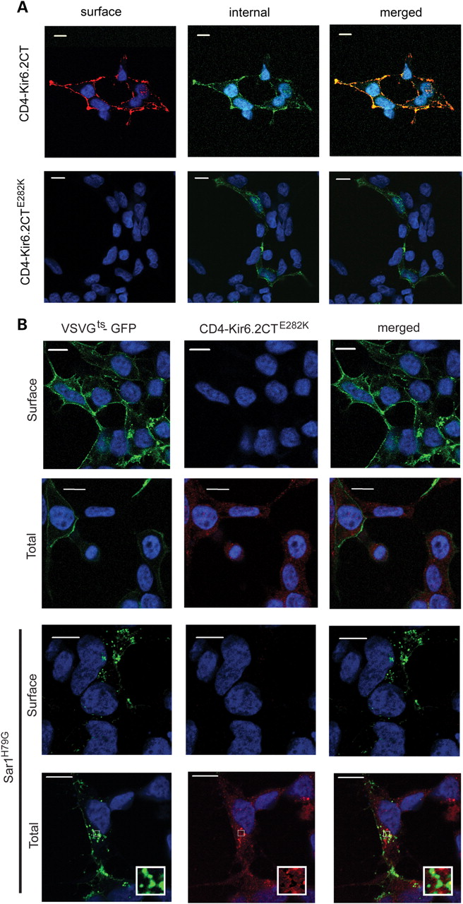
Figure 6. Mutation of the DXE motif in the CD4-Kir6.2-CT prevents the surface expression of the fusion protein. (A) ...
Notes:
Figure 6. Mutation of the DXE motif in the CD4-Kir6.2-CT prevents the surface expression of the fusion protein. (A) HEK293-MSRII cells were transfected with CD4-Kir6.2-CT or CD4-Kir6.2CTE282K. Forty-eight hours after transfection, cells were fixed and stained with anti-CD4 antibody followed by Cy3-conjugated secondary antibody to label the surface channels. The cells were then permeabilized and stained for the intracellular CD4 proteins using anti-CD4 antibody and FITC-conjugated secondary antibody. (B) HEK293-MSRII cells were co-transfected with CD4-Kir6.2-CT or CD4-Kir6.2CTE282K and VSVG045ts-GFP with and without the Sar1H79G construct. Un-permeabilized and permeabilized cells were stained with anti-CD4 antibody followed by Cy3-conjugated secondary antibody to detect surface and total expression of CD4 constructs, respectively. Scale bars, 10 µm.
Unless provided in the caption above, the following copyright applies to the content of this slide: © The Author 2009. Published by Oxford University Press. All rights reserved. For Permissions, please email: journals.permissions@oxfordjournals.org

Slide 7
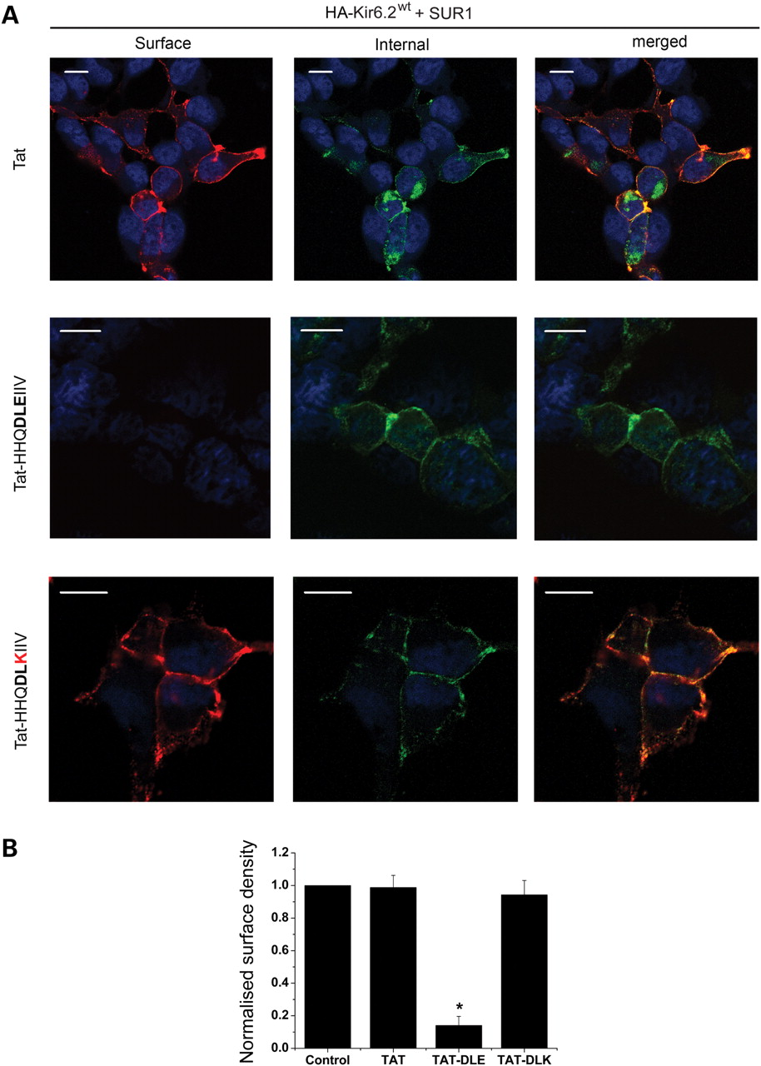
Figure 7. Membrane permeable peptide containing the wild-type, but not the mutant, ER exit signal of Kir6.2 prevents ...
Notes:
Figure 7. Membrane permeable peptide containing the wild-type, but not the mutant, ER exit signal of Kir6.2 prevents surface expression of KATP channels. (A) HEK293-MSRII cells were transfected with HA-Kir6.2 and SUR1 and treated with the indicated peptides (0.5 µM, made up in Optimem) and stained for cell surface and intracellular HA-Kir6.2 as in Figure 1C. Scale bars, 10 µm. (B) Quantitiative analysis of the effect of various peptides on the surface expression of KATP channels. All values are expressed as % control (untreated); *P < 0.001.
Unless provided in the caption above, the following copyright applies to the content of this slide: © The Author 2009. Published by Oxford University Press. All rights reserved. For Permissions, please email: journals.permissions@oxfordjournals.org

Slide 8
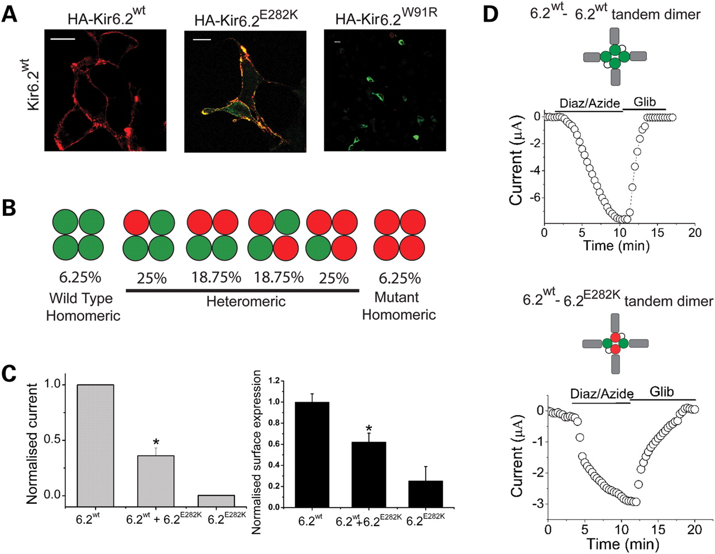
Figure 8. Wild-type Kir6.2 rescues surface expression and function of E282K mutant Kir6.2. (A) Rescue of cell surface ...
Notes:
Figure 8. Wild-type Kir6.2 rescues surface expression and function of E282K mutant Kir6.2. (A) Rescue of cell surface expression. HEK293-MSRII cells were co-transfected with SUR1 plus a 1:1 mixture of untagged Kir6.2WT and the HA-tagged Kir6.2 wild-type or mutant constructs; cells were stained for the surface (red) and intracellular (green) expression as in Figure 1C. Scale bars, 10 µm. (B) The schematic showing the possible combination of Kir6.2 subunits (WT, green; mutant, red) predicted to form channels in an oocyte injected with a 1:1 ratio of WT and mutant cRNA, and the percentage of channels expected from a binomial distribution. (C) Rescue of mutant subunit function (left) and surface expression (right) by co-expression of the wild-type subunit in Xenopus oocytes. Oocytes were injected with SUR1 cRNA plus cRNA for the WT Kir6.2, a 1:1 mixture of WT and mutant Kir6.2 or mutant Kir6.2 as described in Materials and Methods. Left: K+ currents were measured; mean data (n = 7), corresponding to KATP current maximally activated by diazoxide and azide, were normalized to the WT values; error bars represent SEM; star indicates P < 0.01. Right: cell surface density of KATP channels were measured by chemiluminescence; data represent mean ± SEM from batches of three oocytes from two different toads; *P < 0.05. (D) Rescue of channel function using tandem dimer constructs. K+ currents were measured from oocytes co-injected with cRNA for the tandem dimeric Kir6.2 constructs and SUR1 (indicated in the schematic; Kir6.2WT in green, Kir6.2E282K in red, SUR1 in grey) as described in Figure 1A; representative data shown (n≥ 3).
Unless provided in the caption above, the following copyright applies to the content of this slide: © The Author 2009. Published by Oxford University Press. All rights reserved. For Permissions, please email: journals.permissions@oxfordjournals.org

