Slide 1
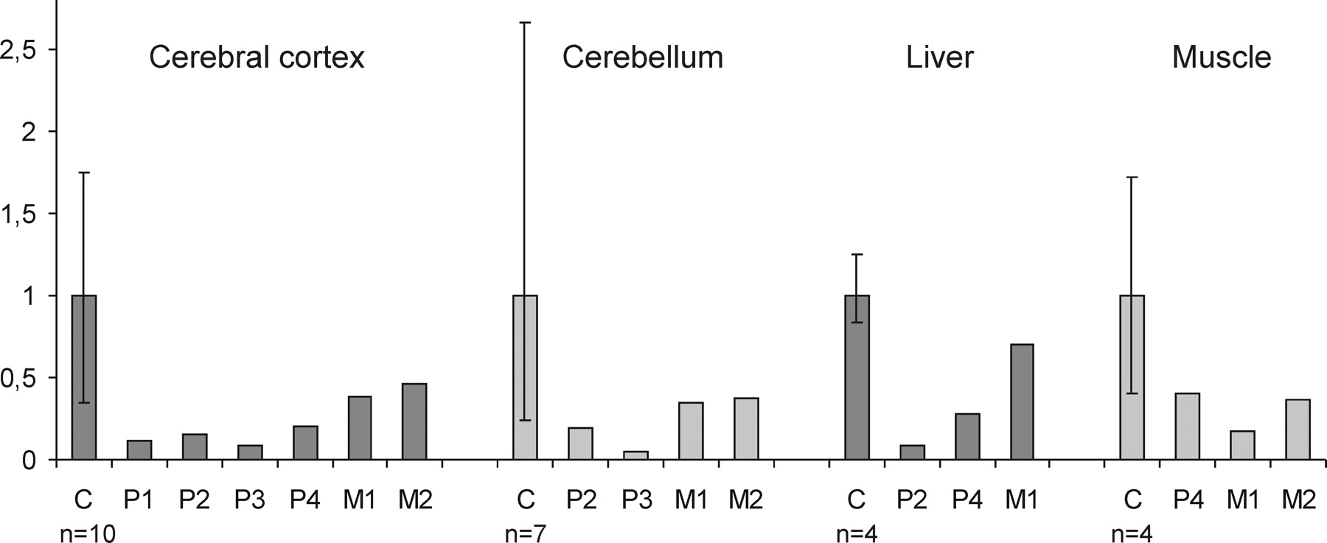
Figure 1. IOSCA is associated with mtDNA depletion in the brain, and the liver. The mtDNA amount in the tissues of the ...
Notes:
Figure 1. IOSCA is associated with mtDNA depletion in the brain, and the liver. The mtDNA amount in the tissues of the IOSCA patients (P1–P4, aged 21–26 years), the MIRAS patients (M1, aged 52 years; M2, aged 36 years), and the controls (C, aged 15–65 years). The results were obtained using real-time q-PCR. Values are shown relative to the average of all control samples for a given tissue. The error bars indicate the range of all control samples. Cerebral cortex, cerebellum and the liver show depletion of mtDNA in the IOSCA patients. The MIRAS patients show decreased mtDNA content in the brain and the liver. Similar results were obtained using Southern blotting.
Unless provided in the caption above, the following copyright applies to the content of this slide: © The Author 2008. Published by Oxford University Press. All rights reserved. For Permissions, please email: journals.permissions@oxfordjournals.org

Slide 2
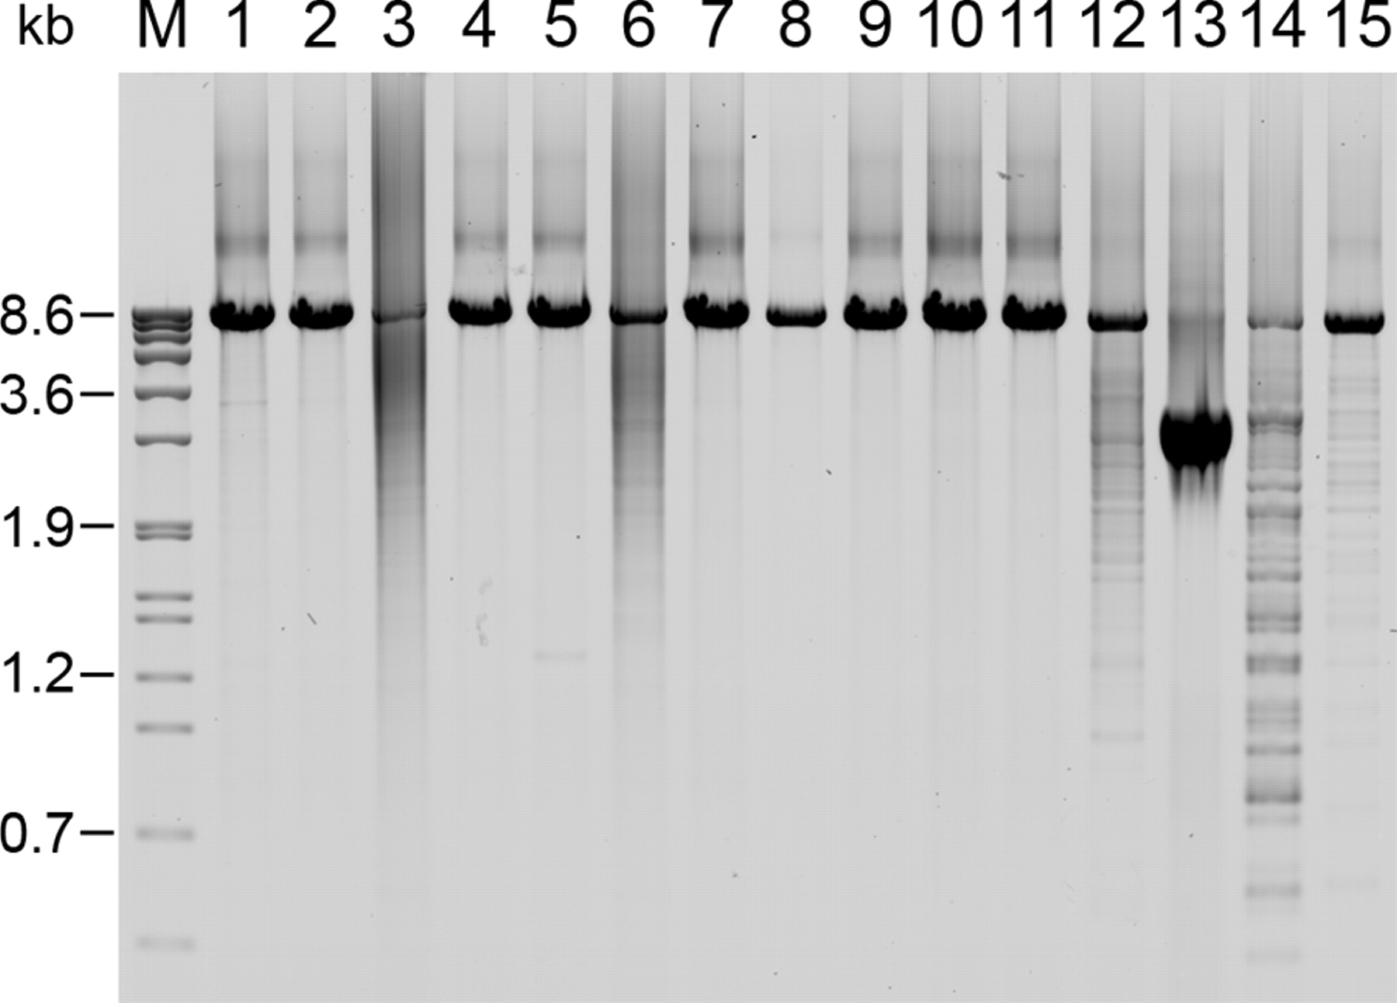
Figure 2. MIRAS brain and muscle show multiple mtDNA deletions, but IOSCA tissues do not. Long-range PCR analysis of ...
Notes:
Figure 2. MIRAS brain and muscle show multiple mtDNA deletions, but IOSCA tissues do not. Long-range PCR analysis of mtDNA. Mitochondrial DNA fragment of 8.3 kb was amplified using total DNA extracted from frontal cortex, cerebellum, liver or muscle (post mortem or muscle biopsy samples). M, molecular weight marker; Lane 1, frontal cortex of a healthy control; Lane 2, frontal cortex of an IOSCA patient; Lane 3, frontal cortex of a MIRAS patient showing mtDNA deletions; Lane 4, cerebellum of a healthy control; Lane 5, cerebellum of an IOSCA patient; Lane 6, cerebellum of a MIRAS patient showing mtDNA deletions; Lane 7, liver of a healthy control; Lane 8, liver of an IOSCA patient; Lane 9, liver of a MIRAS patient; Lane 10, muscle of a healthy control; Lane 11, muscle of an IOSCA patient; Lane 12, muscle of a MIRAS patient with a small amount of mtDNA deletions; Lane 13, positive control sample, a single 5.1 kb mtDNA deletion, muscle biopsy; Lane 14, positive control with multiple mtDNA deletions (POLG-adPEO patient), muscle biopsy; Lane 15, MIRAS-patient with a minimal amount of mtDNA deletions, muscle biopsy.
Unless provided in the caption above, the following copyright applies to the content of this slide: © The Author 2008. Published by Oxford University Press. All rights reserved. For Permissions, please email: journals.permissions@oxfordjournals.org

Slide 3
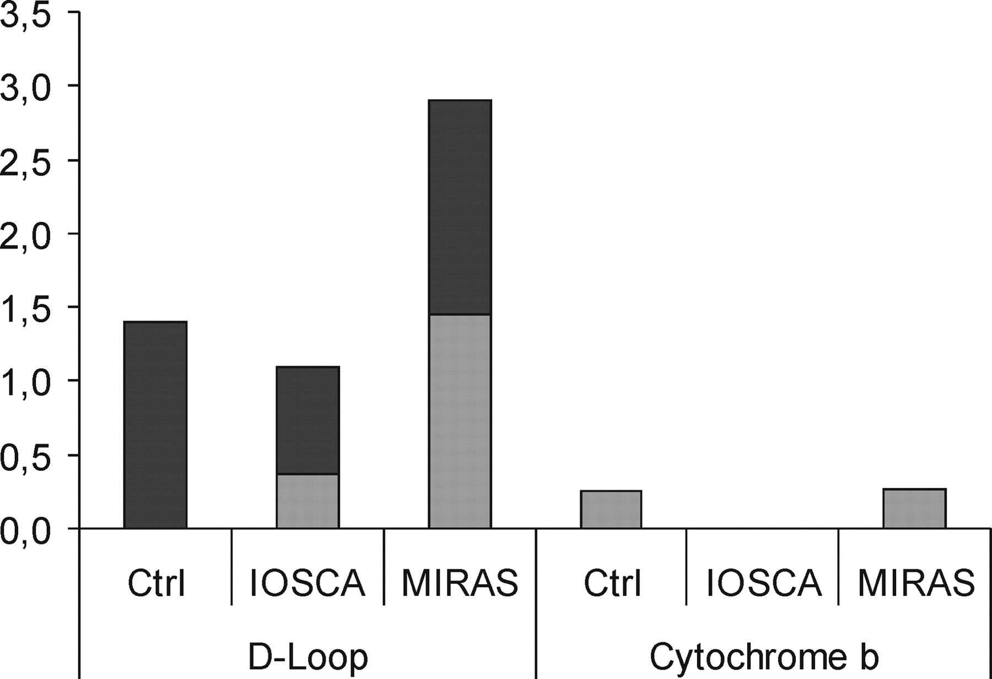
Figure 3. No increase in mtDNA point mutation load in IOSCA or MIRAS. The figure shows the amount of mtDNA point ...
Notes:
Figure 3. No increase in mtDNA point mutation load in IOSCA or MIRAS. The figure shows the amount of mtDNA point mutations in the cerebellum of the IOSCA patient, the MIRAS patient and the control per 10 000 bp. For each individual, the total amount of mtDNA sequence analyzed is ∼28 000 bp for the D-loop region, and more than 35 000 bp for the cytochrome b region. Substitutions are shown in light grey, and insertion/deletion mutations in darker grey.
Unless provided in the caption above, the following copyright applies to the content of this slide: © The Author 2008. Published by Oxford University Press. All rights reserved. For Permissions, please email: journals.permissions@oxfordjournals.org

Slide 4
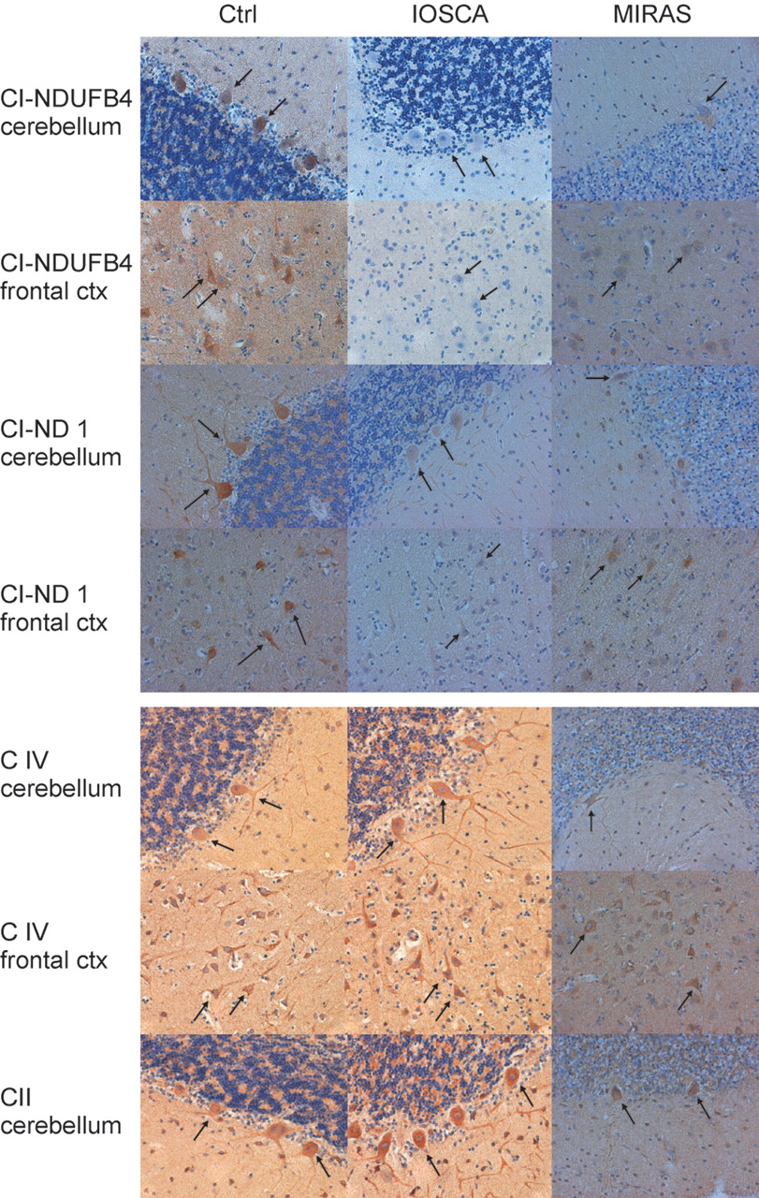
Figure 4. Reduced immunoreactivity of Complex I in IOSCA brain. The figure shows formalin-fixed paraffin sections from ...
Notes:
Figure 4. Reduced immunoreactivity of Complex I in IOSCA brain. The figure shows formalin-fixed paraffin sections from the cerebellum and the frontal cortex of control, IOSCA and MIRAS patients immunostained with antibodies against CI (NDUFB4 and ND1), CII and CIV subunits. The IOSCA patients show drastically reduced immunoreactivity with antibodies against both CI subunits, and the MIRAS patient shows reduced immunoreactivity with the CI antibodies. Immunostainings against CII and CIV subunits in IOSCA and MIRAS are comparable to controls. Paraffin sections, original magnifications ×200.
Unless provided in the caption above, the following copyright applies to the content of this slide: © The Author 2008. Published by Oxford University Press. All rights reserved. For Permissions, please email: journals.permissions@oxfordjournals.org

Slide 5
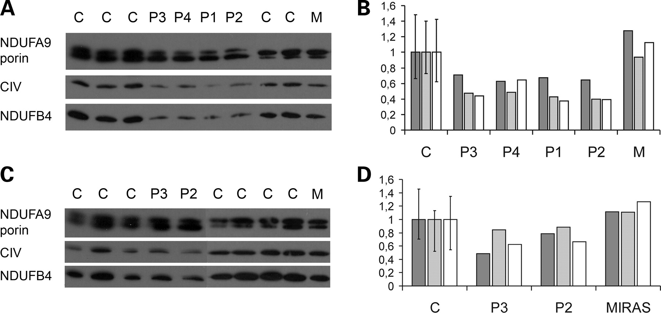
Figure 5. Reduced Complex I and Complex IV in western analysis of IOSCA brain. Analysis of mitochondrial respiratory ...
Notes:
Figure 5. Reduced Complex I and Complex IV in western analysis of IOSCA brain. Analysis of mitochondrial respiratory chain complexes by western analysis and immunoblotting revealed reduced levels of CI and CIV in the IOSCA frontal cortex, but unchanged levels in the MIRAS frontal cortex. In the cerebellum of the IOSCA patients, CI and CIV levels were only slightly reduced. (A) Frontal cortex, immunoblotting with antibodies against CI-NDUFA9, CI-NDUFB4, CIV and porin. (B) Frontal cortex, quantification of CI and CIV normalized to porin. The average of all controls (for each antibody) is shown as 1, and the error bar shows the range of all controls. C = controls (n = 5), P1–P4 = IOSCA patients, M = MIRAS patient. Dark grey bars, CI-NDUFA9/porin ratios; light grey bars, CI-NDUFB4/porin ratios; white bars, CIV/porin ratios. (C) Cerebellum, immunoblotting with antibodies against CI-NDUFA9, CI-NDUFB4, CIV and porin. (D) Cerebellum, quantification of CI and CIV normalized to porin. C = controls (n = 7) (other details and color codes as in (B)).
Unless provided in the caption above, the following copyright applies to the content of this slide: © The Author 2008. Published by Oxford University Press. All rights reserved. For Permissions, please email: journals.permissions@oxfordjournals.org

Slide 6
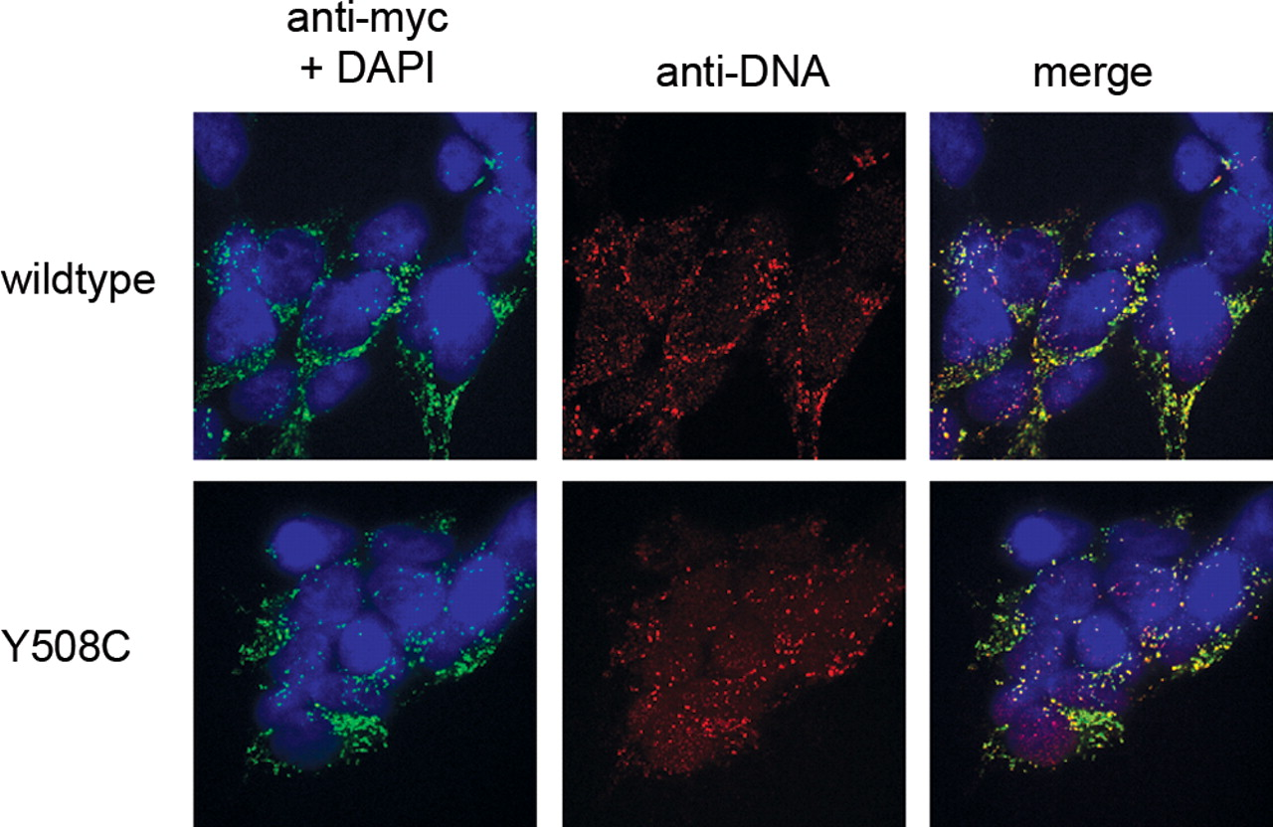
Figure 6. Y508C Twinkle is localized to nucleoids. Immunocytochemistry of 293 FlpIn TREx cells overexpressing the Y508C ...
Notes:
Figure 6. Y508C Twinkle is localized to nucleoids. Immunocytochemistry of 293 FlpIn TREx cells overexpressing the Y508C protein or the wild-type Twinkle. Cells were induced for 3 days with 3 ng/ml doxycycline. The overexpressed proteins were detected by their myc-tag, while mtDNA was detected with an anti-DNA antibody.
Unless provided in the caption above, the following copyright applies to the content of this slide: © The Author 2008. Published by Oxford University Press. All rights reserved. For Permissions, please email: journals.permissions@oxfordjournals.org

Slide 7
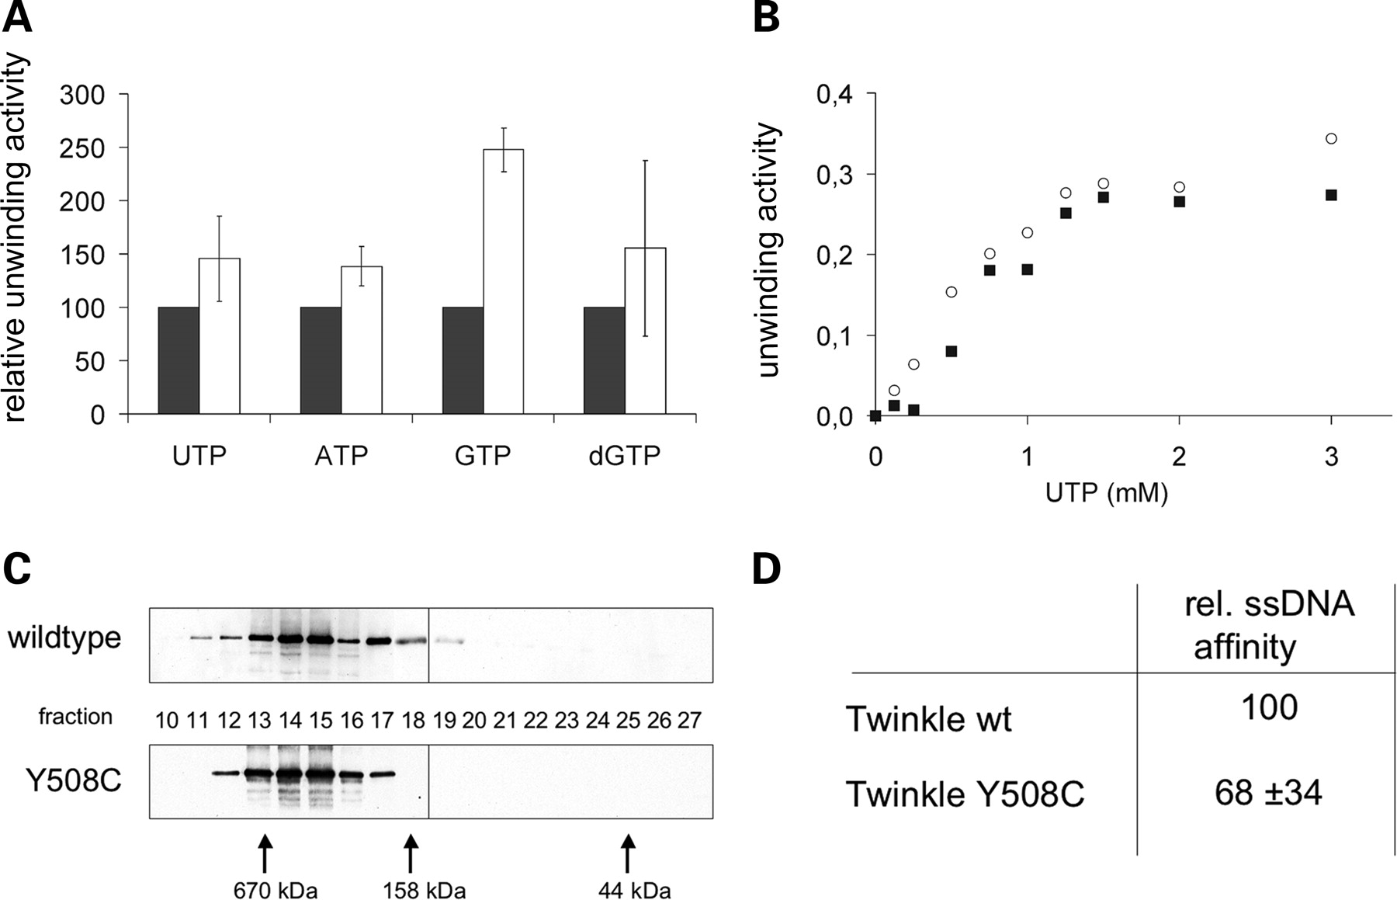
Figure 7. High unwinding activity of Y508C helicase, but normal hexamerization and ssDNA binding affinity. In vitro ...
Notes:
Figure 7. High unwinding activity of Y508C helicase, but normal hexamerization and ssDNA binding affinity. In vitro activity assays of isolated Twinkle proteins. (A) Helicase activity of Twinkle wild-type (black bars) and Y508C (white bars) in vitro using a 20 bp double-stranded substrate and 3 mm of the indicated nucleotide. Y508C showed higher unwinding activity than the wild-type with all the nucleotides observed (n = 5, P < 0.01). (B) Unwinding activity of Twinkle wt (square) and Y508C (circle) depending on the concentration of UTP. No difference in kinetics was observed. (C) Gel filtration analysis of the oligomer formation of isolated proteins. Both Twinkle wt and Y508C formed hexamers that were stable during the course of the chromatography, no monomers of 77 kDa were detected. kDa shows protein size markers. (D) Relative affinity to ssDNA calculated from electromobility shift assays comparing wild-type and Y508C protein (n = 5). The lower tendency of Y508C was not statistically significant.
Unless provided in the caption above, the following copyright applies to the content of this slide: © The Author 2008. Published by Oxford University Press. All rights reserved. For Permissions, please email: journals.permissions@oxfordjournals.org

Slide 8
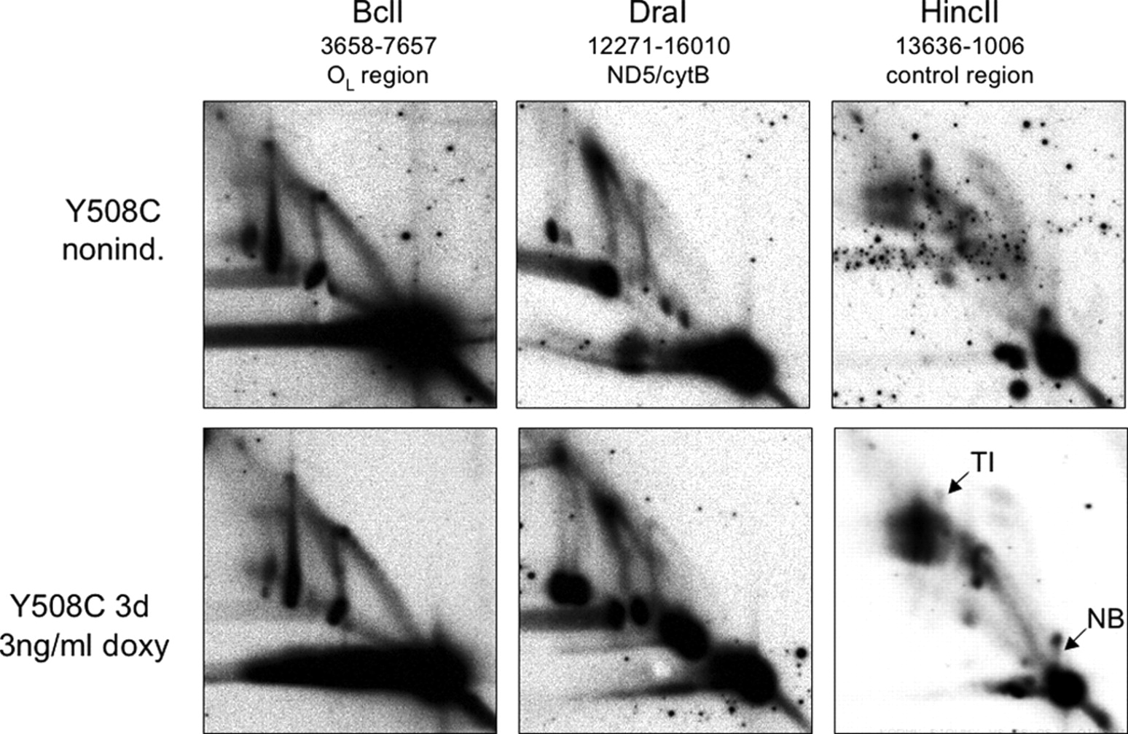
Figure 8. Y508C does not affect mtDNA replication intermediates. MtDNA replication in 293 FlpIn TREx Twinkle Y508C ...
Notes:
Figure 8. Y508C does not affect mtDNA replication intermediates. MtDNA replication in 293 FlpIn TREx Twinkle Y508C cells (with and without doxycycline induction) was analyzed by neutral/neutral two-dimensional agarose gel electrophoresis. No change of replication intermediates was found in the coding region of mtDNA, while in the HincII fragment containing the D-loop (13636-1006), a decrease in termination intermediates (TI) and a structure close to the 1n spot (NB) that is typically associated with fragments containing OH (42) was observed. The changes were not specific for Y508C, but associated with Twinkle overexpression, as wild-type overexpression resulted in similar changes (not shown).
Unless provided in the caption above, the following copyright applies to the content of this slide: © The Author 2008. Published by Oxford University Press. All rights reserved. For Permissions, please email: journals.permissions@oxfordjournals.org

Slide 9
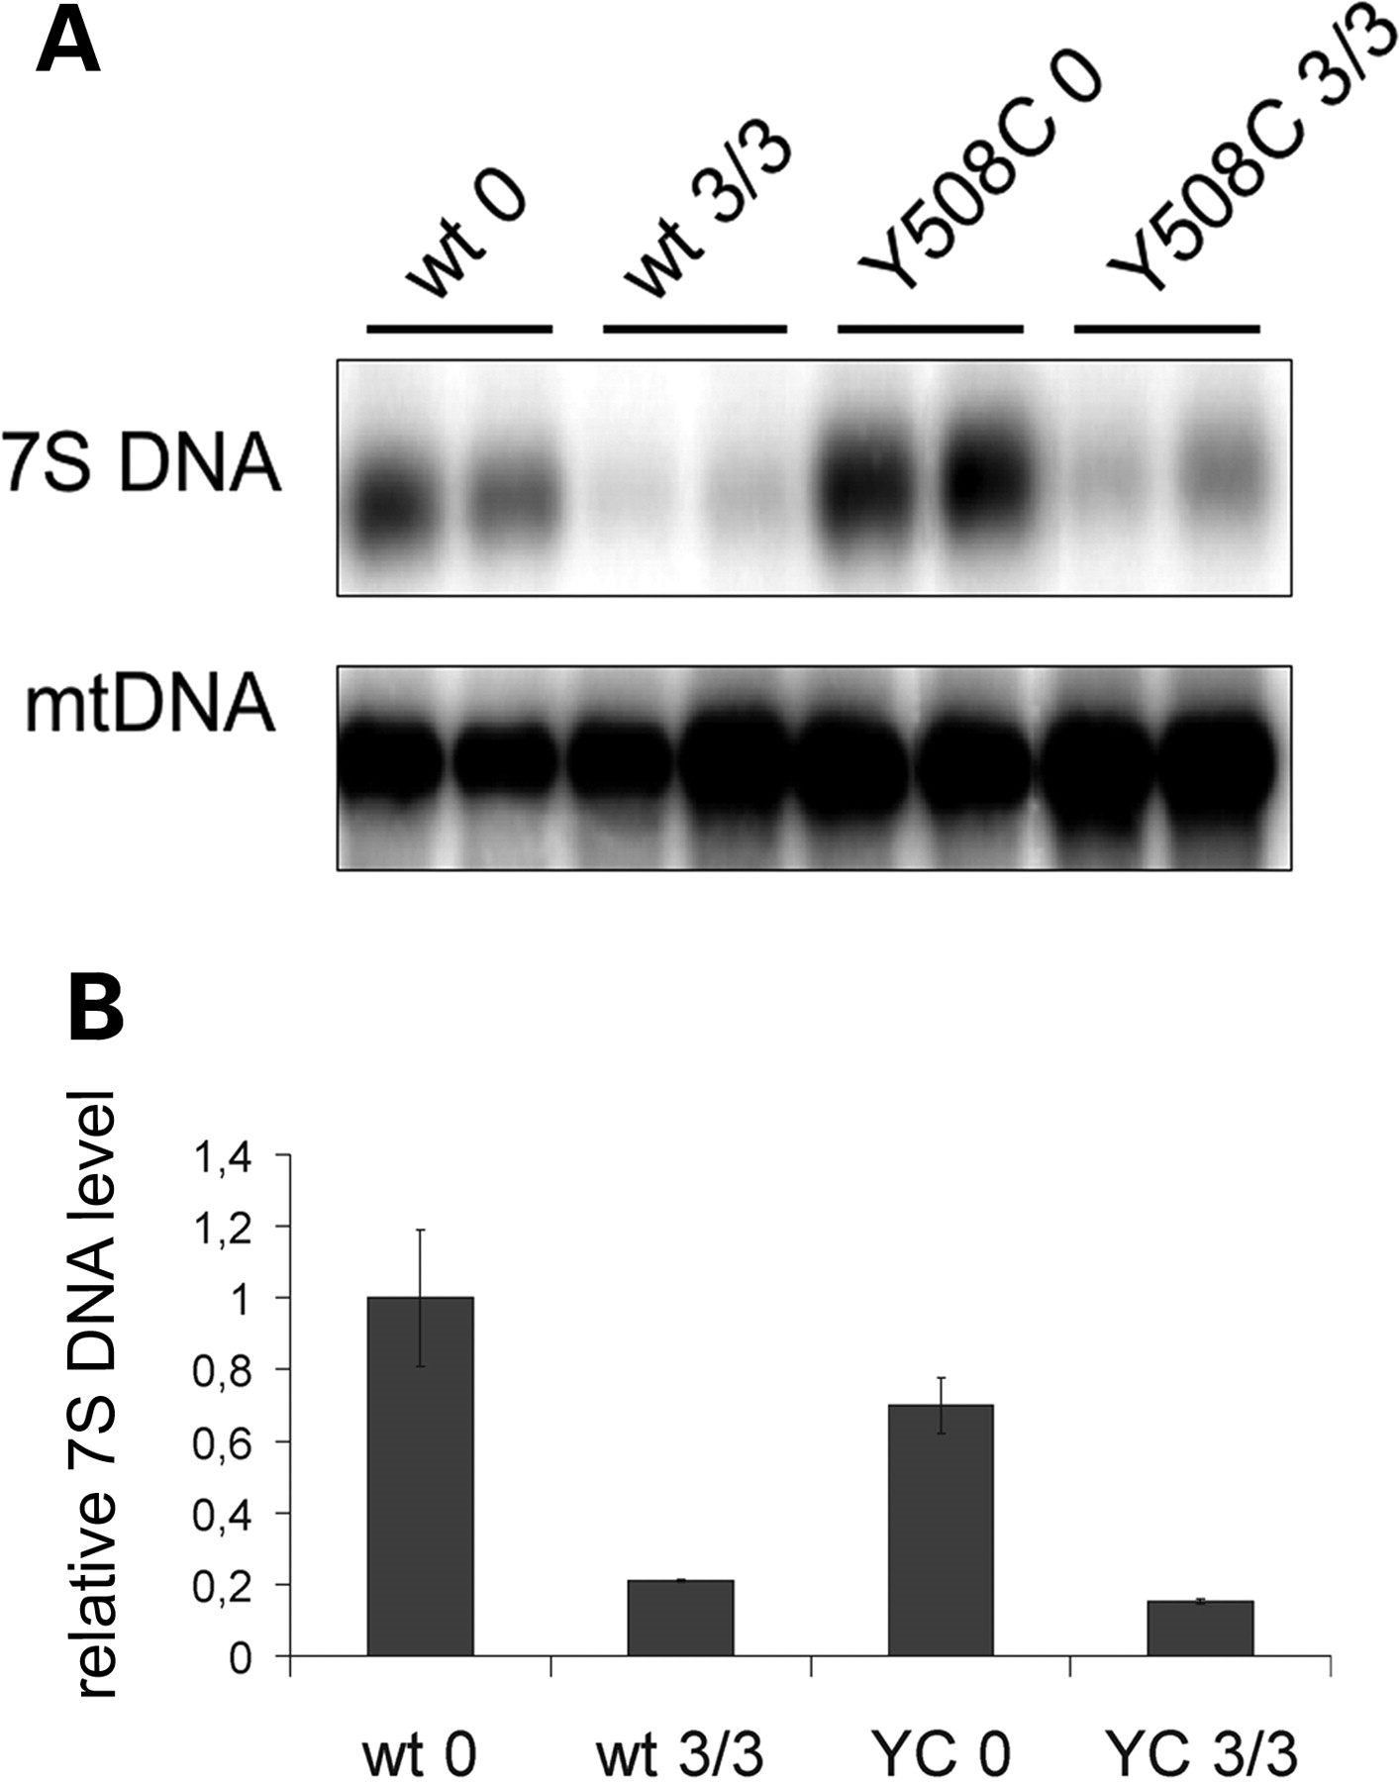
Figure 9. The relative levels of 7S DNA are decreased by overexpression of Twinkle. (A) Southern blot of heat-denatured ...
Notes:
Figure 9. The relative levels of 7S DNA are decreased by overexpression of Twinkle. (A) Southern blot of heat-denatured DNA from 293 FlpIn TREx wild-type and Y508C Twinkle cells induced for 3 days with 0 and 3 ng/ml doxycycline. Both free 7S DNA and total mitochondrial DNA were detected with a probe against the control region of mtDNA and the signal intensity quantified by phosphorimager. (B) Relative abundance of 7S DNA per total mitochondrial DNA. Overexpression of both wild-type and Y508C Twinkle strongly reduce 7S DNA levels to ca. 20% of non-expressing cells.
Unless provided in the caption above, the following copyright applies to the content of this slide: © The Author 2008. Published by Oxford University Press. All rights reserved. For Permissions, please email: journals.permissions@oxfordjournals.org

Slide 10
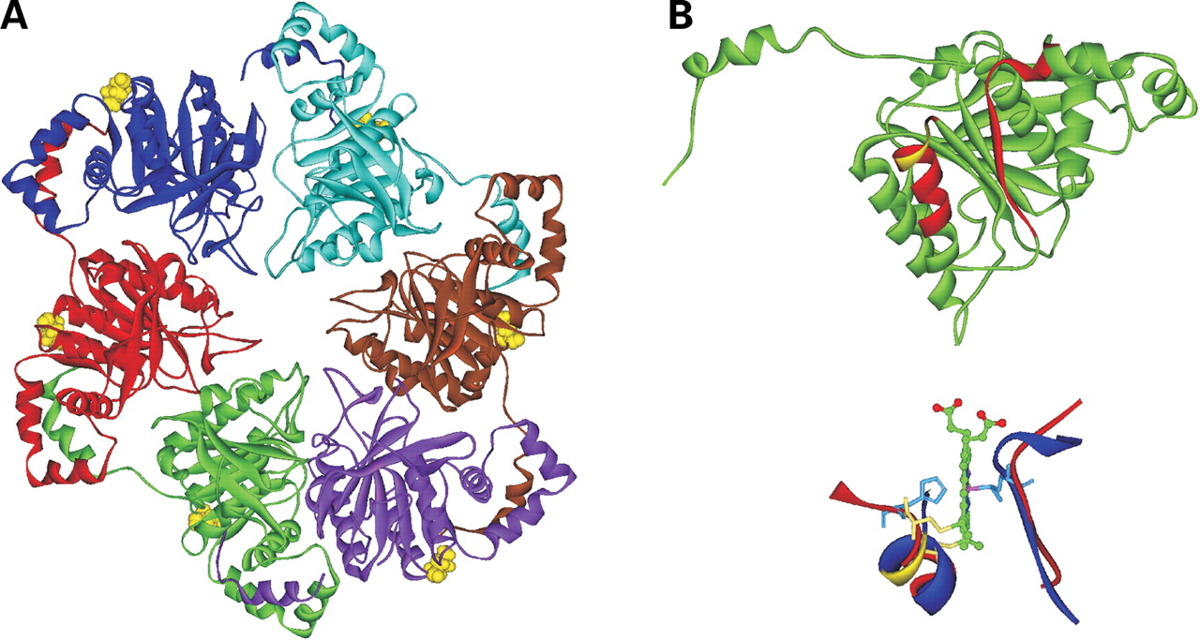
Figure 10. Based on the comparison of Twinkle to the T7 helicase structure, the Y508C mutation is located outside the ...
Notes:
Figure 10. Based on the comparison of Twinkle to the T7 helicase structure, the Y508C mutation is located outside the subunit interface and creates a putative heme-binding site. (A) The hexameric protein structure of the Twinkle homologue, the bacteriophage T7 primase/helicase (the structure comprising the helicase domains of the T7 primase/helicase). The location of K416, roughly corresponding to the IOSCA-Y508C mutation site in Twinkle, is illustrated in yellow. (B) Top; ribbon model of the T7 helicase monomer. The approximate location of the site corresponding to the Y508C mutation is shown in yellow and the red color illustrates the α-helix and β-strand that are analogous to those found in the heme-binding pockets of cytochrome c structures. Below; cytochrome c and the helicase have been superimposed to demonstrate the similarity between the local conformations. The red ribbons represent structures of the heme pocket of cytochrome c. This site binds the heme covalently by two cysteines (yellow stick models) while the heme iron is coordinated by a histidine and a methionine (cyan stick models). The T7 helicase structures that are analogous to the heme-binding site are shown as blue ribbons. The region analogous to IOSCA-Y508C is illustrated in yellow.
Unless provided in the caption above, the following copyright applies to the content of this slide: © The Author 2008. Published by Oxford University Press. All rights reserved. For Permissions, please email: journals.permissions@oxfordjournals.org

Slide 11
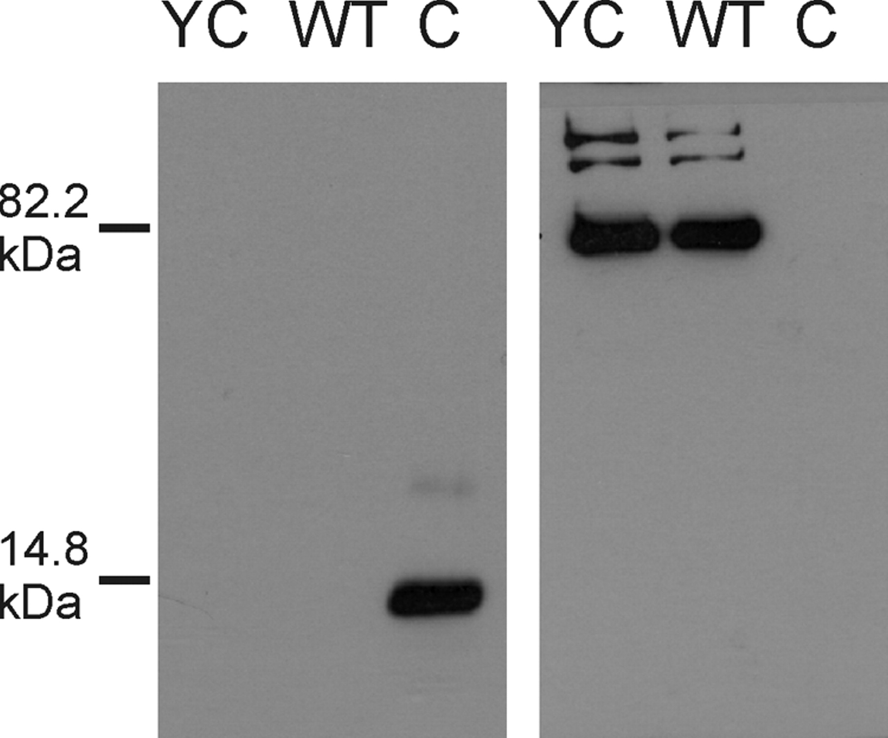
Figure 11. Y508C or wt Twinkle do not bind heme covalently. On the left, the membrane is stained with ECL Plus directly ...
Notes:
Figure 11. Y508C or wt Twinkle do not bind heme covalently. On the left, the membrane is stained with ECL Plus directly after western blotting to detect covalently bound heme. YC, purified Twinkle protein with the Y508C mutation; WT, purified wild-type Twinkle; C, cytochrome c as a positive control. On the right, the presence of the Twinkle proteins is verified with immunoblotting of the same membrane using the c-Myc antibody (c-Myc tag on the Twinkle proteins). kDa shows protein size markers.
Unless provided in the caption above, the following copyright applies to the content of this slide: © The Author 2008. Published by Oxford University Press. All rights reserved. For Permissions, please email: journals.permissions@oxfordjournals.org

