Slide 1
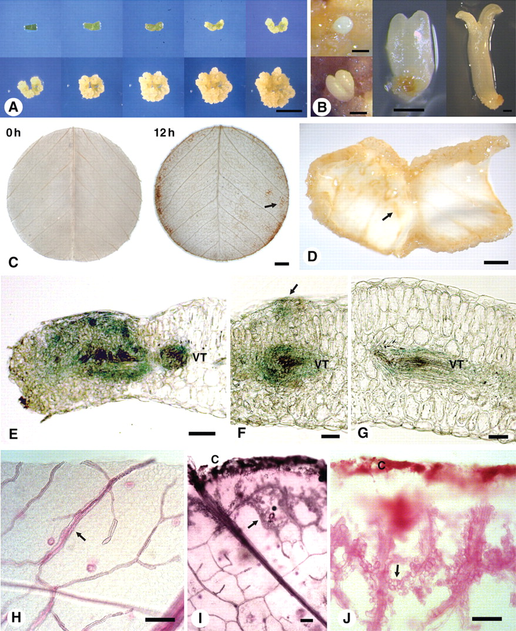
Fig. 1. The M. truncatula SE culture system, early signalling and morphological changes. (A) Time course of ...
Notes:
Fig. 1. The M. truncatula SE culture system, early signalling and morphological changes. (A) Time course of embryogenic callus development from dark-grown leaf explants over 40 d (0, 5, 10, 15, 20, 24, 28, 32, 36 and 40 d). Explants cultured on P4 10:4 medium (auxin + cytokinin) for 3 weeks followed by transfer to P4 10:4:1 medium (auxin + cytokinin + abscisic acid). (B) Somatic embryo development showing globular, heart, torpedo and cotyledon stages. (C) Detection of ROS production using DAB staining after 0 h and 12 h of explant incubation. The arrow points to DAB staining of fine veins in the explant. (D) Three-week-old callus showing curling of the explant. The arrow shows callus formation starting at the veins. Most extensive callusing is at the cut edges. (E–G) Promoter SERK–GUS expression after culture of explant for 1 week showing GUS expression associated with (E) vascular tissue and mesophyll cells near cut surface, (F) vascular tissue and early cell proliferation (arrow) on upper surface of the explant and (G) vascular tissue. (H–J) Whole mount of cleared leaf (H) showing venation (arrow), and after 1 week of culture showing (I) cell division from vein cells nearest the cut surface (arrow) and (J) cell division associated with veins (arrow). Abbreviations: C, callus from cut edge of explant; VT, vascular tissue. Scale bars: (A) = 1 cm; (B) = 0·5 mm; (C, D) = 1 mm; (E–G) = 50 µm; (H–J) = 100 µm.
Unless provided in the caption above, the following copyright applies to the content of this slide: © The Author 2011. Published by Oxford University Press on behalf of the Annals of Botany Company. All rights reserved. For Permissions, please email: journals.permissions@oup.com

Slide 2
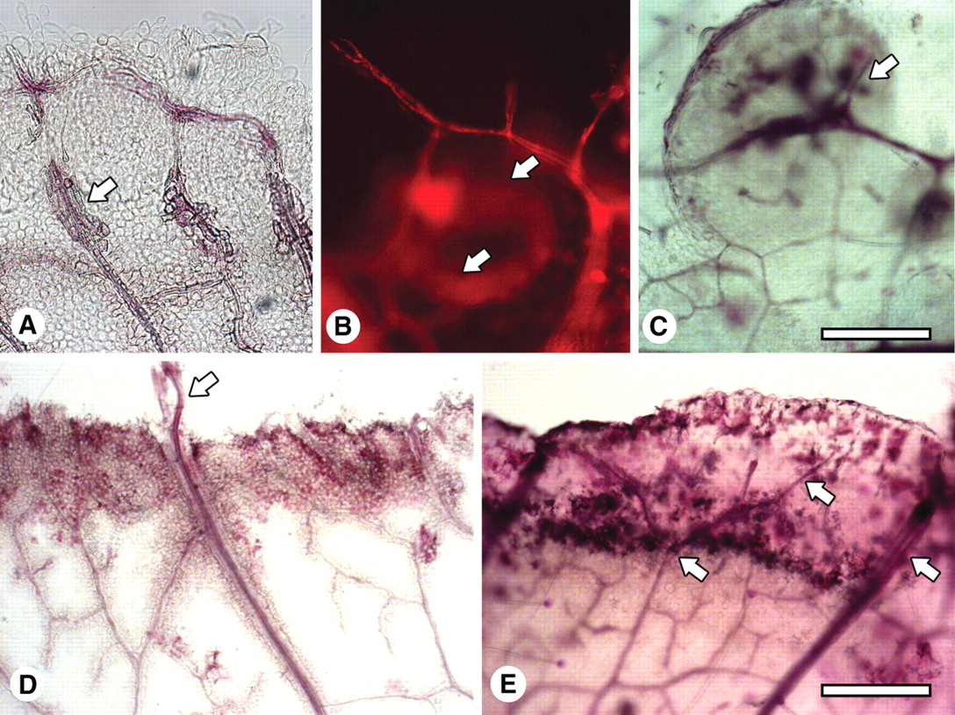
Fig. 2. Whole mounts showing vascularization associated with early callus development. (A) Venation of a leaf explant ...
Notes:
Fig. 2. Whole mounts showing vascularization associated with early callus development. (A) Venation of a leaf explant cultured for 1 -week and the formation of tracheids at the vein (arrow). (B) A newly formed vein associated with cell proliferation after 2 weeks of culture, initiated at an existing vein and reconnecting to it, forming a circular pattern (arrows). Imaged by fluorescence microscopy. (C) Veins forming in a callus island (arrow) after 2 weeks of culture. (D) A major vein that has grown through the callus and into the medium (arrow) after 1 week of culture. (E) Veins (arrows) growing and branching in the newly formed callus at the edge of the explant after 1 week of culture. Scale bars: (A–C) = 200 µm; (D, E) = 400 µm.
Unless provided in the caption above, the following copyright applies to the content of this slide: © The Author 2011. Published by Oxford University Press on behalf of the Annals of Botany Company. All rights reserved. For Permissions, please email: journals.permissions@oup.com

Slide 3
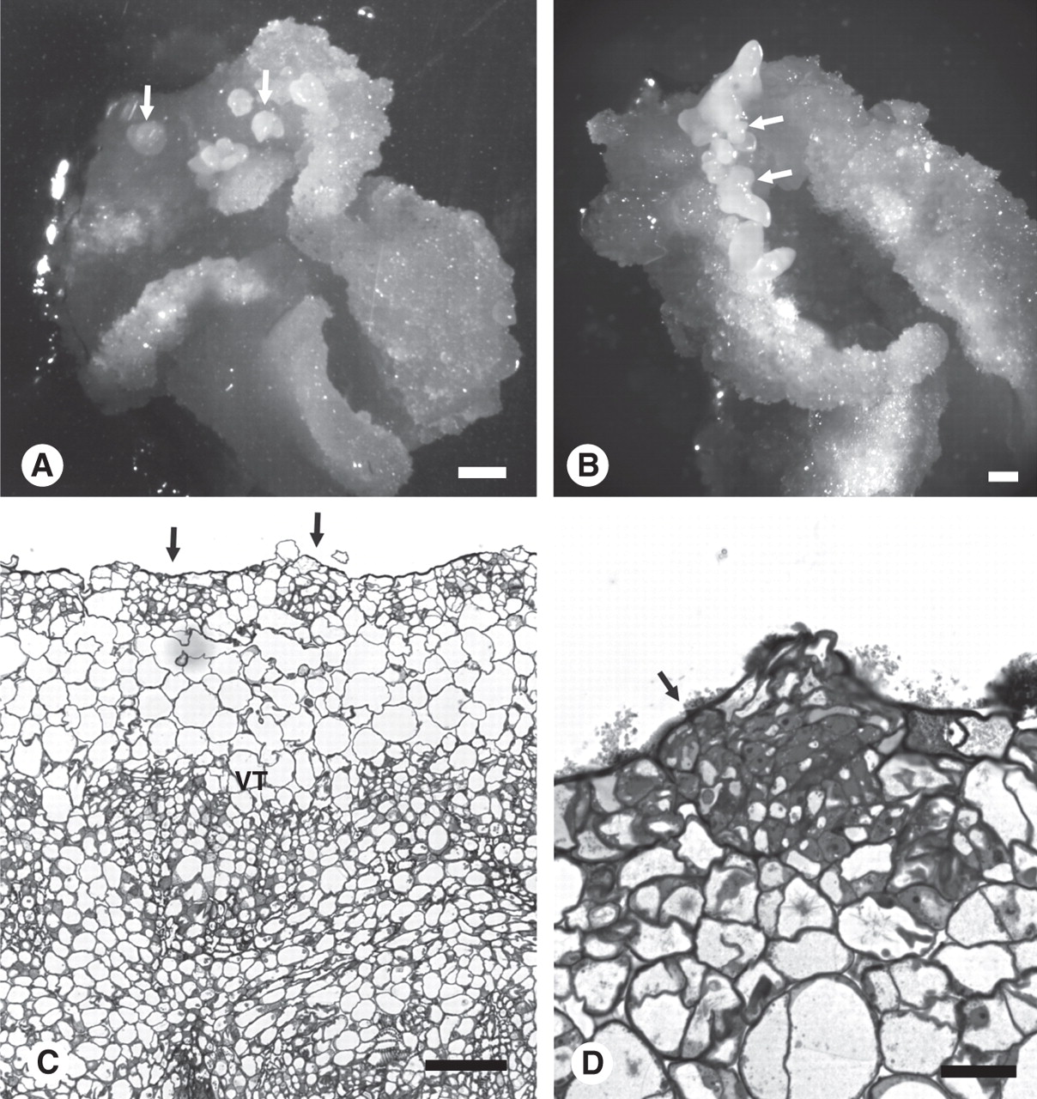
Fig. 3. The formation of somatic embryos in embryogenic callus. (A) Globular stage embryos forming on the surface of ...
Notes:
Fig. 3. The formation of somatic embryos in embryogenic callus. (A) Globular stage embryos forming on the surface of the explant originally in contact with the medium (arrows) after 26 d of culture. Note the explant has curled at the edges where there is extensive callusing. (B) Somatic embryos (arrows) developing on the top surface of the callus away from the medium after 36 d. (C) Section through 3-week embryogenic callus. Arrows show early embryo development near the surface of the explant. (D) Higher magnification of globular somatic stage embryo (arrow) developing near the surface of a 3-week-old callus. VT = vascular tissue. Scale bars: (A, B) = 1 mm; (C) = 100 µm; (D) = 25 µm.
Unless provided in the caption above, the following copyright applies to the content of this slide: © The Author 2011. Published by Oxford University Press on behalf of the Annals of Botany Company. All rights reserved. For Permissions, please email: journals.permissions@oup.com

Slide 4
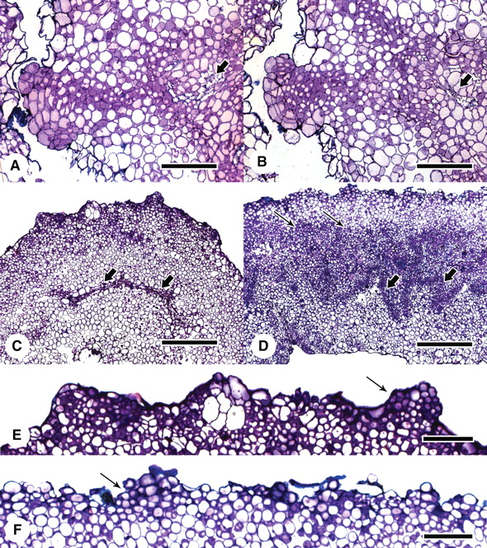
Fig. 4. Investigation into the origin of the cells forming somatic embryos by incubating explants with the adaxial or ...
Notes:
Fig. 4. Investigation into the origin of the cells forming somatic embryos by incubating explants with the adaxial or abaxial surface in contact with the medium. (A, B) Serial sections showing the lineage of cells from the vascular tissue (arrow) to the somatic embryo forming on the surface of a 3-week-old callus. (C) Explant incubated with adaxial surface on the medium for 2 weeks. Arrows show little cellular proliferation or differentiation associated with the veins. (D) Explant incubated with abaxial surface on the medium for 2 weeks. Arrows show massive cell proliferation and vascularization (larger arrows) usually associated with the standard SE procedure. (E) and (F) Respective enlargements of (C) and (D) showing early embryogenesis (arrow) near the explant surface. Scale bars: (A, B) = 400 µm; (C–F) = 100 µm.
Unless provided in the caption above, the following copyright applies to the content of this slide: © The Author 2011. Published by Oxford University Press on behalf of the Annals of Botany Company. All rights reserved. For Permissions, please email: journals.permissions@oup.com

Slide 5
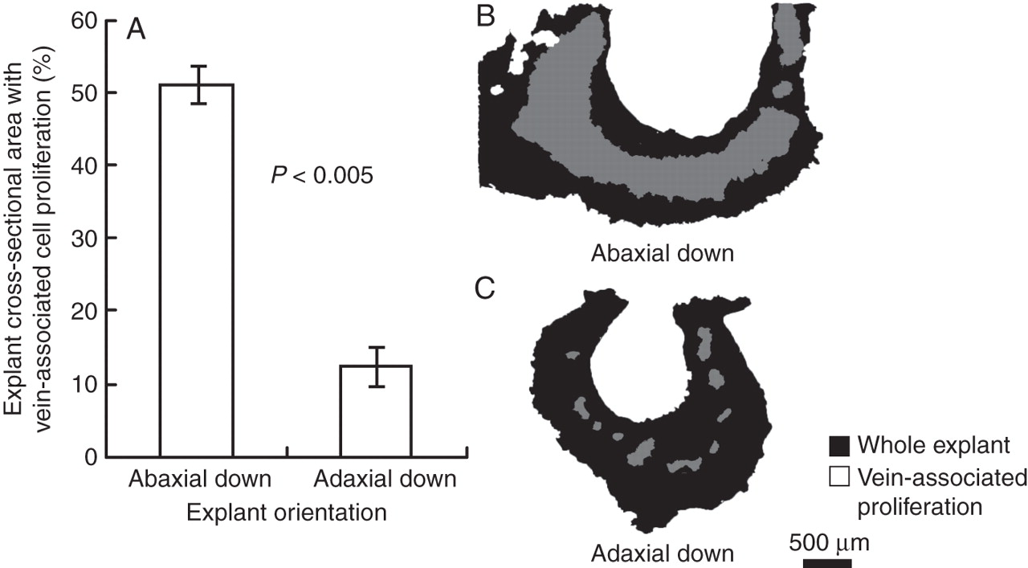
Fig. 5. Quantification of vein-associated cell proliferation in leaf explants with abaxial or adaxial side in contact ...
Notes:
Fig. 5. Quantification of vein-associated cell proliferation in leaf explants with abaxial or adaxial side in contact with the medium. (A) Adaxially plated explants exhibit significantly less cell proliferation associated with the vasculature as compared with abaxially plated explants. (B–C) Representative images of the leaf explant sections used for analysis. Student's t-test was used to assess significance, P < 0·005.
Unless provided in the caption above, the following copyright applies to the content of this slide: © The Author 2011. Published by Oxford University Press on behalf of the Annals of Botany Company. All rights reserved. For Permissions, please email: journals.permissions@oup.com

Slide 6
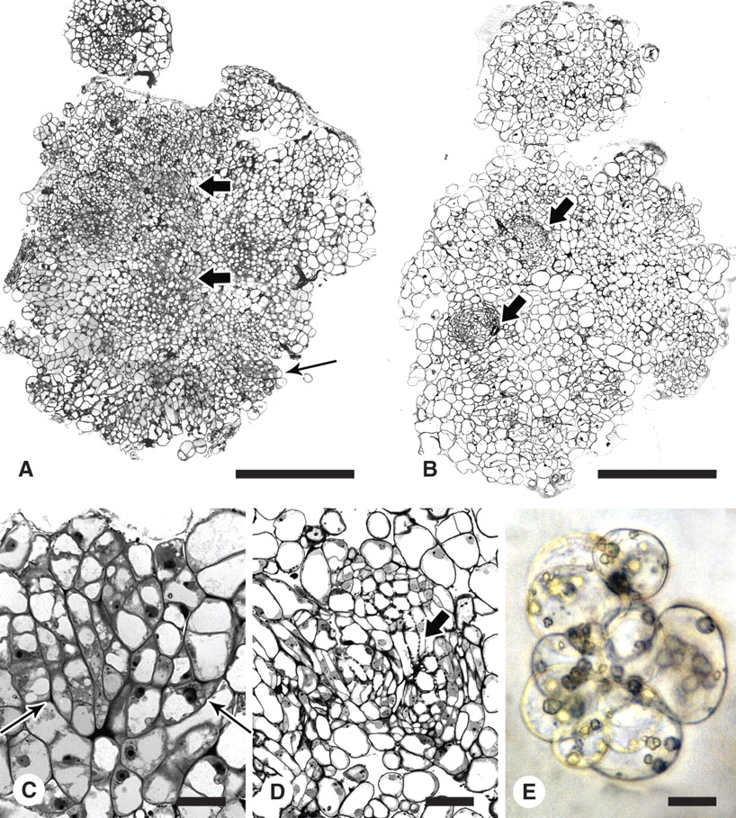
Fig. 6. Culture of protoplasts from embryogenic 2HA and wild-type Jemalong. (A) Transverse section of embryogenic ...
Notes:
Fig. 6. Culture of protoplasts from embryogenic 2HA and wild-type Jemalong. (A) Transverse section of embryogenic callus from 2HA protoplasts. Larger arrows show proembryogenic masses with densely cytoplasmic cells and smaller arrow shows embryos developing near the surface. (B) Transverse section of callus from Jemalong protoplasts showing vascular tissue but no densely cytoplasmic cells or embryos (arrows). (C) Somatic embryo (arrows) developing near the surface of callus derived from 2HA protoplasts. (D) Vascular tissue from Jemalong callus. The arrow indicates a tracheid. (E) Protoplast colony from 2HA. Scale bars: A and B = 400 µm; C = 20 µm; D = 50 µm; E = 25 µm.
Unless provided in the caption above, the following copyright applies to the content of this slide: © The Author 2011. Published by Oxford University Press on behalf of the Annals of Botany Company. All rights reserved. For Permissions, please email: journals.permissions@oup.com

