Slide 1
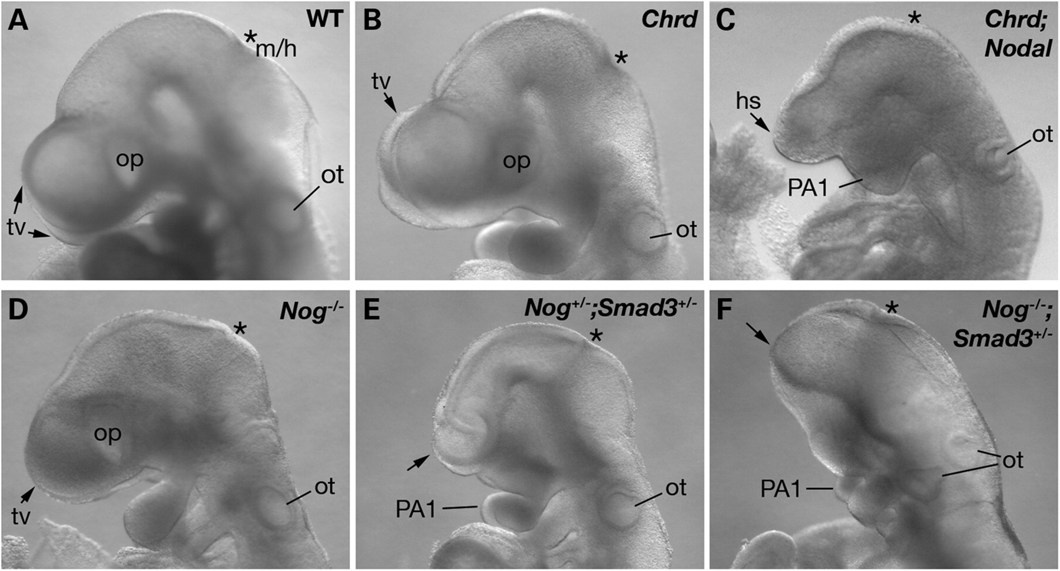
Figure 1. HPE in compound mutant embryos. Lateral view of E9.5 embryos. ( A and B ) WT and Chrd^{−/−} embryos ...
Notes:
Figure 1. HPE in compound mutant embryos. Lateral view of E9.5 embryos. ( A and B ) WT and Chrd−/− embryos have normal bilateral telencephalic vesicles (tv) and optic vesicles (op). ( C ) Chrd−/− ; Nodal+/− embryo with a single holospheric vesicle (hs) and fused, hypoplastic pharyngeal arch 1 (PA1). ( D ) Nog−/− embryo with normal morphology of anterior structures. ( E ) Nog+/− ; Smad3+/− embryo with a lack of the telecephalon (arrow) and abnormal BA1 morphology. ( F ) Nog−/− ; Smad3+/− embryo showing severe forebrain truncation. Asterisks mark midbrain/hindbrain boundary (m/h). ot, otic vesicle.
Unless provided in the caption above, the following copyright applies to the content of this slide: © The Author 2010. Published by Oxford University Press. All rights reserved. For Permissions, please email: journals.permissions@oxfordjournals.org

Slide 2
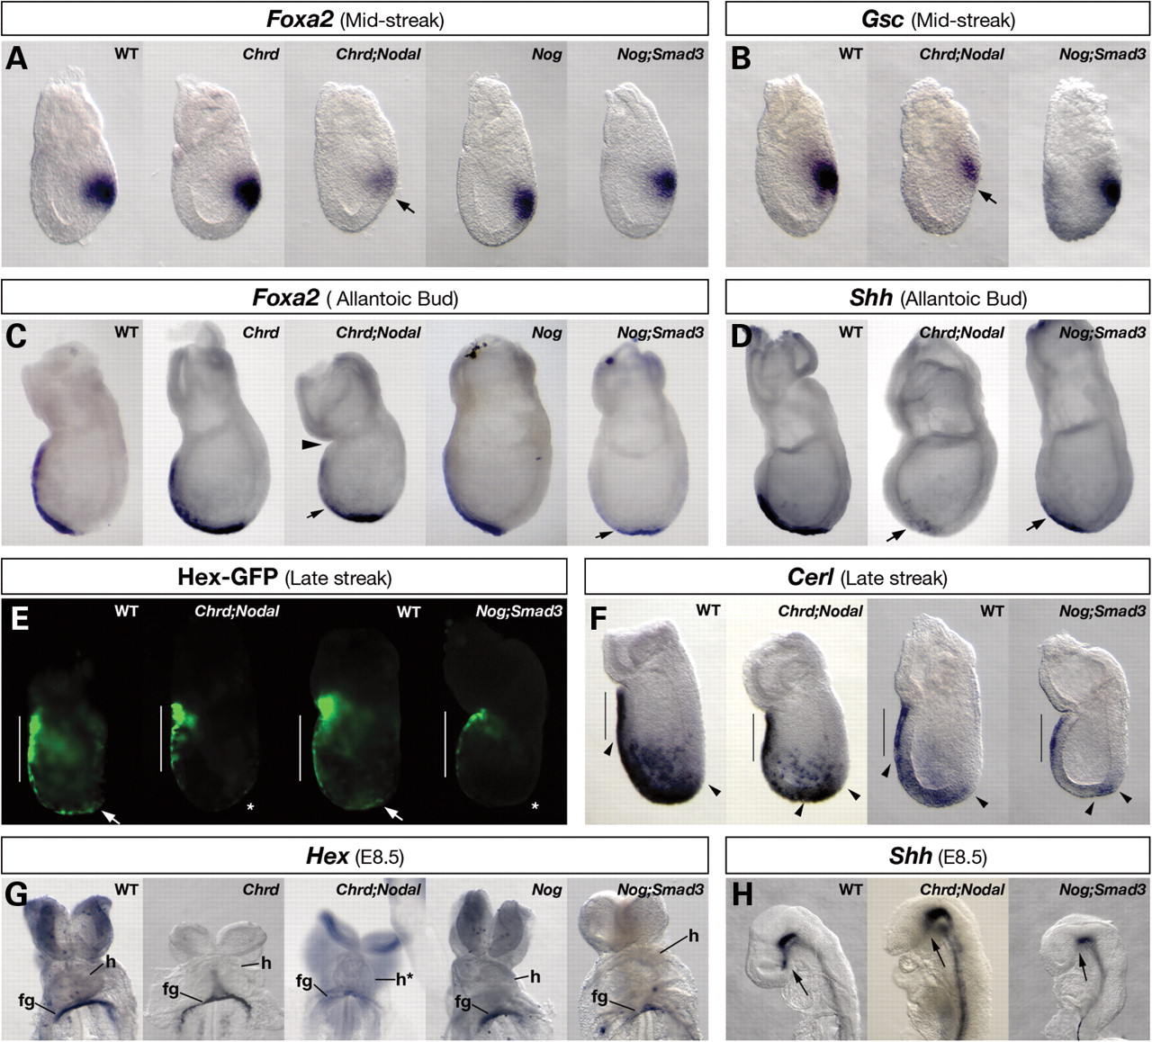
Figure 2. APS and AME marker expression in compound mutant embryos. WMISH ( A – D , F – H ) or optically sectioned GFP ...
Notes:
Figure 2. APS and AME marker expression in compound mutant embryos. WMISH ( A – D , F – H ) or optically sectioned GFP fluorescence ( E ) of APS or AME markers. (A) At MS, Foxa2 is expressed normally in the APS of WT, Chrd−/− , Nog−/− and Nog−/− ; Smad3+/− embryos, but is significantly decreased in Chrd−/− ; Nodal+/− embryos (arrow). (B) At MS, Gsc expression is normal in WT and Nog−/− ; Smad3+/− embryos but decreased in Chrd−/− ; Nodal+/− embryos. (C) At the bud stage, Foxa2 is expressed in the extending AME in WT, Chrd−/− and Nog−/− embryos, but is lost in the anterior AME of Chrd−/− ; Nodal+/− and Nog−/− ; Smad3+/− embryos (arrows). Chrd−/− ; Nodal+/− embryos are sometimes constricted at the extra-embryonic–embryonic junction (arrowhead). (D) At the bud stage, Shh expression in anterior AME is lost in Chrd−/− ; Nodal+/− and Nog−/− ; Smad3+/− embryos (arrows). (E) In LS WT embryos, Hex-GFP is expressed in the AVE (white bar) and in the ADE (arrows). In Chrd−/− ; Nodal+/− and Nog−/− ; Smad3+/− embryos, AVE expression of Hex-GFP is normal, but ADE expression is decreased (asterisks). (F) At LS, Cerl is expressed in the AVE (black bars) as well as in ADE cells (between arrowheads). Relative to WT, ADE expression in Chrd−/− ; Nodal+/− and Nog−/− ; Smad3+/− embryos is markedly decreased and located only distally. (G) Hex is expressed in the foregut endoderm pocket (fg) of WT, Chrd−/− and Nog−/− embryos, but this is decreased or lost in Chrd−/− ; Nodal+/− and Nog−/− ; Smad3+/− embryos. (H) In WT embryos, the PCP expresses Shh (arrow). Shh expression is lost from the PCP area of Chrd−/− ; Nodal+/− and Nog−/− ; Smad3+/− embryos, but is retained in the rest of the midline. h, heart.
Unless provided in the caption above, the following copyright applies to the content of this slide: © The Author 2010. Published by Oxford University Press. All rights reserved. For Permissions, please email: journals.permissions@oxfordjournals.org

Slide 3
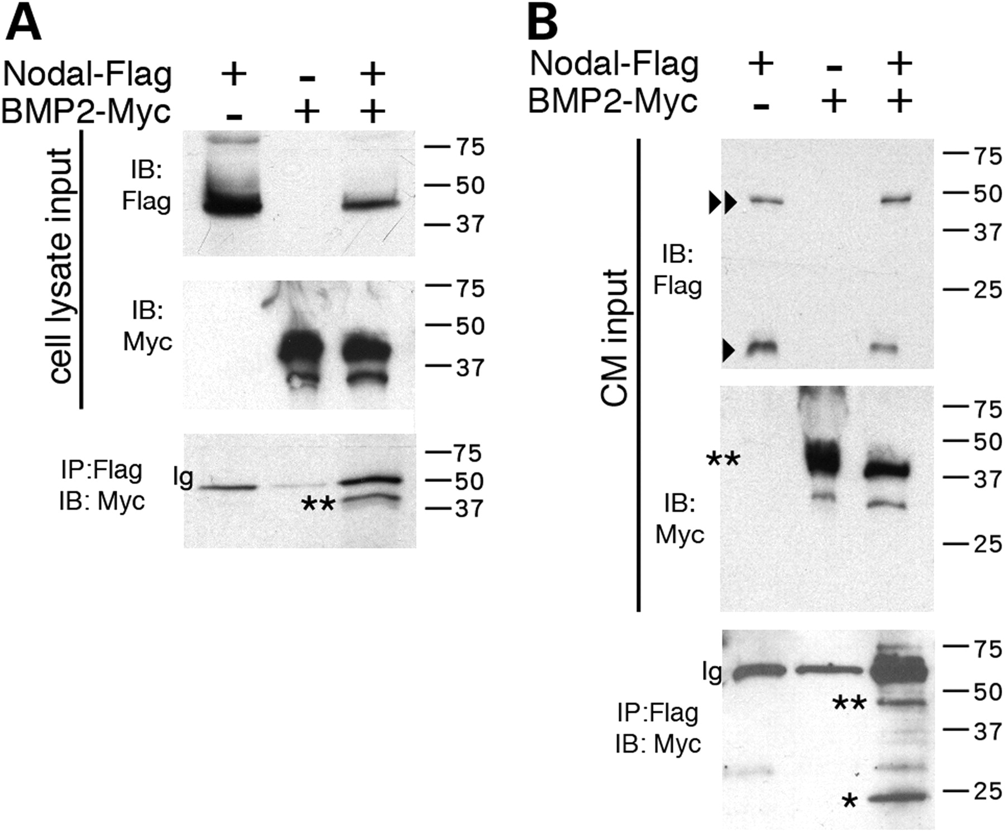
Figure 6. Direct interaction of Nodal and Bmp2 protein. IP of Nodal and Bmp2 proteins from COS cells transfected with ...
Notes:
Figure 6. Direct interaction of Nodal and Bmp2 protein. IP of Nodal and Bmp2 proteins from COS cells transfected with Nodal-Flag and/or Bmp2-Myc. Transfection with either construct is indicated by a plus (+), and absence by a minus (−). IP, immunoprecipitation; IB, immunoblot. ( A ) Cell lysates blotted and incubated with anti-Flag or anti-Myc demonstrate expression of both constructs. IPs were performed with anti-Flag (for Nodal) and blotted for anti-Myc (for Bmp2). Only precursor forms were detected (**). Expected sizes for tagged Nodal and Bmp2 are both around ∼45 kDa. ( B ) IP of Bmp2-Myc by Nodal-Flag from the CM of COS cells, in which separate cell populations were transfected with Nodal-Flag or Bmp2-Myc and then cultured. In the CM input, Bmp2-Myc precursor form (**) was detected, as well as Nodal-Flag precursor (<<) and mature forms (<; ∼18 kDa). Both precursor and mature forms of Bmp2-Myc were immunoprecipitated by Nodal-Flag [∼45 kDa (**) and ∼20 kDa (*), respectively].
Unless provided in the caption above, the following copyright applies to the content of this slide: © The Author 2010. Published by Oxford University Press. All rights reserved. For Permissions, please email: journals.permissions@oxfordjournals.org

Slide 4
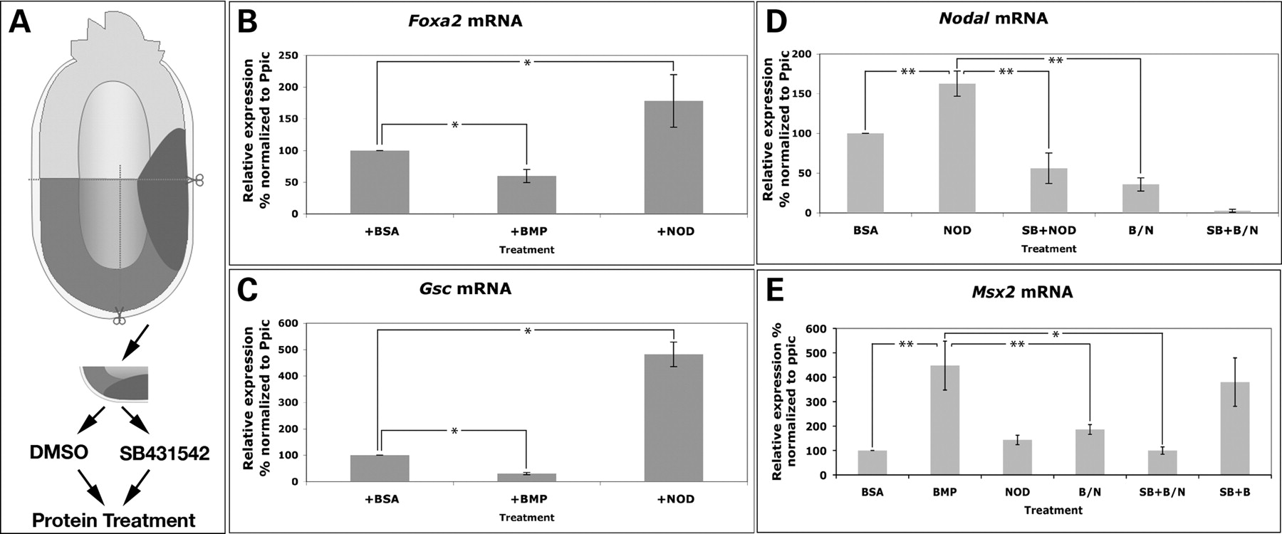
Figure 5. Mutual antagonism of BMP and Nodal does not require Nodal signal transduction. ( A ) Diagram of the APS ...
Notes:
Figure 5. Mutual antagonism of BMP and Nodal does not require Nodal signal transduction. ( A ) Diagram of the APS explant assay. APS fragments were isolated from E6.5 embryos and incubated in culture medium with DMSO or the Nodal inhibitor SB-431542 (SB), followed by protein treatment and then analyzed with qPCR. Protein treatments included BSA, BMP2 (BMP), Nodal (NOD) and BMP2/Nodal co-treatment (B/N). ( B – E ) Relative mRNA levels of Foxa2 , Gsc , Nodal and Msx2 in explants as measured by qPCR after the indicated treatments. Results were normalized to the mouse ‘house-keeping’ gene peptidylprolyl isomerase C ( Ppic ). The asterisks denote a significant difference between the indicated categories as determined by Student's t -test: * P < 0.01; ** P < 0.005.
Unless provided in the caption above, the following copyright applies to the content of this slide: © The Author 2010. Published by Oxford University Press. All rights reserved. For Permissions, please email: journals.permissions@oxfordjournals.org

Slide 5
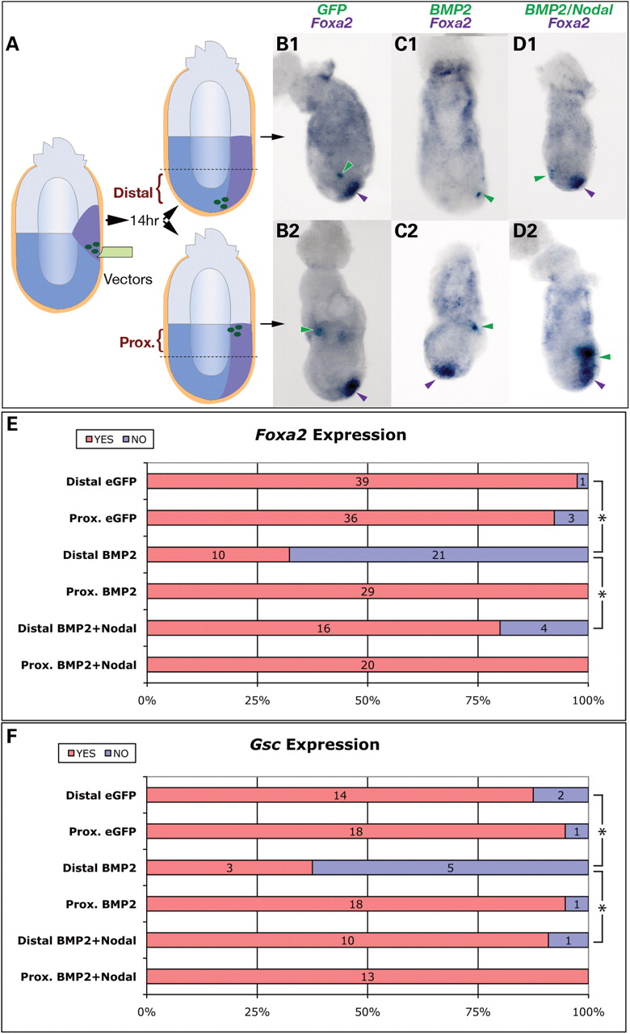
Figure 4. Nodal rescues Bmp2 -mediated suppression of APS gene expression. ( A ) Diagram of the experimental strategy. ...
Notes:
Figure 4. Nodal rescues Bmp2 -mediated suppression of APS gene expression. ( A ) Diagram of the experimental strategy. e GFP alone, or e GFP with experimental transgene expression vectors, was introduced into the APS region of WT E6.5 embryos. After 14 h culture, transgenic embryos were sorted by location of GFP expression (distal or proximal). Two-colored WMISH was used to detect ectopic gene expression (light blue) and endogenous APS gene expression (purple). eGFP expression (green arrowheads) in neither the distal ( B1 ) nor the proximal epiblast ( B2 ) alters Foxa2 expression. Foxa2 expression is inhibited by ectopic Bmp2 in the distal epiblast ( C1 ) but not in the proximal epiblast ( C2 ). Co-expression of Bmp2 and Nodal either distally ( D1 ) or proximally ( D2 ) does not affect Foxa2 expression. ( E and F ) Summary of the effects of transgene expression on Foxa2 and Gsc expression. The numbers of embryos with normal (red) or reduced expression (blue) are indicated. Asterisks denote a significant difference ( P < 0.001) by Student's t -test between the indicated categories.
Unless provided in the caption above, the following copyright applies to the content of this slide: © The Author 2010. Published by Oxford University Press. All rights reserved. For Permissions, please email: journals.permissions@oxfordjournals.org

Slide 6
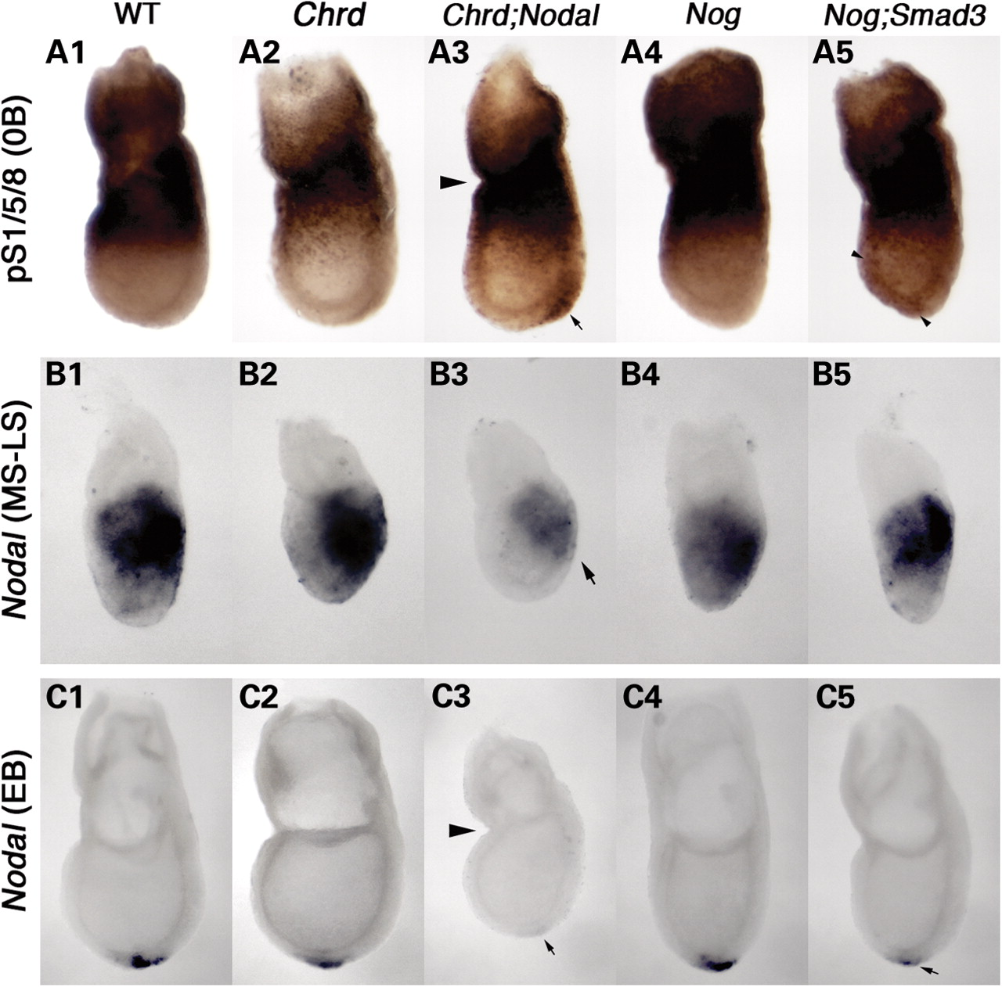
Figure 3. Alteration of BMP and Nodal signaling levels in compound mutant embryos. ( A ) Phospho-Smad1/5/8 (pS1/5/8) ...
Notes:
Figure 3. Alteration of BMP and Nodal signaling levels in compound mutant embryos. ( A ) Phospho-Smad1/5/8 (pS1/5/8) localization at the no-bud (0B) stage. pS1/5/8 is seen in extra-embryonic tissues and at the embryonic/extra-embryonic junction, but is absent in the distal region of wild-type (WT) (A1), Chrd−/− (A2) and Nog−/− embryos (A4). Ectopic pS1/5/8 is detected in the APS region of the distal epiblast of Chrd−/− ; Nodal embryos (arrow in A3) and faintly throughout the epiblast in some Nog−/− ; Smad3+/− embryos (arrowheads in A5). ( B ) Nodal expression at the MS–LS stage. Expression is similar in the primitive streak of WT and all mutant classes except Chrd−/− ; Nodal+/− embryo (B3), where it is decreased (arrow). ( C ) Nodal expression at the EB stage. Nodal is expressed around the node, at the distal tip of the WT embryo (C1). Nodal expression is normal in Chrd−/− and Nog−/− embryos (C2 and C4), but it is lost or decreased in Chrd−/− ; Nodal+/− (C3) and Nog−/− ; Smad3+/− (C5) embryos. Arrowheads in A3 and C3 denote the constriction found in many Chrd−/− ; Nodal+/− embryos.
Unless provided in the caption above, the following copyright applies to the content of this slide: © The Author 2010. Published by Oxford University Press. All rights reserved. For Permissions, please email: journals.permissions@oxfordjournals.org

Slide 7
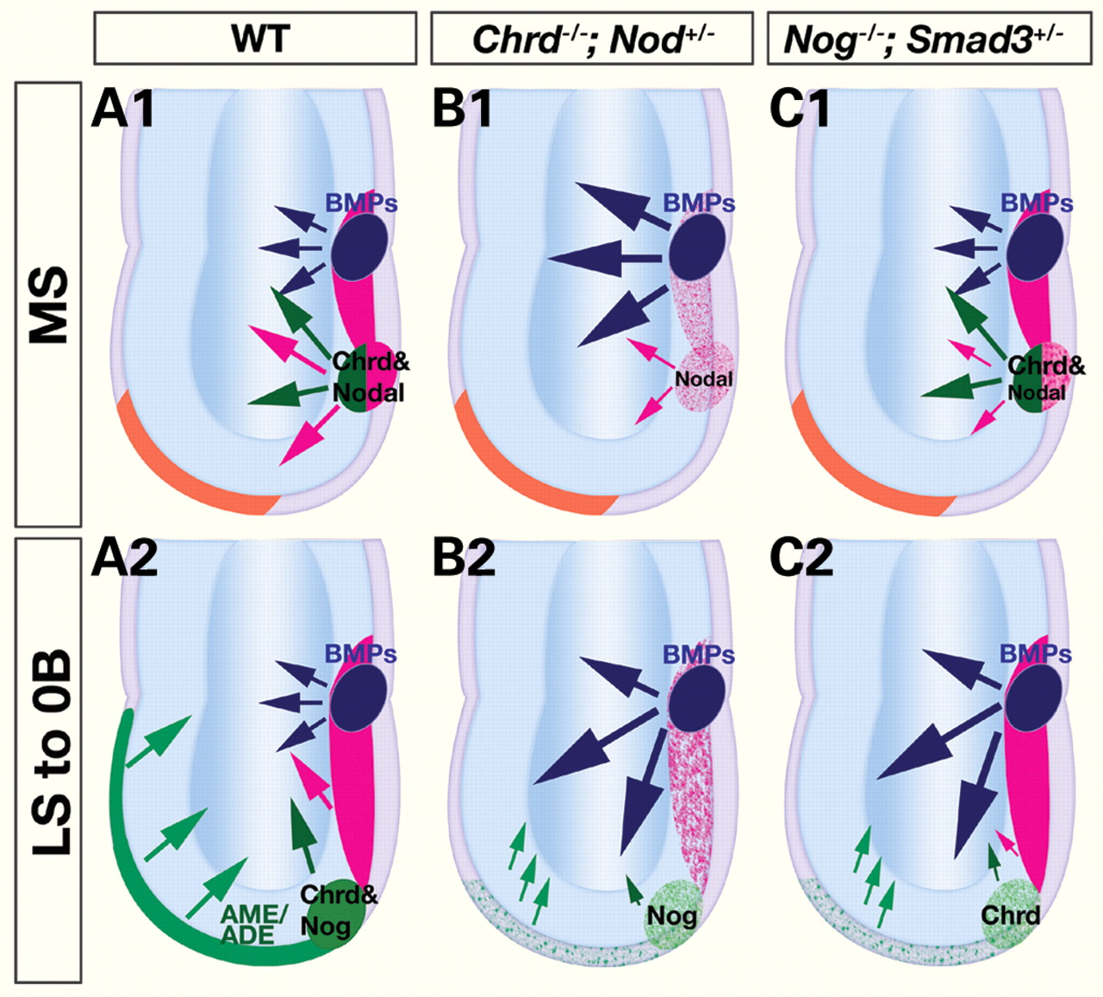
Figure 7. Model for the interaction of Nodal and anti-BMP activities during the formation of the anterior primitive ...
Notes:
Figure 7. Model for the interaction of Nodal and anti-BMP activities during the formation of the anterior primitive streak and its derivatives. ( A ) BMP signaling activation (blue) is restricted, and Nodal signaling enhanced, by the synergistic interaction of Chrd and Nodal in the APS (green/red) at the MS (A1) stage, and of Nog and Smad3 in the anterior AME (green) at the 0B stage (A2). These interactions promote the specification of the APS and/or its derivatives, the AME and ADE, and the BMP antagonism they convey to promote forebrain initiation in the ectoderm (green arrows). ( B ) In Chrd−/− ; Nodal+/− embryos, the APS is defective due to excess BMP activation and reduced Nodal signaling (B1), which results in AME/ADE deficiency (B2). ( C ) In Nog−/− ; Smad3+/− embryos, early APS appears normal (C1), but AME emerging from the compromised distal APS (early node) is defective due to ectopic BMP activation and decreased Nodal pathway signaling (C2).
Unless provided in the caption above, the following copyright applies to the content of this slide: © The Author 2010. Published by Oxford University Press. All rights reserved. For Permissions, please email: journals.permissions@oxfordjournals.org

