Slide 1
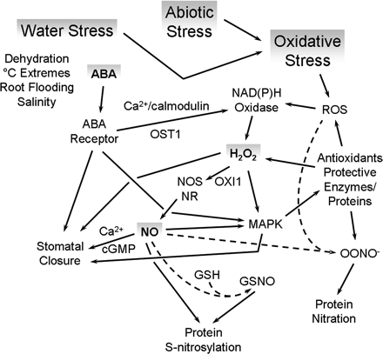
Fig. 1. Water, abiotic and oxidative stress, and the signalling interactions between ABA, H₂O₂, ...
Notes:
Fig. 1. Water, abiotic and oxidative stress, and the signalling interactions between ABA, H2O2, and NO that occur in order to mediate plant survival under adverse conditions. Water stress resulting in the loss of cell turgour triggers ABA biosynthesis. ABA activates H2O2 generation by NAD(P)H oxidase via a signalling pathway involving the ABA receptor(s), Ca2+/calmodulin, the OST1 protein kinase, and other unidentified components. H2O2 induces NO generation by nitrate reductase and NOS-like enzyme(s) via an as yet to be fully characterized signalling pathway that may include the OXI1 protein kinase and involve Ca2+. NO induces stomatal closure through steps that require MAPKs, cGMP, and Ca2+. It is also likely that NO-independent signalling from ABA and H2O2 can also occur to cause stomatal closure during certain conditions. NO also enhances antioxidant gene and enzyme activity via MAPK and other unidentified signalling pathways. For example, superoxide dismutase activity may increase along with that of catalase and ascorbate peroxidase in order to combat increases in ROS, and proteins such as the dehydrins may be produced in order to ameliorate the effects of cell dehydration. Other abiotic stresses also induce oxidative stress, the generation of H2O2 and NO, and enhanced antioxidant defences. NO may also signal by inducing conformational changes in proteins as a result of S-nitrosylation or nitration. However, the exact role of these processes in stomatal closure and stress amelioration awaits clarification.
Unless provided in the caption above, the following copyright applies to the content of this slide: © The Author [2008]. Published by Oxford University Press [on behalf of the Society for Experimental Biology]. All rights reserved. For Permissions, please e-mail: journals.permissions@oxfordjournals.org

Slide 2
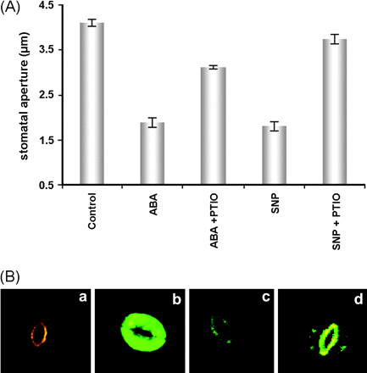
Fig. 2. ABA-induced stomatal closure requires NO synthesis. (A) Stomatal closure. Arabidopsis leaves were treated for ...
Notes:
Fig. 2. ABA-induced stomatal closure requires NO synthesis. (A) Stomatal closure. Arabidopsis leaves were treated for 2.5h with either ABA (10μM) or the NO donor SNP (50μM) in the absence or presence of the NO scavenger PTIO (200μM), and the stomatal apertures in epidermal fragments were observed by light microscopy. (B) NO fluorescence. The stomata of Arabidopsis epidermal fragments loaded with the NO-sensitive fluorescent dye DAF-2DA (a–c) were either left untreated (a) or treated with ABA in the absence (b) or presence (c) of the NO scavenger PTIO, and their fluorescence was observed by confocal microscopy. As a negative control (d), stomata loaded with the non-NO fluorescent dye 4AF-DA were treated with ABA and similarly observed.
Unless provided in the caption above, the following copyright applies to the content of this slide: © The Author [2008]. Published by Oxford University Press [on behalf of the Society for Experimental Biology]. All rights reserved. For Permissions, please e-mail: journals.permissions@oxfordjournals.org

