Slide 1
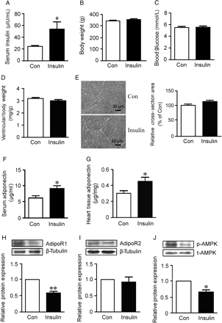
Figure 1 The chronic hyperinsulinaemia rat model (n= 8) was induced by insulin infusion (1 U/day) for 28 days; normal ...
Notes:
Figure 1 The chronic hyperinsulinaemia rat model (n= 8) was induced by insulin infusion (1 U/day) for 28 days; normal saline was used as control (n= 8). (A) Serum insulin. (B) Body weight. (C) Blood glucose. (D) Ratio of left ventricle to body weight. (E) Representative HE staining and cross-sectional area of cardiomyocytes. (F) Serum adiponectin. (G) Heart adiponectin. Western blot analysis of myocardial AdipoR1 (H) and AdipoR2 (I) protein levels. β-Tubulin was an endogenous control. (J) Western blot analysis of myocardial AMPK-α phosphorylation (p-AMPK). Total AMPK (t-AMPK) was a control. *P< 0.05, **P< 0.01 vs. Con.
Unless provided in the caption above, the following copyright applies to the content of this slide: Published on behalf of the European Society of Cardiology. All rights reserved. © The Author 2011. For permissions please email: journals.permissions@oup.com.

Slide 2
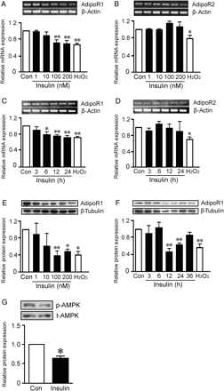
Figure 2 Expression of AdipoRs and AMPK phosphorylation in NRVMs. RT–PCR analysis of AdipoR1 (A and C) and AdipoR2 (B ...
Notes:
Figure 2 Expression of AdipoRs and AMPK phosphorylation in NRVMs. RT–PCR analysis of AdipoR1 (A and C) and AdipoR2 (B and D) mRNA in NRVMs treated with insulin for 24 h at indicated concentrations or with 100 nmol/L insulin for the indicated times. β-Actin was an endogenous control. Western blot analysis of the AdipoR1 protein level in NRVMs treated with insulin for 24 h at the indicated concentrations (E) or with 100 nmol/L insulin for the indicated times (F). β-Tubulin was an endogenous control. H2O2 (10 μmol/L, 24 h) was a positive control. (G) Western blot analysis of p-AMPK and t-AMPK in NRVMs treated with insulin (100 nmol/L, 24 h). Data are mean ± SD of three independent experiments. *P< 0.05, **P< 0.01 vs. Con.
Unless provided in the caption above, the following copyright applies to the content of this slide: Published on behalf of the European Society of Cardiology. All rights reserved. © The Author 2011. For permissions please email: journals.permissions@oup.com.

Slide 3
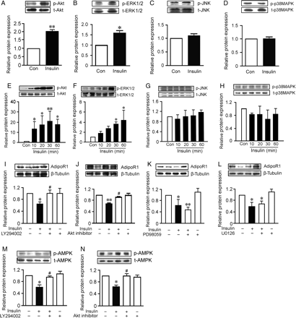
Figure 3 Signalling molecules mediating insulin-mediated AdipoR1 expression. Western blot analysis of Akt (A and E), ...
Notes:
Figure 3 Signalling molecules mediating insulin-mediated AdipoR1 expression. Western blot analysis of Akt (A and E), ERK1/2 (B and F), JNK (C and G) and p38MAPK (D and H) phosphorylation in rat hearts and NRVMs, respectively. The phosphorylation levels were normalized to their total protein levels. Western blot analysis of AdipoR1 protein in NRVMs treated with insulin (100 nmol/L, 24 h) with or without preincubation with LY294002 (I), Akt1/2 kinase inhibitor (J), PD98059 (K), or U0126 (L). β-Tubulin was an endogenous control. Western blot analysis of AMPK phosphorylation in NRVMs treated with insulin (100 nmol/L, 24 h) with or without preincubation with LY294002 (M) or Akt1/2 kinase inhibitor (N). The phosphorylation level was normalized to t-AMPK. Data are mean ± SD of three independent experiments. *P< 0.05, **P< 0.01 vs. Con. #P< 0.05 vs. insulin.
Unless provided in the caption above, the following copyright applies to the content of this slide: Published on behalf of the European Society of Cardiology. All rights reserved. © The Author 2011. For permissions please email: journals.permissions@oup.com.

Slide 4
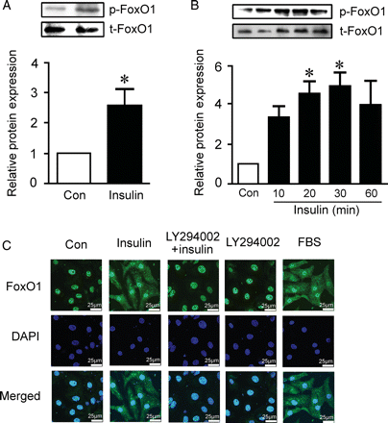
Figure 4 Effect of insulin on FoxO1 phosphorylation and translocation. Western blot analysis of FoxO1 phosphorylation ...
Notes:
Figure 4 Effect of insulin on FoxO1 phosphorylation and translocation. Western blot analysis of FoxO1 phosphorylation in rat hearts (A) and NRVMs (B). The phosphorylation level was normalized to total FoxO1. (C) Immunofluorescence analysis of subcellular localization of FoxO1 (green) in NRVMs preincubated with or without LY294002 before insulin (100 nmol/L, 1 h) treatment. FBS (10%, 1 h) was a positive control. Nuclei (blue) were stained with DAPI. Data are mean ± SD of three independent experiments. *P< 0.05 vs. Con.
Unless provided in the caption above, the following copyright applies to the content of this slide: Published on behalf of the European Society of Cardiology. All rights reserved. © The Author 2011. For permissions please email: journals.permissions@oup.com.

Slide 5
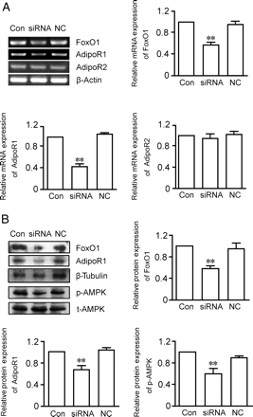
Figure 5 Effect of FoxO1 siRNA on AdipoR expression and AMPK phosphorylation. FoxO1 or negative control (NC) siRNA was ...
Notes:
Figure 5 Effect of FoxO1 siRNA on AdipoR expression and AMPK phosphorylation. FoxO1 or negative control (NC) siRNA was transfected into NRVMs for 48 h. (A) RT–PCR analysis of FoxO1, AdipoR1, and AdipoR2 mRNA expression. β-Actin was an endogenous control. (B) Western blot analysis of FoxO1, AdipoR1 protein expression and AMPK phosphorylation. β-Tubulin was an endogenous control. The AMPK phosphorylation level was normalized to t-AMPK protein. Data are mean ± SD of three independent experiments. **P< 0.01 vs. Con.
Unless provided in the caption above, the following copyright applies to the content of this slide: Published on behalf of the European Society of Cardiology. All rights reserved. © The Author 2011. For permissions please email: journals.permissions@oup.com.

Slide 6
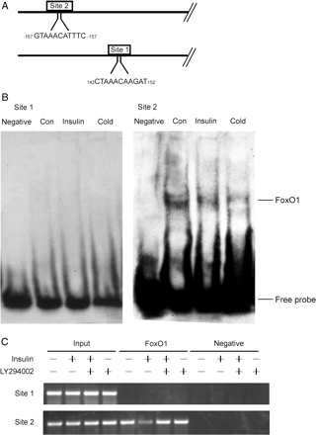
Figure 6 Effect of FoxO1 on insulin-mediated AdipoR1 expression. (A) Two putative FoxO1 binding sites between 142 and ...
Notes:
Figure 6 Effect of FoxO1 on insulin-mediated AdipoR1 expression. (A) Two putative FoxO1 binding sites between 142 and 152 bp (site 1) and −167 and −157 bp (site 2) of the AdipoR1 promoter sequence. (B) Nuclear extracts of NRVMs treated with or without insulin (100 nmol/L, 6 h) were incubated with biotin-labelled probes corresponding to site 1 or site 2 before being applied to a non-denaturing gel. Competition were performed by preincubation with 100-fold of the corresponding unlabelled probe (cold). (C) NRVMs were preincubated with or without LY294002, then treated with insulin (100 nmol/L, 6 h) and underwent ChIP assay. PCR analysis of the input-, FoxO1-, and normal rabbit IgG-immunoprecipitated (negative) samples involved the primer sets corresponding to sites 1 and 2. All results are representative of three independent experiments.
Unless provided in the caption above, the following copyright applies to the content of this slide: Published on behalf of the European Society of Cardiology. All rights reserved. © The Author 2011. For permissions please email: journals.permissions@oup.com.

