Slide 1
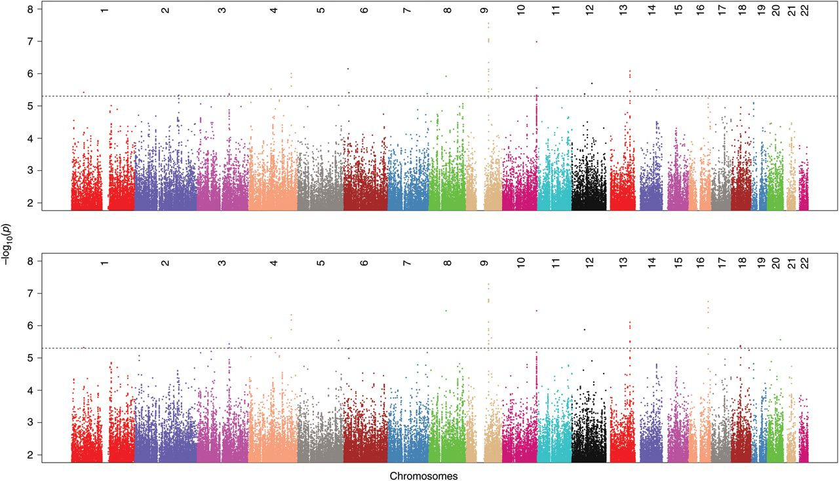
Figure 1. Manhattan plots for genome-wide association for FI (top) and HOMA-IR (bottom). The Y-axis starts from 1 (P ...
Notes:
Figure 1. Manhattan plots for genome-wide association for FI (top) and HOMA-IR (bottom). The Y-axis starts from 1 (P value = 0.1). The block dotted lines indicate P value = 5 × 10−6.
Unless provided in the caption above, the following copyright applies to the content of this slide: © The Author 2012. Published by Oxford University Press. All rights reserved. For Permissions, please email: journals.permissions@oup.com

