Slide 1
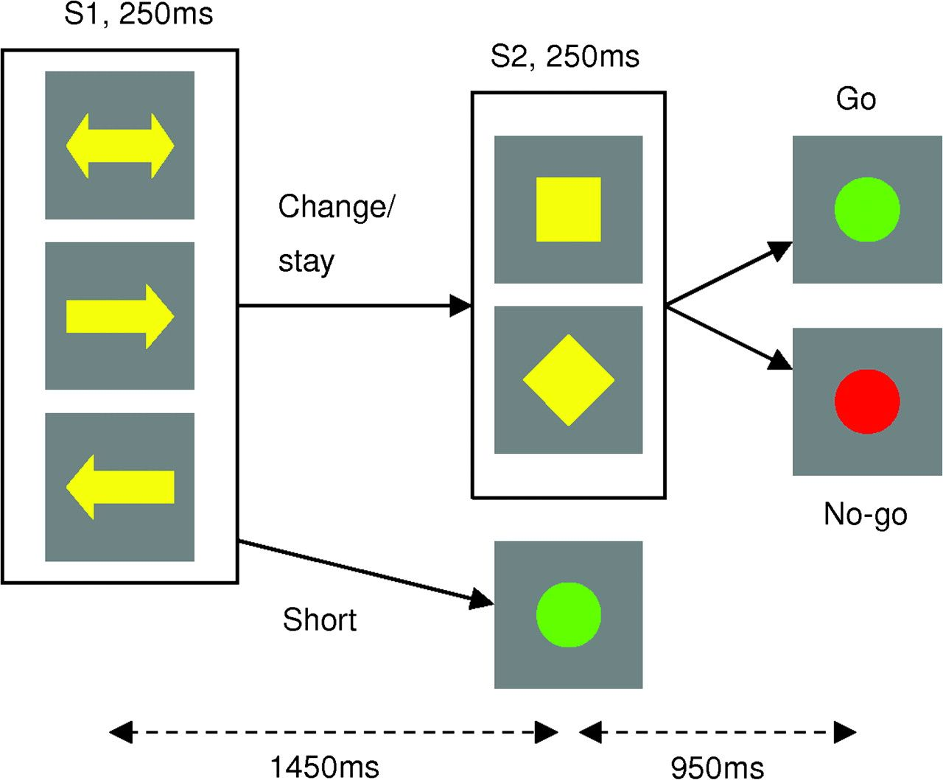
Figure 1. Action selection and reprogramming task. Participants were asked to prepare a left or right button press at ...
Notes:
Figure 1. Action selection and reprogramming task. Participants were asked to prepare a left or right button press at S1 (instructed trials) or were given a free choice (free trials) over which of these actions to prepare. The S2 cue indicated whether the action plan should be changed (28%), maintained (28%), or executed (44%). Change and stay cues were counterbalanced across participants.
Unless provided in the caption above, the following copyright applies to the content of this slide: © The Author 2009. Published by Oxford University Press. All rights reserved. For permissions, please e-mail: journals.permissions@oxfordjournals.org

Slide 2
Figure 2. Mean RT data (+standard error of the mean) averaged over all participants. (a) Behavioral data from the main ...
Notes:
Figure 2. Mean RT data (+standard error of the mean) averaged over all participants. (a) Behavioral data from the main experiment showing that average motor preparation did not differ between choice conditions. (b) Comparison of RT data in experimental trials to a pretest baseline condition, demonstrating that participants significantly engaged in motor preparation for both short trials (response at S2) and change/stay trials (response at the end of the trial). One asterisk (*), P < 0.05; two asterisks (**), P < 0.001.
Unless provided in the caption above, the following copyright applies to the content of this slide: © The Author 2009. Published by Oxford University Press. All rights reserved. For permissions, please e-mail: journals.permissions@oxfordjournals.org

Slide 3
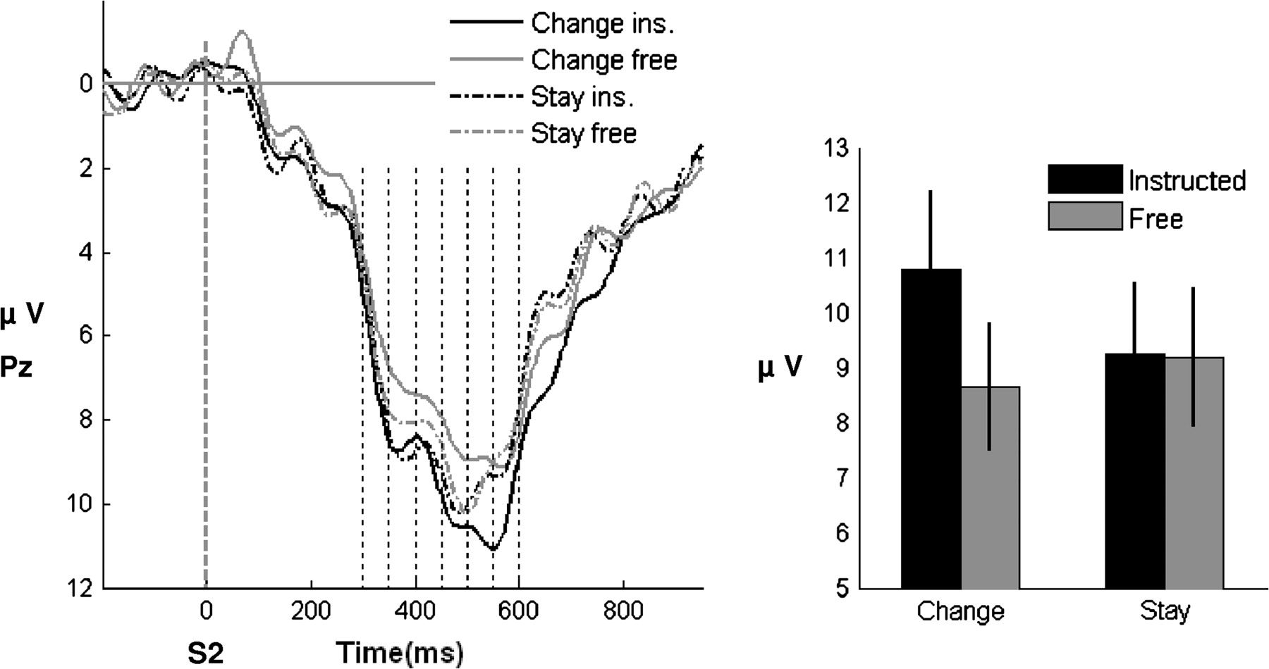
Figure 3. Grand average ERPs at Pz locked to S2 and sorted by trial type. The choice × change factorial design gives 4 ...
Notes:
Figure 3. Grand average ERPs at Pz locked to S2 and sorted by trial type. The choice × change factorial design gives 4 conditions. Time is relative to the onset of S2; the time windows entered into the ANOVA are indicated with broken lines. The right panel displays the mean amplitudes (±standard error of the mean) for each trial type extracted from a time window between 520 and 540 ms (the maximum of the instructed-change − free-change difference wave). The interaction between choice and change conditions is reflected in a greater P300 in instructed-change trials than instructed-stay trials, with a trend toward the opposite pattern in free-choice trials.
Unless provided in the caption above, the following copyright applies to the content of this slide: © The Author 2009. Published by Oxford University Press. All rights reserved. For permissions, please e-mail: journals.permissions@oxfordjournals.org

Slide 4
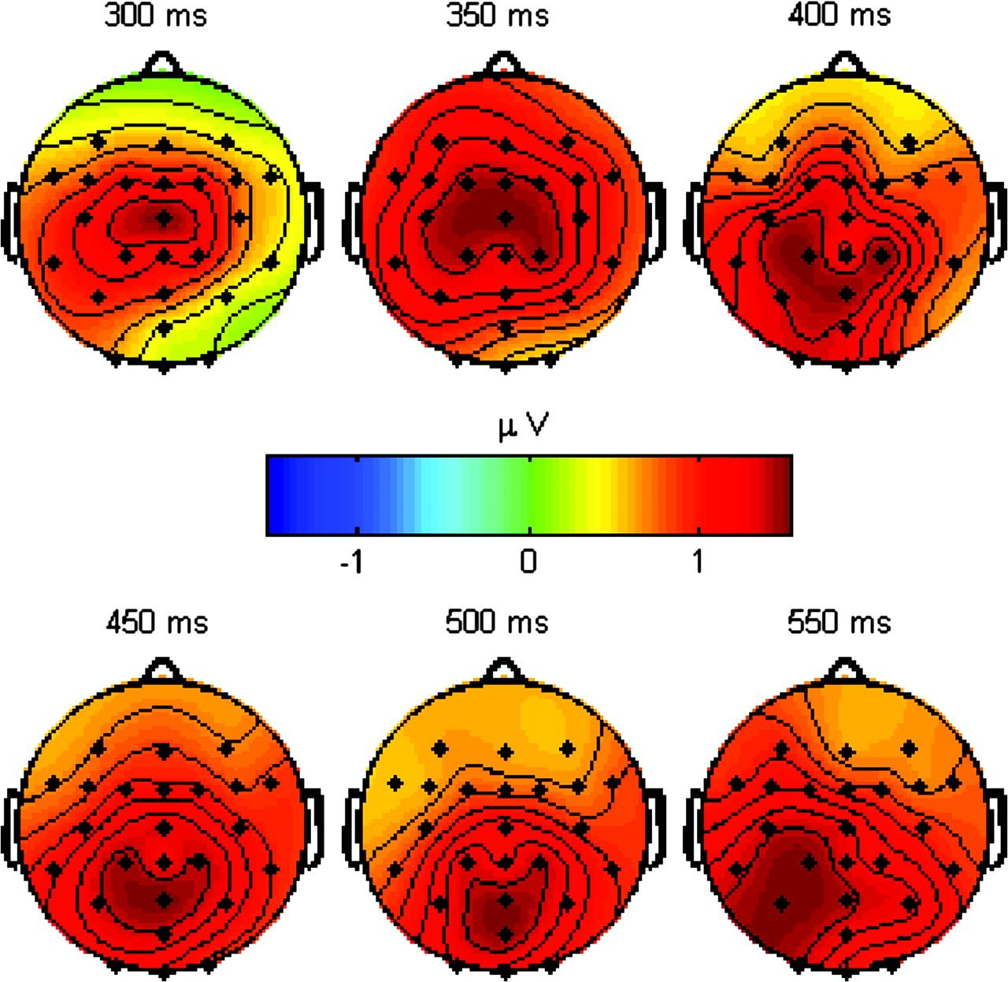
Figure 4. Scalp distribution of the difference wave of interest following S2 (instructed change − free change). Maxima ...
Notes:
Figure 4. Scalp distribution of the difference wave of interest following S2 (instructed change − free change). Maxima over central–parietal electrodes are consistent with the interaction effect shown in Figure 3 being driven by a modulation of the P300.
Unless provided in the caption above, the following copyright applies to the content of this slide: © The Author 2009. Published by Oxford University Press. All rights reserved. For permissions, please e-mail: journals.permissions@oxfordjournals.org

Slide 5
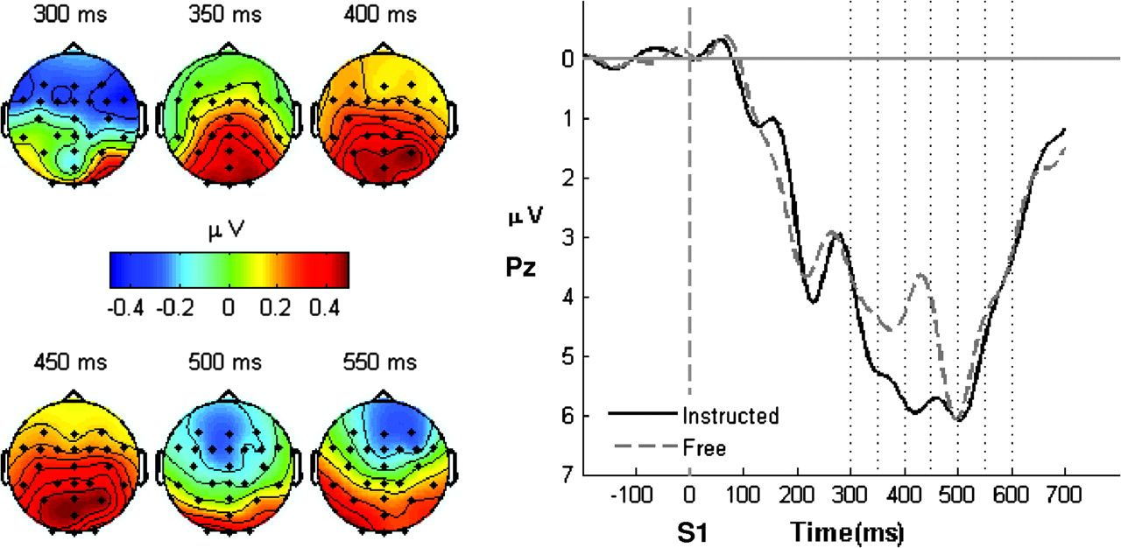
Figure 5. S1-locked ERPs and scalp maps. The left panel shows the scalp distribution of the grand average difference ...
Notes:
Figure 5. S1-locked ERPs and scalp maps. The left panel shows the scalp distribution of the grand average difference wave (instructed − free), revealing a maximum over parietal electrodes. The right panel shows the grand average ERPs sorted by choice condition (instructed, free) at electrode Pz, plotted against time relative to the onset of S1. The time windows used for entry into the choice × time ANOVA are indicated by broken lines.
Unless provided in the caption above, the following copyright applies to the content of this slide: © The Author 2009. Published by Oxford University Press. All rights reserved. For permissions, please e-mail: journals.permissions@oxfordjournals.org

Slide 6
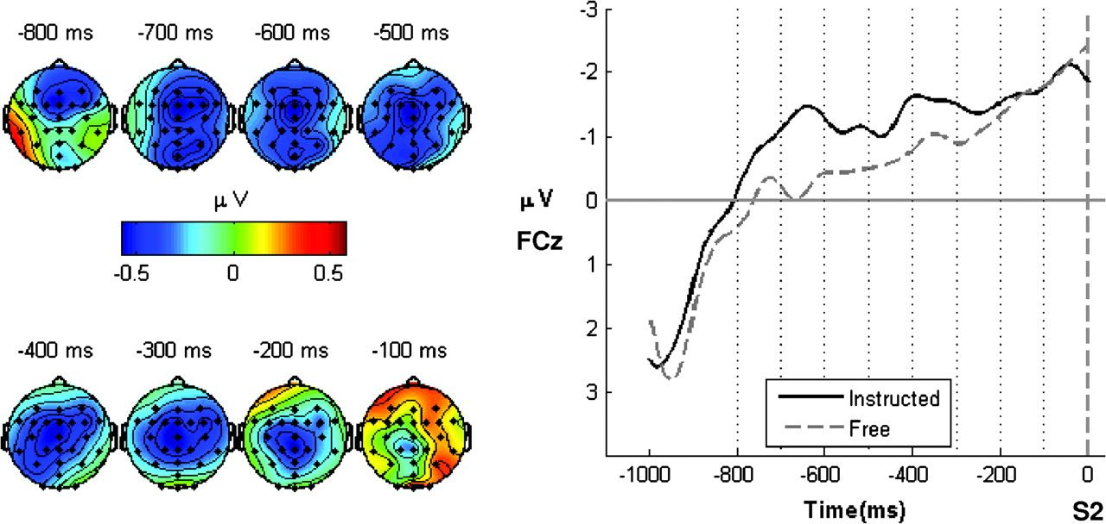
Figure 6. Preparatory potentials (CNV) prior to S2. The left panel shows the scalp distribution of the grand average ...
Notes:
Figure 6. Preparatory potentials (CNV) prior to S2. The left panel shows the scalp distribution of the grand average difference wave (instructed − free), revealing a maximum over frontocentral electrodes. The right panel shows the grand average CNV sorted by choice condition (instructed, free) for electrode FCz. Time is relative to the onset of S2. Broken lines indicate the time bins used for entry into the time × choice ANOVA.
Unless provided in the caption above, the following copyright applies to the content of this slide: © The Author 2009. Published by Oxford University Press. All rights reserved. For permissions, please e-mail: journals.permissions@oxfordjournals.org

Slide 7
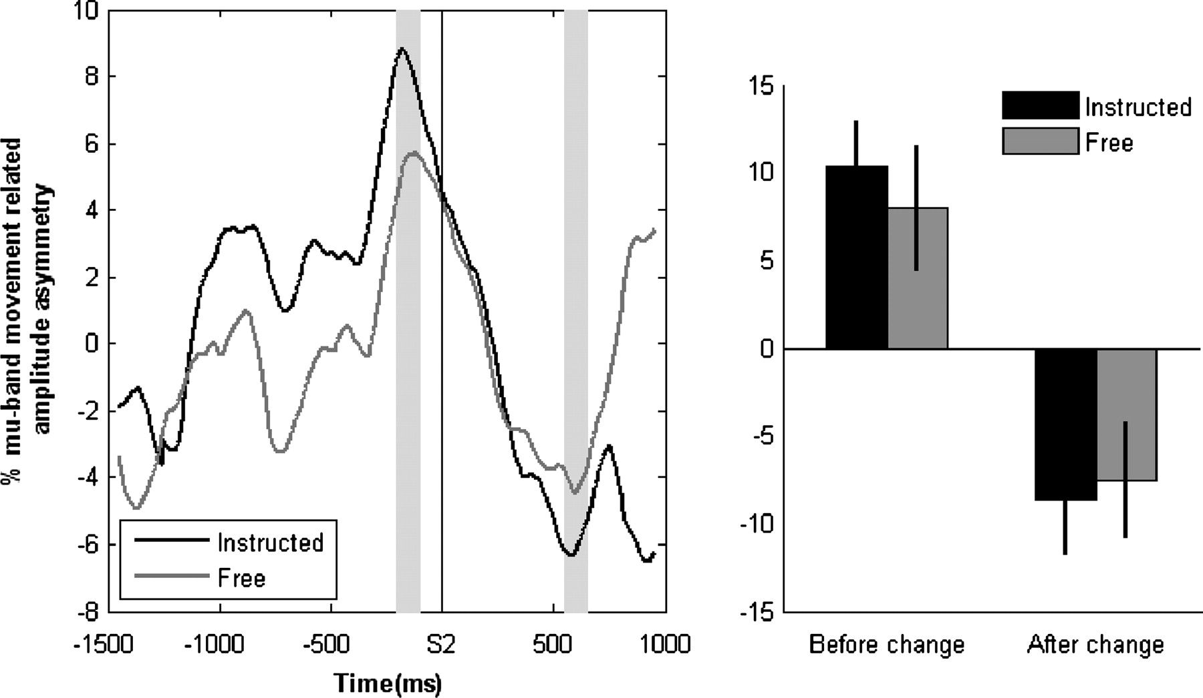
Figure 7. MRAA in change trials. The left panel shows the time course of the normalized MRAA in both instructed and ...
Notes:
Figure 7. MRAA in change trials. The left panel shows the time course of the normalized MRAA in both instructed and free trials in the mu band (9–13 Hz). Time is relative to the onset of the change cue. The gray panels indicate the time bins used for statistical analysis of the reversal. The right panel displays the mean peak amplitudes (±standard error of the mean) extracted from these time windows.
Unless provided in the caption above, the following copyright applies to the content of this slide: © The Author 2009. Published by Oxford University Press. All rights reserved. For permissions, please e-mail: journals.permissions@oxfordjournals.org

