Slide 1
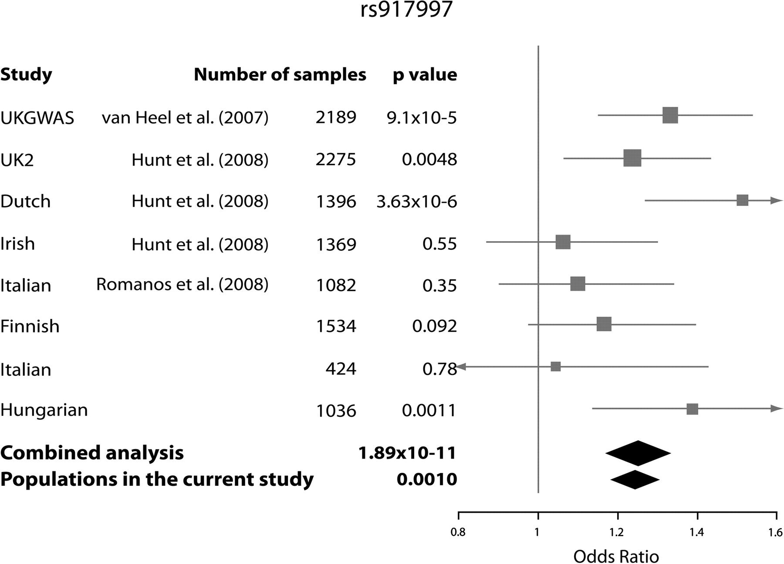
Figure 1. Meta-analysis of our studied populations and those of van Heel et al. (2007), Hunt et al. (2008) and Romanos ...
Notes:
Figure 1. Meta-analysis of our studied populations and those of van Heel et al. (2007), Hunt et al. (2008) and Romanos et al. (2008) for the IL18RAP SNPs rs917997. The number of the subjects in each population, the association P-values and ORs (carriership of risk allele) are shown. Box sizes correspond to the sample sizes in each population.
Unless provided in the caption above, the following copyright applies to the content of this slide: © The Author 2008. Published by Oxford University Press. All rights reserved. For Permissions, please email: journals.permissions@oxfordjournals.org

Slide 2
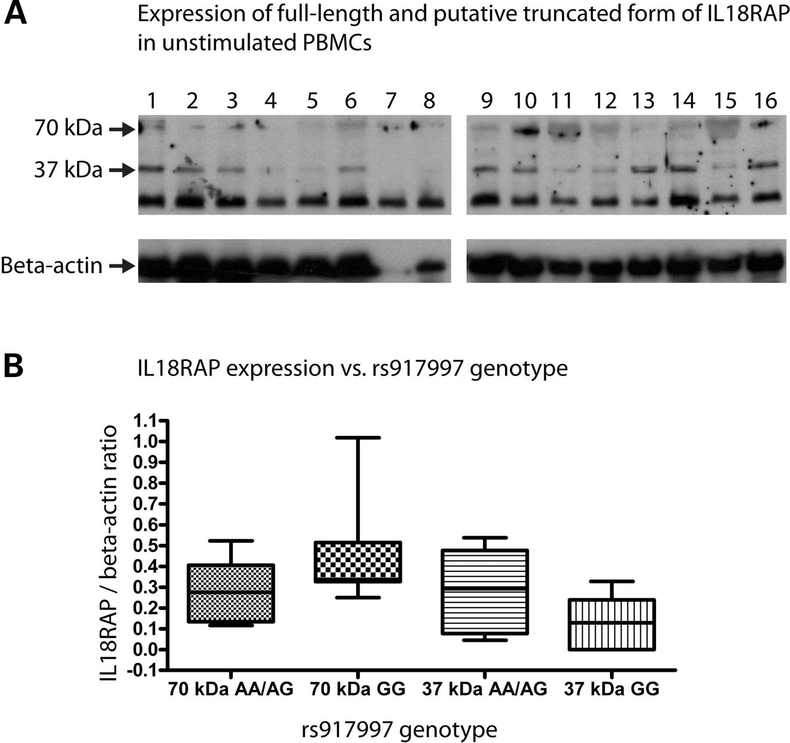
Figure 2. (A) IL18RAP Western blot of unstimulated peripheral PBMCs. The rs917997 genotypes for the PBMC samples: AA: ...
Notes:
Figure 2. (A) IL18RAP Western blot of unstimulated peripheral PBMCs. The rs917997 genotypes for the PBMC samples: AA: lane 5, AG: lanes 1–4 and 13–16, GG: lanes 6–12. The lowest band at ∼25 kDa is an unspecific band detected also when only secondary antibody was used. (B) Densitometric analysis of the 37 and 70 kDa bands standardized over beta-actin levels and grouped by the presence of the rs917997 risk allele A.
Unless provided in the caption above, the following copyright applies to the content of this slide: © The Author 2008. Published by Oxford University Press. All rights reserved. For Permissions, please email: journals.permissions@oxfordjournals.org

