Slide 1
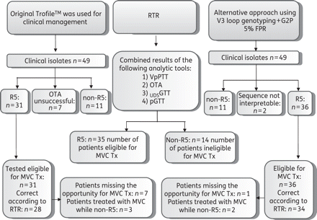
Figure 1. Overview of the study. RTR, reference tropism result; MVC, maraviroc; Tx, treatment.
Notes:
Figure 1. Overview of the study. RTR, reference tropism result; MVC, maraviroc; Tx, treatment.
Unless provided in the caption above, the following copyright applies to the content of this slide: © The Author 2010. Published by Oxford University Press on behalf of the British Society for Antimicrobial Chemotherapy.This is an Open Access article distributed under the terms of the Creative Commons Attribution Non-Commercial License (http://creativecommons.org/licenses/by-nc/2.5), which permits unrestricted non-commercial use, distribution, and reproduction in any medium, provided the original work is properly cited.

