Slide 1
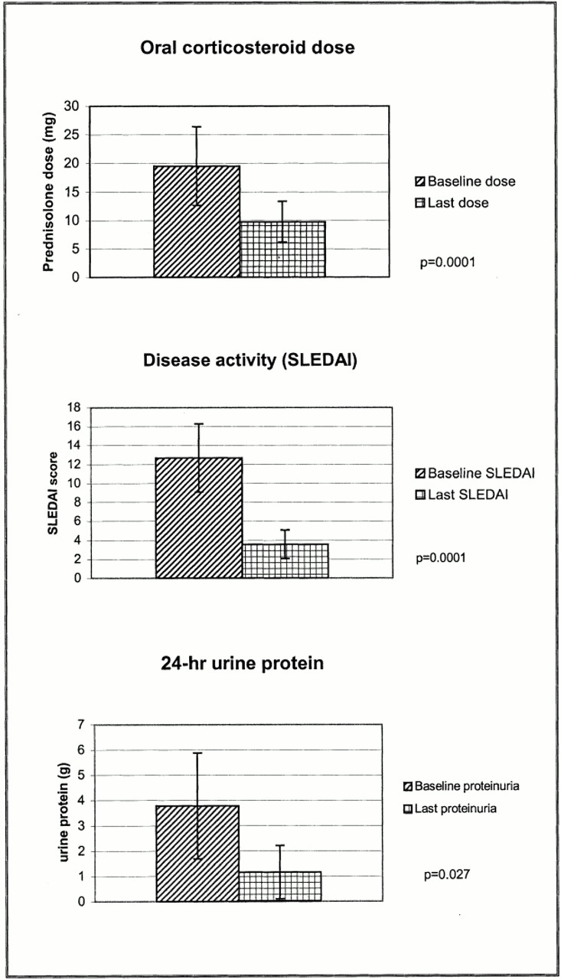
Fig. 1. Oral corticosteroid dose, disease activity index (SLEDAI) and 24‐h urinary protein at baseline and last ...
Notes:
Fig. 1. Oral corticosteroid dose, disease activity index (SLEDAI) and 24‐h urinary protein at baseline and last clinic visits.
Unless provided in the caption above, the following copyright applies to the content of this slide: © British Society for Rheumatology

