Slide 1
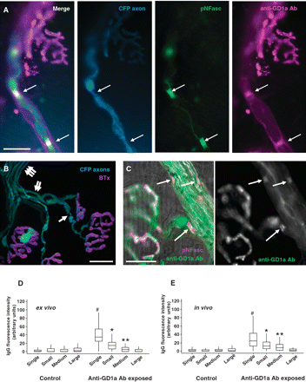
Figure 1 Anti-GD1a antibody is deposited at nodes of Ranvier in a gradient-dependent manner in distal intramuscular ...
Notes:
Figure 1 Anti-GD1a antibody is deposited at nodes of Ranvier in a gradient-dependent manner in distal intramuscular nerves. Triangularis sterni muscle was treated ex vivo with anti-GD1a antibody (100 µg/ml for 160 min) and antibody deposits localized and quantified. (A) Anti-GD1a antibody (magenta) binds at the nodes of Ranvier of distal motor axons as determined by co-localization with neurofascin (green) and a narrowing of the endogenously expressed axonal CFP (blue). (B) Nerve fibres and bundles were categorized by size for quantification. Single arrow = single fibre; double arrow = small bundle; triple arrow = medium bundle. (C) Intensity of anti-GD1a antibody binding was assessed according to bundle size; image shows antibody at a single fibre node of Ranvier compared to that seen at small bundle node of Ranvier. (D) Single fibres showed significantly higher fluorescence intensity at nodes of Ranvier compared to small bundles, small bundles compared to medium bundles and medium bundles compared to large bundles. Single fibre, small bundle and medium bundle nodes of Ranvier all had significantly increased levels compared to control (no antibody) tissue. (E) Sixteen hours after injection of anti-GD1a antibody (i.p. total dose 3 mg), fluorescence intensity at nodes of Ranvier showed the same gradient-dependent binding pattern as that seen in ex vivo antibody treated tissue compared to control mice injected with phosphate buffered saline. #P < 0.05, compared to small, medium, large bundles and control; *P < 0.05 compared to medium, large bundles and control; **P < 0.05, compared to large bundles and control. Scale bar = 20 µm.
Unless provided in the caption above, the following copyright applies to the content of this slide: © The Author (2010). Published by Oxford University Press on behalf of the Guarantors of Brain. All rights reserved. For Permissions, please email: journals.permissions@oxfordjournals.org

Slide 2
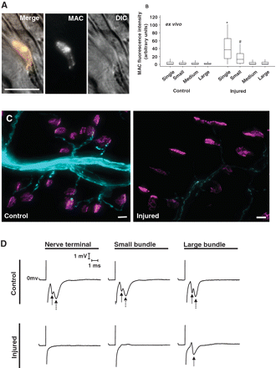
Figure 2 Complement activation at distal nerve nodes of Ranvier is associated with marked attenuation of endogenous ...
Notes:
Figure 2 Complement activation at distal nerve nodes of Ranvier is associated with marked attenuation of endogenous CFP and loss of perineural currents. Ex vivo triangularis sterni preparations exposed to anti-GD1a antibody or Ringer’s control, followed by 40% normal human serum as a source of complement, were examined for membrane attack complex (MAC) deposition at nodes of Ranvier, the distribution of axonal CFP and perineural current recordings. (A) Illustrative image of a node of Ranvier in a small nerve bundle coated with membrane attack complex deposits. (B) Quantification of membrane attack complex deposits demonstrated significantly higher levels at single fibre nodes of Ranvier, and small bundle nodes of Ranvier, compared to all other categories. (C) Illustrative low power images of intramuscular CFP axon bundles (blue) terminating at α-bungarotoxin delineated neuromuscular junction (magenta) in control tissue exposed to Ringer’s followed by normal human serum (left panel), and anti-GD1a antibody followed by normal human serum, the latter showing marked attenuation (right panel). (D) Perineural recordings from control (Ringer’s followed by normal human serum) and treated (anti-GD1a antibody followed by normal human serum) tissue demonstrate intact Na+ (solid arrow) and K+ (broken arrow) currents at nerve terminals, small bundles and large bundles in control nerves. These currents are completely attenuated in treated nerves, with the exception of the Na+ currents in large bundles. *P < 0.05, compared to small, medium, large bundles and control; #P < 0.05 compared to medium, large bundles and control. Scale bar = 10 µm (A) and 20 µm (C). DIC = differential interference contrast.
Unless provided in the caption above, the following copyright applies to the content of this slide: © The Author (2010). Published by Oxford University Press on behalf of the Guarantors of Brain. All rights reserved. For Permissions, please email: journals.permissions@oxfordjournals.org

Slide 3
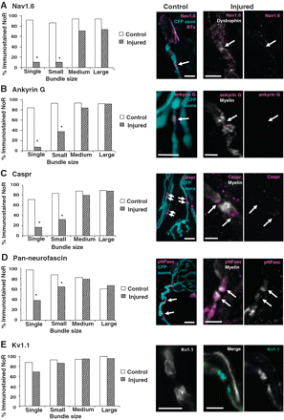
Figure 3 Immunohistological appearance of nodal markers at the nodes of Ranvier (NoR) of distal intramuscular nerves ...
Notes:
Figure 3 Immunohistological appearance of nodal markers at the nodes of Ranvier (NoR) of distal intramuscular nerves following exposure to anti-GD1a antibody and normal human serum (treated), compared with Ringer’s and normal human serum (control). Ex vivo triangularis sterni muscles were incubated with 100 µg/ml anti-GD1a antibody and 40% normal human serum as a source of complement. The percentages of nodes of Ranvier positive for immunostaining in each bundle category for five nodal proteins were determined. (A–D) Nav1.6, ankyrin G, Caspr and neurofascin immunostaining was significantly reduced at single fibre and small bundle nodes of Ranvier after treatment, compared to controls. (E) Kv1.1 immunostaining remained unchanged after treatment in all bundle categories. Merged illustrations are shown for control tissue; and both single and merged illustrations for treated tissue. *P < 0.05, compared to control counterpart. Scale bar = 10 µm. Arrows indicate location of the nodal region.
Unless provided in the caption above, the following copyright applies to the content of this slide: © The Author (2010). Published by Oxford University Press on behalf of the Guarantors of Brain. All rights reserved. For Permissions, please email: journals.permissions@oxfordjournals.org

Slide 4
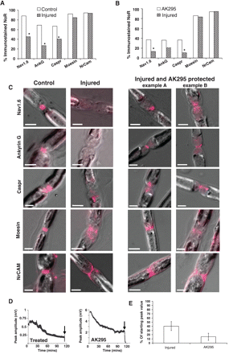
Figure 8 Phrenic nerve nodes of Ranvier immunostaining profiles of nodal proteins after exposure to anti-GD1a antibody ...
Notes:
Figure 8 Phrenic nerve nodes of Ranvier immunostaining profiles of nodal proteins after exposure to anti-GD1a antibody plus normal human serum are partially protected by AK295. Phrenic nerve was desheathed and treated with anti-GD1a antibody or Ringer’s, plus normal human serum, with and without AK295, and the effect on nodal protein immunostaining was quantified. (A) Anti-GD1a antibody treated phrenic nerve has significantly less Nodes of Ranvier that were immunopositive for Nav1.6 channel, ankyrin G and Caspr, than controls. (B) AK295 does not protect ankyrin G and only modestly protects Nav1.6 channel and Caspr immunostaining from complement-mediated injury. (C) Moesin and NrCAM staining profiles are not significantly altered in intensity after anti-GD1a antibody exposure; however they both show an abnormal distribution as highlighted in the images. Examples of normal control staining of all of the proteins (magenta) versus treated and AK295 protected nerve. Note occurrence of swollen morphology of treated nerves in differential interference contrast that is not ameliorated by AK295 treatment. (D) Extracellular recordings of anti-GD1a antibody-treated phrenic nerve show a reduction in CAP amplitudes over time that are unaffected by AK295. Anti-GD1a antibody was added for 2 h; subsequently normal human serum was added for 2 h, starting at 0 min. Arrows indicate the addition of 5 µM tetrodotoxin to terminate the experiment. (E) CAP amplitudes are expressed as the percentage of the starting value, there being no significant difference between AK295 treated or untreated nerves. *P < 0.05, compared to control or AK295 counterpart. Scale bar = 5 µm.
Unless provided in the caption above, the following copyright applies to the content of this slide: © The Author (2010). Published by Oxford University Press on behalf of the Guarantors of Brain. All rights reserved. For Permissions, please email: journals.permissions@oxfordjournals.org

Slide 5
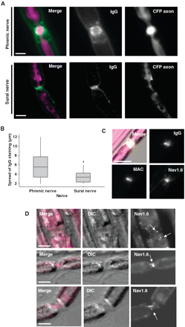
Figure 7 Differential anti-GD1a antibody binding at nodes of Ranvier in phrenic nerve (motor) and sural nerve ...
Notes:
Figure 7 Differential anti-GD1a antibody binding at nodes of Ranvier in phrenic nerve (motor) and sural nerve (sensory). Phrenic and sural nerves were desheathed and incubated with anti-GD1a antibody (100 µg/ml for 2 h) before the distribution of antibody across the node of Ranvier was quantitated. (A) Illustrative images of staining profile. (B) There was a significantly greater spread of antibody in phrenic nerve compared to sural nerve nodes of Ranvier. (C) In sural nerve treated with anti-GD1a antibody plus normal human serum, deposits of IgG and membrane attack complex (MAC) were frequently seen at nodes of Ranvier without loss of Nav1.6 immunostaining, which was very rarely seen in either phrenic nerve or distal motor nerve nodes of Ranvier in triangularis sterni preparations. (D) Three examples of Nav1.6 channel immunostaining at phrenic nerve nodes of Ranvier after anti-GD1a antibody exposure and 30 min treatment with normal human serum, conditions under which membrane attack complex deposits are extensive. Various stages of dissolution of Nav1.6 immunostaining are evident (arrows), prior to its subsequent complete disappearance. *P < 0.05, compared to phrenic nerve. DIC = differential interference contrast; Scale bars = 5 µm.
Unless provided in the caption above, the following copyright applies to the content of this slide: © The Author (2010). Published by Oxford University Press on behalf of the Guarantors of Brain. All rights reserved. For Permissions, please email: journals.permissions@oxfordjournals.org

Slide 6
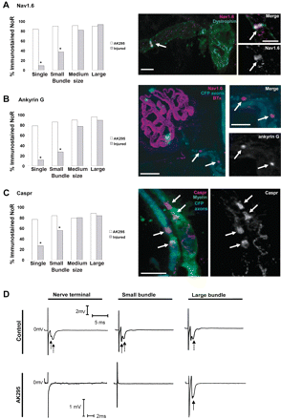
Figure 6 Calpain inhibition preserves immunostaining profiles of node of Ranvier proteins, without protecting ...
Notes:
Figure 6 Calpain inhibition preserves immunostaining profiles of node of Ranvier proteins, without protecting conduction of distal axons after treatment with anti-GD1a antibody and normal human serum. Ex vivo triangularis sterni preparations were incubated with anti-GD1a antibody and normal human serum with or without 100 µM AK295 and its protective effect on the immunostaining of proteins quantified in different bundle categories. Perineural recordings were performed after 3 h of treatment. (A–C) Nav1.6 channel, ankyrin G and Caspr immunostaining was significantly preserved by AK295 treatment in single fibres and small bundles compared to the same categories in AK295 unprotected tissue. Illustrative images depict intact staining to the right of the corresponding graphs. (D) Perineural current traces show Na+ (solid arrow) and K+ (broken arrow) ion currents in nerve terminals, small bundles and large bundles from completely normal triangularis sterni tissue (control, upper traces) and in tissue treated with anti-GD1a antibody, normal human serum and AK295. In AK295 treated preparations, no protection of perineural currents in single and small bundles is seen. *P < 0.05, compared to AK295 treatment. Scale bar = 10 µm. BTx = bungarotoxin; NoR = nodes of Ranvier. Arrows indicate location of the nodal region.
Unless provided in the caption above, the following copyright applies to the content of this slide: © The Author (2010). Published by Oxford University Press on behalf of the Guarantors of Brain. All rights reserved. For Permissions, please email: journals.permissions@oxfordjournals.org

Slide 7
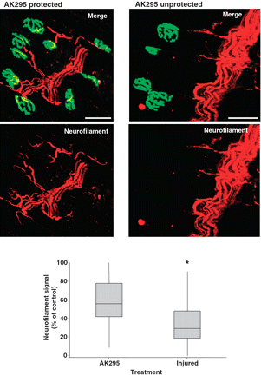
Figure 5 The calpain inhibitor AK295 protects neurofilament at the nerve terminal from degradation by anti-GD1a ...
Notes:
Figure 5 The calpain inhibitor AK295 protects neurofilament at the nerve terminal from degradation by anti-GD1a antibody and normal human serum exposure. Ex vivo triangularis sterni muscle was treated with anti-GD1a antibody and normal human serum with or without 100 µM AK295. Neurofilament immunostaining (red) intensity over the motor endplate (delineated by α-bungarotoxin, green) was measured and expressed as a percentage of normal levels. In the images, extensive pruning of the distal neurofilament arborisation can be seen in AK295 unprotected tissue (right), compared with protected tissue (left). *P < 0.05, compared to AK295 treatment. Scale bar = 50 µm.
Unless provided in the caption above, the following copyright applies to the content of this slide: © The Author (2010). Published by Oxford University Press on behalf of the Guarantors of Brain. All rights reserved. For Permissions, please email: journals.permissions@oxfordjournals.org

Slide 8
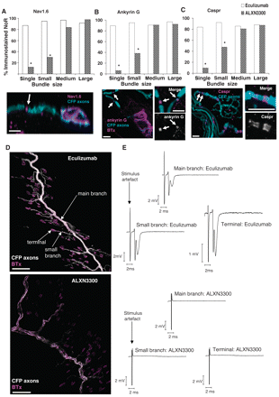
Figure 4 The complement inhibitor, eculizumab, neuroprotects the distal nerve nodes of Ranvier on treatment with ...
Notes:
Figure 4 The complement inhibitor, eculizumab, neuroprotects the distal nerve nodes of Ranvier on treatment with anti-GD1a antibody and normal human serum. Eculizumab (100 µg/ml) plus 40% normal human serum were admixed 10 min before addition to ex vivo triangularis sterni muscle preparations and the protective effects on the immunostaining signal of Nav1.6 channel, ankyrin G, Caspr and endogenous axonal CFP were compared to tissue treated with anti-GD1a antibody and normal human serum admixed with the isotype matched control monoclonal antibody ALXN3300. (A–C) Nav1.6, ankyrin G and Caspr immunostaining was significantly preserved at single fibre and small bundle nodes of Ranvier following eculizumab treatment; illustrative images below. *P < 0.05, compared to control counterpart. Scale bar = 10 µm. (D) Illustrative low power images of intramuscular CFP axon bundles (white) in triangularis sterni muscle terminating at α-bungarotoxin delineated neuromuscular junction (magenta) after treatment with eculizumab (top image) or ALXN3300 (lower image). The CFP signal is completely preserved by eculizumab, but markedly attenuated with the isotype control antibody. (E) Perineural recordings demonstrate a protection of Na+ and K+ currents at nerve terminals, small and main branches of nerve bundles, in triangularis sterni preparations protected by eculizumab (upper traces), compared to no protection afforded by control antibody, ALXN3300, in which currents are abolished (lower traces). Scale bar = 100 µm. Arrows indicate location of the nodal region.
Unless provided in the caption above, the following copyright applies to the content of this slide: © The Author (2010). Published by Oxford University Press on behalf of the Guarantors of Brain. All rights reserved. For Permissions, please email: journals.permissions@oxfordjournals.org

